Slide 1
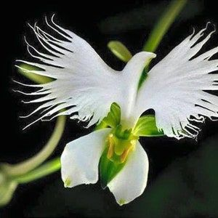
WELCOME TO THE
JACKSON STREET CHURCH OF CHRIST
PLEASE TURN OFF CELLPHONES

Slide 2


Slide 3

LET US PRAY

Slide 4

SINGING

Slide 5
Acts 2:36–39 “Therefore let all the house of Israel know assuredly that God has made this Jesus, whom you crucified, both Lord and Christ.” 37 Now when they heard this, they were cut to the heart, and said to Peter and the rest of the apostles, “Men and brethren, what shall we do?” 38 Then Peter said to them, “Repent, and let every one of you be baptized in the name of Jesus Christ for the remission of sins; and you shall receive the gift of the Holy Spirit. 39 For the promise is to you and to your children, and to all who are afar off, as many as the Lord our God will call.”

Slide 6
LET US PRAY

Slide 7
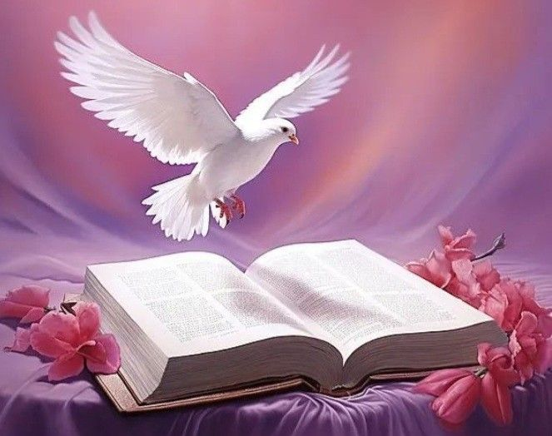
WHAT THE HOLY SPIRIT DOES FOR US TODAY 2

Slide 8
WHAT THE HOLY SPIRIT DOES?
A. Because of false teaching about the Holy Spirit, we have been reluctant to teach about the Spirit.
B. Many, today in the religious world, believe the Spirit gives people the ability to work miracles.
C. Miracles were given in the first century to prove that those speaking were from God.
1. John 20:30–31 And truly Jesus did many other signs in the presence of His disciples, which are not written in this book; 31 but these are written that you may believe that Jesus is the Christ, the Son of God, and that believing you may have life in His name.
2. Mark 16:19–20 So then, after the Lord had spoken to them, He was received up into heaven, and sat down at the right hand of God. 20 And they went out and preached everywhere, the Lord working with them and confirming the word through the accompanying signs. Amen.

Slide 9
WHAT THE HOLY SPIRIT DOES?
D. Paul said, miracles would cease when that which was perfect would come.
1. 1 Corinthians 13:8–10 Love never fails. But whether there are prophecies, they will fail; whether there are tongues, they will cease; whether there is knowledge, it will vanish away. 9 For we know in part and we prophesy in part. 10 But when that which is perfect has come, then that which is in part will be done away.
2. Miraculous knowledge was partial. The completed New Testament brought complete, perfect knowledge. - 1 Corinthians 13:12 For now we see in a mirror, dimly, but then face to face. Now I know in part, but then I shall know just as I also am known.

Slide 10
GENTILES SANCTIFIED BY THE SPIRIT
Romans 15:16 that I might be a minister of Jesus Christ to the Gentiles, ministering the gospel of God, that the offering of the Gentiles might be acceptable, sanctified by the Holy Spirit.

Slide 11
GOD’S WILL REVEALED TO US BY HIS SPIRIT
1 Corinthians 2:9–12 But as it is written: “Eye has not seen, nor ear heard, Nor have entered into the heart of man The things which God has prepared for those who love Him.” 10 But God has revealed them to us through His Spirit. For the Spirit searches all things, yes, the deep things of God. 11 For what man knows the things of a man except the spirit of the man which is in him? Even so no one knows the things of God except the Spirit of God. 12 Now we have received, not the spirit of the world, but the Spirit who is from God, that we might know the things that have been freely given to us by God.

Slide 12
TEACHES US WISDOM OF GOD
1 Corinthians 2:13-16 These things we also speak, not in words which man's wisdom teaches but which the Holy Spirit teaches, comparing spiritual things with spiritual. 14 But the natural man does not receive the things of the Spirit of God, for they are foolishness to him; nor can he know them, because they are spiritually discerned. 15 But he who is spiritual judges all things, yet he himself is rightly judged by no one. 16 For "who has known the mind of the LORD that he may instruct Him?" But we have the mind of Christ.

Slide 13
JUSTIFIED BY THE SPIRIT
1 Corinthians 6:11 And such were some of you. But you were washed, but you were sanctified, but you were justified in the name of the Lord Jesus and by the Spirit of our God.

Slide 14
OUR BODY IS THE SPIRIT’S TEMPLE
1 Corinthians 6:19 Or do you not know that your body is the temple of the Holy Spirit who is in you, whom you have from God, and you are not your own?

Slide 15
WRITES AN EPISTLE ON OUR HEART
2 Corinthians 3:2-3 You are our epistle written in our hearts, known and read by all men; 3 clearly you are an epistle of Christ, ministered by us, written not with ink but by the Spirit of the living God, not on tablets of stone but on tablets of flesh, that is, of the heart.

Slide 16
MINISTERS OF THE NEW COVENANT TO GIVE LIFE
2 Corinthians 3:4-6 And we have such trust through Christ toward God. 5 Not that we are sufficient of ourselves to think of anything as being from ourselves, but our sufficiency is from God, 6 who also made us sufficient as ministers of the new covenant, not of the letter but of the Spirit; for the letter kills, but the Spirit gives life.

Slide 17
GIVES US LIBERTY
2 Corinthians 3:17 Now the Lord is the Spirit; and where the Spirit of the Lord is, there is liberty.

Slide 18
TRANSFORMED US INTO THE IMAGE OF CHRIST
2 Corinthians 3:18 But we all, with unveiled face, beholding as in a mirror the glory of the Lord, are being transformed into the same image from glory to glory, just as by the Spirit of the Lord.

Slide 19
BY THE SPIRIT WE EAGERLY WAIT FOR THE HOPE OF RIGHTEOUSNESS
Galatians 5:5 For we through the Spirit eagerly wait for the hope of righteousness by faith.

Slide 20
BY THE SPIRIT WE DO NOT FULFILL THE LUST OF THE FLESH
Galatians 5:16-17 I say then: Walk in the Spirit, and you shall not fulfill the lust of the flesh. 17 For the flesh lusts against the Spirit, and the Spirit against the flesh; and these are contrary to one another, so that you do not do the things that you wish.

Slide 21
NOT UNDER LAW
Galatians 5:18 But if you are led by the Spirit, you are not under the law.

Slide 22
PRODUCE FRUIT
Galatians 5:22–23 But the fruit of the Spirit is love, joy, peace, longsuffering, kindness, goodness, faithfulness, 23 gentleness, self-control. Against such there is no law.

Slide 23
WALK IN THE SPIRIT
Galatians 5:25 If we live in the Spirit, let us also walk in the Spirit.

Slide 24
SOW TO SPIRIT REAP EVERLASTING LIFE
Galatians 6:8 For he who sows to his flesh will of the flesh reap corruption, but he who sows to the Spirit will of the Spirit reap everlasting life.

Slide 25
GIVES US ACCESS TO THE FATHER
Ephesians 2:18 For through Him we both have access by one Spirit to the Father.

Slide 26
GIVES US STRENGTH
Ephesians 3:16 that He would grant you, according to the riches of His glory, to be strengthened with might through His Spirit in the inner man,

Slide 27
SPIRIT WORKS POWERFULLY IN US
Ephesians 3:20–21 Now to Him who is able to do exceedingly abundantly above all that we ask or think, according to the power that works in us, 21 to Him be glory in the church by Christ Jesus to all generations, forever and ever. Amen.

Slide 28
SPIRIT CAN BE GRIEVED
Ephesians 4:30 And do not grieve the Holy Spirit of God, by whom you were sealed for the day of redemption.

Slide 29
PRODUCES FRUIT
Ephesians 5:9 (for the fruit of the Spirit is in all goodness, righteousness, and truth),

Slide 30
WORD IS THE SWORD OF THE SPIRIT
Ephesians 6:17 And take the helmet of salvation, and the sword of the Spirit, which is the word of God;

Slide 31
MEETS NEEDS
Philippians 1:19 For I know that this will turn out for my deliverance through your prayer and the supply of the Spirit of Jesus Christ,

Slide 32
SANCTIFIED BY THE SPIRIT
2 Thessalonians 2:13 But we are bound to give thanks to God always for you, brethren beloved by the Lord, because God from the beginning chose you for salvation through sanctification by the Spirit and belief in the truth,

Slide 33
KEEP GOD’S WORD BY THE SPIRIT
2 Timothy 1:13–14 Hold fast the pattern of sound words which you have heard from me, in faith and love which are in Christ Jesus. 14 That good thing which was committed to you, keep by the Holy Spirit who dwells in us.

Slide 34
SPIRIT WITHIN IS JEALOUS
James 4:5 Or do you think that the Scripture says in vain, “The Spirit who dwells in us yearns jealously”?

Slide 35
SANCTIFIED FOR OBEDIENCE
1 Peter 1:2 elect according to the foreknowledge of God the Father, in sanctification of the Spirit, for obedience and sprinkling of the blood of Jesus Christ: Grace to you and peace be multiplied.

Slide 36
54. SOULS PURIFIED IN OBEDIENCE THROUGH THE SPIRIT
1 Peter 1:22 Since you have purified your souls in obeying the truth through the Spirit in sincere love of the brethren, love one another fervently with a pure heart,

Slide 37
55. SPIRIT IS ON US WHEN WE ARE REPROACHED
1 Peter 4:14 If you are reproached for the name of Christ, blessed are you, for the Spirit of glory and of God rests upon you. On their part He is blasphemed, but on your part He is glorified.

Slide 38
THE HOLY SPIRIT AND YOU?
Have you been baptized into Christ for the remission of you sins to receive the gift of the holy spirit?
If so, are you allowing the Spirit to direct you into obedience to the Word of God?
Do you need to do something to get your life right with God?

Slide 39
SINGING

Slide 40
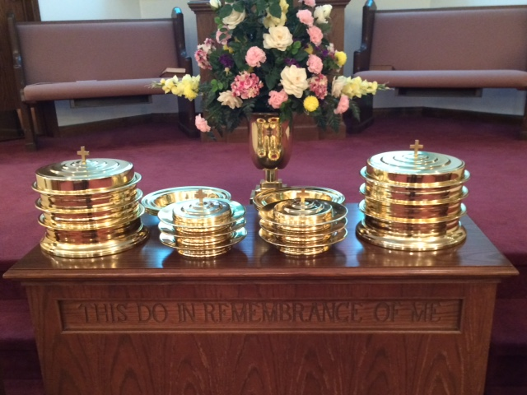
IN REMEMBRANCE OF JESUS

Slide 41
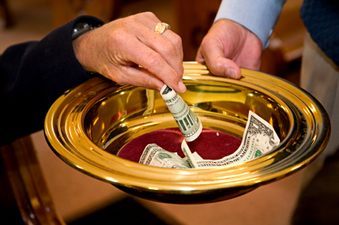
CONTRIBUTION

Slide 42
SINGING

Slide 43
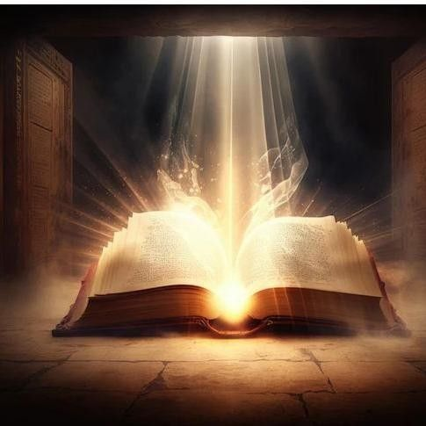
HAVE A
SPIRIT-LED WEEK

