Slide 1

WELCOME TO THE
JACKSON STREET CHURCH OF CHRIST
PLEASE TURN OFF CELLPHONES

Slide 2


Slide 3


Slide 4

SINGING

Slide 5
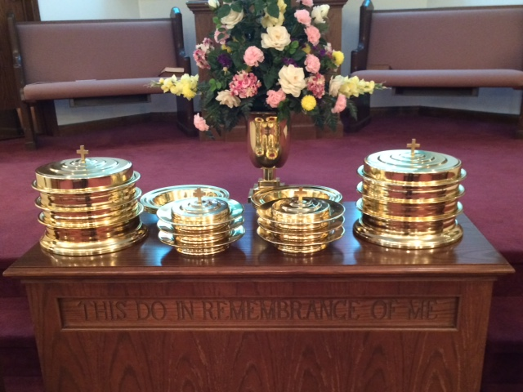
IN REMEMBRANCE OF JESUS

Slide 6
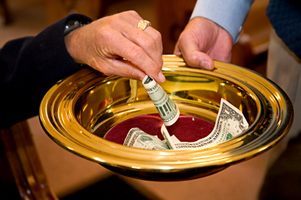
CONTRIBUTION

Slide 7



Slide 8
1 Peter 2:19–21 For this is commendable, if because of conscience toward God one endures grief, suffering wrongfully. ²⁰ For what credit is it if, when you are beaten for your faults, you take it patiently? But when you do good and suffer, if you take it patiently, this is commendable before God. ²¹ For to this you were called, because Christ also suffered for us, leaving us an example, that you should follow His steps.

Slide 10
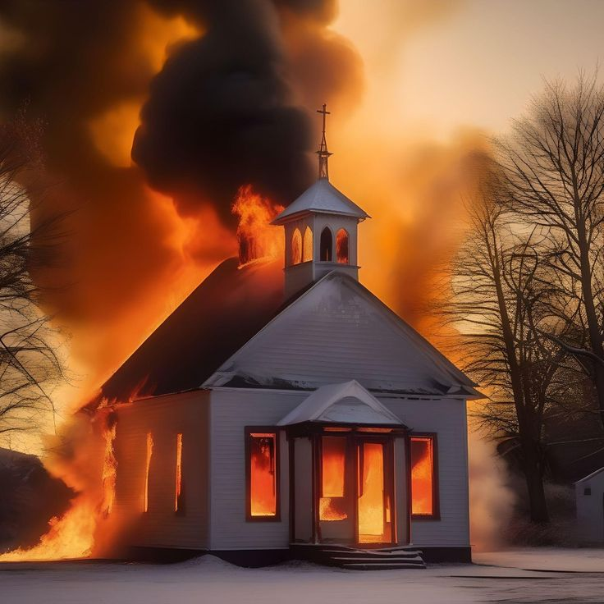
WHY BAD THINGS HAPPEN TO GOOD PEOPLE!

Slide 11
WHY BAD THINGS HAPPEN TO GOOD PEOPLE
None of us like to suffer. Air conditioning, padded pews etc.
Paul points out that we are heirs of God, with Jesus, if we suffer with Him. - Romans 8:16–18 The Spirit Himself bears witness with our spirit that we are children of God, ¹⁷ and if children, then heirs—heirs of God and joint heirs with Christ, if indeed we suffer with Him, that we may also be glorified together. ¹⁸ For I consider that the sufferings of this present time are not worthy to be compared with the glory which shall be revealed in us.
Belief and suffering go together. - Philippians 1:29 For to you it has been granted on behalf of Christ, not only to believe in Him, but also to suffer for His sake,

Slide 12
WHY BAD THINGS HAPPEN TO GOOD PEOPLE
Godliness brings persecution. - 2 Timothy 3:12 Yes, and all who desire to live godly in Christ Jesus will suffer persecution.
We follow Jesus’ example of suffering. - 1 Peter 2:19–21 For this is commendable, if because of conscience toward God one endures grief, suffering wrongfully. ²⁰ For what credit is it if, when you are beaten for your faults, you take it patiently? But when you do good and suffer, if you take it patiently, this is commendable before God. ²¹ For to this you were called, because Christ also suffered for us, leaving us an example, that you should follow His steps:

Slide 13
To teach us that this world is not our home! Suffering keeps this world from becoming too attractive!
Heb 13:14) For here we have no continuing city, but we seek the one to come.

Slide 14
To teach us the meaning and application of Empathy! Suffering actually helps us to be empathic.
2 Corinthians 1:3–4 Blessed be the God and Father of our Lord Jesus Christ, the Father of mercies and God of all comfort, ⁴ who comforts us in all our tribulation, that we may be able to comfort those who are in any trouble, with the comfort with which we ourselves are comforted by God.

Slide 15
To teach us to keep our focus on the most important (not the most popular, not the most expensive, not the most beautiful). Suffering makes us more dependent upon God.
Matthew 6:31–34 “Therefore do not worry, saying, ‘What shall we eat?’ or ‘What shall we drink?’ or ‘What shall we wear?’ ³² For after all these things the Gentiles seek. For your heavenly Father knows that you need all these things. ³³ But seek first the kingdom of God and His righteousness, and all these things shall be added to you. ³⁴ Therefore do not worry about tomorrow, for tomorrow will worry about its own things. Sufficient for the day is its own trouble.

Slide 16
To teach us that our choices have consequences.
Ecclesiastes 11:9 Rejoice, O young man, in your youth, And let your heart cheer you in the days of your youth; Walk in the ways of your heart, And in the sight of your eyes; But know that for all these God will bring you into judgment.

Slide 17
To teach us to stay away from sinful actions.
1 Peter 2:11 Beloved, I beg you as sojourners and pilgrims, abstain from fleshly lusts which war against the soul,

Slide 18
To teach us the value of a strong prayer life. Suffering strengthens my praying!
James 5:13 Is anyone among you suffering? Let him pray. Is anyone cheerful? Let him sing psalms.

Slide 19
To teach us that free will, may sometimes infringe on our well-being.
Acts 8:1–3 Now Saul was consenting to his death. At that time a great persecution arose against the church which was at Jerusalem; and they were all scattered throughout the regions of Judea and Samaria, except the apostles. ² And devout men carried Stephen to his burial, and made great lamentation over him. ³ As for Saul, he made havoc of the church, entering every house, and dragging off men and women, committing them to prison.

Slide 20
To teach us that Satan is alive and well and influencing those around us in negative ways.
1 Peter 5:8–9 Be sober, be vigilant; because your adversary the devil walks about like a roaring lion, seeking whom he may devour. ⁹ Resist him, steadfast in the faith, knowing that the same sufferings are experienced by your brotherhood in the world.

Slide 21
To teach us that sometimes suffering is a matter of time and chance.
Ecclesiastes 9:11–12 I returned and saw under the sun that— The race is not to the swift, Nor the battle to the strong, Nor bread to the wise, Nor riches to men of understanding, Nor favor to men of skill; But time and chance happen to them all. ¹² For man also does not know his time: Like fish taken in a cruel net, Like birds caught in a snare, So the sons of men are snared in an evil time, When it falls suddenly upon them.

Slide 22
To teach us that Jesus is there to help us in our suffering.
Hebrews 4:15–16 For we do not have a High Priest who cannot sympathize with our weaknesses, but was in all points tempted as we are, yet without sin. ¹⁶ Let us therefore come boldly to the throne of grace, that we may obtain mercy and find grace to help in time of need.

Slide 23
To teach us to appreciate the good things in our life.
Philippians 1:3–8 I thank my God upon every remembrance of you, ⁴ always in every prayer of mine making request for you all with joy, ⁵ for your fellowship in the gospel from the first day until now, ⁶ being confident of this very thing, that He who has begun a good work in you will complete it until the day of Jesus Christ; ⁷ just as it is right for me to think this of you all, because I have you in my heart, inasmuch as both in my chains and in the defense and confirmation of the gospel, you all are partakers with me of grace. ⁸ For God is my witness, how greatly I long for you all with the affection of Jesus Christ.

Slide 24
To teach us that suffering is necessary to purify us.
1 Pet 1:6-7 In this you greatly rejoice, though now for a little while, if need be, you have been grieved by various trials, ⁷ that the genuineness of your faith, being much more precious than gold that perishes, though it is tested by fire, may be found to praise, honor, and glory at the revelation of Jesus Christ,

Slide 25
To teach us perseverance.
Romans 5:3–4 And not only that, but we also glory in tribulations, knowing that tribulation produces perseverance; ⁴ and perseverance, character; and character, hope.

Slide 26
To teach us to be patient.
James 1:2–4 My brethren, count it all joy when you fall into various trials, ³ knowing that the testing of your faith produces patience. ⁴ But let patience have its perfect work, that you may be perfect and complete, lacking nothing.

Slide 27
WHY BAD THINGS HAPPEN TO GOOD PEOPLE
To teach us that this world is not our home! Suffering keeps this world from becoming too attractive!
To teach us the meaning and application of Empathy! Suffering actually helps us to be empathic.
To teach us to keep our focus on the most important (not the most popular, not the most expensive, not the most beautiful). Suffering makes us more dependent upon God.
To teach us that our choices have consequences
To teach us to stay away from sinful actions.
To teach us the value of a strong prayer life. Suffering strengthens my praying!

Slide 28
WHY BAD THINGS HAPPEN TO GOOD PEOPLE
To teach us that free will, may sometimes infringe on our well-being.
To teach us that Satan is alive and well and influencing those around us in negative ways.
To teach us that sometimes suffering is a matter of time and chance.
To teach us that Jesus is there to help us in our suffering.
To teach us to appreciate the good things in our life.
To teach us that suffering is necessary to purify us.
To teach us perseverance.

Slide 30

PRAYER

Slide 31
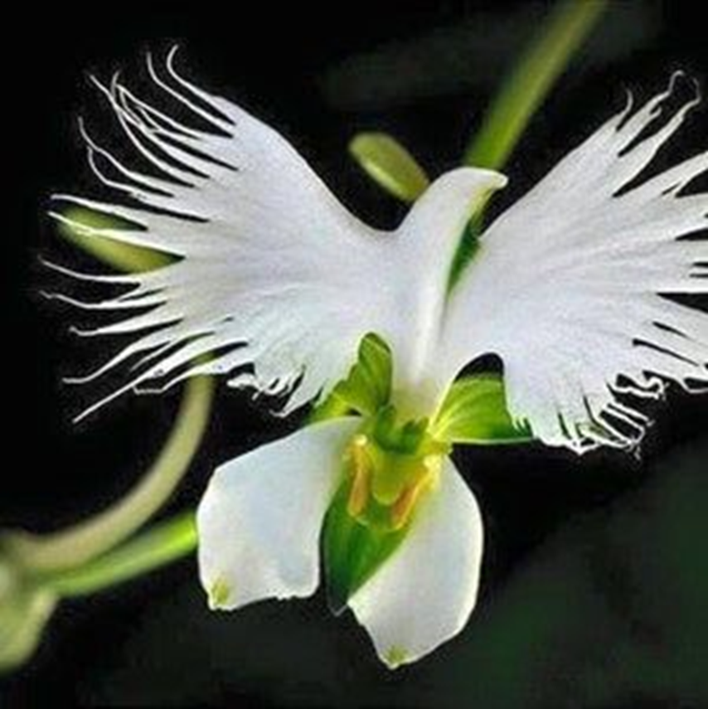
TONIGHT’S SERMON: WHAT THE HOLY SPIRIT DOES FOR US TODAY

