Slide 1
WELCOME TO THE
JACKSON STREET CHURCH OF CHRIST
PLEASE TURN OFF CELLPHONES
This Photo by Unknown Author is licensed under CC BY-NC-ND

Slide 4
SINGING

Slide 5
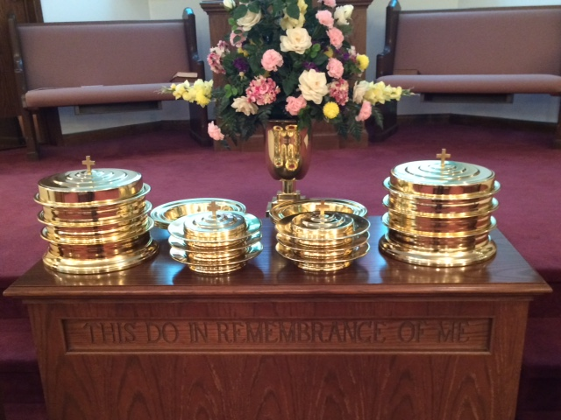
IN REMEMBRANCE OF JESUS

Slide 6
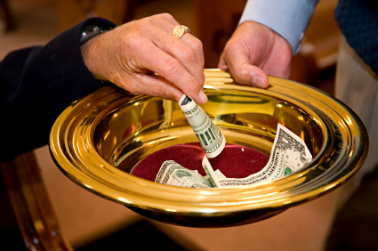
CONTRIBUTION

Slide 7
SINGING

Slide 8
Colossians 3:23–25 And whatever you do, do it heartily, as to the Lord and not to men, ²⁴ knowing that from the Lord you will receive the reward of the inheritance; for you serve the Lord Christ. ²⁵ But he who does wrong will be repaid for what he has done, and there is no partiality.

Slide 10
WRONG

Slide 11
WRONG IS WRONG
Colossians 3:25 But he who does wrong will be repaid for what he has done, and there is no partiality.
We are responsible and must answer to God for the decisions we make and the things we do.
People frequently try to defend, excuse, or explain away the wrongs they have done.
We must insist that wrong is wrong, regardless.

Slide 12
I. Wrong Is Wrong Even If One Does Not Get Caught.
One may cheat on his income tax, copy answers from another on a school test, break the speed limit, or shoplift from a store.
His philosophy may be, "It's only wrong if you get caught."
Of course, sooner or later one's sin will find him out and God sees everything. - Numbers 32:23 But if you do not do so, then take note, you have sinned against the Lord; and be sure your sin will find you out.

Slide 13
2. Wrong Is Wrong Even If It's Legal.
Civil government is good and we are taught to respect and obey it, but sometimes the laws of the state conflict with the laws of God. Romans 13:1–7 Let every soul be subject to the governing authorities. For there is no authority except from God, and the authorities that exist are appointed by God. ² Therefore whoever resists the authority resists the ordinance of God, and those who resist will bring judgment on themselves. ³ For rulers are not a terror to good works, but to evil. Do you want to be unafraid of the authority? Do what is good, and you will have praise from the same. >>>

Slide 14
2. Wrong Is Wrong Even If It's Legal.
⁴ For he is God’s minister to you for good. But if you do evil, be afraid; for he does not bear the sword in vain; for he is God’s minister, an avenger to execute wrath on him who practices evil. ⁵ Therefore you must be subject, not only because of wrath but also for conscience’ sake. ⁶ For because of this you also pay taxes, for they are God’s ministers attending continually to this very thing. ⁷ Render therefore to all their due: taxes to whom taxes are due, customs to whom customs, fear to whom fear, honor to whom honor.

Slide 15
2. Wrong Is Wrong Even If It's Legal.
Civil government has made gambling, alcohol, abortion, and divorce for many reasons, legal, but government cannot make them right.
Neither can religious leaders make thing acceptable that God has not authorized
Acts 5:26–29 Then the captain went with the officers and brought them without violence, for they feared the people, lest they should be stoned. ²⁷ And when they had brought them, they set them before the council. And the high priest asked them, >>>

Slide 16
2. Wrong Is Wrong Even If It's Legal.
Neither can religious leaders make things acceptable that God has not authorized
²⁸ saying, “Did we not strictly command you not to teach in this name? And look, you have filled Jerusalem with your doctrine, and intend to bring this Man’s blood on us!” ²⁹ But Peter and the other apostles answered and said: “We ought to obey God rather than men.
Acts 4:18–20 So they called them and commanded them not to speak at all nor teach in the name of Jesus. ¹⁹ But Peter and John answered and said to them, “Whether it is right in the sight of God to listen to you more than to God, you judge. ²⁰ For we cannot but speak the things which we have seen and heard.”

Slide 17
3. Wrong Is Wrong Even If It's For A "Good Cause".
A state run lottery is begun because "It's for a good cause." It will help our schools. But it just makes poor people poorer in hopes they can win the lottery.
A casino coming to Tunica MS gave promise of visitors coming to give business to the existing restaurants and motels but instead the casino opened its own motel and restaurant.
Paul strongly rejected the false excuse, - Romans 3:8 And why not say, “Let us do evil that good may come”?—as we are slanderously reported and as some affirm that we say. Their condemnation is just.

Slide 18
4. Wrong Is Wrong Even If Someone Else Causes You To Do It.
Sometimes people cave-in to pressure or are provoked into doing something wrong, but they are still responsible.
Adam tried to blame Eve for his sin, but he was still wrong.
Genesis 3:9–13 Then the LORD God called to Adam and said to him, “Where are you?” 10 So he said, “I heard Your voice in the garden, and I was afraid because I was naked; and I hid myself.” 11 And He said, “Who told you that you were naked? Have you eaten from the tree of which I commanded you that you should not eat?” 12 Then the man said, “The woman whom You gave to be with me, she gave me of the tree, and I ate.” 13 And the LORD God said to the woman, “What is this you have done?” The woman said, “The serpent deceived me, and I ate.”

Slide 19
5. Wrong Is Wrong Even If It Is Difficult To Do What Is Right.
Some things are very hard to give up.
Our heart goes out to those who struggle with alcoholism, drugs or other addictions, lustful thoughts, or an unscriptural divorce and remarriage.
We wish to comfort, encourage, and support them, but we cannot give them the idea that something is not wrong just because it is difficult to overcome.

Slide 20
5. Wrong Is Wrong Even If It Is Difficult To Do What Is Right.
1 Peter 4:1–5 Therefore, since Christ suffered for us in the flesh, arm yourselves also with the same mind, for he who has suffered in the flesh has ceased from sin, ² that he no longer should live the rest of his time in the flesh for the lusts of men, but for the will of God. ³ For we have spent enough of our past lifetime in doing the will of the Gentiles—when we walked in lewdness, lusts, drunkenness, revelries, drinking parties, and abominable idolatries. ⁴ In regard to these, they think it strange that you do not run with them in the same flood of dissipation, speaking evil of you. ⁵ They will give an account to Him who is ready to judge the living and the dead.

Slide 21
6. Wrong Is Wrong Even If Someone Else Has Done Something As Bad Or Worse.
The lesser of two evils is still evil.
"Everybody's doing it”, is the national anthem of hell.
Someone excuses himself by saying, "Well, at least what I did wasn't as bad as what John did."
2 Corinthians 10:12 For we dare not class ourselves or compare ourselves with those who commend themselves. But they, measuring themselves by themselves, and comparing themselves among themselves, are not wise.

Slide 22
7. Wrong Is Wrong Regardless Of Who Does It.
A preacher who preached the truth about homosexuality, stopped preaching about it when his son announced he was homosexual.
An elder asked the preacher to stop preaching about divorce and remarriage after his daughter had an unscriptural divorce.
Galatians 2:11–13 Now when Peter had come to Antioch, I withstood him to his face, because he was to be blamed; ¹² for before certain men came from James, he would eat with the Gentiles; but when they came, he withdrew and separated himself, fearing those who were of the circumcision. ¹³ And the rest of the Jews also played the hypocrite with him, so that even Barnabas was carried away with their hypocrisy.

Slide 23
8. Wrong Is Wrong Even If It Doesn't Bother You.
Some may insist‑, "I don't see anything wrong with it."
Once I read about a man who walked through a glass patio door.
He didn't see it, but it was still there.
In spite of persecuting Christians earlier, Paul said his conscience was pure. - Acts 23:1 Then Paul, looking earnestly at the council, said, “Men and brethren, I have lived in all good conscience before God until this day.”

Slide 24
9. Wrong Is Wrong Even If It Appears To Be Expedient.
A salesman may think it is expedient to lie in order to make a big sale. Which will be of great financial benefit to his family.
But wrong is wrong even if it seems like the only way we can gain something we think is needed.
Caiphas was willing to let Jesus be crucified even though he was a just and innocent man ‑ so that the whole nation would not perish. - John 18:12–14 Then the detachment of troops and the captain and the officers of the Jews arrested Jesus and bound Him. ¹³ And they led Him away to Annas first, for he was the father-in-law of Caiaphas who was high priest that year. ¹⁴ Now it was Caiaphas who advised the Jews that it was expedient that one man should die for the people.

Slide 25
10. Wrong Is Wrong Even If You Do Not Admit It.
The prophet Malachi condemned the people of his day for, a number of wrongs.
Rather than admitting and turning from them, they tried to bluff their way through.
They said, "Where have we done (this)?"
Malachi 1:6 “A son honors his father, And a servant his master. If then I am the Father, Where is My honor? And if I am a Master, Where is My reverence? Says the Lord of hosts To you priests who despise My name. Yet you say, ‘In what way have we despised Your name?’

Slide 26
10. Wrong Is Wrong Even If You Do Not Admit It.
They said, "Where have we done (this)?"
Malachi 2:17 You have wearied the Lord with your words; “Yet you say, “In what way have we wearied Him?” In that you say, “Everyone who does evil Is good in the sight of the Lord, And He delights in them,” Or, “Where is the God of justice?”
Malachi 3:7 Yet from the days of your fathers You have gone away from My ordinances And have not kept them. Return to Me, and I will return to you,” Says the Lord of hosts. “But you said, ‘In what way shall we return?’
Malachi 3:8 “Will a man rob God? Yet you have robbed Me! But you say, ‘In what way have we robbed You?’ In tithes and offerings.
D. The fact that they tried to deny wrong‑doing did not mean that they were innocent.

Slide 27
WRONG IS WRONG
Yes, wrong is wrong regardless of these things (and more).
We must be willing to face our wrongs and make them right.
1 John 1:8–10 If we say that we have no sin, we deceive ourselves, and the truth is not in us. ⁹ If we confess our sins, He is faithful and just to forgive us our sins and to cleanse us from all unrighteousness. ¹⁰ If we say that we have not sinned, we make Him a liar, and His word is not in us.

Slide 28
SINGING

Slide 29
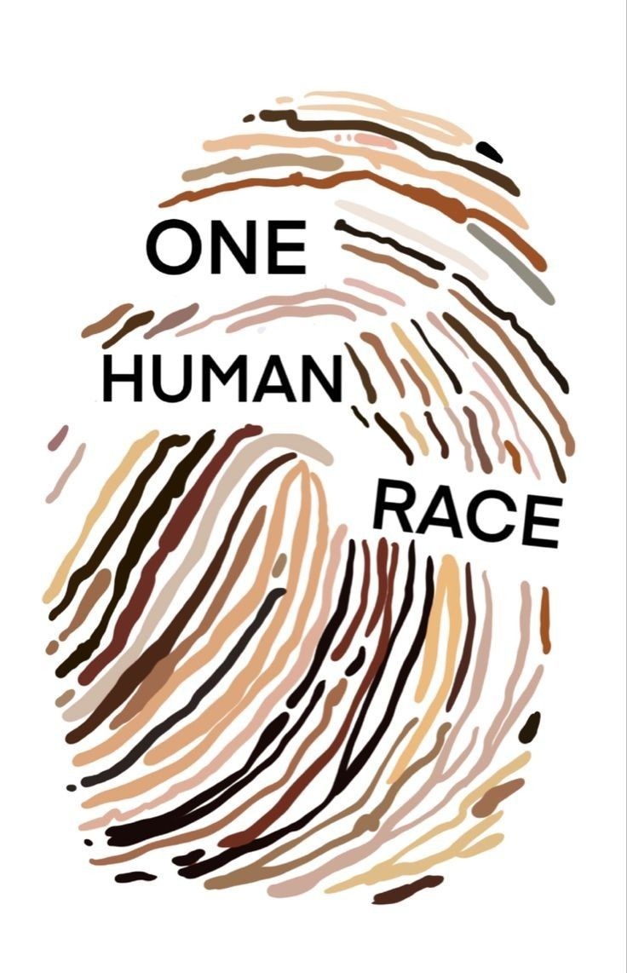
TONIGHT’S SERMON RACISM IS RIDICULOUS

