Slide 1
WELCOME TO THE
JACKSON STREET CHURCH OF CHRIST
PLEASE TURN OFF CELLPHONES
This Photo by Unknown Author is licensed under CC BY-NC-ND

Slide 4
SINGING

Slide 5
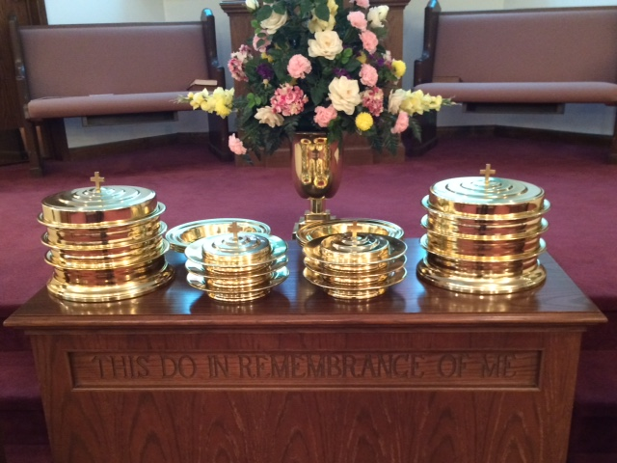
IN REMEMBRANCE OF JESUS

Slide 6
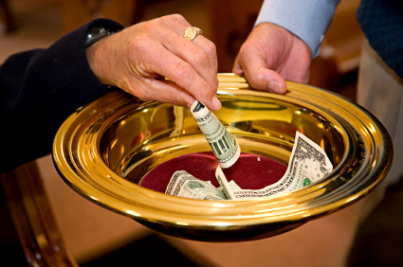
CONTRIBUTION

Slide 7
SINGING

Slide 8
Hosea 4:6–10 My people are destroyed for lack of knowledge. Because you have rejected knowledge, I also will reject you from being priest for Me; Because you have forgotten the law of your God, I also will forget your children. ⁷ “The more they increased, The more they sinned against Me; I will change their glory into shame. ⁸ They eat up the sin of My people; They set their heart on their iniquity. ⁹ And it shall be: like people, like priest. So I will punish them for their ways, And reward them for their deeds. ¹⁰ For they shall eat, but not have enough; They shall commit harlotry, but not increase; Because they have ceased obeying the LORD.

Slide 10
IGNORANCE IS NOT BLISS

Slide 11
HOSEA
Hosea was told to take a harlot as his wife (Gomer). He did so and she went back into her harlotry and Hosea had to buy her back out of her harlotry.
This was done as an illustration of what Israel/Ephraim was doing to God in their going after idolatry.
Hosea 4:6 My people are destroyed for lack of knowledge. Because you have rejected knowledge, I also will reject you from being priest for Me; Because you have forgotten the law of your God, I also will forget your children.
Ignorance is not bliss. It brought the downfall of Israel

Slide 12
HOSEA
Israel’s problem is outlined in Hosea 4:1 Hosea 4:1 Hear the word of the LORD, You children of Israel, For the LORD brings a charge against the inhabitants of the land: “There is no truth or mercy Or knowledge of God in the land.
They were doing these things because they had NO KNOWLEDGE OF GOD, choosing not to retain Him in their knowledge - Romans 1:28–32 And even as they did not like to retain God in their knowledge, God gave them over to a debased mind, to do those things which are not fitting; ²⁹ being filled with all unrighteousness, sexual immorality, wickedness, covetousness, maliciousness; full of envy, murder, strife, deceit, evil-mindedness; they are whisperers, >>>

Slide 13
HOSEA
Israel’s problem is outlined in Hosea 4:1 “There is no truth or mercy Or knowledge of God in the land.
³⁰ backbiters, haters of God, violent, proud, boasters, inventors of evil things, disobedient to parents, ³¹ undiscerning, untrustworthy, unloving, unforgiving, unmerciful; ³² who, knowing the righteous judgment of God, that those who practice such things are deserving of death, not only do the same but also approve of those who practice them.
It’s dangerous for any nation to omit God - Psalms 33:12 Blessed is the nation whose God is the LORD; and the people whom he has chosen for his own inheritance.
Ignorance is definitely not bliss in relationship to our Christianity.

Slide 14
I. IGNORANCE KEEPS US FROM HAVING DIRECTION IN LIFE
The Word of God provides direction - Proverbs 3:5–10 Trust in the LORD with all your heart, And lean not on your own understanding; ⁶ In all your ways acknowledge Him, And He shall direct your paths. ⁷ Do not be wise in your own eyes; Fear the LORD and depart from evil. ⁸ It will be health to your flesh, And strength to your bones. ⁹ Honor the LORD with your possessions, And with the firstfruits of all your increase; ¹⁰ So your barns will be filled with plenty, And your vats will overflow with new wine.

Slide 15
I. IGNORANCE KEEPS US FROM HAVING DIRECTION IN LIFE
One of the first things we do when we come home at night…turn on the light.
If you need help in life, turn on the light - Psalm 119:105 Your word is a lamp to my feet And a light to my path.
God’s book is light…if we don’t turn it on, we’re in the dark and lost.

Slide 16
I. IGNORANCE KEEPS US FROM HAVING DIRECTION IN LIFE
This is a common thought in Scripture
(John 8:12 Then spoke Jesus again unto them, saying, I am the light of the world: he that follows me shall not walk in darkness, but shall have the light of life.;
1 John 1:5-7 This then is the message which we have heard of him, and declare unto you, that God is light, and in him is no darkness at all. ⁶ If we say that we have fellowship with him, and walk in darkness, we lie, and do not the truth: ⁷ But if we walk in the light, as he is in the light, we have fellowship one with another, and the blood of Jesus Christ his Son cleanses us from all sin.

Slide 17
I. IGNORANCE KEEPS US FROM HAVING DIRECTION IN LIFE
This is a common thought in Scripture
A person is either walking in light or fumbling in darkness.
God intends for us to be the light to other people - Matthew 5:14–15 “You are the light of the world. A city that is set on a hill cannot be hidden. ¹⁵ Nor do they light a lamp and put it under a basket, but on a lampstand, and it gives light to all who are in the house.
We can’t do that if we are in darkness ourselves! - Ephesians 5:8 For you were once darkness, but now you are light in the Lord. Walk as children of light

Slide 18
I. IGNORANCE KEEPS US FROM HAVING DIRECTION IN LIFE
Some are not willing to step in the light - John 3:19 And this is the condemnation, that light is come into the world, and men loved darkness rather than light, because their deeds were evil.
If our deeds are evil, we tend to hang around in the shadows.
Light exposes us for what we are and what we are doing.
Why did those people “not like” and “change truth into a lie”? Because it contradicted their lifestyle - Romans 1:28–32 And even as they did not like to retain God in their knowledge, God gave them over to a debased mind, to do those things which are not fitting; >>>

Slide 19
I. IGNORANCE KEEPS US FROM HAVING DIRECTION IN LIFE
Some are not willing to step in the light
²⁹ being filled with all unrighteousness, sexual immorality, wickedness, covetousness, maliciousness; full of envy, murder, strife, deceit, evil-mindedness; they are whisperers, ³⁰ backbiters, haters of God, violent, proud, boasters, inventors of evil things, disobedient to parents, ³¹ undiscerning, untrustworthy, unloving, unforgiving, unmerciful; ³² who, knowing the righteous judgment of God, that those who practice such things are deserving of death, not only do the same but also approve of those who practice them.

Slide 20
I. IGNORANCE KEEPS US FROM HAVING DIRECTION IN LIFE
Some are not willing to step in the light
So they’ve closed their eyes
Following the blind - Matthew 15:13–14 But He answered and said, “Every plant which My heavenly Father has not planted will be uprooted. ¹⁴ Let them alone. They are blind leaders of the blind. And if the blind leads the blind, both will fall into a ditch.
Satan blinds their eyes - 2 Corinthians 4:3–4 But even if our gospel is veiled, it is veiled to those who are perishing, ⁴ whose minds the god of this age has blinded, who do not believe, lest the light of the gospel of the glory of Christ, who is the image of God, should shine on them.

Slide 21
I. IGNORANCE KEEPS US FROM HAVING DIRECTION IN LIFE
The key to a better society is simply God’s Word - Psalms 19:7-8 The law of the LORD is perfect, converting the soul: the testimony of the LORD is sure, making wise the simple. ⁸ The statutes of the LORD are right, rejoicing the heart: the commandment of the LORD is pure, enlightening the eyes.
Some say we’re blinded by the Bible…they have no idea what “enlightenment” is.

Slide 22
II. IGNORANCE CAUSES A LACK OF SPIRITUAL FOOD
We have enough food—I don’t like to miss a meal—but what if we didn’t?
We are concerned with growth; if children don’t grow, worried—some parents even give hormone pills to make their children taller.
When someone gets sick, we’re encouraged when they regain their appetite.
Indian story—in every person, there are two dogs fighting—one good, one bad. Which will win? Whichever one you feed.

Slide 23
II. IGNORANCE CAUSES A LACK OF SPIRITUAL FOOD
Israel was feeding the bad dog and eventually perished due to a lack of knowledge.
Hebrews 5:11-14 Of whom we have many things to say, and hard to be uttered, seeing you are dull of hearing. ¹² For when for the time you ought to be teachers, you have need that one teach you again which be the first principles of the oracles of God; and are become such as have need of milk, and not of strong meat. ¹³ For every one that uses milk is unskilled in the word of righteousness: for he is a babe. >>>

Slide 24
II. IGNORANCE CAUSES A LACK OF SPIRITUAL FOOD
Israel was feeding the bad dog and eventually perished due to a lack of knowledge.
¹⁴ But strong meat belongs to them that are of full age, even those who by reason of use have their senses exercised to discern both good and evil.
When we grow spiritually, we can better discern between right and wrong.
Staying a physical baby is dangerous—young children don’t realize dangers.
Older Christians “ought” to have this knowledge to teach the babes (v. 12).

Slide 25
II. IGNORANCE CAUSES A LACK OF SPIRITUAL FOOD
What makes up your spiritual diet?
It’s easy to get junk food, but our bodies don’t need that—need a good diet.
Our diets should consist of the Word
1 Peter 2:2 as newborn babes, desire the pure milk of the word, that you may grow thereby,
Acts 20:32 “So now, brethren, I commend you to God and to the word of His grace, which is able to build you up and give you an inheritance among all those who are sanctified.

Slide 26
III. IGNORANCE CAUSES US TO MISS SALVATION
It is the Gospel that saves us
Ephesians 1:13–14 In Him you also trusted, after you heard the word of truth, the gospel of your salvation; in whom also, having believed, you were sealed with the Holy Spirit of promise, ¹⁴ who is the guarantee of our inheritance until the redemption of the purchased possession, to the praise of His glory.
James 1:21 Therefore lay aside all filthiness and overflow of wickedness, and receive with meekness the implanted word, which is able to save your souls.

Slide 27
III. IGNORANCE CAUSES US TO MISS SALVATION
But how? - James 1:22 But be doers of the word, and not hearers only, deceiving yourselves.
John 8:31–32 Then Jesus said to those Jews who believed Him, “If you abide in My word, you are My disciples indeed. ³² And you shall know the truth, and the truth shall make you free.”
John 17:16–19 They are not of the world, just as I am not of the world. ¹⁷ Sanctify them by Your truth. Your word is truth. ¹⁸ As You sent Me into the world, I also have sent them into the world. ¹⁹ And for their sakes I sanctify Myself, that they also may be sanctified by the truth.

Slide 28
DO YOU THINK IGNORANCE IS BLISS?
Hosea loved his wife, though she had committed adultery—in fact, he bought her out of slavery.
So, too, does God love us, that he bought us out of the bondage of sin with the blood of His Son.
1 John 5:11–13 And this is the testimony: that God has given us eternal life, and this life is in His Son. ¹² He who has the Son has life; he who does not have the Son of God does not have life. ¹³ These things I have written to you who believe in the name of the Son of God, that you may know that you have eternal life, and that you may continue to believe in the name of the Son of God.
Don’t allow ignorance to keep you our of heaven.
Ignorance is not bliss

Slide 29
SINGING

Slide 30
TONIGHT’S SERMON RACISM IS RIDICULOUS 2

