Slide 1
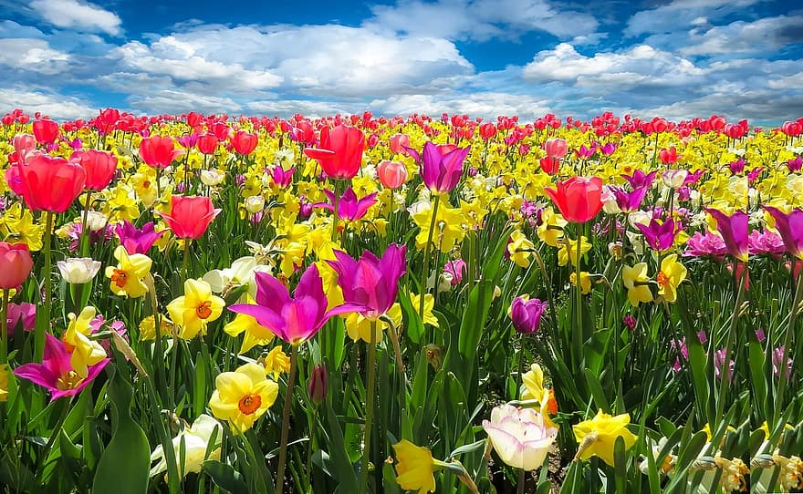
WELCOME TO THE JACKSON STREET CHURCH OF CHRIST
PLEASE SILENCE CELLPHONES

Slide 2


Slide 3

LET US PRAY

Slide 4

SINGING

Slide 5
(Mat 7:21-27) "Not everyone who says to Me, 'Lord, Lord,' shall enter the kingdom of heaven, but he who does the will of My Father in heaven. {22} "Many will say to Me in that day, 'Lord, Lord, have we not prophesied in Your name, cast out demons in Your name, and done many wonders in Your name?' {23} "And then I will declare to them, 'I never knew you; depart from Me, you who practice lawlessness!' {24} "Therefore whoever hears these sayings of Mine, and does them, I will liken him to a wise man who built his house on the rock: {25} "and the rain descended, the floods came, and the winds blew and beat on that house; and it did not fall, for it was founded on the rock. {26} "But everyone who hears these sayings of Mine, and does not do them, will be like a foolish man who built his house on the sand: {27} "and the rain descended, the floods came, and the winds blew and beat on that house; and it fell. And great was its fall."

Slide 6
LET US PRAY

Slide 7

RACISM IS RIDICULOUS - 2
Adapted from an article by Eric Lyons,

Slide 8
Acts 17:23–31 for as I was passing through and considering the objects of your worship, I even found an altar with this inscription: TO THE UNKNOWN GOD. Therefore, the One whom you worship without knowing, Him I proclaim to you: ²⁴ God, who made the world and everything in it, since He is Lord of heaven and earth, does not dwell in temples made with hands. ²⁵ Nor is He worshiped with men’s hands, as though He needed anything, since He gives to all life, breath, and all things. ²⁶ And He has made from one blood every nation of men to dwell on all the face of the earth, and has determined their preappointed times and the boundaries of their dwellings, >>>

Slide 9
²⁷ so that they should seek the Lord, in the hope that they might grope for Him and find Him, though He is not far from each one of us; ²⁸ for in Him we live and move and have our being, as also some of your own poets have said, ‘For we are also His offspring.’ ²⁹ Therefore, since we are the offspring of God, we ought not to think that the Divine Nature is like gold or silver or stone, something shaped by art and man’s devising. ³⁰ Truly, these times of ignorance God overlooked, but now commands all men everywhere to repent, ³¹ because He has appointed a day on which He will judge the world in righteousness by the Man whom He has ordained. He has given assurance of this to all by raising Him from the dead.”

Slide 10
ERIC LYONS’ INTRODUCTION
Atheism has no rational basis upon which to call anything objectively just or unjust, including racism.
If mankind is merely the result of billions of years of mindless evolution and is nothing more than animals (as atheistic evolution contends; Marchant, 2008), then man can logically make evolutionary-based racist remarks that are consistent with the godless General Theory of Evolution.
In fact, Charles Darwin’s “Bulldog,” atheist Thomas Huxley, did just that in his 1865 essay, “Emancipation—Black and White.” He alleged, for example, “no rational man, cognizant of the facts, believes that the average Negro is the equal, still less superior, of the white man.”

Slide 11
ERIC LYONS’ INTRODUCTION
In truth, if there is no God, mankind could just as easily look down upon and mistreat others (whom he deems are less evolved), as he does roaches, rats, and orangutans (Lyons, 2011; Lyons and Butt, 2009).
Those who are Christians, however, logically contend that since (1) God exists, and (2) the Bible is the Word of God, racism is morally wrong—and completely ridiculous for the following five reasons.

Slide 12
ALL HUMAN BEINGS ARE MADE IN THE IMAGE OF GOD
Made in the image of God - Genesis 1:26–27 Then God said, “Let Us make man in Our image, according to Our likeness; let them have dominion over the fish of the sea, over the birds of the air, and over the cattle, over all the earth and over every creeping thing that creeps on the earth.” ²⁷ So God created man in His own image; in the image of God He created him; male and female He created them.
We are God’s offspring - Acts 17:28–29 for in Him we live and move and have our being, as also some of your own poets have said, ‘For we are also His offspring.’ ²⁹ Therefore, since we are the offspring of God, we ought not to think that the Divine Nature is like gold or silver or stone, something shaped by art and man’s devising.

Slide 13
ALL HUMAN BEINGS ARE MADE IN THE IMAGE OF GOD
We are made in the similitude or likeness of God - James 3:8–9 But no man can tame the tongue. It is an unruly evil, full of deadly poison. ⁹ With it we bless our God and Father, and with it we curse men, who have been made in the similitude of God.
All human beings (of every color and ethnicity) bear the image of the divine God.

Slide 14
II. GOD ONLY MADE ONE RACE—THE HUMAN RACE
We are all descendant of Adam and Eve - Genesis 3:20 And Adam called his wife’s name Eve, because she was the mother of all living.
We are all descendants of Mr. & Mrs. Noah - Genesis 8:15–17 Then God spoke to Noah, saying, ¹⁶ “Go out of the ark, you and your wife, and your sons and your sons’ wives with you. ¹⁷ Bring out with you every living thing of all flesh that is with you: birds and cattle and every creeping thing that creeps on the earth, so that they may abound on the earth, and be fruitful and multiply on the earth.”

Slide 15
II. GOD ONLY MADE ONE RACE—THE HUMAN RACE
We are all from one blood - Acts 17:26 And He has made from one blood every nation of men to dwell on all the face of the earth, and has determined their preappointed times and the boundaries of their dwellings,
We are all of one race, the human race. Although we come in different colors, shapes and sizes, all humans, homo sapiens, all nations are related through Adam & Eve and Noah and his wife.

Slide 16
III. GOD DOESN’T PLAY FAVORITES
AND NEITHER SHOULD WE
God shows no partiality
  Deuteronomy 10:17–19 For the Lord your God is God of gods and Lord of lords, the great God, mighty and awesome, who shows no partiality nor takes a bribe. ¹⁸ He administers justice for the fatherless and the widow, and loves the stranger, giving him food and clothing. ¹⁹ Therefore love the stranger, for you were strangers in the land of Egypt.
  Acts 10:34-35 Then Peter opened his mouth and said: “In truth I perceive that God shows no partiality. ³⁵ But in every nation whoever fears Him and works righteousness is accepted by Him.

Slide 17
III. GOD DOESN’T PLAY FAVORITES
AND NEITHER SHOULD WE
God shows personal favoritism to no man - Galatians 2:6 But from those who seemed to be something—whatever they were, it makes no difference to me; God shows personal favoritism to no man—for those who seemed to be something added nothing to me.
God provides for the just and the unjust, and so should we
  Matthew 5:44–48 But I say to you, love your enemies, bless those who curse you, do good to those who hate you, and pray for those who spitefully use you and persecute you, ⁴⁵ that you may be sons of your Father in heaven; for He makes His sun rise on the evil and on the good, and sends rain on the just and on the unjust. >>>

Slide 18
III. GOD DOESN’T PLAY FAVORITES
AND NEITHER SHOULD WE
God provides for the just and the unjust, and so should we
  ⁴⁷ And if you greet your brethren only, what do you do more than others? Do not even the tax collectors do so? ⁴⁸ Therefore you shall be perfect, just as your Father in heaven is perfect.
  James 2:1 My brethren, do not hold the faith of our Lord Jesus Christ, the Lord of glory, with partiality.
Man looks at the outward appearance, God looks at the heart - 1 Samuel 16:7 But the LORD said to Samuel, “Do not look at his appearance or at his physical stature, because I have refused him. For the LORD does not see as man sees; for man looks at the outward appearance, but the LORD looks at the heart.”

Slide 19
IV. LOVE IS NOT RACIST
Abound in love - Philippians 1:9-11 “And this I pray, that your love may abound still more and more in knowledge and all discernment, that you may approve the things that are excellent, that you may be sincere and without offense till the day of Christ, being filled with the fruits of righteousness which are by Jesus Christ, to the glory and praise of God”.
Do good to all - Galatians 6:7–10 Do not be deceived, God is not mocked; for whatever a man sows, that he will also reap. ⁸ For he who sows to his flesh will of the flesh reap corruption, but he who sows to the Spirit will of the Spirit reap everlasting life. ⁹ And let us not grow weary while doing good, for in due season we shall reap if we do not lose heart. ¹⁰ Therefore, as we have opportunity, let us do good to all, especially to those who are of the household of faith.
Love is kind - 1 Corinthians 13:4–6 Love suffers long and is kind; love does not envy; love does not parade itself, is not puffed up; ⁵ does not behave rudely, does not seek its own, is not provoked, thinks no evil; ⁶ does not rejoice in iniquity, but rejoices in the truth;

Slide 20
IV. LOVE IS NOT RACIST
Do not be overcome by evil but overcome evil with good - Romans 12:9–21 Let love be without hypocrisy. Abhor what is evil. Cling to what is good. ¹⁰ Be kindly affectionate to one another with brotherly love, in honor giving preference to one another; ¹¹ not lagging in diligence, fervent in spirit, serving the Lord; ¹² rejoicing in hope, patient in tribulation, continuing steadfastly in prayer; ¹³ distributing to the needs of the saints, given to hospitality. ¹⁴ Bless those who persecute you; bless and do not curse. ¹⁵ Rejoice with those who rejoice, and weep with those who weep. >>>

Slide 21
IV. LOVE IS NOT RACIST
¹⁶ Be of the same mind toward one another. Do not set your mind on high things, but associate with the humble. Do not be wise in your own opinion. ¹⁷ Repay no one evil for evil. Have regard for good things in the sight of all men. ¹⁸ If it is possible, as much as depends on you, live peaceably with all men. ¹⁹ Beloved, do not avenge yourselves, but rather give place to wrath; for it is written, “Vengeance is Mine, I will repay,” says the Lord. ²⁰ Therefore “If your enemy is hungry, feed him; If he is thirsty, give him a drink; For in so doing you will heap coals of fire on his head.” ²¹ Do not be overcome by evil, but overcome evil with good.

Slide 22
IV. LOVE IS NOT RACIST
Abound in love - Philippians 1:9-11 “And this I pray, that your love may abound still more and more in No Christian can be a racist, and any racist who claims to be a Christian is, in truth, a liar. - 1 John 4:20-21 “If someone says, ‘I love God,’ and hates his brother, he is a liar; for he who does not love his brother whom he has seen, how can he love God whom he has not seen? ²¹ And this commandment we have from Him: that he who loves God must love his brother also”.

Slide 23
IV. LOVE IS NOT RACIST
Love fulfills the law - Romans 13:8–10 Owe no one anything except to love one another, for he who loves another has fulfilled the law. ⁹ For the commandments, “You shall not commit adultery,” “You shall not murder,” “You shall not steal,” “You shall not bear false witness,” “You shall not covet,” and if there is any other commandment, are all summed up in this saying, namely, “You shall love your neighbor as yourself.” ¹⁰ Love does no harm to a neighbor; therefore love is the fulfillment of the law.

Slide 24
V. JESUS IS EVERYONE’S SAVIOR
A. God wants all people to be saved
  God told Abraham that all nations would be blessed by his seed (Jesus) - Genesis 22:18 In your seed all the nations of the earth shall be blessed, because you have obeyed My voice.”
  God loved the world - John 3:16 For God so loved the world that He gave His only begotten Son, that whoever believes in Him should not perish but have everlasting life.
  Make disciples of all the nations - Matthew 28:18–19 And Jesus came and spoke to them, saying, “All authority has been given to Me in heaven and on earth. ¹⁹ Go therefore and make disciples of all the nations, baptizing them in the name of the Father and of the Son and of the Holy Spirit,

Slide 25
V. JESUS IS EVERYONE’S SAVIOR
A. God wants all people to be saved
  Salvation to all who believe, Jew and Greek - Romans 1:16 For I am not ashamed of the gospel of Christ, for it is the power of God to salvation for everyone who believes, for the Jew first and also for the Greek.
  Desires all men to be saved - 1 Timothy 2:1–4 Therefore I exhort first of all that supplications, prayers, intercessions, and giving of thanks be made for all men, ² for kings and all who are in authority, that we may lead a quiet and peaceable life in all godliness and reverence. ³ For this is good and acceptable in the sight of God our Savior, ⁴ who desires all men to be saved and to come to the knowledge of the truth.

Slide 26
V. JESUS IS EVERYONE’S SAVIOR
B. No distinctions in Christ
  We are all one in Christ - Galatians 3:26–29 For you are all sons of God through faith in Christ Jesus. ²⁷ For as many of you as were baptized into Christ have put on Christ. ²⁸ There is neither Jew nor Greek, there is neither slave nor free, there is neither male nor female; for you are all one in Christ Jesus. ²⁹ And if you are Christ’s, then you are Abraham’s seed, and heirs according to the promise.

Slide 27
V. JESUS IS EVERYONE’S SAVIOR
B. No distinctions in Christ
  Christ is all, and in all - Colossians 3:8–11 But now you yourselves are to put off all these: anger, wrath, malice, blasphemy, filthy language out of your mouth. ⁹ Do not lie to one another, since you have put off the old man with his deeds, ¹⁰ and have put on the new man who is renewed in knowledge according to the image of Him who created him, ¹¹ where there is neither Greek nor Jew, circumcised nor uncircumcised, barbarian, Scythian, slave nor free, but Christ is all and in all.

Slide 28
ERIC LYONS’ CONCLUSION
I do not claim to be an expert on race relations, but I know that some people genuinely struggle with the sin of racism.
Some struggle with being the recipients of racism, which in turn may cause them to be tempted to react in racist ways.
Others struggle with cowardly silence as they tolerate the sin of racism in their homes, churches, schools, businesses, and communities.
Still others seem so preoccupied with advancing their own racial agenda that they appear to hastily interpret most everything as a racial problem, when most things are not.

Slide 29
ERIC LYONS’ CONCLUSION
Jesus once taught the hypocrites of His day, saying, “Do not judge according to appearance, but judge with righteous judgment” (John 7:24).
May God help us to see as He sees: “for man looks at the outward appearance, but the Lord looks at the heart” (1 Samuel 16:7).
What a better world this would be if everyone realized the foolishness of judging a book by its cover.
Racism really is ridiculous.

Slide 30
SINGING

Slide 31
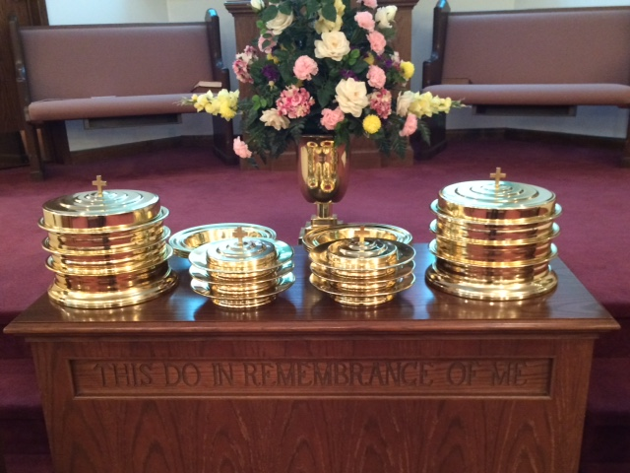
IN REMEMBRANCE OF JESUS

Slide 32
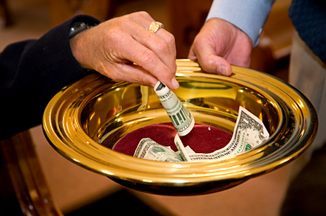
CONTRIBUTION

Slide 33
SINGING

Slide 34
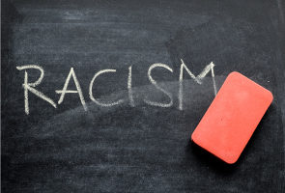
HAVE AN ALL-PEOPLE- LOVING WEEK

