Slide 1
WELCOME TO THE JACKSON STREET CHURCH OF CHRIST
PLEASE SILENCE CELLPHONES

Slide 3
LET US PRAY

Slide 4
SINGING

Slide 5
Hebrews 9:24–28 For Christ has not entered the holy places made with hands, which are copies of the true, but into heaven itself, now to appear in the presence of God for us; ²⁵ not that He should offer Himself often, as the high priest enters the Most Holy Place every year with blood of another—²⁶ He then would have had to suffer often since the foundation of the world; but now, once at the end of the ages, He has appeared to put away sin by the sacrifice of Himself. ²⁷ And as it is appointed for men to die once, but after this the judgment, ²⁸ so Christ was offered once to bear the sins of many. To those who eagerly wait for Him He will appear a second time, apart from sin, for salvation.

Slide 6
LET US PRAY

Slide 7
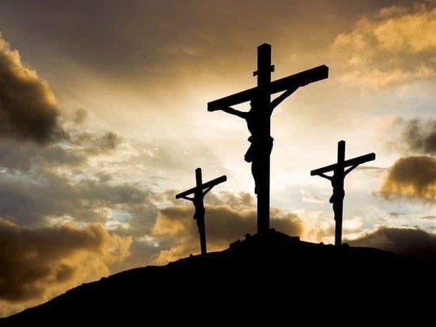
THE DEATH OF JESUS

Slide 8
THE DEATH OF JESUS
The birth of Jesus was so significant that our counting of time is based on that event.
But the death of Jesus is even more significant.
His birth was not celebrated by the early church but His death was remembered through the Lord’s Supper and is still remembered by His church, every first day of the week, even today.
We want to examine some reasons for the significance of Jesus’ death.

Slide 9
HIS DEATH WAS FOR ALL WHO HAVE EVER LIVED
This is not the same as dying for some people. Some can help save a country. Others can help those around them. But the death of Jesus helped all men past and future.
Taste death for everyone - Heb 2:9 But we see Jesus, who was made a little lower than the angels, for the suffering of death crowned with glory and honor, that He, by the grace of God, might taste death for everyone.
Propiatiation for the whole world - 1 John 2:1-2 My little children, these things I write to you, so that you may not sin. And if anyone sins, we have an Advocate with the Father, Jesus Christ the righteous. {2} And He Himself is the propitiation for our sins, and not for ours only but also for the whole world.

Slide 10
HIS DEATH WAS FOR ALL WHO HAVE EVER LIVED
Ransom for all - 1 Tim 2:6 who gave Himself a ransom for all, to be testified in due time,
Redemption of those under the first covenant - Hebrews 9:15 And for this reason He is the Mediator of the new covenant, by means of death, for the redemption of the transgressions under the first covenant, that those who are called may receive the promise of the eternal inheritance.
The people under the OT benefited from the death of Jesus. Those born 2,000 years later benefit as well. No other death could do that.

Slide 11
II. HIS DEATH WAS ONCE FOR ALL
Heb 7:26-27 For such a High Priest was fitting for us, who is holy, harmless, undefiled, separate from sinners, and has become higher than the heavens; {27} who does not need daily, as those high priests, to offer up sacrifices, first for His own sins and then for the people's, for this He did once for all when He offered up Himself.
Heb 9:12 Not with the blood of goats and calves, but with His own blood He entered the Most Holy Place once for all, having obtained eternal redemption.
1 Peter 3:18 For Christ also suffered once for sins, the just for the unjust, that He might bring us to God, being put to death in the flesh but made alive by the Spirit,

Slide 12
II. HIS DEATH WAS ONCE FOR ALL
Hebrews 9:24–28 For Christ has not entered the holy places made with hands, which are copies of the true, but into heaven itself, now to appear in the presence of God for us; ²⁵ not that He should offer Himself often, as the high priest enters the Most Holy Place every year with blood of another—²⁶ He then would have had to suffer often since the foundation of the world; but now, once at the end of the ages, He has appeared to put away sin by the sacrifice of Himself. ²⁷ And as it is appointed for men to die once, but after this the judgment, ²⁸ so Christ was offered once to bear the sins of many. To those who eagerly wait for Him He will appear a second time, apart from sin, for salvation.

Slide 13
II. HIS DEATH WAS ONCE FOR ALL
We see the significance of this one offering in Hebrews 10:1–10 For the law, having a shadow of the good things to come, and not the very image of the things, can never with these same sacrifices, which they offer continually year by year, make those who approach perfect. ² For then would they not have ceased to be offered? For the worshipers, once purified, would have had no more consciousness of sins. ³ But in those sacrifices there is a reminder of sins every year. ⁴ For it is not possible that the blood of bulls and goats could take away sins. ⁵ Therefore, when He came into the world, He said: “Sacrifice and offering You did not desire, But a body You have prepared for Me. >>>

Slide 14
II. HIS DEATH WAS ONCE FOR ALL
⁶ In burnt offerings and sacrifices for sin You had no pleasure. ⁷ Then I said, ‘Behold, I have come— In the volume of the book it is written of Me— To do Your will, O God.’ ” ⁸ Previously saying, “Sacrifice and offering, burnt offerings, and offerings for sin You did not desire, nor had pleasure in them” which are offered according to the law, ⁹ then He said, “Behold, I have come to do Your will, O God.” He takes away the first that He may establish the second. ¹⁰ By that will we have been sanctified through the offering of the body of Jesus Christ once for all.

Slide 15
III. HIS DEATH CONQUERED SATAN
Prophesied from the beginning - Gen 3:15 And I will put enmity Between you and the woman, And between your seed and her Seed; He shall bruise your head, And you shall bruise His heel.”
His death destroyed Satan’s works - 1 John 3:8 He who sins is of the devil, for the devil has sinned from the beginning. For this purpose the Son of God was manifested, that He might destroy the works of the devil.

Slide 16
III. HIS DEATH CONQUERED SATAN
His death destroyed Satan - Heb 2:14 Inasmuch then as the children have partaken of flesh and blood, He Himself likewise shared in the same, that through death He might destroy him who had the power of death, that is, the devil,
We already know the outcome. Satan’s fate is sealed.
His doom is declared Mat 25:41 “Then He will also say to those on the left hand, ‘Depart from Me, you cursed, into the everlasting fire prepared for the devil and his angels'

Slide 17
IV. HIS DEATH FOR US SANCTIFIED US ALL
Through the offering of Jesus’ body - Heb 10:10 By that will we have been sanctified through the offering of the body of Jesus Christ once for all.
By one offering - Hebrews 10:14 For by one offering He has perfected forever those who are being sanctified.
With His own blood - Heb 13:12 Therefore Jesus also, that He might sanctify the people with His own blood, suffered outside the gate.
Gave Himself to sanctify and cleanse - Ephesians 5:25–27 Husbands, love your wives, just as Christ also loved the church and gave Himself for her, ²⁶ that He might sanctify and cleanse her with the washing of water by the word, ²⁷ that He might present her to Himself a glorious church, not having spot or wrinkle or any such thing, but that she should be holy and without blemish.

Slide 18
V. HIS DEATH FOR US CHANGED THE WAY WE LIVE
Dead to sin - Rom 6:8-11 Now if we died with Christ, we believe that we shall also live with Him, {9} knowing that Christ, having been raised from the dead, dies no more. Death no longer has dominion over Him. {10} For the death that He died, He died to sin once for all; but the life that He lives, He lives to God. {11} Likewise you also, reckon yourselves to be dead indeed to sin, but alive to God in Christ Jesus our Lord.
Live not for self but for Him - 2 Cor 5:14-15 For the love of Christ compels us, because we judge thus: that if One died for all, then all died; {15} and He died for all, that those who live should live no longer for themselves, but for Him who died for them and rose again.

Slide 19
V. HIS DEATH FOR US CHANGED THE WAY WE LIVE
Live for righteousness - 1 Pet 2:21-24 For to this you were called, because Christ also suffered for us, leaving us an example, that you should follow His steps: {22} “Who committed no sin, Nor was deceit found in His mouth”; {23} who, when He was reviled, did not revile in return; when He suffered, He did not threaten, but committed Himself to Him who judges righteously; {24} who Himself bore our sins in His own body on the tree, that we, having died to sins, might live for righteousness; by whose stripes you were healed.
Live for the will of God - 1 Pet 4:1-2 Therefore, since Christ suffered for us in the flesh, arm yourselves also with the same mind, for he who has suffered in the flesh has ceased from sin, {2} that he no longer should live the rest of his time in the flesh for the lusts of men, but for the will of God.

Slide 20
THE DEATH OF JESUS
His Death Was For All Who Have Ever Lived
His Death Was Once For All
His Death Conquered Satan
His Death For Us Sanctified Us All (Set Us Apart For Holy Use)
His Death For Us Changed The Way We Live
Have You Benefitted From Jesus’ Death?

Slide 21
SINGING

Slide 22
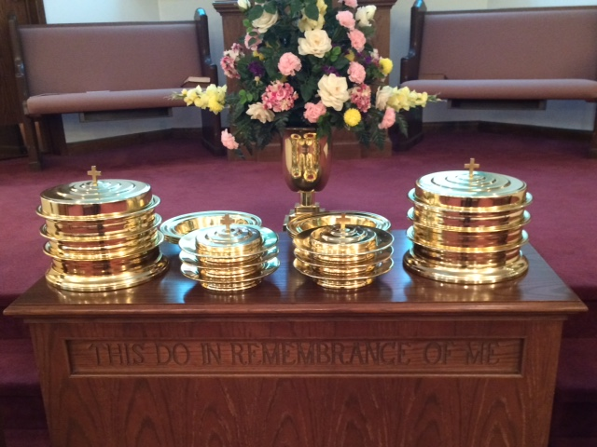
IN REMEMBRANCE OF JESUS

Slide 23
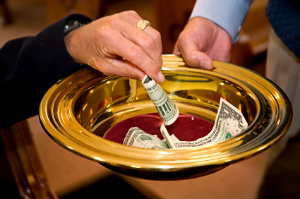
CONTRIBUTION

Slide 24
SINGING

Slide 25
HAVE A SANCTIFIED WEEK

