Slide 1
WELCOME TO THE
JACKSON STREET CHURCH OF CHRIST
PLEASE TURN OFF CELLPHONES
This Photo by Unknown Author is licensed under CC BY-NC-ND

Slide 4
SINGING

Slide 5
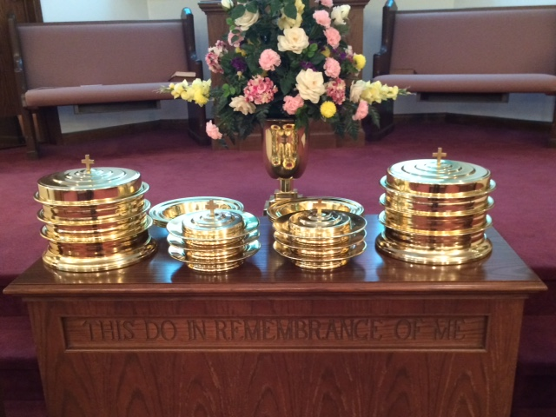
IN REMEMBRANCE OF JESUS

Slide 6
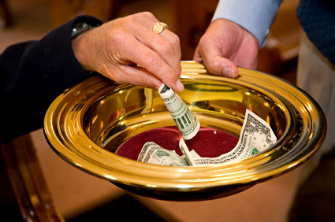
CONTRIBUTION

Slide 7
SINGING

Slide 8
Job 1:1–5 There was a man in the land of Uz, whose name was Job; and that man was blameless and upright, and one who feared God and shunned evil. ² And seven sons and three daughters were born to him. ³ Also, his possessions were seven thousand sheep, three thousand camels, five hundred yoke of oxen, five hundred female donkeys, and a very large household, so that this man was the greatest of all the people of the East. ⁴ And his sons would go and feast in their houses, each on his appointed day, and would send and invite their three sisters to eat and drink with them. ⁵ So it was, when the days of feasting had run their course, that Job would send and sanctify them, and he would rise early in the morning and offer burnt offerings according to the number of them all. For Job said, “It may be that my sons have sinned and cursed God in their hearts.” Thus Job did regularly.

Slide 10
A FATHER TO FOLLOW

Slide 11
FATHERS
Parenting is no easy task.
Especially when you do not fully understand parenting.
And we seem to be puzzled about what's wrong with children today, but sometime we need to stop and ask what's wrong with the parents.
Because the last time I checked the child is a product of the parent and not vise versa.
So, this morning I want us to look at a Father who set an example for Fathers everywhere.
Follow the example of a Father who knew the importance of being spiritually connected to God.
Buying name brand clothes, video games, and putting money in kids pockets will not get them an escort into Heaven however,
If we Fathers stay in a solid relationship with God we'll do our best to make sure they get there.
Job was a Father that every Father should be willing to follow.

Slide 12
I. Disposition - vs. 1 There was a man in the land of Uz, whose name was Job; and that man was blameless and upright, and one who feared God and shunned evil.

Slide 13
I. Disposition
Fruit doesn't fall to far from the tree
Like father, like son
The characteristics of a good Father are
1. Fear of God {fear of God is the beginning of wisdom} Prov. 1:7
Honor, respect, and awe (terror) "knowing the terror of the Lord we persuade men"
What does it mean to fear God? Hebrews 12:28–29 Therefore, since we are receiving a kingdom which cannot be shaken, let us have grace, by which we may serve God acceptably with reverence and godly fear. ²⁹ For our God is a consuming fire.

Slide 14
I. Disposition
The characteristics of a good Father are…
Fear of God {fear of God is the beginning of wisdom} Prov. 1:7
Stay away from Evil.
Pro. 14:6 A wise man fears and departs from evil, But a fool rages and is self-confident.
Psalm 34:11–16 Come, you children, listen to me; I will teach you the fear of the LORD. 12 Who is the man who desires life, And loves many days, that he may see good? ¹³ Keep your tongue from evil, And your lips from speaking deceit. ¹⁴ Depart from evil and do good; Seek peace and pursue it. ¹⁵ The eyes of the LORD are on the righteous, And His ears are open to their cry. ¹⁶ The face of the LORD is against those who do evil, To cut off the remembrance of them from the earth.
1 Thessalonians 5:21–22 Test all things; hold fast what is good. ²² Abstain from every form of evil.

Slide 15
I. Disposition
The characteristics of a good Father are…
2. Be the greatest example before your children and all mankind by obeying God's command and keep yourself unspotted from this evil and perverted world.
However, there will be occasions when they still won’t act right, but like Job; Fathers, we must continue on with God.’
Young folks there is a payday for sin it's death, physically and spiritually.
Parent’s hearts will break at the knowledge of their children’s being overtaken by sin, but we must stand with God.

Slide 16
II. Attitude vs. 4-6 And his sons would go and feast in their houses, each on his appointed day, and would send and invite their three sisters to eat and drink with them. ⁵ So it was, when the days of feasting had run their course, that Job would send and sanctify them, and he would rise early in the morning and offer burnt offerings according to the number of them all. For Job said, “It may be that my sons have sinned and cursed God in their hearts.” Thus Job did regularly.

Slide 17
II. Attitude
His children may have participated in activities which were sinful in nature.
Job would send for them and sanctify them.
He offered a burnt offering for their sin.
It might be that my sons have sinned and cursed God in their hearts.
Job's attitude was!
"If you mess up I'll do all I can to help you clean it up."
I won’t pretend that I don't know what your struggling with.
I will not support your wrong doing.
But, I will do all that I can to help you clean up the mess you have created. So, you may get back in the grace of God.
The Prodigal Son – the father was waiting and longing for his son to return. Luke 15:11-32
Never support the wrong that your children do.

Slide 18
II. Attitude
Job didn't seem to drink with his children.
Job 1:13 Now there was a day when his sons and daughters were eating and drinking wine in their oldest brother’s house;
Job 1:18 While he was still speaking, another also came and said, “Your sons and daughters were eating and drinking wine in their oldest brother’s house,
Proverbs 23:29–35 Who has woe? Who has sorrow? Who has contentions? Who has complaints? Who has wounds without cause? Who has redness of eyes? ³⁰ Those who linger long at the wine, Those who go in search of mixed wine. ³¹ Do not look on the wine when it is red, When it sparkles in the cup, When it swirls around smoothly; ³² At the last it bites like a serpent, And stings like a viper. ³³ Your eyes will see strange things, And your heart will utter perverse things. ³⁴ Yes, you will be like one who lies down in the midst of the sea, Or like one who lies at the top of the mast, saying: ³⁵ “They have struck me, but I was not hurt; They have beaten me, but I did not feel it. When shall I awake, that I may seek another drink?”

Slide 19
III. Dedicated, end of vs.5 - Thus Job did regularly.
Note, these were grown children with homes of their own.
Job never gave up on his disposition nor his attitude.
1 Thessalonians 5:17 pray without ceasing,
We should never give up on our children.
Ephesians 6:1–4 Children, obey your parents in the Lord, for this is right. ² “Honor your father and mother,” which is the first commandment with promise: ³ “that it may be well with you and you may live long on the earth.” ⁴ And you, fathers, do not provoke your children to wrath, but bring them up in the training and admonition of the Lord.

Slide 20
Fathers, Follow Job’s Example As Father In Your…
Disposition
Attitude
Dedication

Slide 21
SINGING

Slide 22
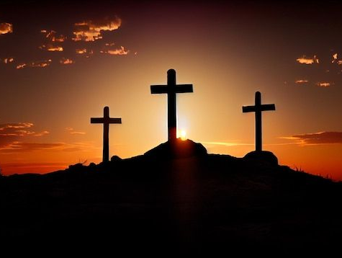
TONIGHT’S SERMON THE DEATH OF JESUS

