Slide 1

WELCOME TO THE
JACKSON STREET CHURCH OF CHRIST
PLEASE TURN OFF CELLPHONES

Slide 2


Slide 3


Slide 4

SINGING

Slide 5
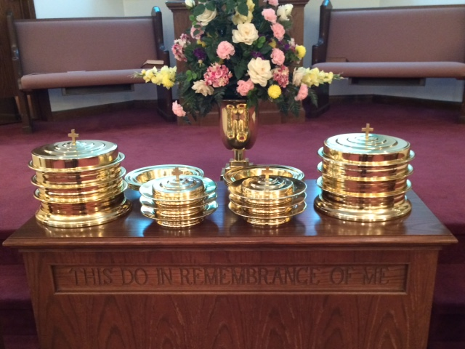
IN REMEMBRANCE OF JESUS

Slide 6
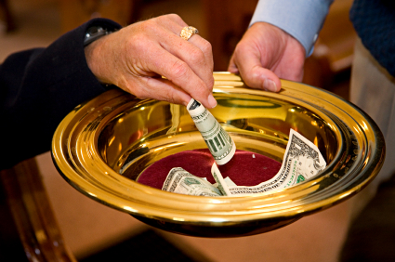
CONTRIBUTION

Slide 7



Slide 8
(Luke 15:11-32) Then He said: “A certain man had two sons. {12} “And the younger of them said to his father, ‘Father, give me the portion of goods that falls to me.’ So he divided to them his livelihood. {13} “And not many days after, the younger son gathered all together, journeyed to a far country, and there wasted his possessions with prodigal living. {14} “But when he had spent all, there arose a severe famine in that land, and he began to be in want. {15} “Then he went and joined himself to a citizen of that country, and he sent him into his fields to feed swine. {16} “And he would gladly have filled his stomach with the pods that the swine ate, and no one gave him anything. {17} “But when he came to himself, he said, ‘How many of my father’s hired servants have bread enough and to spare, and I perish with hunger! >>>

Slide 9
{18} ‘I will arise and go to my father, and will say to him, “Father, I have sinned against heaven and before you, {19} “and I am no longer worthy to be called your son. Make me like one of your hired servants.”’ {20} “And he arose and came to his father. But when he was still a great way off, his father saw him and had compassion, and ran and fell on his neck and kissed him. {21} “And the son said to him, ‘Father, I have sinned against heaven and in your sight, and am no longer worthy to be called your son.’ {22} “But the father said to his servants, ‘Bring out the best robe and put it on him, and put a ring on his hand and sandals on his feet. {23} ‘And bring the fatted calf here and kill it, and let us eat and be merry; {24} ‘for this my son was dead and is alive again; he was lost and is found.’ And they began to be merry. {25} “Now his older son was in the field. And as he came and drew near to the house, he heard music and dancing. >>>

Slide 10
{26} “So he called one of the servants and asked what these things meant. {27} “And he said to him, ‘Your brother has come, and because he has received him safe and sound, your father has killed the fatted calf.’ {28} “But he was angry and would not go in. Therefore his father came out and pleaded with him. {29} “So he answered and said to his father, ‘Lo, these many years I have been serving you; I never transgressed your commandment at any time; and yet you never gave me a young goat, that I might make merry with my friends. {30} ‘But as soon as this son of yours came, who has devoured your livelihood with harlots, you killed the fatted calf for him.’ {31} “And he said to him, ‘Son, you are always with me, and all that I have is yours. {32} ‘It was right that we should make merry and be glad, for your brother was dead and is alive again, and was lost and is found.’”

Slide 13
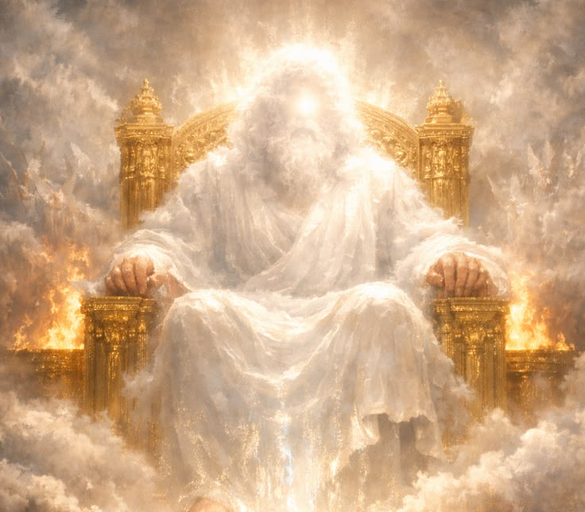
PICTURE OF THE FATHER

Slide 14
A PICTURE OF THE FATHER
It is interesting that God chose to refer to Himself as our Father.
It puts a great deal of responsibility on us as fathers to live up to the example he sets for us.
The parable of the prodigal son shows us some facts about our heavenly father which are worth remembering.
Our emphasis is usually on the prodigal and/or his brother. Norman Kramer asked why we never look at it from the viewpoint of the father. Norman had a prodigal son also.

Slide 15
I. THE FATHER ALLOWS CHOICE, ALTHOUGH OFTEN DISAPPOINTED. (Luke 15:11-16) Then He said: “A certain man had two sons. {12} “And the younger of them said to his father, ‘Father, give me the portion of goods that falls to me.’ So he divided to them his livelihood. {13} “And not many days after, the younger son gathered all together, journeyed to a far country, and there wasted his possessions with prodigal living. {14} “But when he had spent all, there arose a severe famine in that land, and he began to be in want. {15} “Then he went and joined himself to a citizen of that country, and he sent him into his fields to feed swine. {16} “And he would gladly have filled his stomach with the pods that the swine ate, and no one gave him anything.

Slide 16
I. THE FATHER ALLOWS CHOICE, ALTHOUGH OFTEN DISAPPOINTED.
A. BIBLE EXAMPLES
  1. ADAM & EVE - (Gen 2:15-17) Then the LORD God took the man and put him in the garden of Eden to tend and keep it. {16} And the LORD God commanded the man, saying, "Of every tree of the garden you may freely eat; {17} "but of the tree of the knowledge of good and evil you shall not eat, for in the day that you eat of it you shall surely die."
  2. THE ISRAELITES - (Deu 30:19) "I call heaven and earth as witnesses today against you, that I have set before you life and death, blessing and cursing; therefore choose life, that both you and your descendants may live;

Slide 17
I. THE FATHER ALLOWS CHOICE, ALTHOUGH OFTEN DISAPPOINTED.
A. BIBLE EXAMPLES
  3. JOSHUA - (Josh 24:15) "And if it seems evil to you to serve the LORD, choose for yourselves this day whom you will serve, whether the gods which your fathers served that were on the other side of the River, or the gods of the Amorites, in whose land you dwell. But as for me and my house, we will serve the LORD."

Slide 18
I. THE FATHER ALLOWS CHOICE, ALTHOUGH OFTEN DISAPPOINTED.
A. BIBLE EXAMPLES
  4. ANANIAS & SAPPHIRA - (Acts 5:2-5) And he kept back part of the proceeds, his wife also being aware of it, and brought a certain part and laid it at the apostles' feet. {3} But Peter said, "Ananias, why has Satan filled your heart to lie to the Holy Spirit and keep back part of the price of the land for yourself? {4} "While it remained, was it not your own? And after it was sold, was it not in your own control? Why have you conceived this thing in your heart? You have not lied to men but to God." {5} Then Ananias, hearing these words, fell down and breathed his last. So great fear came upon all those who heard these things.

Slide 19
I. THE FATHER ALLOWS CHOICE, ALTHOUGH OFTEN DISAPPOINTED.
A. BIBLE EXAMPLES
  5. PAUL - (1 Tim 1:12-16) And I thank Christ Jesus our Lord who has enabled me, because He counted me faithful, putting me into the ministry, {13} although I was formerly a blasphemer, a persecutor, and an insolent man; but I obtained mercy because I did it ignorantly in unbelief. {14} And the grace of our Lord was exceedingly abundant, with faith and love which are in Christ Jesus. {15} This is a faithful saying and worthy of all acceptance, that Christ Jesus came into the world to save sinners, of whom I am chief. {16} However, for this reason I obtained mercy, that in me first Jesus Christ might show all longsuffering, as a pattern to those who are going to believe on Him for everlasting life.

Slide 20
I. THE FATHER ALLOWS CHOICE, ALTHOUGH OFTEN DISAPPOINTED.
B. God gives us free choice even though he is disappointed when we make bad choices
C. Parenting is designed to bring children to the point that they make good choices in life
D. We as fathers must give our children freedom of choice as they grow in age and responsibility even though we are disappointed in their choices at times.

Slide 21
II. THE FATHER AWAITS CHANGE THAT BRINGS SOMEONE BACK TO HIM. (Luke 15:17-20) “But when he came to himself, he said, ‘How many of my father’s hired servants have bread enough and to spare, and I perish with hunger! {18} ‘I will arise and go to my father, and will say to him, “Father, I have sinned against heaven and before you, {19} “and I am no longer worthy to be called your son. Make me like one of your hired servants.”’ {20} “And he arose and came to his father. But when he was still a great way off, his father saw him and had compassion, and ran and fell on his neck and kissed him.

Slide 22
II. THE FATHER AWAITS CHANGE THAT BRINGS SOMEONE BACK TO HIM.
A. GOD WANTS ALL TO BE SAVED AND RETURN TO HIM
  (Rom 2:4) } Or do you despise the riches of His goodness, forbearance, and longsuffering, not knowing that the goodness of God leads you to repentance?
  (2 Pet 3:9) The Lord is not slack concerning His promise, as some count slackness, but is longsuffering toward us, not willing that any should perish but that all should come to repentance.

Slide 23
II. THE FATHER AWAITS CHANGE THAT BRINGS SOMEONE BACK TO HIM.
A. GOD WANTS ALL TO BE SAVED AND RETURN TO HIM
  (1 Tim 2:1-4) Therefore I exhort first of all that supplications, prayers, intercessions, and giving of thanks be made for all men, {2} for kings and all who are in authority, that we may lead a quiet and peaceable life in all godliness and reverence. {3} For this is good and acceptable in the sight of God our Savior, {4} who desires all men to be saved and to come to the knowledge of the truth.
B. Many fathers and mothers are waiting for their prodigals to return to their loving arms. Video – homecoming: waiting for them to come home
C. Sometimes all we can do is wait for them to repent or “come to themselves”

Slide 24
III. THE FATHER APPROVES CONFORMITY TO HIS WILL – (Luke 15:21-32) “And the son said to him, ‘Father, I have sinned against heaven and in your sight, and am no longer worthy to be called your son.’ {22} “But the father said to his servants, ‘Bring out the best robe and put it on him, and put a ring on his hand and sandals on his feet. {23} ‘And bring the fatted calf here and kill it, and let us eat and be merry; {24} ‘for this my son was dead and is alive again; he was lost and is found.’ And they began to be merry. {25} “Now his older son was in the field. And as he came and drew near to the house, he heard music and dancing. {26} “So he called one of the servants and asked what these things meant. >>>

Slide 25
III. THE FATHER APPROVES CONFORMITY TO HIS WILL – {27} “And he said to him, ‘Your brother has come, and because he has received him safe and sound, your father has killed the fatted calf.’ {28} “But he was angry and would not go in. Therefore his father came out and pleaded with him. {29} “So he answered and said to his father, ‘Lo, these many years I have been serving you; I never transgressed your commandment at any time; and yet you never gave me a young goat, that I might make merry with my friends. {30} ‘But as soon as this son of yours came, who has devoured your livelihood with harlots, you killed the fatted calf for him.’ {31} “And he said to him, ‘Son, you are always with me, and all that I have is yours. {32} ‘It was right that we should make merry and be glad, for your brother was dead and is alive again, and was lost and is found.’”

Slide 26
III. THE FATHER APPROVES CONFORMITY TO HIS WILL
A. REPENTANCE - (Acts 17:30) "Truly, these times of ignorance God overlooked, but now commands all men everywhere to repent,
B. CONFESSION
1. CONFESS JESUS
    a. (Mat 10:32-33) "Therefore whoever confesses Me before men, him I will also confess before My Father who is in heaven. {33} "But whoever denies Me before men, him I will also deny before My Father who is in heaven.
    b. (Rom 10:9-10) that if you confess with your mouth the Lord Jesus and believe in your heart that God has raised Him from the dead, you will be saved. {10} For with the heart one believes unto righteousness, and with the mouth confession is made unto salvation.

Slide 27
III. THE FATHER APPROVES CONFORMITY TO HIS WILL
B. CONFESSION
2. CONFESS OUR SINS
a. (James 5:16) Confess your trespasses to one another, and pray for one another, that you may be healed. The effective, fervent prayer of a righteous man avails much.
b. (1 John 1:7-10) But if we walk in the light as He is in the light, we have fellowship with one another, and the blood of Jesus Christ His Son cleanses us from all sin. {8} If we say that we have no sin, we deceive ourselves, and the truth is not in us. {9} If we confess our sins, He is faithful and just to forgive us our sins and to cleanse us from all unrighteousness. {10} If we say that we have not sinned, we make Him a liar, and His word is not in us.

Slide 28
III. THE FATHER APPROVES CONFORMITY TO HIS WILL
C. BAPTISM AND A CHANGED LIFE - (Rom 6:1-14) What shall we say then? Shall we continue in sin that grace may abound? {2} Certainly not! How shall we who died to sin live any longer in it? {3} Or do you not know that as many of us as were baptized into Christ Jesus were baptized into His death? {4} Therefore we were buried with Him through baptism into death, that just as Christ was raised from the dead by the glory of the Father, even so we also should walk in newness of life. {5} For if we have been united together in the likeness of His death, certainly we also shall be in the likeness of His resurrection, {6} knowing this, that our old man was crucified with Him, that the body of sin might be done away with, that we should no longer be slaves of sin. {7} For he who has died has been freed from sin. {8} Now if we died with Christ, we believe that we shall also live with Him, {9} knowing that Christ, having been raised from the dead, dies no more. Death no longer has dominion over Him. >>>

Slide 29
III. THE FATHER APPROVES CONFORMITY TO HIS WILL
{10} For the death that He died, He died to sin once for all; but the life that He lives, He lives to God. {11} Likewise you also, reckon yourselves to be dead indeed to sin, but alive to God in Christ Jesus our Lord. {12} Therefore do not let sin reign in your mortal body, that you should obey it in its lusts. {13} And do not present your members as instruments of unrighteousness to sin, but present yourselves to God as being alive from the dead, and your members as instruments of righteousness to God. {14} For sin shall not have dominion over you, for you are not under law but under grace.

Slide 30
III. THE FATHER APPROVES CONFORMITY TO HIS WILL
D. FAITHFUL LIVING - (Rev 2:10) "Do not fear any of those things which you are about to suffer. Indeed, the devil is about to throw some of you into prison, that you may be tested, and you will have tribulation ten days. Be faithful until death, and I will give you the crown of life.
E. WHEN THE PRODIGAL RETURNED TO GOD HE IN ESSENCE SAID “YOU WERE RIGHT.” ONE OF THE MOST WELCOME THINGS A PARENT CAN HEAR IS “YOU WERE RIGHT.”

Slide 31
WHAT ABOUT YOU?
Have you made choices which led you away from God?
Are you willing to make changes in your life to conform to His will?
Do you need to return to the Father?

Slide 32

PRAYER

Slide 33

TONIGHT’S SERMON: GOD’S JEWELS

