Slide 1

WELCOME TO THE
JACKSON STREET CHURCH OF CHRIST
PLEASE TURN OFF CELLPHONES

Slide 2


Slide 3

LET US PRAY

Slide 4

SINGING

Slide 5
(Psa 100) Make a joyful shout to the LORD, all you lands! {2} Serve the LORD with gladness; Come before His presence with singing. {3} Know that the LORD, He is God; It is He who has made us, and not we ourselves; We are His people and the sheep of His pasture. {4} Enter into His gates with thanksgiving, And into His courts with praise. Be thankful to Him, and bless His name. {5} For the LORD is good; His mercy is everlasting, And His truth endures to all generations.

Slide 6
LET US PRAY

Slide 7
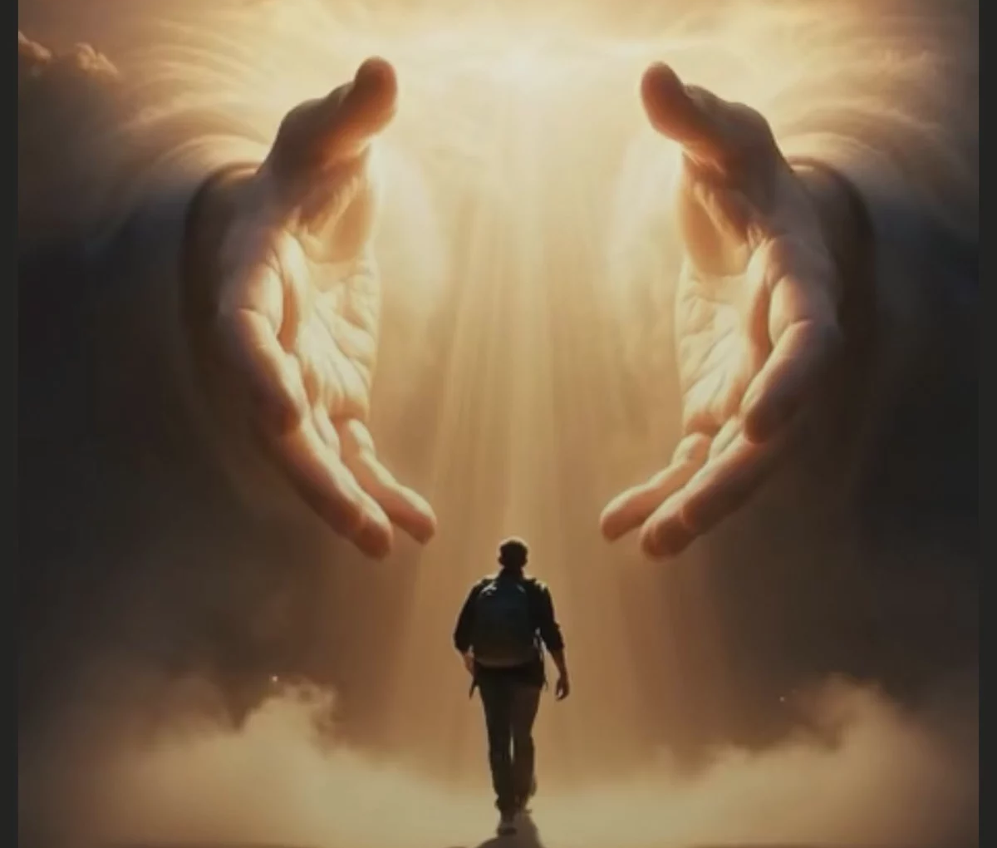
OUR RELATIONSHIP WITH GOD

Slide 8
OUR RELATIONSHIP WITH GOD?
A. WHAT WE DO,
B. WHERE WE GO
C. AND WHAT WE KNOW (FILL OUR MINDS WITH)
D. DEFINES WHO WE ARE

Slide 9
I. WHAT TO DO - Vss. 1-2,4
A. Make a joyful shout - (Psa 32:11 b) Shout for joy, all you upright in heart!
B. Serve the Lord with gladness
  (Psa 32:11 a) Be glad in the LORD and rejoice, you righteous;
  (Psa 68:3) But let the righteous be glad; Let them rejoice before God; Yes, let them rejoice exceedingly.
C. Come before His presence with singing
  (Psa 68:4) Sing to God, sing praises to His name; Extol Him who rides on the clouds, By His name YAH, And rejoice before Him.
  (Psa 95:1) Oh come, let us sing to the LORD! Let us shout joyfully to the Rock of our salvation.
D. Be thankful to Him - (Psa 95:2) Let us come before His presence with thanksgiving; Let us shout joyfully to Him with psalms.
E. Bless his name - (Psa 103:1-2) Bless the LORD, O my soul; And all that is within me, bless His holy name! {2} Bless the LORD, O my soul, And forget not all His benefits:

Slide 10
II. WHERE TO GO - Vs. 4
Into His gates with thanksgiving
    (Psa 116:17) I will offer to You the sacrifice of thanksgiving, And will call upon the name of the LORD.
    Psalm 100:4–5 Enter into His gates with thanksgiving, And into His courts with praise. Be thankful to Him, and bless His name. ⁵ For the LORD is good; His mercy is everlasting, And His truth endures to all generations.
B. and into his courts with praise
(Psa 111:1) Praise the LORD! I will praise the LORD with my whole heart, In the assembly of the upright and in the congregation.
Psalm 9:1–2 I will praise You, O LORD, with my whole heart; I will tell of all Your marvelous works. ² I will be glad and rejoice in You; I will sing praise to Your name, O Most High.

Slide 11
III. WHAT TO KNOW - Vss. 3, 5
The Lord is God - (Psa 46:10) Be still, and know that I am God; I will be exalted among the nations, I will be exalted in the earth!
He has made us, and not we ourselves - (Psa 95:6) Oh come, let us worship and bow down; Let us kneel before the LORD our Maker.
We are his people - (Psa 94:14) For the LORD will not cast off His people, Nor will He forsake His inheritance.
We are his sheep - (Psa 95:7) For He is our God, And we are the people of His pasture, And the sheep of His hand.
The Lord is compassionate - Psalm 145:8–9 The LORD is gracious and full of compassion, Slow to anger and great in mercy. ⁹ The LORD is good to all, And His tender mercies are over all His works.

Slide 12
III. WHAT TO KNOW - Vss. 3, 5
His mercy is everlasting - (Psa 103:11) For as the heavens are high above the earth, So great is His mercy toward those who fear Him;
His truth endures to all generations - (Psa 146:6) Who made heaven and earth, The sea, and all that is in them; Who keeps truth forever.
Vengeance belongs to Him – (Psalm 94:1) O LORD God, to whom vengeance belongs—O God, to whom vengeance belongs, shine forth!
He is forgiving – (Psalm 103:10–12) He has not dealt with us according to our sins, Nor punished us according to our iniquities. 11 For as the heavens are high above the earth, So great is His mercy toward those who fear Him; 12 As far as the east is from the west, So far has He removed our transgressions from us.

Slide 13
YOUR RELATIONSHIP WITH GOD?
WHAT DO YOU DO,
WHERE DO YOU GO
AND WHAT DO YOU KNOW (FILL YOUR MIND WITH)
THOSE THREE THINGS DEFINE WHO YOU ARE
WHO ARE YOU?

Slide 14
SINGING

Slide 15
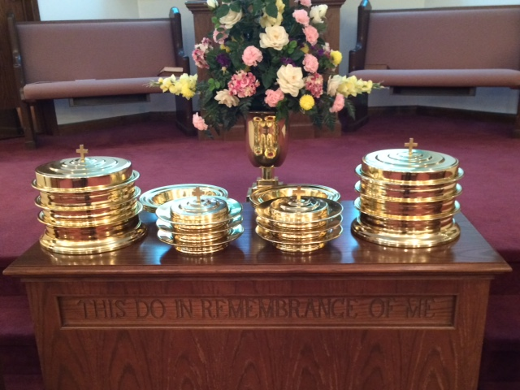
IN REMEMBRANCE OF JESUS

Slide 16
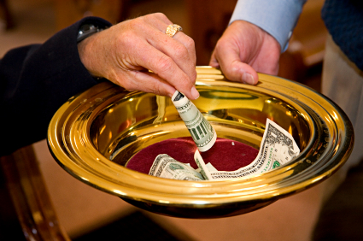
CONTRIBUTION

Slide 17
SINGING

Slide 18

HAVE A GODLY WEEK

