Slide 1
WELCOME TO THE
JACKSON STREET CHURCH OF CHRIST
PLEASE TURN OFF CELLPHONES
This Photo by Unknown Author is licensed under CC BY-NC-ND

Slide 4
SINGING

Slide 5
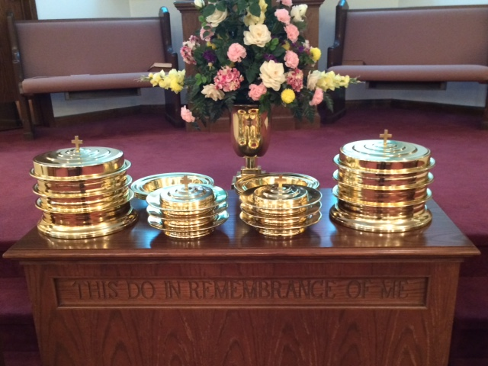
IN REMEMBRANCE OF JESUS

Slide 6
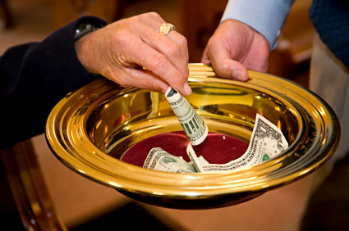
CONTRIBUTION

Slide 7
SINGING

Slide 8
2 Samuel 11:1–5 It happened in the spring of the year, at the time when kings go out to battle, that David sent Joab and his servants with him, and all Israel; and they destroyed the people of Ammon and besieged Rabbah. But David remained at Jerusalem. ² Then it happened one evening that David arose from his bed and walked on the roof of the king’s house. And from the roof he saw a woman bathing, and the woman was very beautiful to behold. ³ So David sent and inquired about the woman. And someone said, “Is this not Bathsheba, the daughter of Eliam, the wife of Uriah the Hittite?” ⁴ Then David sent messengers, and took her; and she came to him, and he lay with her, for she was cleansed from her impurity; and she returned to her house. ⁵ And the woman conceived; so she sent and told David, and said, “I am with child.”

Slide 10
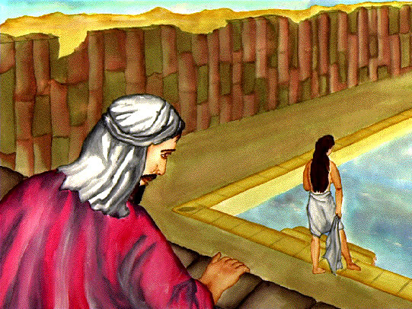
Learning from David’s mistakes

Slide 11
LEARNING FROM DAVID’S MISTAKES
Someone has described the life of King David as being like the two sides of a roof. The one side rises and rises, and then, at the top, it suddenly drops off and falls an equal distance on the other side.
In fact, when we think of David we don’t first think about…
his years of faithfulness as Saul tried to kill him,
his wisdom in drawing the northern and southern parts of Israel together,
his military genius,
his religious sincerity,
or his love of Mephibosheth;
Instead we remember his one night affair with Bathsheba and the murder of her husband Uriah.

Slide 12
LEARNING FROM DAVID’S MISTAKES
In the Biblical record David’s reputation was tarnished by this episode; the Bible says, (1 Ki 15:5) because David did what was right in the eyes of the LORD, and had not turned aside from anything that He commanded him all the days of his life, except in the matter of Uriah the Hittite.
The chapter of the Bible we have before us today is one we might want to skip right over ... but we cannot do that.
The Bible doesn’t pull any punches ... even when it describes one of the heroes of the faith.
We need to study these verses so that we can learn from David’s sinful mistakes.
We are going to look at five lessons we can learn from David’s sin.

Slide 13
The first lesson is that falling into sin doesn’t happen in a day.
The law had warned against David’s actions.
(Deu 17:14, 17) "When you come to the land which the LORD your God is giving you, and possess it and dwell in it, and say, 'I will set a king over me like all the nations that are around me,' {17} "Neither shall he multiply wives for himself, lest his heart turn away; nor shall he greatly multiply silver and gold for himself.
(James 1:14-16) But each one is tempted when he is drawn away by his own desires and enticed. {15} Then, when desire has conceived, it gives birth to sin; and sin, when it is full-grown, brings forth death. {16} Do not be deceived, my beloved brethren.

Slide 14
The first lesson is that falling into sin doesn’t happen in a day.
(Eph 4:22-24) that you put off, concerning your former conduct, the old man which grows corrupt according to the deceitful lusts, {23} and be renewed in the spirit of your mind, {24} and that you put on the new man which was created according to God, in true righteousness and holiness.
(Heb 3:12-13) Beware, brethren, lest there be in any of you an evil heart of unbelief in departing from the living God; {13} but exhort one another daily, while it is called "Today," lest any of you be hardened through the deceitfulness of sin.
"there’s no such thing as a little sin"? So called "little sins" quickly turn into big sins.

Slide 15
II. The second lesson is that we need to keep busy.
(2 Sam 11:1-2a) It happened in the spring of the year, at the time when kings go out to battle, that David sent Joab and his servants with him, and all Israel; and they destroyed the people of Ammon and besieged Rabbah. But David remained at Jerusalem. {2} Then it happened one evening that David arose from his bed and walked on the roof of the king's house.
David was in bed instead on the battlefield! Why David didn’t accompany the troops as he usually did we don’t know. It turned out to be among the worst decisions of his life.
(1 Cor 15:58) Therefore, my beloved brethren, be steadfast, immovable, always abounding in the work of the Lord, knowing that your labor is not in vain in the Lord.

Slide 16
II. The second lesson is that we need to keep busy.
(1 Th 4:1-5) Finally then, brethren, we urge and exhort in the Lord Jesus that you should abound more and more, just as you received from us how you ought to walk and to please God; {2} for you know what commandments we gave you through the Lord Jesus. {3} For this is the will of God, your sanctification: that you should abstain from sexual immorality; {4} that each of you should know how to possess his own vessel in sanctification and honor, {5} not in passion of lust, like the Gentiles who do not know God;

Slide 17
II. The second lesson is that we need to keep busy.
(2 Th 3:11-13) For we hear that there are some who walk among you in a disorderly manner, not working at all, but are busybodies. {12} Now those who are such we command and exhort through our Lord Jesus Christ that they work in quietness and eat their own bread. {13} But as for you, brethren, do not grow weary in doing good.
An idle mind is the devil’s workshop.
If we keep busy doing God’s will then sin will have a much more difficult time finding a home in our heart.

Slide 18
III. The third lesson we can learn from David is that fighting desire is vital.
(2 Sam 11:2b) And from the roof he saw a woman bathing, and the woman was very beautiful to behold.
The Bible doesn’t use the word "very beautiful" too often. Sarah, Rebekah & Bathsheba. Bathsheba must have been a knock-out.
David caught sight of her bathing in the moonlight. David’s horrible mistake was that he didn’t fight these sinful desires. Instead of forcing them out of his mind he dwelled on these thoughts ... and then acted on them.

Slide 19
III. The third lesson we can learn from David is that fighting desire is vital.
(Mat 5:27-28) "You have heard that it was said to those of old, 'You shall not commit adultery.' {28} "But I say to you that whoever looks at a woman to lust for her has already committed adultery with her in his heart.
(1 John 2:15-17) Do not love the world or the things in the world. If anyone loves the world, the love of the Father is not in him. {16} For all that is in the world; the lust of the flesh, the lust of the eyes, and the pride of life; is not of the Father but is of the world. {17} And the world is passing away, and the lust of it; but he who does the will of God abides forever.

Slide 20
III. The third lesson we can learn from David is that fighting desire is vital.
(Prov 6:24-28) To keep you from the evil woman, From the flattering tongue of a seductress. {25} Do not lust after her beauty in your heart, Nor let her allure you with her eyelids. {26} For by means of a harlot A man is reduced to a crust of bread; And an adulteress will prey upon his precious life. {27} Can a man take fire to his bosom, And his clothes not be burned? {28} Can one walk on hot coals, And his feet not be seared?

Slide 21
III. The third lesson we can learn from David is that fighting desire is vital.
(1 Cor 6:18-20) Flee sexual immorality. Every sin that a man does is outside the body, but he who commits sexual immorality sins against his own body. {19} Or do you not know that your body is the temple of the Holy Spirit who is in you, whom you have from God, and you are not your own? {20} For you were bought at a price; therefore glorify God in your body and in your spirit, which are God's.

Slide 22
IV. The fourth lesson we learn is to listen to good advise.
(2 Sam 11:3) So David sent and inquired about the woman. And someone said, "Is this not Bathsheba, the daughter of Eliam, the wife of Uriah the Hittite?"
He gently tried to call David back to God’s law by saying, "My king, she is a married woman." David could have ended the whole mess before it started if he had listened to his servant.
(Prov 19:20) Listen to counsel and receive instruction, That you may be wise in your latter days.
(Prov 8:33) Hear instruction and be wise, And do not disdain it.

Slide 23
IV. The fourth lesson we learn is to listen to good advise.
(Prov 15:31) The ear that hears the rebukes of life Will abide among the wise.
(Prov 22:17) Incline your ear and hear the words of the wise, And apply your heart to my knowledge;
(Eccl 7:5) It is better to hear the rebuke of the wise Than for a man to hear the song of fools.
When is the last time that you could have avoided a great deal of heartache if you had listened to good advise of a fellow Christian? Thank God for the people He has put in your life to give you good advise. Promise yourself that you will listen to them.

Slide 24
The last lesson: when we have sinned God calls us to repent, not to cover up the sin.
Bathsheba must have slipped home from the palace late that night. It looked like no one would ever know about their night of pleasure until the message was sent to David from Bathsheba. (2 Sam 11:5-6) And the woman conceived; so she sent and told David, and said, "I am with child." {6} Then David sent to Joab, saying, "Send me Uriah the Hittite." And Joab sent Uriah to David.
David should have repented of his sin and dealt with the consequences the best he could. Instead he tried to cover up the sin. This cover up ended with David murdering one of his most faithful warriors. Instead of having the assurance of God’s forgiveness David had to deal with loneliness, guilt, worry, and heartache.

Slide 25
The last lesson: when we have sinned God calls us to repent, not to cover up the sin.
(Psa 19:12) Who can understand his errors? Cleanse me from secret faults.
(Eccl 12:14) For God will bring every work into judgment, Including every secret thing, Whether good or evil.
(Acts 17:30) "Truly, these times of ignorance God overlooked, but now commands all men everywhere to repent,
(1 Cor 4:5) Therefore judge nothing before the time, until the Lord comes, who will both bring to light the hidden things of darkness and reveal the counsels of the hearts. Then each one's praise will come from God.

Slide 26
The last lesson: when we have sinned God calls us to repent, not to cover up the sin.
(Heb 4:12-13) For the word of God is living and powerful, and sharper than any two-edged sword, piercing even to the division of soul and spirit, and of joints and marrow, and is a discerner of the thoughts and intents of the heart. {13} And there is no creature hidden from His sight, but all things are naked and open to the eyes of Him to whom we must give account.

Slide 27
HAVE YOU LEARNED FROM DAVID’S MISTAKES?
Have you got secret sin in your life, that is slowly eating away at you from the inside?
Look at David and see how this sin began his downfall.
Are you keeping busy with the work of the Lord?
Are you fighting the temptation to sin in your life?
Will you listen to the advice for you to get your life right with God?
Recognize your sin, confess it, repent of it, and turn back to God.

Slide 28
SINGING

Slide 29
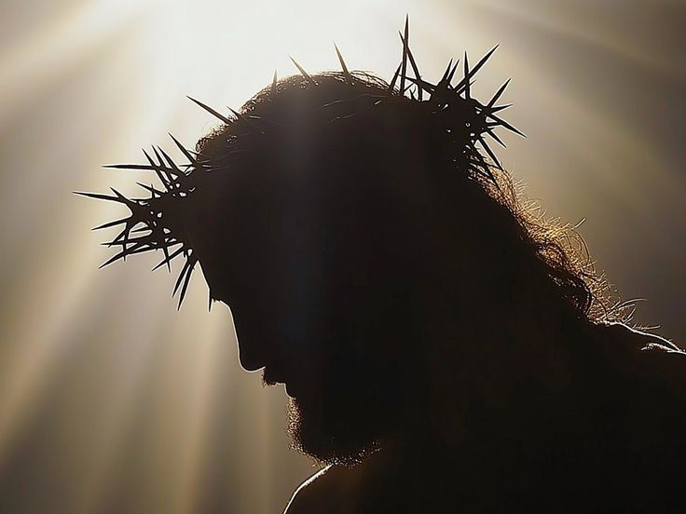
TONIGHT’S SERMON JESUS, HIMSELF

