Slide 1
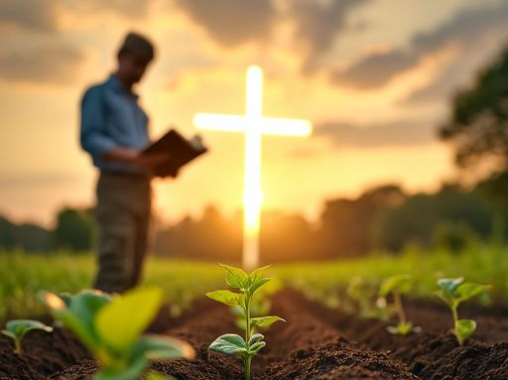
WELCOME TO THE JACKSON STREET
CHURCH OF CHRIST
PLEASE SILENCE CELLPHONES

Slide 3
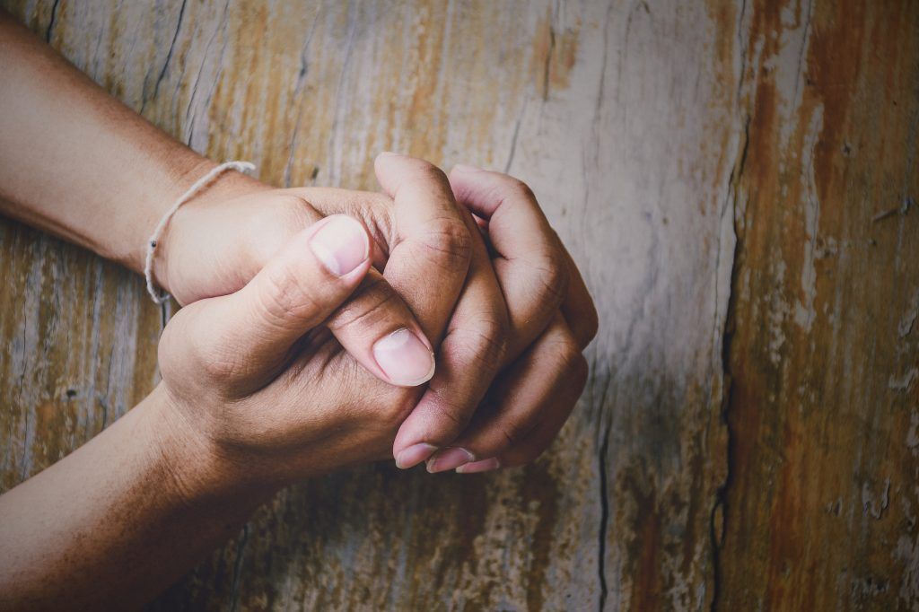
LET US PRAY

Slide 4
SINGING

Slide 5
(John 5:24-29) "Most assuredly, I say to you, he who hears My word and believes in Him who sent Me has everlasting life, and shall not come into judgment, but has passed from death into life. {25} "Most assuredly, I say to you, the hour is coming, and now is, when the dead will hear the voice of the Son of God; and those who hear will live. {26} "For as the Father has life in Himself, so He has granted the Son to have life in Himself, {27} "and has given Him authority to execute judgment also, because He is the Son of Man. {28} "Do not marvel at this; for the hour is coming in which all who are in the graves will hear His voice {29} "and come forth; those who have done good, to the resurrection of life, and those who have done evil, to the resurrection of condemnation.

Slide 6
LET US PRAY

Slide 7
JESUS, HIMSELF

Slide 8
JESUS, HIMSELF
Children: I did it, myself.
When I first became a Christian, I remember wondering why God sent His Son to die for our sins, then I learned that Jesus was God in the flesh.
So, Jesus/God did these things for us, Himself.

Slide 9
JESUS HUMBLED HIMSELF
(Phil 2:5-8) } Let this mind be in you which was also in Christ Jesus, {6} who, being in the form of God, did not consider it robbery to be equal with God, {7} but made Himself of no reputation, taking the form of a bondservant, and coming in the likeness of men. {8} And being found in appearance as a man, He humbled Himself and became obedient to the point of death, even the death of the cross.

Slide 10
JESUS HUMBLED HIMSELF
WE MUST HUMBLE OURSELVES - (Luke 18:10-14) "Two men went up to the temple to pray, one a Pharisee and the other a tax collector. {11} "The Pharisee stood and prayed thus with himself, 'God, I thank You that I am not like other men; extortioners, unjust, adulterers, or even as this tax collector. {12} 'I fast twice a week; I give tithes of all that I possess.' {13} "And the tax collector, standing afar off, would not so much as raise his eyes to heaven, but beat his breast, saying, 'God, be merciful to me a sinner!' {14} "I tell you, this man went down to his house justified rather than the other; for everyone who exalts himself will be humbled, and he who humbles himself will be exalted."

Slide 11
2. HE COMMITTED HIMSELF TO GOD
(1 Pet 2:19-23) For this is commendable, if because of conscience toward God one endures grief, suffering wrongfully. {20} For what credit is it if, when you are beaten for your faults, you take it patiently? But when you do good and suffer, if you take it patiently, this is commendable before God. {21} For to this you were called, because Christ also suffered for us, leaving us an example, that you should follow His steps: {22} "Who committed no sin, Nor was deceit found in His mouth"; {23} who, when He was reviled, did not revile in return; when He suffered, He did not threaten, but committed Himself to Him who judges righteously;

Slide 12
2. HE COMMITTED HIMSELF TO GOD
WE SHOULD COMMIT OURSELVES TO GOD - (1 Pet 4:14-19) If you are reproached for the name of Christ, blessed are you, for the Spirit of glory and of God rests upon you. On their part He is blasphemed, but on your part He is glorified. {15} But let none of you suffer as a murderer, a thief, an evildoer, or as a busybody in other people's matters. {16} Yet if anyone suffers as a Christian, let him not be ashamed, but let him glorify God in this matter. {17} For the time has come for judgment to begin at the house of God; and if it begins with us first, what will be the end of those who do not obey the gospel of God? {18} Now "If the righteous one is scarcely saved, Where will the ungodly and the sinner appear?" {19} Therefore let those who suffer according to the will of God commit their souls to Him in doing good, as to a faithful Creator.

Slide 13
3. HE OFFERED HIMSELF
(Gal 2:20) “I have been crucified with Christ; it is no longer I who live, but Christ lives in me; and the life which I now live in the flesh I live by faith in the Son of God, who loved me and gave Himself for me.
WE SHOULD OFFER OURSELVES - (Rom 12:1-2) I beseech you therefore, brethren, by the mercies of God, that you present your bodies a living sacrifice, holy, acceptable to God, which is your reasonable service. {2} And do not be conformed to this world, but be transformed by the renewing of your mind, that you may prove what is that good and acceptable and perfect will of God.

Slide 14
4. HE HIMSELF PRAYED ALONE
(Luke 5:16) So He Himself often withdrew into the wilderness and prayed.
WE SHOULD PRAY ALONE ALSO - Matthew 6:5–6 “And when you pray, you shall not be like the hypocrites. For they love to pray standing in the synagogues and on the corners of the streets, that they may be seen by men. Assuredly, I say to you, they have their reward. ⁶ But you, when you pray, go into your room, and when you have shut your door, pray to your Father who is in the secret place; and your Father who sees in secret will reward you openly.

Slide 15
5. HE HAD LIFE IN HIMSELF
(John 5:24-29) "Most assuredly, I say to you, he who hears My word and believes in Him who sent Me has everlasting life, and shall not come into judgment, but has passed from death into life. {25} "Most assuredly, I say to you, the hour is coming, and now is, when the dead will hear the voice of the Son of God; and those who hear will live. {26} "For as the Father has life in Himself, so He has granted the Son to have life in Himself, {27} "and has given Him authority to execute judgment also, because He is the Son of Man. {28} "Do not marvel at this; for the hour is coming in which all who are in the graves will hear His voice {29} "and come forth; those who have done good, to the resurrection of life, and those who have done evil, to the resurrection of condemnation.
LIFE IN OUR HANDS - Acts 2:38–39 Then Peter said to them, “Repent, and let every one of you be baptized in the name of Jesus Christ for the remission of sins; and you shall receive the gift of the Holy Spirit. ³⁹ For the promise is to you and to your children, and to all who are afar off, as many as the Lord our God will call.”

Slide 16
6. HE MADE A SERVANT OF HIMSELF
(Phil 2:6-7) who, being in the form of God, did not consider it robbery to be equal with God, {7} but made Himself of no reputation, taking the form of a bondservant, and coming in the likeness of men.
WE SHOULD MAKE OURSELVES SERVANTS - (Phil 2:5-8) Let this mind be in you which was also in Christ Jesus, {6} who, being in the form of God, did not consider it robbery to be equal with God, {7} but made Himself of no reputation, taking the form of a bondservant, and coming in the likeness of men. {8} And being found in appearance as a man, He humbled Himself and became obedient to the point of death, even the death of the cross.

Slide 17
7. HIMSELF IS OUR PEACE
(Eph 2:13-16) But now in Christ Jesus you who once were far off have been brought near by the blood of Christ. {14} For He Himself is our peace, who has made both one, and has broken down the middle wall of separation, {15} having abolished in His flesh the enmity, that is, the law of commandments contained in ordinances, so as to create in Himself one new man from the two, thus making peace, {16} and that He might reconcile them both to God in one body through the cross, thereby putting to death the enmity.
(2 Th 3:16) Now may the Lord of peace Himself give you peace always in every way. The Lord be with you all.

Slide 18
8. HE HIMSELF IS COMING AGAIN
(1 Th 4:16-18) For the Lord Himself will descend from heaven with a shout, with the voice of an archangel, and with the trumpet of God. And the dead in Christ will rise first. {17} Then we who are alive and remain shall be caught up together with them in the clouds to meet the Lord in the air. And thus we shall always be with the Lord. {18} Therefore comfort one another with these words.
WE NEED TO BE READY FOR HIS COMING - Hebrews 9:27–28 And as it is appointed for men to die once, but after this the judgment, ²⁸ so Christ was offered once to bear the sins of many. To those who eagerly wait for Him He will appear a second time, apart from sin, for salvation.

Slide 19
9. HE HIMSELF CAN COMFORT AND ESTABLISH US
(2 Th 2:16-17) Now may our Lord Jesus Christ Himself, and our God and Father, who has loved us and given us everlasting consolation and good hope by grace, {17} comfort your hearts and establish you in every good word and work.
WE SHOULD COMFORT OTHERS - 2 Corinthians 1:3–4 Blessed be the God and Father of our Lord Jesus Christ, the Father of mercies and God of all comfort, ⁴ who comforts us in all our tribulation, that we may be able to comfort those who are in any trouble, with the comfort with which we ourselves are comforted by God.

Slide 20
10. HE HIMSELF SHARED IN FLESH AND BLOOD
(Heb 2:14-15) Inasmuch then as the children have partaken of flesh and blood, He Himself likewise shared in the same, that through death He might destroy him who had the power of death, that is, the devil, {15} and release those who through fear of death were all their lifetime subject to bondage.
WE CAN’T SAY HE DOESN’T UNDERSTAND WHAT IT’S LIKE DOWN HERE - Hebrews 2:17–18 Therefore, in all things He had to be made like His brethren, that He might be a merciful and faithful High Priest in things pertaining to God, to make propitiation for the sins of the people. ¹⁸ For in that He Himself has suffered, being tempted, He is able to aid those who are tempted.

Slide 21
WHAT WILL YOU DO FOR HIM?
2 Corinthians 5:14–15 For the love of Christ compels us, because we judge thus: that if One died for all, then all died; ¹⁵ and He died for all, that those who live should live no longer for themselves, but for Him who died for them and rose again.
Do you appreciate all that Jesus, Himself, did for you?
What are you willing to do for Him?

Slide 22
SINGING

Slide 23
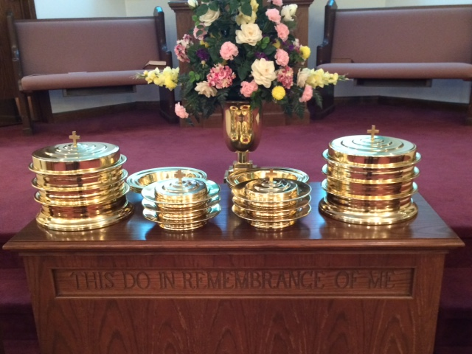
IN REMEMBRANCE OF JESUS

Slide 24
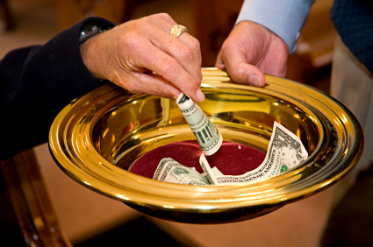
CONTRIBUTION

Slide 25
SINGING

Slide 26
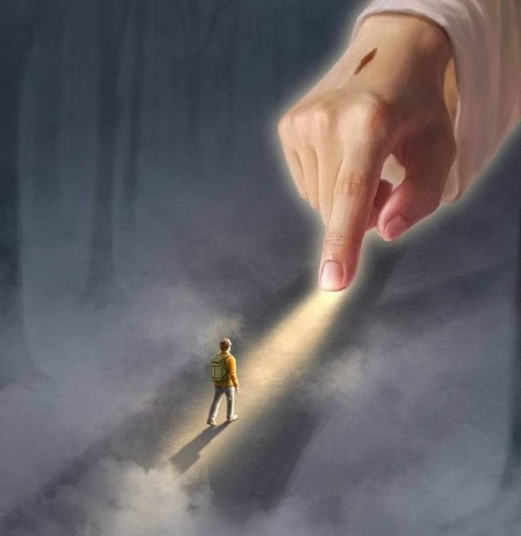
HAVE AN APPRECIATIVE WEEK

