Slide 1
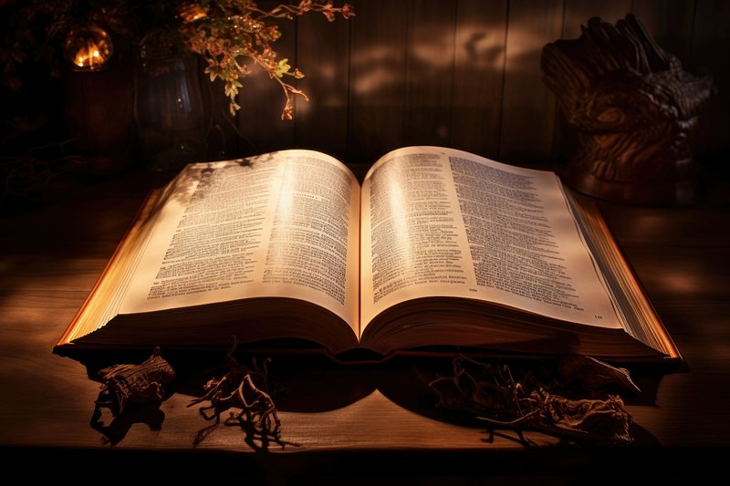
WELCOME TO THE
JACKSON STREET CHURCH OF CHRIST
PLEASE TURN OFF CELLPHONES

Slide 2


Slide 3
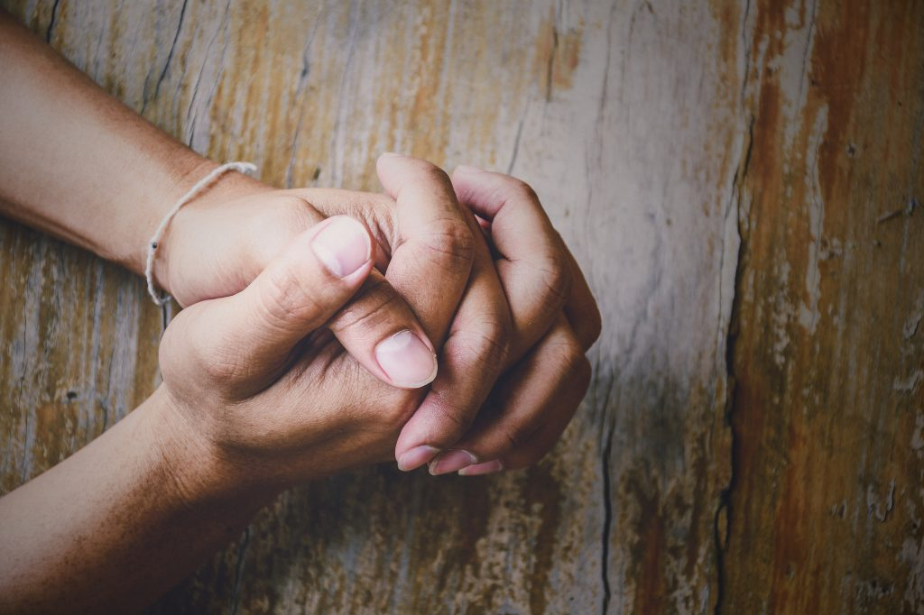
LET US PRAY

Slide 4

SINGING

Slide 5
(1 Th 1:1-7) Paul, Silvanus, and Timothy, To the church of the Thessalonians in God the Father and the Lord Jesus Christ: Grace to you and peace from God our Father and the Lord Jesus Christ. {2} We give thanks to God always for you all, making mention of you in our prayers,

Slide 6
LET US PRAY

Slide 7

Paul Thanks God For The Thessalonians

Slide 8
THANKS FOR THE BRETHREN
How thankful are you for your fellow Christians?
Have you listed the things for which you are thankful as a group?
Have you listed the things for which you are thankful in each individual?
That’s what Paul did with the Christians in Thessalonica.

Slide 9
BECAUSE OF THEIR WORK OF FAITH, LABOR OF LOVE, PATIENCE OF HOPE & ELECTION BY GOD - (1 Th 1:1-7)
{1} Paul, Silvanus, and Timothy, To the church of the Thessalonians in God the Father and the Lord Jesus Christ: Grace to you and peace from God our Father and the Lord Jesus Christ.
{2} We give thanks to God always for you all, making mention of you in our prayers,
{3} remembering without ceasing your work of faith, labor of love, and patience of hope in our Lord Jesus Christ in the sight of our God and Father,

Slide 10
BECAUSE OF THEIR WORK OF FAITH, LABOR OF LOVE, PATIENCE OF HOPE & ELECTION BY GOD - (1 Th 1:1-7)
{4} knowing, beloved brethren, your election by God.
{5} For our gospel did not come to you in word only, but also in power, and in the Holy Spirit and in much assurance, as you know what kind of men we were among you for your sake.
{6} And you became followers of us and of the Lord,
having received the word in much affliction, with joy of the Holy Spirit,
{7} so that you became examples to all in Macedonia and Achaia who believe.

Slide 11
II. BECAUSE THEY ACCEPTED THE WORD OF GOD - (1 Th 2:12-13)
that you would walk worthy of God who calls you into His own kingdom and glory.
{13} For this reason we also thank God without ceasing,
because when you received the word of God which you heard from us, you welcomed it not as the word of men, but as it is in truth, the word of God, which also effectively works in you who believe.

Slide 12
III. BECAUSE THEY WERE STANDING FAST IN THE LORD - (1 Th 3:6-10)
But now that Timothy has come to us from you, and brought us good news of your faith and love,
and that you always have good remembrance of us,
greatly desiring to see us, as we also to see you;
{7} therefore, brethren, in all our affliction and distress we were comforted concerning you by your faith.
{8} For now we live, if you stand fast in the Lord.
{9} For what thanks can we render to God for you,
for all the joy with which we rejoice for your sake before our God,
{10} night and day praying exceedingly that we may see your face and perfect what is lacking in your faith?

Slide 13
IV. BECAUSE OF THEIR GROWING FAITH AND LOVE FOR EACH OTHER - (2 Th 1:3-4)
We are bound to thank God always for you, brethren, as it is fitting,
because your faith grows exceedingly,
and the love of every one of you all abounds toward each other,
{4} so that we ourselves boast of you among the churches of God for your patience and faith in all your persecutions and tribulations that you endure,

Slide 14
V. BECAUSE OF THEIR SALVATION - (2 Th 2:13-14)
But we are bound to give thanks to God always for you, brethren beloved by the Lord,
because God from the beginning chose you for salvation through sanctification by the Spirit and belief in the truth,
{14} to which He called you by our gospel, for the obtaining of the glory of our Lord Jesus Christ.

Slide 15
THEY ALSO NEEDED TO BE THANKFUL IN ALL THINGS (1 Th 5:14-22)
Now we exhort you, brethren,
warn those who are unruly,
comfort the fainthearted,
uphold the weak,
be patient with all.
{15} See that no one renders evil for evil to anyone,
but always pursue what is good both for yourselves and for all.
{16} Rejoice always,
{17} pray without ceasing,
{18} in everything give thanks; for this is the will of God in Christ Jesus for you.
{19} Do not quench the Spirit.
{20} Do not despise prophecies.
{21} Test all things; hold fast what is good.
{22} Abstain from every form of evil.

Slide 16
SINGING

Slide 17
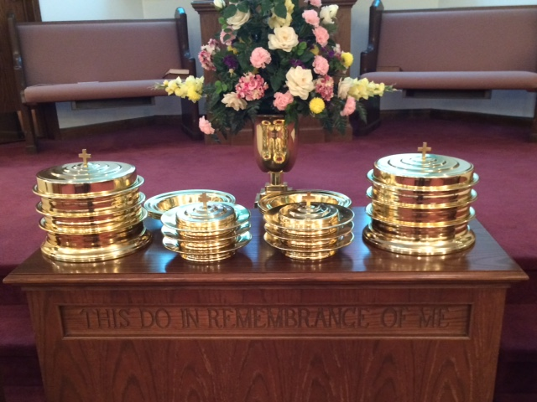
IN REMEMBRANCE OF JESUS

Slide 18
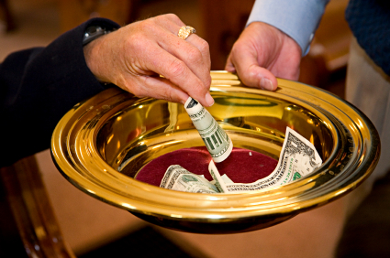
CONTRIBUTION

Slide 19
SINGING

Slide 20
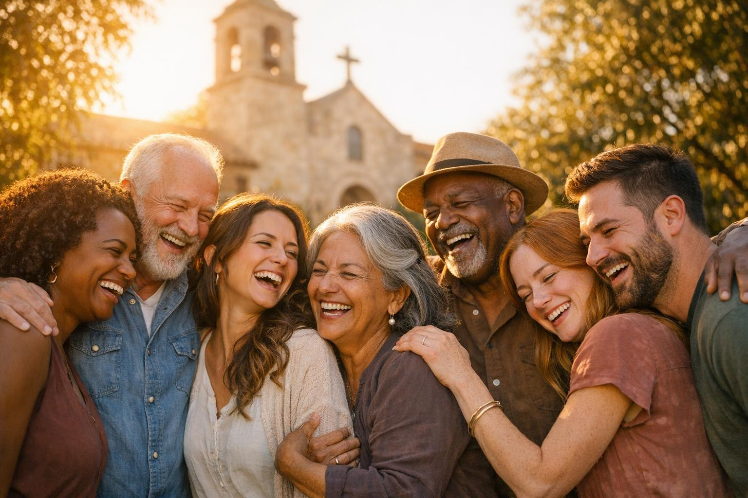
HAVE A “THANKFUL FOR THE BRETHREN” WEEK

