Slide 1
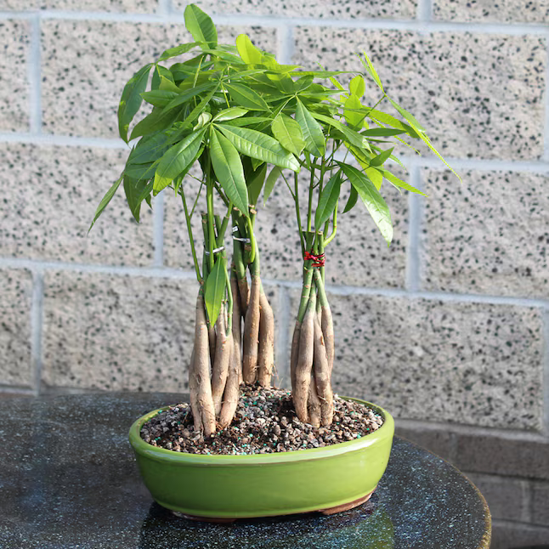
WELCOME TO THE
JACKSON STREET CHURCH OF CHRIST
PLEASE TURN OFF CELLPHONES

Slide 2


Slide 3


Slide 4

SINGING

Slide 5
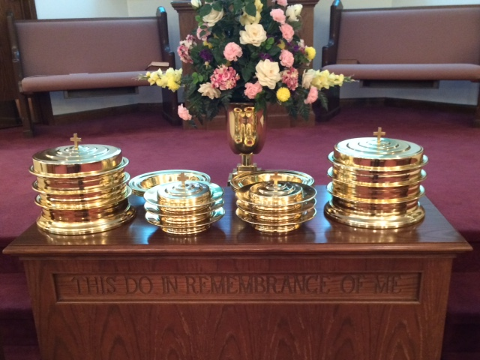
IN REMEMBRANCE OF JESUS

Slide 6
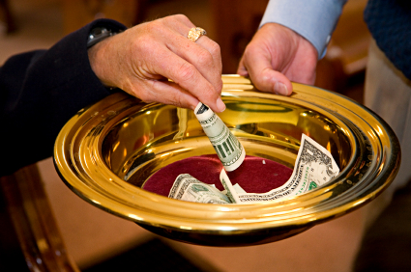
CONTRIBUTION

Slide 7



Slide 8
Mark 10:17–22 Now as He was going out on the road, one came running, knelt before Him, and asked Him, “Good Teacher, what shall I do that I may inherit eternal life?” ¹⁸ So Jesus said to him, “Why do you call Me good? No one is good but One, that is, God. ¹⁹ You know the commandments: ‘Do not commit adultery,’ ‘Do not murder,’ ‘Do not steal,’ ‘Do not bear false witness,’ ‘Do not defraud,’ ‘Honor your father and your mother.’ ” ²⁰ And he answered and said to Him, “Teacher, all these things I have kept from my youth.” ²¹ Then Jesus, looking at him, loved him, and said to him, “One thing you lack: Go your way, sell whatever you have and give to the poor, and you will have treasure in heaven; and come, take up the cross, and follow Me.” ²² But he was sad at this word, and went away sorrowful, for he had great possessions.

Slide 10
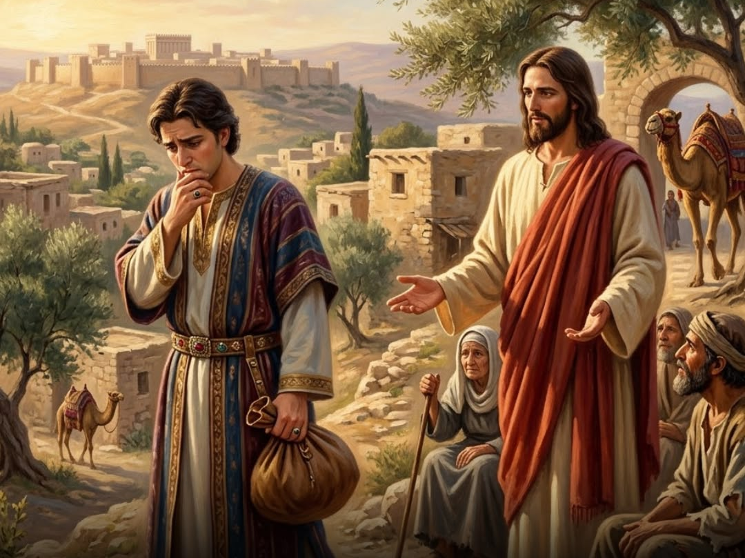
THE RICH YOUNG MAN

Slide 11
THE RICH YOUNG MAN
The man in this scripture asked what he needed to do to inherit eternal life but he did not like the answer Jesus gave him.
Many people today ask the question, “What must I do to inherit eternal life?
But, many of those who ask, don’t like the answer the bible gives them.
Many come up with more acceptable answers which people like so they will become a part of their group.
Only God’s word has the answer to that question for us today.

Slide 12
I. HOW DO I INHERIT
ETERNAL LIFE
(Mark 10:17-31) Now as He was going out on the road, one came running, knelt before Him, and asked Him, "Good Teacher, what shall I do that I may inherit eternal life?"

Slide 13
II. KEEP THE COMMANDMENTS
Mark 10:18-20 So Jesus said to him, "Why do you call Me good? No one is good but One, that is, God. {19} "You know the commandments: 'Do not commit adultery,' 'Do not murder,' 'Do not steal,' 'Do not bear false witness,' 'Do not defraud,' 'Honor your father and your mother.'" {20} And he answered and said to Him, "Teacher, all these things I have kept from my youth."
Mark 12:28–31 Then one of the scribes came, and having heard them reasoning together, perceiving that He had answered them well, asked Him, “Which is the first commandment of all?” ²⁹ Jesus answered him, “The first of all the commandments is: ‘Hear, O Israel, the LORD our God, the LORD is one. ³⁰ And you shall love the LORD your God with all your heart, with all your soul, with all your mind, and with all your strength.’ This is the first commandment. ³¹ And the second, like it, is this: ‘You shall love your neighbor as yourself.’ There is no other commandment greater than these.”

Slide 14
III. TREASURE IN HEAVEN
Mark 10:21 Then Jesus, looking at him, loved him, and said to him, "One thing you lack: Go your way, sell whatever you have and give to the poor, and you will have treasure in heaven; and come, take up the cross, and follow Me."

Slide 15
IV. DECEITFULNESS OF RICHES
Mark 10:22 But he was sad at this word, and went away sorrowful, for he had great possessions.
DECEITFUL RICHES - (Mark 4:18-19) "Now these are the ones sown among thorns; they are the ones who hear the word, {19} "and the cares of this world, the deceitfulness of riches, and the desires for other things entering in choke the word, and it becomes unfruitful.

Slide 16
V. HARD FOR THE RICH TO ENTER KINGDOM – Mark 10:23-25
HAVE RICHES - {23} Then Jesus looked around and said to His disciples, "How hard it is for those who have riches to enter the kingdom of God!"
TRUST IN RICHES - {24} And the disciples were astonished at His words. But Jesus answered again and said to them, "Children, how hard it is for those who trust in riches to enter the kingdom of God!
HOW DIFFICULT - {25} "It is easier for a camel to go through the eye of a needle than for a rich man to enter the kingdom of God."

Slide 17
V. HARD FOR THE RICH TO ENTER KINGDOM – Mark 10:23-25
OUT OF POVERTY - Mark 12:41–44 Now Jesus sat opposite the treasury and saw how the people put money into the treasury. And many who were rich put in much. ⁴² Then one poor widow came and threw in two mites, which make a quadrans. ⁴³ So He called His disciples to Himself and said to them, “Assuredly, I say to you that this poor widow has put in more than all those who have given to the treasury; ⁴⁴ for they all put in out of their abundance, but she out of her poverty put in all that she had, her whole livelihood.”

Slide 18
VI. WHO CAN BE SAVED?
{26} And they were greatly astonished, saying among themselves, "Who then can be saved?"

Slide 19
VII. WITH GOD IT IS POSSIBLE
{27} But Jesus looked at them and said, "With men it is impossible, but not with God; for with God all things are possible."

Slide 20
VIII. SACRIFICE NOW FOR BLESSINGS NOW AND LATER
Mark 10:28-30 Then Peter began to say to Him, "See, we have left all and followed You." {29} So Jesus answered and said, "Assuredly, I say to you, there is no one who has left house or brothers or sisters or father or mother or wife or children or lands, for My sake and the gospel's, {30} "who shall not receive a hundredfold now in this time; houses and brothers and sisters and mothers and children and lands, with persecutions; and in the age to come, eternal life.
Mark 8:34–35 When He had called the people to Himself, with His disciples also, He said to them, “Whoever desires to come after Me, let him deny himself, and take up his cross, and follow Me. 35 For whoever desires to save his life will lose it, but whoever loses his life for My sake and the gospel’s will save it.

Slide 21
IX. REVERSAL OF FORTUNE
Mark 10:31 "But many who are first will be last, and the last first."
Mark 9:35 And He sat down, called the twelve, and said to them, “If anyone desires to be first, he shall be last of all and servant of all.”

Slide 22
SELLING YOUR SOUL
A. (Mark 8:36-37) "For what will it profit a man if he gains the whole world, and loses his own soul? {37} "Or what will a man give in exchange for his soul?
B. What will you give in exchange for your soul?
  Money,
  Time,
  Energy,
  Relationships,
  Prestige,
  Position,
  Power/Control.
C. Will you sacrifice them all for eternal life?

Slide 23
SELLING YOUR SOUL
D. Will you do what the bible tells you to do be saved to eternal life?
  Believe in Jesus?
  Confess Him as the Son of God?
  Repent of your sins?
  Be baptized for the remission of your sins?
  Live faithfully the rest of your life on this earth

Slide 25

PRAYER

Slide 26
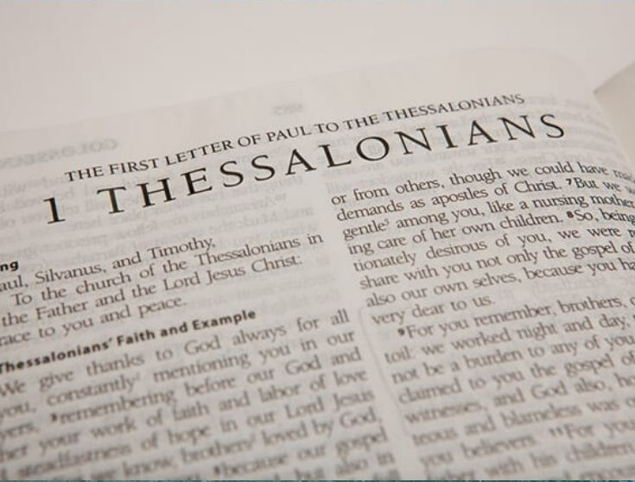
TONIGHT’S SERMON: PAUL’S THANKS FOR THE THESSALONIANS

