Slide 1
WELCOME TO THE
JACKSON STREET CHURCH OF CHRIST
PLEASE TURN OFF CELLPHONES
This Photo by Unknown Author is licensed under CC BY-NC-ND

Slide 4
SINGING

Slide 5
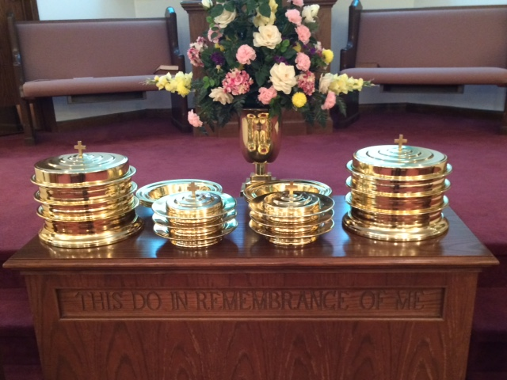
IN REMEMBRANCE OF JESUS

Slide 6
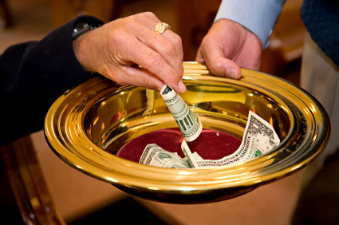
CONTRIBUTION

Slide 7
SINGING

Slide 8
Galatians 3:26–29 For you are all sons of God through faith in Christ Jesus. ²⁷ For as many of you as were baptized into Christ have put on Christ. ²⁸ There is neither Jew nor Greek, there is neither slave nor free, there is neither male nor female; for you are all one in Christ Jesus. ²⁹ And if you are Christ’s, then you are Abraham’s seed, and heirs according to the promise.

Slide 10
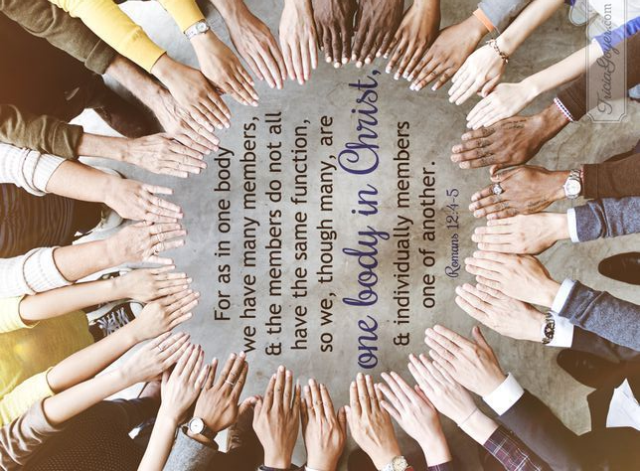
YOU ARE ALL ONE IN CHRIST
YOU ARE ALL ONE IN CHRIST

Slide 11
WE ARE ALL ONE IN CHRIST
The Jenkins Institute Podcast
Frankly, the last five years the air has felt thick with a blanket of argument, of fighting. Pick your media, right or left, you’ll be fed the same, talking heads berating those on whatever the other side may be.
It’s so very frustrating. It’s exhausting. And, heartbreakingly, sometimes it spills over to the church. People are set for a fight, the issue is not what’s important, the defending is. Perhaps more sadly, we can find ourselves drawn into it. And, it pushes us toward hate, toward hating those with whom we disagree. Today, may I remind us of three truths:
We become what we feed on: May I suggest that we put down the remote and pick up the Bible podcast. May I suggest we stop arguing with a picture and start talking to God. If we spend more time with FOX and CNN than the FATHER and CHRIST, we will be more political than spiritual. Check yourself on this. Be honest with you.

Slide 12
WE ARE ALL ONE IN CHRIST
The Jenkins Institute Podcast
We are to love, even our enemies: It’s so easy for those on the other side to become idiots, for us to consider them evil, and to allow ourselves to be triggered by a slogan, a t-shirt, or a hat. Yes, there is a war, but that war is not against things of this earth. Could the Lord have been more specific? “If we only love those who love us, we are no better than the pagans.” But, we are to be better than the pagans. If it were easy everyone would do it. It is hard, but let us be led by love for even the worst. Jesus died for them as much as for us.

Slide 13
WE ARE ALL ONE IN CHRIST
The Jenkins Institute Podcast
We are ambassadors of peace: It is only the peace found in the Lord that will change a heart. And, yes, we can have peace. As 135,000 Midianites surrounded Israel, Gideon was in conflict until he moved his focus from them to HIM. Then as war threatened all around he built an altar and in his worship named it Jehovahshalom. Translated: The Lord is Peace. We too can have peace when things around us escalate if we worship the Lord and remember: The Lord is Peace. And it won’t make sense to others - the Spirit moved Paul’s pen to describe that “peace that passes understanding.” It can be ours and we are called upon to imitate it and to bring it.

Slide 14
WE ARE ALL ONE IN CHRIST
Galatians 3:26–27 For you are all sons of God through faith in Christ Jesus. ²⁷ For as many of you as were baptized into Christ have put on Christ.
When we were baptized into Christ, we became children of God, brothers and sisters in Christ. We are family.
The nest two verses show us what that means.

Slide 15
THERE IS NEITHER JEW NOR GREEK
Were there Jews and Greeks in the church at this time? Yes!
Were they divided or one more important than the other? No!
Jesus, by His death, brought them together - Ephesians 2:14–18 For He Himself is our peace, who has made both one, and has broken down the middle wall of separation, ¹⁵ having abolished in His flesh the enmity, that is, the law of commandments contained in ordinances, so as to create in Himself one new man from the two, thus making peace, ¹⁶ and that He might reconcile them both to God in one body through the cross, thereby putting to death the enmity. ¹⁷ And He came and preached peace to you who were afar off and to those who were near. ¹⁸ For through Him we both have access by one Spirit to the Father.
Being Jew or Gentile did not destroy the unity they had in Christ.

Slide 16
II. THERE IS NEITHER SLAVE NOR FREE
Were there slaves and free in the church at that time? Yes!
Were they divided or one more important than the other? No!
Just as employees and employers are equal in the church, so were slaves and free - Philemon 8–16 Therefore, though I might be very bold in Christ to command you what is fitting, ⁹ yet for love’s sake I rather appeal to you—being such a one as Paul, the aged, and now also a prisoner of Jesus Christ—¹⁰ I appeal to you for my son Onesimus, whom I have begotten while in my chains, ¹¹ who once was unprofitable to you, but now is profitable to you and to me. >>>

Slide 17
II. THERE IS NEITHER SLAVE NOR FREE
¹² I am sending him back. You therefore receive him, that is, my own heart, ¹³ whom I wished to keep with me, that on your behalf he might minister to me in my chains for the gospel. ¹⁴ But without your consent I wanted to do nothing, that your good deed might not be by compulsion, as it were, but voluntary. ¹⁵ For perhaps he departed for a while for this purpose, that you might receive him forever, ¹⁶ no longer as a slave but more than a slave—a beloved brother, especially to me but how much more to you, both in the flesh and in the Lord.
Being slave or free did not destroy the unity they had in Christ.

Slide 18
III. THERE IS NEITHER MALE NOR FEMALE
Were there males and females in the church at that time? Yes!
Were they divided or one more important than the other? No!
They had differing roles and responsibilities but no less equal in importance.
Romans 16:3–15 Greet Priscilla and Aquila, my fellow workers in Christ Jesus, ⁴ who risked their own necks for my life, to whom not only I give thanks, but also all the churches of the Gentiles. ⁵ Likewise greet the church that is in their house. Greet my beloved Epaenetus, who is the firstfruits of Achaia to Christ. ⁶ Greet Mary, who labored much for us. ⁷ Greet Andronicus and Junia, my countrymen and my fellow prisoners, who are of note among the apostles, who also were in Christ before me. >>>

Slide 19
III. THERE IS NEITHER MALE NOR FEMALE
⁸ Greet Amplias, my beloved in the Lord. ⁹ Greet Urbanus, our fellow worker in Christ, and Stachys, my beloved. ¹⁰ Greet Apelles, approved in Christ. Greet those who are of the household of Aristobulus. ¹¹ Greet Herodion, my countryman. Greet those who are of the household of Narcissus who are in the Lord. ¹² Greet Tryphena and Tryphosa, who have labored in the Lord. Greet the beloved Persis, who labored much in the Lord. ¹³ Greet Rufus, chosen in the Lord, and his mother and mine. ¹⁴ Greet Asyncritus, Phlegon, Hermas, Patrobas, Hermes, and the brethren who are with them. ¹⁵ Greet Philologus and Julia, Nereus and his sister, and Olympas, and all the saints who are with them.
Being male and female did not destroy the unity they had in Christ.

Slide 20
IV. THERE IS NEITHER REPUBLICAN OR DEMOCRAT
Were there Republican and Democrats in the church then? No!
But there were differing factions even within the apostles, Simon was a zealot, Matthew was a tax collector, opposites on the political spectrum.
Were they divided or one more important than the other? No!
Political affiliation is never as important as brotherhood.
Our political views should never destroy our unity in Christ.

Slide 21
V. THERE IS NEITHER EDUCATED NOR UNEDUCATED
Were there educated and uneducated in the church at that time? Yes!
Were they divided or one more important than the other? No!
Peter, James and John were uneducated fishermen. - Acts 4:13 Now when they saw the boldness of Peter and John, and perceived that they were uneducated and untrained men, they marveled. And they realized that they had been with Jesus.
Paul was an educated Pharisee. - Acts 22:3 “I am indeed a Jew, born in Tarsus of Cilicia, but brought up in this city at the feet of Gamaliel, taught according to the strictness of our fathers’ law, and was zealous toward God as you all are today.
Differing educational levels should not destroy our unity in Christ.

Slide 22
VI. THERE IS NEITHER RICH NOR POOR
Were there rich and poor in the church at that time? Yes!
Were they divided or one more important than the other? No! At least, shouldn’t be.
James 2:1–9 My brethren, do not hold the faith of our Lord Jesus Christ, the Lord of glory, with partiality. ² For if there should come into your assembly a man with gold rings, in fine apparel, and there should also come in a poor man in filthy clothes, ³ and you pay attention to the one wearing the fine clothes and say to him, “You sit here in a good place,” and say to the poor man, “You stand there,” or, “Sit here at my footstool,” ⁴ have you not shown partiality among yourselves, and become judges with evil thoughts? >>>

Slide 23
VI. THERE IS NEITHER RICH NOR POOR
⁵ Listen, my beloved brethren: Has God not chosen the poor of this world to be rich in faith and heirs of the kingdom which He promised to those who love Him? ⁶ But you have dishonored the poor man. Do not the rich oppress you and drag you into the courts? 7 Do they not blaspheme that noble name by which you are called? ⁸ If you really fulfill the royal law according to the Scripture, “You shall love your neighbor as yourself,” you do well; ⁹ but if you show partiality, you commit sin, and are convicted by the law as transgressors.
Differing financial level should never destroy our unity in Christ.

Slide 24
VII. THERE IS NEITHER BEAUTY NOR UGLY
Were there beautiful and ugly people in the church at that time? Yes!
Were they divided or one more important than the other? No!
1 Samuel 16:7 But the LORD said to Samuel, “Do not look at his appearance or at his physical stature, because I have refused him. For the LORD does not see as man sees; for man looks at the outward appearance, but the LORD looks at the heart.”

Slide 25
VII. THERE IS NEITHER BEAUTY NOR UGLY
1 Peter 3:1–4 Wives, likewise, be submissive to your own husbands, that even if some do not obey the word, they, without a word, may be won by the conduct of their wives, ² when they observe your chaste conduct accompanied by fear. ³ Do not let your adornment be merely outward—arranging the hair, wearing gold, or putting on fine apparel—⁴ rather let it be the hidden person of the heart, with the incorruptible beauty of a gentle and quiet spirit, which is very precious in the sight of God.
Differing physical appearances should never destroy our unity in Christ.

Slide 26
VIII. THERE IS NEITHER BLACK NOR WHITE, BROWN NOR PINK
Were there different skin colors in the church at that time? Yes!
Acts 2:5–11 And there were dwelling in Jerusalem Jews, devout men, from every nation under heaven. ⁶ And when this sound occurred, the multitude came together, and were confused, because everyone heard them speak in his own language. ⁷ Then they were all amazed and marveled, saying to one another, “Look, are not all these who speak Galileans? ⁸ And how is it that we hear, each in our own language in which we were born? >>>

Slide 27
VIII. THERE IS NEITHER BLACK NOR WHITE, BROWN NOR PINK
⁹ Parthians and Medes and Elamites, those dwelling in Mesopotamia, Judea and Cappadocia, Pontus and Asia, ¹⁰ Phrygia and Pamphylia, Egypt and the parts of Libya adjoining Cyrene, visitors from Rome, both Jews and proselytes, ¹¹ Cretans and Arabs—we hear them speaking in our own tongues the wonderful works of God.”
Were they divided or one color more important than the other? No!
Skin color was never even mentioned in the New Testament.
Note: recent sermons on “Why Racism is Ridiculous”.

Slide 28
WE ARE ALL ONE IN CHRIST
Paul’s point was that, in the church, differences don’t matter.
We are one in Christ.
We are family
Is there any difference that you would allow to divide you from your brother or sister?
Are you a part of that wonderful family of God?

Slide 29
SINGING

Slide 30
TONIGHT’S SERMON: FIVE PEOPLE LIVING INSIDE US

