Slide 1
WELCOME TO THE JACKSON STREET
CHURCH OF CHRIST
PLEASE
SILENCE CELLPHONES

Slide 3
LET US PRAY

Slide 4
SINGING

Slide 5
Romans 7:21–25 I find then a law, that evil is present with me, the one who wills to do good. ²² For I delight in the law of God according to the inward man. ²³ But I see another law in my members, warring against the law of my mind, and bringing me into captivity to the law of sin which is in my members. ²⁴ O wretched man that I am! Who will deliver me from this body of death? ²⁵ I thank God—through Jesus Christ our Lord! So then, with the mind I myself serve the law of God, but with the flesh the law of sin.

Slide 6
LET US PRAY

Slide 7
FIVE PEOPLE WITHIN US

Slide 8
FIVE PEOPLE WHO LIVE WITHIN US
Split personality
Personality tests
Clara has a problem deciding on A, B, C or D, because some aspect of all apply to her.
We all have different personality traits.
We are going to look tonight at five different people who live within us.

Slide 9
I. THE PERSON I WANT YOU TO THINK I AM
There are things we don’t want others to know about us. Not necessarily things they need to know.
The facade.
The hypocrite.
The masks
The false impression.
The pretense
The deception
Not only do we deceive others, but we sometimes deceive ourselves.
It is hard to stop playing the game of make–believe once you begin.

Slide 10
I. THE PERSON I WANT YOU TO THINK I AM
HYPOCRITE? Mark 7:6–15 He answered and said to them, “Well did Isaiah prophesy of you hypocrites, as it is written: ‘This people honors Me with their lips, But their heart is far from Me.
PLEASE MAN OR GOD
Galatians 1:10 For do I now persuade men, or God? Or do I seek to please men? For if I still pleased men, I would not be a bondservant of Christ.
1 Thessalonians 2:4–6 But as we have been approved by God to be entrusted with the gospel, even so we speak, not as pleasing men, but God who tests our hearts. ⁵ For neither at any time did we use flattering words, as you know, nor a cloak for covetousness—God is witness. ⁶ Nor did we seek glory from men, either from you or from others, when we might have made demands as apostles of Christ.

Slide 11
II. THE PERSON YOU THINK I AM
Here lies my "blind spots." Good or bad.
I can’t see them, but you can.
We all have these areas.
You may see problems in me that I don’t see. - Matthew 7:3–5 And why do you look at the speck in your brother’s eye, but do not consider the plank in your own eye? ⁴ Or how can you say to your brother, ‘Let me remove the speck from your eye’; and look, a plank is in your own eye? ⁵ Hypocrite! First remove the plank from your own eye, and then you will see clearly to remove the speck from your brother’s eye.
You may see potential in me that I don’t see. - 1 Thessalonians 3:1–2 Therefore, when we could no longer endure it, we thought it good to be left in Athens alone, ² and sent Timothy, our brother and minister of God, and our fellow laborer in the gospel of Christ, to establish you and encourage you concerning your faith,

Slide 12
III. THE PERSON I THINK I AM
This is the person I think, I know and see.
You can know this person only to the degree that I am open, honest, genuine and transparent
This person may be deceived.
Jeremiah 17:9 "The heart is deceitful above all things and beyond cure. Who can understand it?"
1 John 1:8–9 If we say that we have no sin, we deceive ourselves, and the truth is not in us. ⁹ If we confess our sins, He is faithful and just to forgive us our sins and to cleanse us from all unrighteousness.

Slide 13
III. THE PERSON I THINK I AM
We may think we not under God’s grace when we are - 1 John 3:19–22 And by this we know that we are of the truth, and shall assure our hearts before Him. ²⁰ For if our heart condemns us, God is greater than our heart, and knows all things. ²¹ Beloved, if our heart does not condemn us, we have confidence toward God. ²² And whatever we ask we receive from Him, because we keep His commandments and do those things that are pleasing in His sight.
We may think we are saved when we are lost - Matthew 7:21–23 “Not everyone who says to Me, ‘Lord, Lord,’ shall enter the kingdom of heaven, but he who does the will of My Father in heaven. ²² Many will say to Me in that day, ‘Lord, Lord, have we not prophesied in Your name, cast out demons in Your name, and done many wonders in Your name?’ ²³ And then I will declare to them, ‘I never knew you; depart from Me, you who practice lawlessness!’

Slide 14
IV. THE PERSON ONLY GOD KNOWS
This is the part hidden deep within me.
It contains the concealed secrets of my subconscious mind.
Only the Spirit of God knows this part of my life.
Jeremiah, the prophet, realized this when he wrote in
1 Corinthians 2:11–13 For what man knows the things of a man except the spirit of the man which is in him? Even so no one knows the things of God except the Spirit of God. ¹² Now we have received, not the spirit of the world, but the Spirit who is from God, that we might know the things that have been freely given to us by God. ¹³ These things we also speak, not in words which man’s wisdom teaches but which the Holy Spirit teaches, comparing spiritual things with spiritual.
We may think we not under God’s grace when we are - 1 John 3:19–20 And by this we know that we are of the truth, and shall assure our hearts before Him. ²⁰ For if our heart condemns us, God is greater than our heart, and knows all things.

Slide 15
V. THE PERSON THAT I WANT TO BECOME
As a Christian, this is the person I am becoming by the grace of God.
This represents all my hopes, desires, goals, ambitions, etc.
Who is it I want to become in the Christian life?
If I were guaranteed 100% success at doing something in the next three years, what would I do?
The Apostle Paul understood this aspect of spiritual growth when he wrote in Galatians 2:20 I have been crucified with Christ; it is no longer I who live, but Christ lives in me; and the life which I now live in the flesh I live by faith in the Son of God, who loved me and gave Himself for me.
Jesus died for us, so we would live for Him - 2 Corinthians 5:14–15 For the love of Christ compels us, because we judge thus: that if One died for all, then all died; ¹⁵ and He died for all, that those who live should live no longer for themselves, but for Him who died for them and rose again.

Slide 16
V. THE PERSON THAT I WANT TO BECOME
Ephesians 4:22–24 that you put off, concerning your former conduct, the old man which grows corrupt according to the deceitful lusts, ²³ and be renewed in the spirit of your mind, ²⁴ and that you put on the new man which was created according to God, in true righteousness and holiness.
Press toward the goal - Philippians 3:10–14 that I may know Him and the power of His resurrection, and the fellowship of His sufferings, being conformed to His death, ¹¹ if, by any means, I may attain to the resurrection from the dead. ¹² Not that I have already attained, or am already perfected; but I press on, that I may lay hold of that for which Christ Jesus has also laid hold of me. ¹³ Brethren, I do not count myself to have apprehended; but one thing I do, forgetting those things which are behind and reaching forward to those things which are ahead, ¹⁴ I press toward the goal for the prize of the upward call of God in Christ Jesus.

Slide 17
WHICH OF THESE PEOPLE INSIDE OF YOU IS WINNING?
The Person I Want You To Think I Am – Do I need to take off some masks?
The Person You Think I Am – Do I need to ask others how they see us, good or bad?
The Person I Think I Am – Am I seeing myself realistically?
The Person Only God Knows – Do I have secret faults that need correcting?
The Person That I Want To Become - Am I living for Jesus, since He died for me?

Slide 18
SINGING

Slide 19
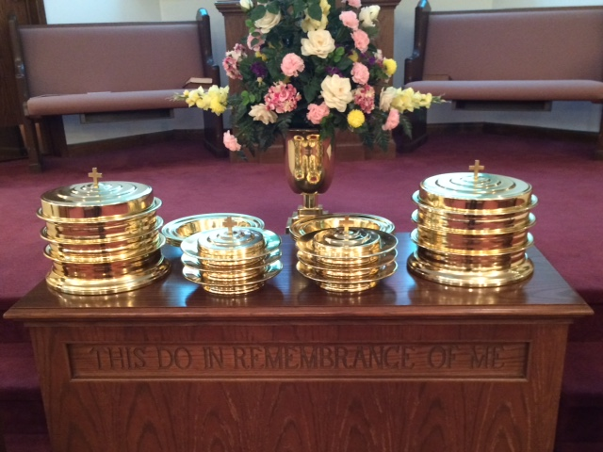
IN REMEMBRANCE OF JESUS

Slide 20
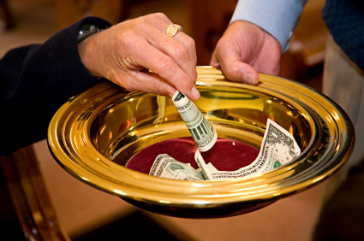
CONTRIBUTION

Slide 21
SINGING

Slide 22
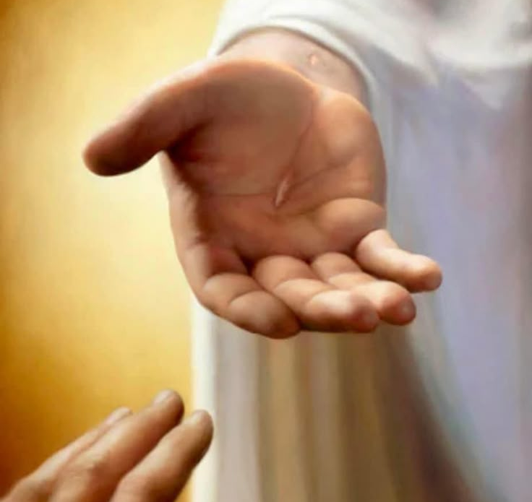
HAVE A CHRIST LIKE WEEK

