Slide 1
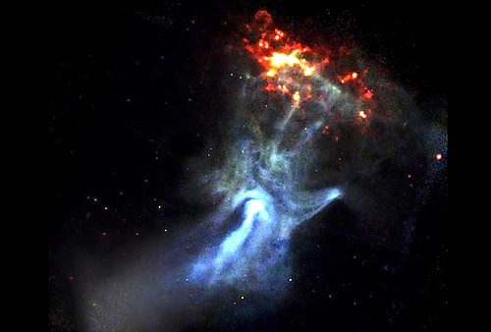
WELCOME TO THE
JACKSON STREET CHURCH OF CHRIST
PLEASE TURN OFF CELLPHONES

Slide 2


Slide 3


Slide 4

SINGING

Slide 5
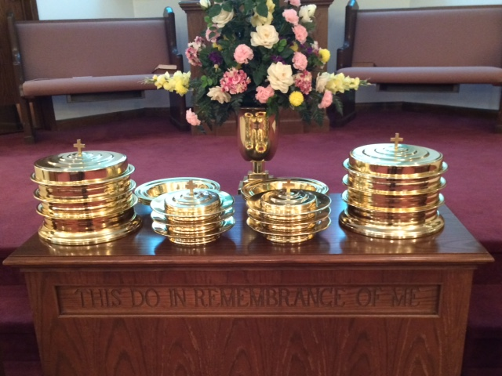
IN REMEMBRANCE OF JESUS

Slide 6
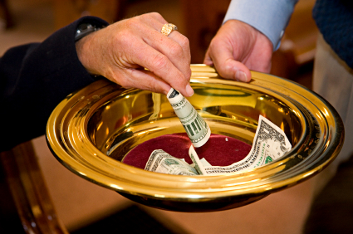
CONTRIBUTION

Slide 7



Slide 8
Colossians 1:9–10 For this reason we also, since the day we heard it, do not cease to pray for you, and to ask that you may be filled with the knowledge of His will in all wisdom and spiritual understanding; ¹⁰ that you may walk worthy of the Lord, fully pleasing Him, being fruitful in every good work and increasing in the knowledge of God;

Slide 10
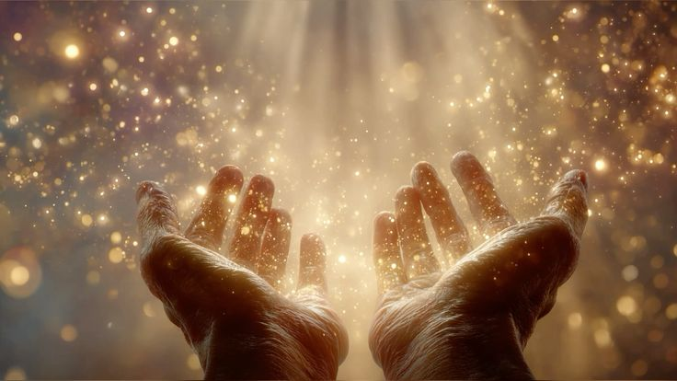
What Pleases God

Slide 11
PLEASING GOD
Psalms 149:4 For the LORD takes pleasure in His people; He will beautify the humble with salvation.
Matthew 3:17 And suddenly a voice came from heaven, saying, "This is My beloved Son, in whom I am well pleased."
John 8:29 And He who sent Me is with Me. The Father has not left Me alone, for I always do those things that please Him.”
Hebrews 11:5 By faith Enoch was taken away so that he did not see death, "and was not found, because God had taken him"; for before he was taken he had this testimony, that he pleased God.

Slide 12
PLEASING GOD
1 Thessalonians 4:1–2 Finally then, brethren, we urge and exhort in the Lord Jesus that you should abound more and more, just as you received from us how you ought to walk and to please God; ² for you know what commandments we gave you through the Lord Jesus.
1 Thessalonians 2:14–15 For you, brethren, became imitators of the churches of God which are in Judea in Christ Jesus. For you also suffered the same things from your own countrymen, just as they did from the Judeans, ¹⁵ who killed both the Lord Jesus and their own prophets, and have persecuted us; and they do not please God and are contrary to all men,

Slide 13
I. The Forgiveness Of His People.
Ezekiel 33:10–11 “Therefore you, O son of man, say to the house of Israel: ‘Thus you say, “If our transgressions and our sins lie upon us, and we pine away in them, how can we then live?” ’ ¹¹ Say to them: ‘As I live,’ says the Lord GOD, ‘I have no pleasure in the death of the wicked, but that the wicked turn from his way and live. Turn, turn from your evil ways! For why should you die, O house of Israel?’
1 Corinthians 1:21 For since, in the wisdom of God, the world through wisdom did not know God, it pleased God through the foolishness of the message preached to save those who believe.
1 John 1:9 If we confess our sins, He is faithful and just to forgive us our sins and to cleanse us from all unrighteousness.

Slide 14
II. The Faith Of His People.
Hebrews 11:6 But without faith it is impossible to please Him, for he who comes to God must believe that He is, and that He is a rewarder of those who diligently seek Him.
Psalm 101:6 My eyes shall be on the faithful of the land, That they may dwell with me; He who walks in a perfect way, He shall serve me.
Galatians 3:26–27 For you are all sons of God through faith in Christ Jesus. ²⁷ For as many of you as were baptized into Christ have put on Christ.
Hebrews 10:38–39 Now the just shall live by faith; But if anyone draws back, My soul has no pleasure in him.” ³⁹ But we are not of those who draw back to perdition, but of those who believe to the saving of the soul.

Slide 15
III. The Following Of His People.
Matthew 10:38–39 And he who does not take his cross and follow after Me is not worthy of Me. ³⁹ He who finds his life will lose it, and he who loses his life for My sake will find it.
Hebrews 13:20–21 Now may the God of peace who brought up our Lord Jesus from the dead, that great Shepherd of the sheep, through the blood of the everlasting covenant, ²¹ make you complete in every good work to do His will, working in you what is well pleasing in His sight, through Jesus Christ, to whom be glory forever and ever. Amen.
To "follow" means to "move behind in the same direction.

Slide 16
IV. The Fellowship Of His People.
John 8:29 "And He who sent Me is with Me. The Father has not left Me alone, for I always do those things that please Him."
Hebrews 10:24–25 And let us consider one another in order to stir up love and good works, ²⁵ not forsaking the assembling of ourselves together, as is the manner of some, but exhorting one another, and so much the more as you see the Day approaching.
Proverbs 16:7 When a man’s ways please the LORD, He makes even his enemies to be at peace with him.

Slide 17
V. The Forsaking Of His People.
A. Romans 8:5-14 For those who live according to the flesh set their minds on the things of the flesh, but those who live according to the Spirit, the things of the Spirit. {6} For to be carnally minded is death, but to be spiritually minded is life and peace. {7} Because the carnal mind is enmity against God; for it is not subject to the law of God, nor indeed can be. {8} So then, those who are in the flesh cannot please God. {9} But you are not in the flesh but in the Spirit, if indeed the Spirit of God dwells in you. Now if anyone does not have the Spirit of Christ, he is not His.

Slide 18
V. The Forsaking Of His People.
{10} And if Christ is in you, the body is dead because of sin, but the Spirit is life because of righteousness. {11} But if the Spirit of Him who raised Jesus from the dead dwells in you, He who raised Christ from the dead will also give life to your mortal bodies through His Spirit who dwells in you. {12} Therefore, brethren, we are debtors; not to the flesh, to live according to the flesh. {13} For if you live according to the flesh you will die; but if by the Spirit you put to death the deeds of the body, you will live. {14} For as many as are led by the Spirit of God, these are sons of God.
B. They are to forsake the world, the flesh, and the devil to follow Him.

Slide 19
VI. THE FRUITFULNESS OF HIS PEOPLE
Colossians 1:9–10 For this reason we also, since the day we heard it, do not cease to pray for you, and to ask that you may be filled with the knowledge of His will in all wisdom and spiritual understanding; ¹⁰ that you may walk worthy of the Lord, fully pleasing Him, being fruitful in every good work and increasing in the knowledge of God;
Hebrews 13:16 But do not forget to do good and to share, for with such sacrifices God is well pleased.
John 15:8 By this My Father is glorified, that you bear much fruit; so you will be My disciples.

Slide 20
VIII. THE FEAR OF HIS PEOPLE
Psalm 147:11 the Lord takes pleasure in those who fear Him, in those who hope in His mercy.
Psalm 33:18 Behold, the eye of the Lord is on those who fear Him, On those who hope in His mercy,
1 Peter 1:17–19 And if you call on the Father, who without partiality judges according to each one’s work, conduct yourselves throughout the time of your stay here in fear; ¹⁸ knowing that you were not redeemed with corruptible things, like silver or gold, from your aimless conduct received by tradition from your fathers, ¹⁹ but with the precious blood of Christ, as of a lamb without blemish and without spot.

Slide 21
IX. THE FINANCIAL GROWTH OF HIS PEOPLE
Psalm 35:27 Let them shout for joy and be glad, Who favor my righteous cause; And let them say continually, “Let the LORD be magnified, Who has pleasure in the prosperity of His servant.”
1 Timothy 6:17–19 Command those who are rich in this present age not to be haughty, nor to trust in uncertain riches but in the living God, who gives us richly all things to enjoy. ¹⁸ Let them do good, that they be rich in good works, ready to give, willing to share, ¹⁹ storing up for themselves a good foundation for the time to come, that they may lay hold on eternal life.
1 Samuel 2:7–8 The LORD makes poor and makes rich; He brings low and lifts up. ⁸ He raises the poor from the dust And lifts the beggar from the ash heap, To set them among princes And make them inherit the throne of glory. “For the pillars of the earth are the LORD’s, And He has set the world upon them.

Slide 22
X. The Future Of His People.
Luke 12:32 "Do not fear, little flock, for it is your Father's good pleasure to give you the kingdom.
1 John 3:22 And whatever we ask we receive from Him, because we keep His commandments and do those things that are pleasing in His sight.
Colossians 3:20 Children, obey your parents in all things, for this is well pleasing to the Lord.
Ephesians 6:1–3 Children, obey your parents in the Lord, for this is right. ² “Honor your father and mother,” which is the first commandment with promise: ³ “that it may be well with you and you may live long on the earth.”

Slide 23
DO YOU WANT TO PLEASE GOD?
Are you willing to suffer by following Jesus - 1 Peter 2:19–21 For this is commendable, if because of conscience toward God one endures grief, suffering wrongfully. ²⁰ For what credit is it if, when you are beaten for your faults, you take it patiently? But when you do good and suffer, if you take it patiently, this is commendable before God. ²¹ For to this you were called, because Christ also suffered for us, leaving us an example, that you should follow His steps:
Have you chosen the right way? - 2 Peter 2:15 They have forsaken the right way and gone astray, following the way of Balaam the son of Beor, who loved the wages of unrighteousness;

Slide 25

PRAYER

Slide 26

TONIGHT’S SERMON: 7 WONDERS OF THE WORD

