Slide 1
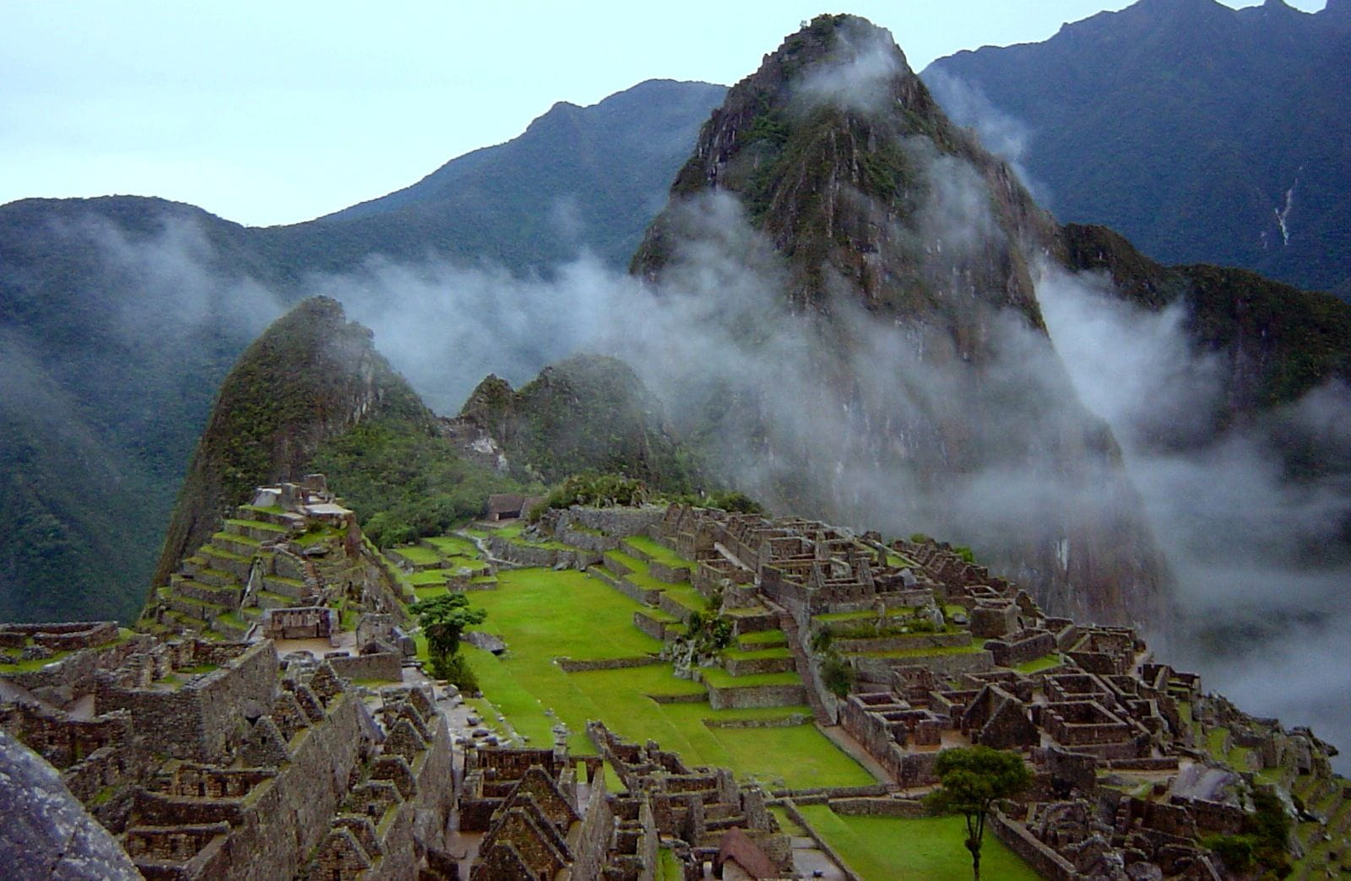
WELCOME TO THE
JACKSON STREET CHURCH OF CHRIST
PLEASE TURN OFF CELLPHONES

Slide 2


Slide 3

LET US PRAY

Slide 4

SINGING

Slide 5
Psalm 119:161–162 Princes persecute me without a cause, But my heart stands in awe of Your word. ¹⁶² I rejoice at Your word As one who finds great treasure.

Slide 6
LET US PRAY

Slide 7
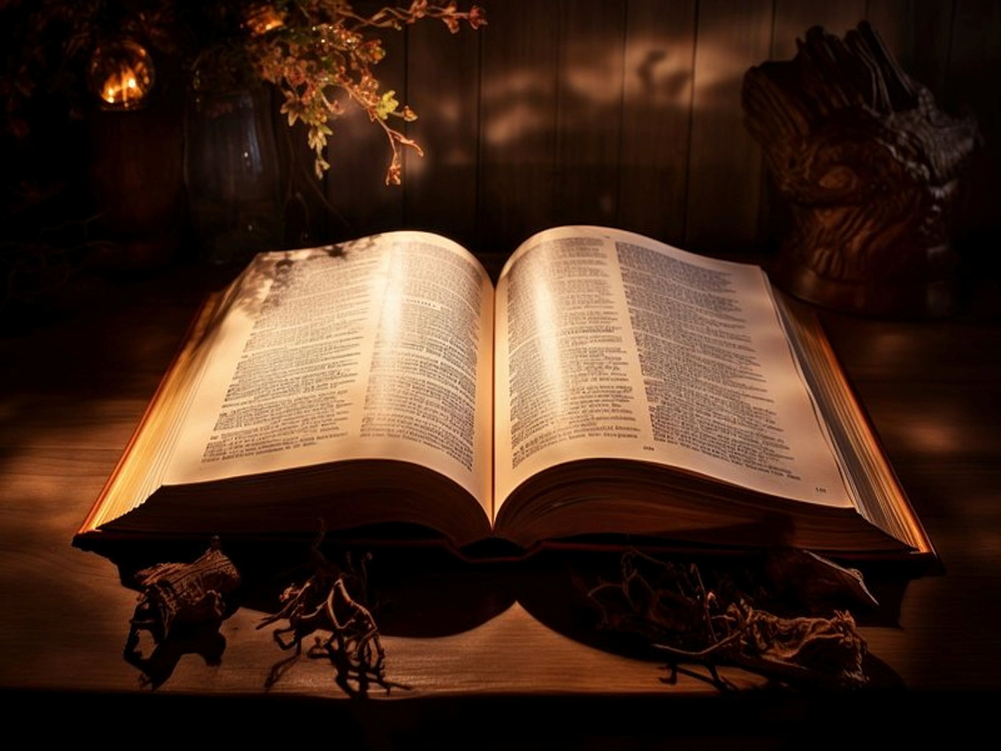
7 WONDERS OF THE WORD

Slide 8
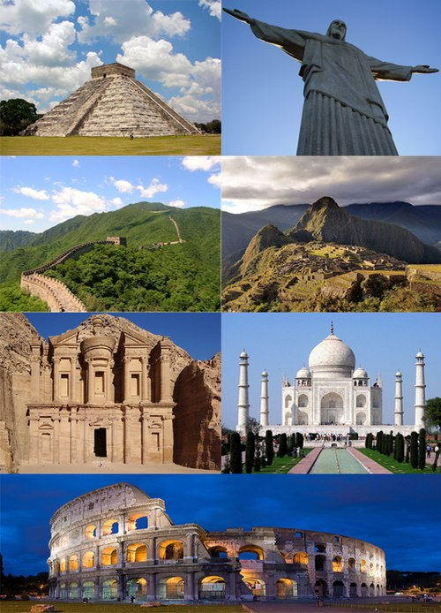
SEVEN WONDERS OF THE WORLD

Slide 9
SEVEN WONDERS
Most have heard about “the seven wonders of the world.”
There are the 7 wonders of the ancient world.
There are the 7 wonders of the natural world.
The list goes on and on of wonders of the world.
David said, “Open my eyes, that I may see wondrous things from Your law” (Psalm 119:18).
Again, he declared, “Your testimonies are wonderful” (Psalm 119:129).
We are going to look at the 7 wonders of the Word (the Bible).

Slide 10
1. THE WONDER OF ITS INSPIRATION!
All Scripture is inspired - 2 Timothy 3:16–17 All Scripture is given by inspiration of God, and is profitable for doctrine, for reproof, for correction, for instruction in righteousness, ¹⁷ that the man of God may be complete, thoroughly equipped for every good work.
Even the smallest parts are inspired - Matthew 5:18 For assuredly, I say to you, till heaven and earth pass away, one jot or one tittle will by no means pass from the law till all is fulfilled.

Slide 11
2. THE WONDER OF ITS FORMATION!
2 Peter 1:19–21 And so we have the prophetic word confirmed, which you do well to heed as a light that shines in a dark place, until the day dawns and the morning star rises in your hearts; ²⁰ knowing this first, that no prophecy of Scripture is of any private interpretation, ²¹ for prophecy never came by the will of man, but holy men of God spoke as they were moved by the Holy Spirit.
John 16:13 However, when He, the Spirit of truth, has come, He will guide you into all truth; for He will not speak on His own authority, but whatever He hears He will speak; and He will tell you things to come.

Slide 12
3. THE WONDER OF ITS UNIFICATION!
It is a library of 66 books, yet ONE BOOK. Written by some 40 writers over approximately 1,600 years, yet ONE MESSAGE (Rev. 19:10).
one unified message – God made man – Satan tempted - man sinned – God redeemed through Jesus.
Genesis 3:15 And I will put enmity Between you and the woman, And between your seed and her Seed; He shall bruise your head, And you shall bruise His heel.”
Revelation 1:4–5 John, to the seven churches which are in Asia: Grace to you and peace from Him who is and who was and who is to come, and from the seven Spirits who are before His throne, ⁵ and from Jesus Christ, the faithful witness, the firstborn from the dead, and the ruler over the kings of the earth. To Him who loved us and washed us from our sins in His own blood,

Slide 13
4. THE WONDER OF ITS REVELATION!
GOD’S MIND REVEALED - 1 Corinthians 2:10–12 But God has revealed them to us through His Spirit. For the Spirit searches all things, yes, the deep things of God. ¹¹ For what man knows the things of a man except the spirit of the man which is in him? Even so no one knows the things of God except the Spirit of God. ¹² Now we have received, not the spirit of the world, but the Spirit who is from God, that we might know the things that have been freely given to us by God.

Slide 14
4. THE WONDER OF ITS REVELATION!
MOVED BY HOLY SPIRIT - 2 Peter 1:19–21 And so we have the prophetic word confirmed, which you do well to heed as a light that shines in a dark place, until the day dawns and the morning star rises in your hearts; 20 knowing this first, that no prophecy of Scripture is of any private interpretation, 21 for prophecy never came by the will of man, but holy men of God spoke as they were moved by the Holy Spirit.
COMPLETE - Jude 3 Beloved, while I was very diligent to write to you concerning our common salvation, I found it necessary to write to you exhorting you to contend earnestly for the faith which was once for all delivered to the saints.

Slide 15
5. THE WONDER OF ITS INFORMATION!
EVERYTHING NEEDED - 2 Peter 1:2–4 Grace and peace be multiplied to you in the knowledge of God and of Jesus our Lord, ³ as His divine power has given to us all things that pertain to life and godliness, through the knowledge of Him who called us by glory and virtue,
LAMP TO OUR FEET - Psalm 119:105 Your word is a lamp to my feet And a light to my path.
THOROUGHLY EQUIPS - 2 Timothy 3:16–17 All Scripture is given by inspiration of God, and is profitable for doctrine, for reproof, for correction, for instruction in righteousness, ¹⁷ that the man of God may be complete, thoroughly equipped for every good work.

Slide 16
6. THE WONDER OF ITS PROPAGATION!
Matthew 28:19–20 Go therefore and make disciples of all the nations, baptizing them in the name of the Father and of the Son and of the Holy Spirit, ²⁰ teaching them to observe all things that I have commanded you; and lo, I am with you always, even to the end of the age.” Amen.
Acts 1:8 But you shall receive power when the Holy Spirit has come upon you; and you shall be witnesses to Me in Jerusalem, and in all Judea and Samaria, and to the end of the earth.”
Acts 13:47 For so the Lord has commanded us: ‘I have set you as a light to the Gentiles, That you should be for salvation to the ends of the earth.’ ”
Read by all nations, languages, classes & races. It is the world’s best seller;

Slide 17
7. THE WONDER OF ITS PRESERVATION!
The most hated of all books, yet it continues!
1 Peter 1:22–25 Since you have purified your souls in obeying the truth through the Spirit in sincere love of the brethren, love one another fervently with a pure heart, ²³ having been born again, not of corruptible seed but incorruptible, through the word of God which lives and abides forever, ²⁴ because “All flesh is as grass, And all the glory of man as the flower of the grass. The grass withers, And its flower falls away, ²⁵ But the word of the LORD endures forever.” Now this is the word which by the gospel was preached to you.
Luke 16:16–17 “The law and the prophets were until John. Since that time the kingdom of God has been preached, and everyone is pressing into it. ¹⁷ And it is easier for heaven and earth to pass away than for one tittle of the law to fail.

Slide 18
Do you realize the wonders of God’s Word?
Are you obedient to the Word?
2 Thessalonians 1:8–9 in flaming fire taking vengeance on those who do not know God, and on those who do not obey the gospel of our Lord Jesus Christ. ⁹ These shall be punished with everlasting destruction from the presence of the Lord and from the glory of His power,
1 Peter 1:22–23 Since you have purified your souls in obeying the truth through the Spirit in sincere love of the brethren, love one another fervently with a pure heart, ²³ having been born again, not of corruptible seed but incorruptible, through the word of God which lives and abides forever,
1 Peter 4:17–18 For the time has come for judgment to begin at the house of God; and if it begins with us first, what will be the end of those who do not obey the gospel of God? ¹⁸ Now “If the righteous one is scarcely saved, Where will the ungodly and the sinner appear?”

Slide 19
SINGING

Slide 20
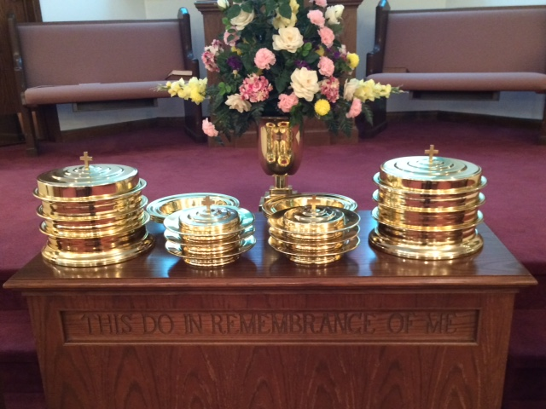
IN REMEMBRANCE OF JESUS

Slide 21
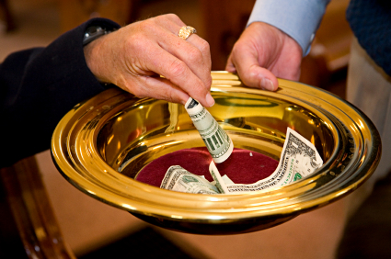
CONTRIBUTION

Slide 22
SINGING

Slide 23
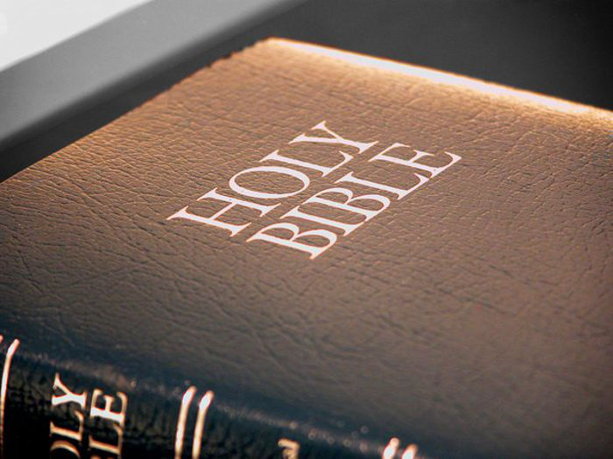
HAVE A WONDROUS WEEK

