Slide 1
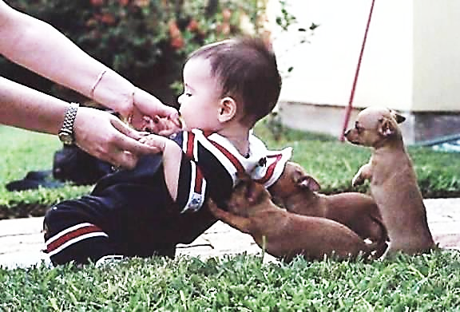
WELCOME TO THE
JACKSON STREET CHURCH OF CHRIST
PLEASE TURN OFF CELLPHONES

Slide 2


Slide 3


Slide 4

SINGING

Slide 5
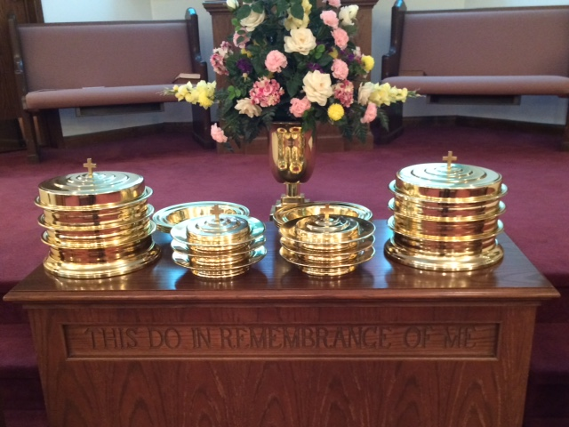
IN REMEMBRANCE OF JESUS

Slide 6
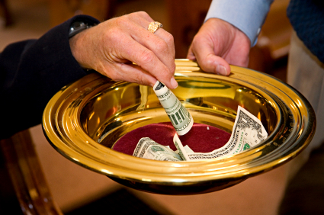
CONTRIBUTION

Slide 7



Slide 8
James 2:22–24 Do you see that faith was working together with his works, and by works faith was made perfect? ²³ And the Scripture was fulfilled which says, “Abraham believed God, and it was accounted to him for righteousness.” And he was called the friend of God. ²⁴ You see then that a man is justified by works, and not by faith only.

Slide 10
FIVE FACETS OF FRIENDSHIP
WITH GOD and Others

Slide 11
FRIENDSHIP WITH GOD
Friendship is a very important part of human relationships.
To be called a friend of God is the most important friendship we can have.
We will be looking at characteristics of friendship in this lesson.

Slide 12
1. FACE TO FACE RELATIONSHIP
Exodus 33:8-11 So it was, whenever Moses went out to the tabernacle, that all the people rose, and each man stood at his tent door and watched Moses until he had gone into the tabernacle. ⁹ And it came to pass, when Moses entered the tabernacle, that the pillar of cloud descended and stood at the door of the tabernacle, and the Lord talked with Moses. ¹⁰ All the people saw the pillar of cloud standing at the tabernacle door, and all the people rose and worshiped, each man in his tent door. ¹¹ So the Lord spoke to Moses face to face, as a man speaks to his friend.
Deuteronomy 34:10 But since then there has not arisen in Israel a prophet like Moses, whom the LORD knew face to face,

Slide 13
1. FACE TO FACE RELATIONSHIP
Numbers 12:6–8 Then He said, “Hear now My words: If there is a prophet among you, I, the LORD, make Myself known to him in a vision; I speak to him in a dream. ⁷ Not so with My servant Moses; He is faithful in all My house. ⁸ I speak with him face to face, Even plainly, and not in dark sayings; And he sees the form of the LORD. Why then were you not afraid To speak against My servant Moses?”
Through Jesus, we have access to God. - Hebrews 10:19–22 Therefore, brethren, having boldness to enter the Holiest by the blood of Jesus, ²⁰ by a new and living way which He consecrated for us, through the veil, that is, His flesh, ²¹ and having a High Priest over the house of God, ²² let us draw near with a true heart in full assurance of faith, having our hearts sprinkled from an evil conscience and our bodies washed with pure water.

Slide 14
2. OUR ACTIONS BASED ON TRUST
Proverbs 3:5–6 Trust in the LORD with all your heart, And lean not on your own understanding; 6 In all your ways acknowledge Him, And He shall direct your paths.
Proverbs 27:10 Do not forsake your own friend or your father’s friend, Nor go to your brother’s house in the day of your calamity; Better is a neighbor nearby than a brother far away.

Slide 15
2. OUR ACTIONS BASED ON TRUST
God made us and He knows what is best for us. - Proverbs 3:5–6 Trust in the LORD with all your heart, And lean not on your own understanding; ⁶ In all your ways acknowledge Him, And He shall direct your paths.
Ephesians 1:11–13 In Him also we have obtained an inheritance, being predestined according to the purpose of Him who works all things according to the counsel of His will, ¹² that we who first trusted in Christ should be to the praise of His glory. ¹³ In Him you also trusted, after you heard the word of truth, the gospel of your salvation; in whom also, having believed, you were sealed with the Holy Spirit of promise,

Slide 16
3. REVEALING OF THE HEART
John 15:14-15 You are My friends if you do whatever I command you. ¹⁵ No longer do I call you servants, for a servant does not know what his master is doing; but I have called you friends, for all things that I heard from My Father I have made known to you.
Psalm 19:14 Let the words of my mouth and the meditation of my heart Be acceptable in Your sight, O LORD, my strength and my Redeemer.
God loves us and cares about us. He wants us to open up to him with all our problems. - 1 Peter 5:6–7 Therefore humble yourselves under the mighty hand of God, that He may exalt you in due time, ⁷ casting all your care upon Him, for He cares for you.
Psalm 34:15 The eyes of the LORD are on the righteous, And His ears are open to their cry.

Slide 17
4. DEEPLY COMMITTED AND LOYAL
Proverbs 17:17 A friend loves at all times, And a brother is born for adversity.
Proverbs 18:24 A man who has friends must himself be friendly, But there is a friend who sticks closer than a brother.
Jesus always did His Father’s will. John 8:29 And He who sent Me is with Me. The Father has not left Me alone, for I always do those things that please Him.”
We must be totally committed to God. - 2 Timothy 2:15 Be diligent to present yourself approved to God, a worker who does not need to be ashamed, rightly dividing the word of truth.
Colossians 1:10 that you may walk worthy of the Lord, fully pleasing Him, being fruitful in every good work and increasing in the knowledge of God;
John 15:13–14 Greater love has no one than this, than to lay down one’s life for his friends. ¹⁴ You are My friends if you do whatever I command you.

Slide 18
5. WILLINGNESS TO BE
PAINFULLY HONEST
Proverbs 27:6 Faithful are the wounds of a friend, But the kisses of an enemy are deceitful.
Psalm 141:5 Let the righteous strike me; It shall be a kindness. And let him rebuke me; It shall be as excellent oil; Let my head not refuse it. For still my prayer is against the deeds of the wicked.
2 Samuel 12:7 Then Nathan said to David, “You are the man! Thus says the LORD God of Israel: ‘I anointed you king over Israel, and I delivered you from the hand of Saul.
God hurts when we sin, but He wants to hear us confess our sin, He knows it anyway. 1 John 1:9 If we confess our sins, He is faithful and just to forgive us our sins and to cleanse us from all unrighteousness.
Galatians 4:16 Have I therefore become your enemy because I tell you the truth?

Slide 19
ARE YOU A FRIEND OF GOD?
Do you have a close relationship with Him?
Do your actions show you have complete trust in Him?
Do you open up your heart to Him?
Are you totally committed to Him?
Are you willing to be painfully honest with Him?

Slide 21

PRAYER

Slide 22

TONIGHT’S SERMON:
LOVE GOD WITH ALL YOUR HEART
This Photo by Unknown Author is licensed under CC BY-SA-NC

