Slide 1

WELCOME TO THE
JACKSON STREET CHURCH OF CHRIST
PLEASE TURN OFF CELLPHONES

Slide 2


Slide 3
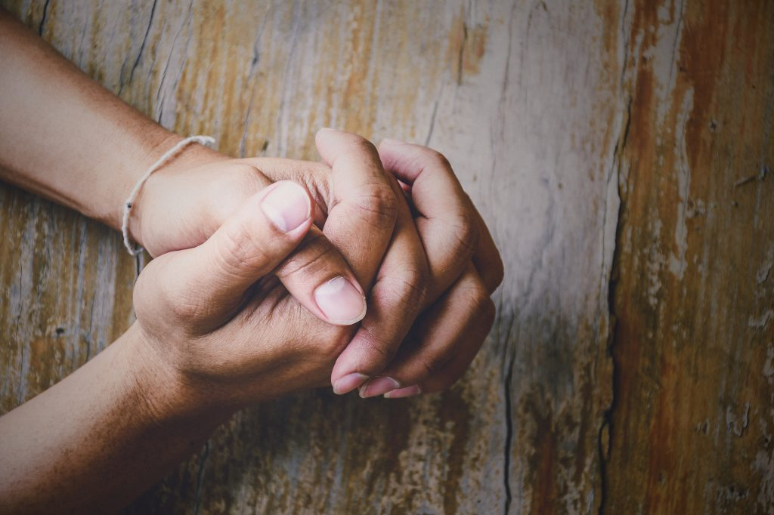
LET US PRAY

Slide 4

SINGING

Slide 5
Matthew 22:34–40 But when the Pharisees heard that He had silenced the Sadducees, they gathered together. ³⁵ Then one of them, a lawyer, asked Him a question, testing Him, and saying, ³⁶ “Teacher, which is the great commandment in the law?” ³⁷ Jesus said to him, “ ‘You shall love the LORD your God with all your heart, with all your soul, and with all your mind.’ ³⁸ This is the first and great commandment. ³⁹ And the second is like it: ‘You shall love your neighbor as yourself.’ ⁴⁰ On these two commandments hang all the Law and the Prophets.”

Slide 6
LET US PRAY

Slide 7

HOW TO LOVE GOD WITH ALL YOUR HEART

Slide 8
LOVE GOD WITH ALL YOUR HEART
Christ placed His priority on love and wants that to be our priority also.
Matthew 22:34–40 But when the Pharisees heard that He had silenced the Sadducees, they gathered together. ³⁵ Then one of them, a lawyer, asked Him a question, testing Him, and saying, ³⁶ “Teacher, which is the great commandment in the law?” ³⁷ Jesus said to him, “ ‘You shall love the LORD your God with all your heart, with all your soul, and with all your mind.’ ³⁸ This is the first and great commandment. ³⁹ And the second is like it: ‘You shall love your neighbor as yourself.’ ⁴⁰ On these two commandments hang all the Law and the Prophets.”
The primary command of all of Scripture is to Love God with all of our heart, soul, mind, and strength.
HOW CAN WE LOVE GOD WITH OUR WHOLE HEART?

Slide 9
1. OBEY GOD
A. Our love is proved by our actions.
John 14:21 He who has My commandments and keeps them, it is he who loves Me. And he who loves Me will be loved by My Father, and I will love him and manifest Myself to him.”
1 John 5:3 For this is the love of God, that we keep His commandments. And His commandments are not burdensome.
1 John 2:5 But whoever keeps His word, truly the love of God is perfected in him. By this we know that we are in Him.
John 14:15 “If you love Me, keep My commandments.
B. Our lives are the testimony to how much we love God! - 2 Corinthians 5:14–15 For the love of Christ compels us, because we judge thus: that if One died for all, then all died; ¹⁵ and He died for all, that those who live should live no longer for themselves, but for Him who died for them and rose again.

Slide 10
2. DESIRE GOD
Psalm 63:1–3 O God, You are my God; Early will I seek You; My soul thirsts for You; My flesh longs for You In a dry and thirsty land Where there is no water. ² So I have looked for You in the sanctuary, To see Your power and Your glory. ³ Because Your lovingkindness is better than life, My lips shall praise You.
Psalm 63:7–8 Because You have been my help, Therefore in the shadow of Your wings I will rejoice. ⁸ My soul follows close behind You; Your right hand upholds me.
Psalm 73:25–26 Whom have I in heaven but You? And there is none upon earth that I desire besides You. ²⁶ My flesh and my heart fail; But God is the strength of my heart and my portion forever.

Slide 11
2. DESIRE GOD
Psalm 84:2–4 My soul longs, yes, even faints For the courts of the Lord; My heart and my flesh cry out for the living God. ³ Even the sparrow has found a home, And the swallow a nest for herself, Where she may lay her young— Even Your altars, O Lord of hosts, My King and my God. ⁴ Blessed are those who dwell in Your house; They will still be praising You.
Matthew 6:33 But seek first the kingdom of God and His righteousness, and all these things shall be added to you.
Hebrews 11:6 But without faith it is impossible to please Him, for he who comes to God must believe that He is, and that He is a rewarder of those who diligently seek Him.

Slide 12
3. TRUST GOD
Psalm 18:1–3 I will love You, O Lord, my strength. ² The Lord is my rock and my fortress and my deliverer; My God, my strength, in whom I will trust; My shield and the horn of my salvation, my stronghold. ³ I will call upon the Lord, who is worthy to be praised; So shall I be saved from my enemies.
2 Corinthians 1:9–10 Yes, we had the sentence of death in ourselves, that we should not trust in ourselves but in God who raises the dead, ¹⁰ who delivered us from so great a death, and does deliver us; in whom we trust that He will still deliver us,
1 Timothy 4:8–10 For bodily exercise profits a little, but godliness is profitable for all things, having promise of the life that now is and of that which is to come. ⁹ This is a faithful saying and worthy of all acceptance. ¹⁰ For to this end we both labor and suffer reproach, because we trust in the living God, who is the Savior of all men, especially of those who believe.

Slide 13
4. CHOOSE GOD
Matthew 6:24 “No one can serve two masters; for either he will hate the one and love the other, or else he will be loyal to the one and despise the other. You cannot serve God and mammon.
Matthew 6:31–34 “Therefore do not worry, saying, ‘What shall we eat?’ or ‘What shall we drink?’ or ‘What shall we wear?’ ³² For after all these things the Gentiles seek. For your heavenly Father knows that you need all these things. ³³ But seek first the kingdom of God and His righteousness, and all these things shall be added to you. ³⁴ Therefore do not worry about tomorrow, for tomorrow will worry about its own things. Sufficient for the day is its own trouble.
1 Kings 18:21 And Elijah came to all the people, and said, “How long will you falter between two opinions? If the LORD is God, follow Him; but if Baal, follow him.” But the people answered him not a word.

Slide 14
4. CHOOSE GOD
Joshua 24:15 And if it seems evil to you to serve the LORD, choose for yourselves this day whom you will serve, whether the gods which your fathers served that were on the other side of the River, or the gods of the Amorites, in whose land you dwell. But as for me and my house, we will serve the LORD.”
Luke 10:41–42 And Jesus answered and said to her, “Martha, Martha, you are worried and troubled about many things. ⁴² But one thing is needed, and Mary has chosen that good part, which will not be taken away from her.”
How easy it is for too many good things to squeeze out the very best thing.

Slide 15
5. SPEND TIME WITH GOD
John 14:23–24 Jesus answered and said to him, “If anyone loves Me, he will keep My word; and My Father will love him, and We will come to him and make Our home with him. ²⁴ He who does not love Me does not keep My words; and the word which you hear is not Mine but the Father’s who sent Me.
2 Timothy 3:16–17 All Scripture is given by inspiration of God, and is profitable for doctrine, for reproof, for correction, for instruction in righteousness, ¹⁷ that the man of God may be complete, thoroughly equipped for every good work.
2 Timothy 2:15 Be diligent to present yourself approved to God, a worker who does not need to be ashamed, rightly dividing the word of truth.

Slide 16
5. SPEND TIME WITH GOD
Psalm 119:97–100 Oh, how I love Your law! It is my meditation all the day. ⁹⁸ You, through Your commandments, make me wiser than my enemies; For they are ever with me. ⁹⁹ I have more understanding than all my teachers, For Your testimonies are my meditation. ¹⁰⁰ I understand more than the ancients, Because I keep Your precepts.
John 8:29 And He who sent Me is with Me. The Father has not left Me alone, for I always do those things that please Him.”
1 Thess 5:17 Pray without ceasing.

Slide 17
6. WORSHIP GOD
Matthew 4:8–10 Again, the devil took Him up on an exceedingly high mountain, and showed Him all the kingdoms of the world and their glory. ⁹ And he said to Him, “All these things I will give You if You will fall down and worship me.” ¹⁰ Then Jesus said to him, “Away with you, Satan! For it is written, ‘You shall worship the LORD your God, and Him only you shall serve.’ ”
John 4:23–24 But the hour is coming, and now is, when the true worshipers will worship the Father in spirit and truth; for the Father is seeking such to worship Him. ²⁴ God is Spirit, and those who worship Him must worship in spirit and truth.”
Matthew 15:8–9 ‘These people draw near to Me with their mouth, And honor Me with their lips, But their heart is far from Me. ⁹ And in vain they worship Me, Teaching as doctrines the commandments of men.’ ”

Slide 18
LOVE GOD WITH YOUR WHOLE HEART
Loving God with all our heart, mind, soul and strength is a lifelong quest - not a one-time accomplishment.
Revelation 2:4–5 Nevertheless I have this against you, that you have left your first love. ⁵ Remember therefore from where you have fallen; repent and do the first works, or else I will come to you quickly and remove your lampstand from its place—unless you repent.
Do you remember your first love? Have you lost your love for Christ? When you lose your first love it means that Christ is no longer first in your life.
What has replaced Him?
Your job or career
Your boyfriend or girlfriend
Your husband or wife
Your leisure time
Your hobbies
5. Do you need to grow deeper in your love for God?

Slide 19
SINGING

Slide 20
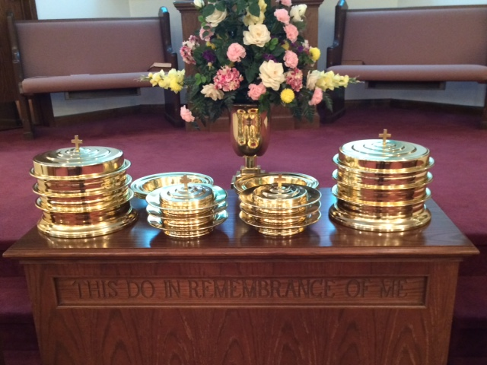
IN REMEMBRANCE OF JESUS

Slide 21
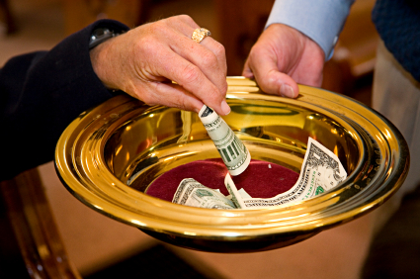
CONTRIBUTION

Slide 22
SINGING

Slide 23
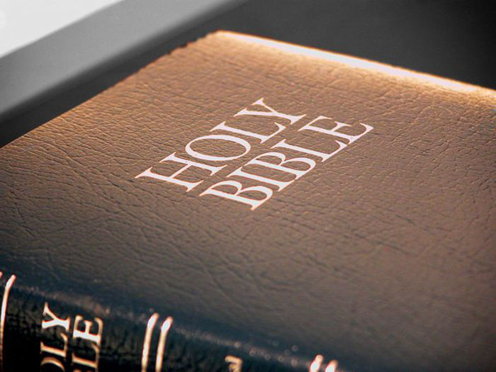

HAVE A GOD-LOVING WEEK

