Slide 1

WELCOME TO THE
JACKSON STREET CHURCH OF CHRIST
PLEASE TURN OFF CELLPHONES

Slide 2


Slide 3


Slide 4

SINGING

Slide 5
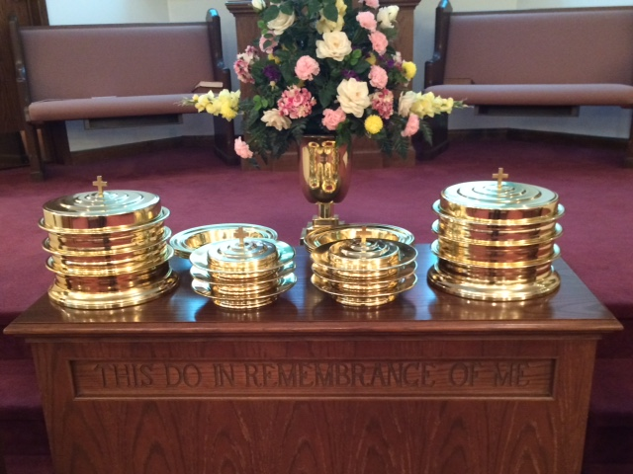
IN REMEMBRANCE OF JESUS

Slide 6
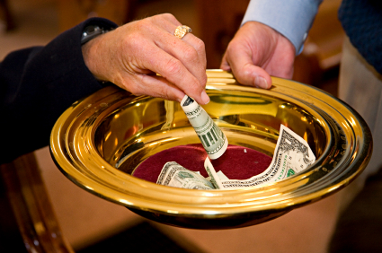
CONTRIBUTION

Slide 7



Slide 8
Hebrews 6:1–3 Therefore, leaving the discussion of the elementary principles of Christ, let us go on to perfection, not laying again the foundation of repentance from dead works and of faith toward God, ² of the doctrine of baptisms, of laying on of hands, of resurrection of the dead, and of eternal judgment. ³ And this we will do if God permits.

Slide 10
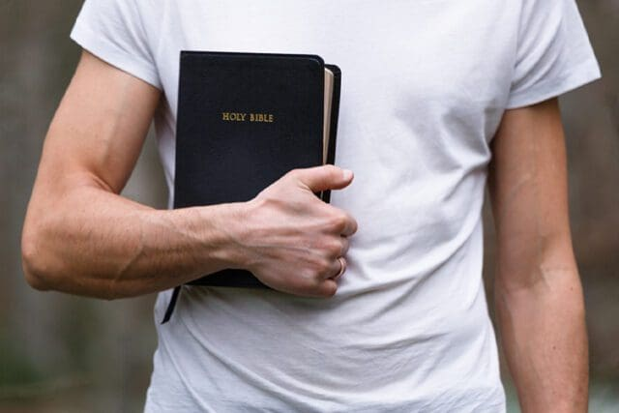
THE CHRISTIAN LIFE
IN HEBREWS 12 & 13

Slide 11
THE HEBREWS
IN THE BOOK OF HEBREWS
JEWISH CHRISTIANS
THEY WERE IN DANGER OF GIVING UP CHRISTIANITY AND GOING BACK INTO JUDAISM

Slide 12
GET RID OF SIN
Heb 12:1 Therefore we also, since we are surrounded by so great a cloud of witnesses, let us lay aside every weight, and the sin which so easily ensnares us,

Slide 13
2. RUN THE RACE WITH ENDURANCE
^{1b} and let us run with endurance the race that is set before us,

Slide 14
3. LOOK UNTO JESUS
² looking unto Jesus, the author and finisher of our faith, who for the joy that was set before Him endured the cross, despising the shame, and has sat down at the right hand of the throne of God. ³ For consider Him who endured such hostility from sinners against Himself, lest you become weary and discouraged in your souls. ⁴ You have not yet resisted to bloodshed, striving against sin.

Slide 15
4. ACCEPT GOD’S CHASTENING
⁵ And you have forgotten the exhortation which speaks to you as to sons: "My son, do not despise the chastening of the LORD, Nor be discouraged when you are rebuked by Him; ⁶ For whom the LORD loves He chastens, And scourges every son whom He receives. ⁷ If you endure chastening, God deals with you as with sons; for what son is there whom a father does not chasten? ⁸ But if you are without chastening, of which all have become partakers, then you are illegitimate and not sons. ⁹ Furthermore we have had human fathers who corrected us, and we paid them respect. Shall we not much more readily be in subjection to the Father of spirits and live? ¹⁰ For they indeed for a few days chastened us as seemed best to them, but He for our profit, that we may be partakers of His holiness, ¹¹ Now no chastening seems to be joyful for the present, but painful; nevertheless, afterward it yields the peaceable fruit of righteousness to those who have been trained by it.

Slide 16
5. BE STRONG AND CAREFUL
¹² Therefore strengthen the hands which hang down, and the feeble knees, ¹³ and make straight paths for your feet, so that what is lame may not be dislocated, but rather be healed,

Slide 17
6. PURSUE PEACE
¹⁴ Pursue peace with all people,

Slide 18
7. PURSUE HOLNESS and holiness, without which no one will see the Lord: ¹⁵ looking carefully lest anyone fall short of the grace of God; lest any root of bitterness springing up cause trouble, and by this many become defiled;

Slide 19
7. PURSUE HOLNESS
DONT BE LIKE ESAU ¹⁶ lest there be any fornicator or profane person like Esau, who for one morsel of food sold his birthright, ¹⁷ For you know that afterward, when he wanted to inherit the blessing, he was rejected, for he found no place for repentance, though he sought it diligently with tears,
REMEMBER MOUNT SINAI ¹⁸ For you have not come to the mountain that may be touched and that burned with fire, and to blackness and darkness and tempest, ¹⁹ and the sound of a trumpet and the voice of words, so that those who heard it begged that the word should not be spoken to them anymore. ²⁰ (For they could not endure what was commanded: "And if so much as a beast touches the mountain, it shall be stoned or shot with an arrow. ²¹ And so terrifying was the sight that Moses said, "I am exceedingly afraid and trembling.

Slide 20
7. PURSUE HOLNESS
YOU HAVE COME TO A GREATER MOUNTAIN ²² But you have come to Mount Zion and to the city of the living God, the heavenly Jerusalem, to an innumerable company of angels, ²³ to the general assembly and church of the firstborn who are registered in heaven, to God the Judge of all, to the spirits of just men made perfect,
YOU HAVE COME TO JESUS THE MESSIAH ²⁴ to Jesus the Mediator of the new covenant, and to the blood of sprinkling that speaks better things than that of Abel.

Slide 21
7. PURSUE HOLNESS
REMEMBER WHO YOU ARE DEALNG WITH ²⁵ see that you do not refuse Him who speaks. For if they did not escape who refused Him who spoke on earth, much more shall we not escape if we turn away from Him who speaks from heaven, ²⁶ whose voice then shook the earth; but now He has promised, saying, "Yet once more I shake not only the earth: but also heaven," ²⁷ Now this, "Yet once more," indicates the removal of those things that are being shaken. as of things that are made, that the things which cannot be shaken may remain. ²⁸ Therefore, since we are receiving a kingdom which cannot be shaken, let us have grace, by which we may serve God acceptably with reverence and godly fear. ²⁹ For our God is a consuming fire.

Slide 22
LOVE AS BROTHERS Heb 13 Let brotherly love continue.
LOVE STRANGERS ² Do not forget to entertain strangers, for by so doing some have unwittingly entertained angels.
LOVE THOSE IMPRISONED FOR FAITH ³ Remember the prisoners as if chained with them; those who are mistreated; since you yourselves are in the body also

Slide 23
9. HONOR MARRIAGE
⁴ Marriage is honorable among all, and the bed undefiled; but fornicators and adulterers God will judge.

Slide 24
10. BE CONTENT, DEPEND ON GOD
⁵ Let your conduct be without covetousness; be content with such things as you have. For He Himself has said, "I will never leave you nor forsake you." ⁶ So we may boldly say: %The LORD is my helper; I will not fear. What can man do to me?"

Slide 25
11. REMEMBER YOUR LEADERS
⁷ Remember those who rule over you, who have spoken the word of God to you, whose faith follow, considering the outcome of their conduct,

Slide 26
12. KEEP PURE IN DOCTRINE
⁸ Jesus Christ is the same yesterday, today, and forever. ⁹ Do not be carried about with various and strange doctrines. For it is good that the heart be established by grace, not with foods which have not profited those who have been occupied with them, ¹⁰ We have an altar from which those who serve the tabernacle have no right to eat. ¹¹ For the bodies of those animals, whose blood is brought into the sanctuary bv the high priest for sin, are burned outside the camp. ¹² Therefore Jesus also, that He might sanctify the people with His own blood, suffered outside the gate. ¹³ Therefore let us go forth to Him, outside the camp, bearing His reproach. ¹⁴ For here we have no continuing city, but we seek the one to come,

Slide 27
13. OFFER SACRIFICE…
OF PRAISE ¹⁵ Therefore by Him let us continually offer the sacrifice of praise to God, that is, the fruit of our lips, giving thanks to His name,
OF GOOD WORKS ¹⁶ But do not forget to do good and to share, for with such sacrifices God is well pleased,

Slide 28
OBEY YOUR SPIRITUAL RULERS
¹⁷ Obey those who rule over you, and be submissive, for they watch out for your souls, as those who must give account. Let them do so with joy and not with grief, for that would be unprofitable for you,

Slide 29
COMPLETE
²⁰ Now may the God of peace who brought up our Lord Jesus from the dead, that great Shepherd of the sheep, through the blood of the everlasting covenant, ²¹ make you complete in every good work to do His will, working in you what is well pleasing in His sight, through Jesus Christ, to whom be glory forever and ever, Amen,

Slide 31

PRAYER

Slide 32
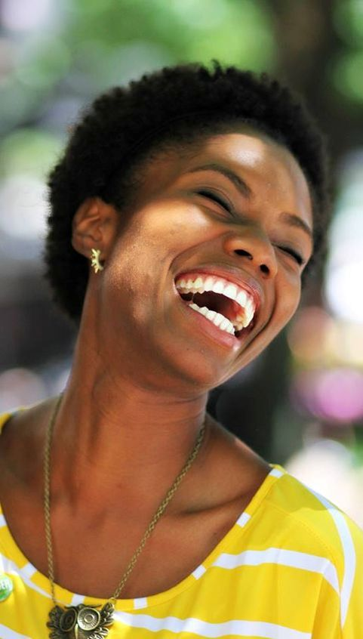
TONIGHT’S SERMON:
HAPPINESS

