Slide 1

WELCOME TO THE
JACKSON STREET CHURCH OF CHRIST
PLEASE TURN OFF CELLPHONES

Slide 2


Slide 3

LET US PRAY

Slide 4

SINGING

Slide 5
Ecclesiastes 3:12–13 I know that nothing is better for them than to rejoice, and to do good in their lives, ¹³ and also that every man should eat and drink and enjoy the good of all his labor—it is the gift of God.

Slide 6
LET US PRAY

Slide 7

H
A
P
P
I
N
E
S
S

Slide 8
HAPPINESS
DOES ANYONE HERE NOT WANT TO BE HAPPY?
ENJOYMENT IS THE GIFT OF GOD
  Ecclesiastes 3:12–13 I know that nothing is better for them than to rejoice, and to do good in their lives, ¹³ and also that every man should eat and drink and enjoy the good of all his labor—it is the gift of God.
  Ecclesiastes 8:15 So I commended enjoyment, because a man has nothing better under the sun than to eat, drink, and be merry; for this will remain with him in his labor all the days of his life which God gives him under the sun.
HAPPINESS IS GOOD FOR US - Proverbs 17:22 A merry heart does good, like medicine, But a broken spirit dries the bones.
We will be looking at happiness and joy from the books of Proverbs and Ecclesiastes.

Slide 9
WISDOM
Proverbs 3:13 Happy is the man who finds wisdom, And the man who gains understanding;
Proverbs 3:18 She is a tree of life to those who take hold of her, And happy are all who retain her.

Slide 10
2. MERCY
Proverbs 14:21 He who despises his neighbor sins; But he who has mercy on the poor, happy is he.

Slide 11
TRUST
Proverbs 16:20 He who heeds the word wisely will find good, And whoever trusts in the LORD, happy is he.

Slide 12
4. REVERENCE
Proverbs 28:14 Happy is the man who is always reverent, But he who hardens his heart will fall into calamity.

Slide 13
5. OBEDIENT
Proverbs 29:18 Where there is no revelation, the people cast off restraint; But happy is he who keeps the law.

Slide 14
6. PEACEMAKERS
Proverbs 12:20 Deceit is in the heart of those who devise evil, But counselors of peace have joy.

Slide 15
7. ENCOURAGE
Proverbs 15:23 A man has joy by the answer of his mouth, And a word spoken in due season, how good it is!

Slide 16
8. JUSTICE
Proverbs 21:15 It is a joy for the just to do justice, But destruction will come to the workers of iniquity.

Slide 17
9. GOODNESS
Ecclesiastes 2:24–26 Nothing is better for a man than that he should eat and drink, and that his soul should enjoy good in his labor. This also, I saw, was from the hand of God. ²⁵ For who can eat, or who can have enjoyment, more than I? ²⁶ For God gives wisdom and knowledge and joy to a man who is good in His sight; but to the sinner He gives the work of gathering and collecting, that he may give to him who is good before God. This also is vanity and grasping for the wind.

Slide 18
10. JOY
Ecclesiastes 5:20 For he will not dwell unduly on the days of his life, because God keeps him busy with the joy of his heart.

Slide 19
11. PROSPERITY & ADVERSITY
Ecclesiastes 7:14 In the day of prosperity be joyful, But in the day of adversity consider: Surely God has appointed the one as well as the other, So that man can find out nothing that will come after him.

Slide 20
12. ACCEPTANCE
Ecclesiastes 9:7 Go, eat your bread with joy, And drink your wine with a merry heart; For God has already accepted your works.

Slide 21
ARE YOU HAPPY?
GOD WANTS YOU TO BE HAPPY AND ENJOY YOUR LIFE HERE ON EARTH.
HE WANTS EVEN MORE FOR YOU TO LIVE WITH HIM ETERNALLY IN HEAVEN.
Luke 12:29–32 “And do not seek what you should eat or what you should drink, nor have an anxious mind. ³⁰ For all these things the nations of the world seek after, and your Father knows that you need these things. ³¹ But seek the kingdom of God, and all these things shall be added to you. ³² “Do not fear, little flock, for it is your Father’s good pleasure to give you the kingdom.

Slide 22
SINGING

Slide 23
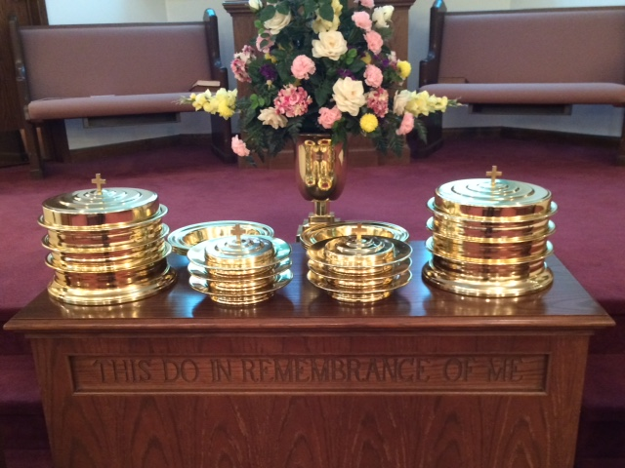
IN REMEMBRANCE OF JESUS

Slide 24
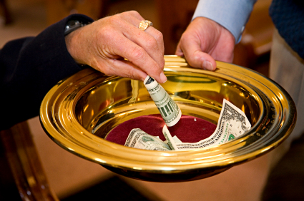
CONTRIBUTION

Slide 25
SINGING

Slide 26

HAVE A HAPPY WEEK

