Slide 1
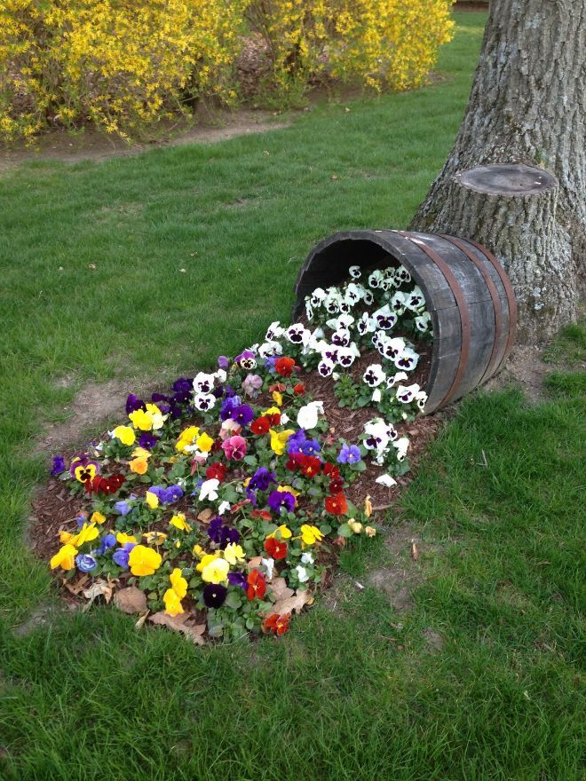
WELCOME TO THE
JACKSON STREET CHURCH OF CHRIST
PLEASE TURN OFF CELLPHONES

Slide 2


Slide 3


Slide 4

SINGING

Slide 5

IN REMEMBRANCE OF JESUS

Slide 6

CONTRIBUTION

Slide 7



Slide 8
Matthew 28:18–20 And Jesus came and spoke to them, saying, “All authority has been given to Me in heaven and on earth. ¹⁹ Go therefore and make disciples of all the nations, baptizing them in the name of the Father and of the Son and of the Holy Spirit, ²⁰ teaching them to observe all things that I have commanded you; and lo, I am with you always, even to the end of the age.” Amen.

Slide 10

SPREADING THE GOSPEL

Slide 11
THE RESTORATION
Restoring the worship of the church (sing, pray, give, commune, teach)
Restoring the plan of salvation (hear, believe, repent, confess, be baptized)
Restoring the organization of the church (Jesus head, elders, deacons, preacher, teachers, members)
Restoring proper terminology (call bible things by bible names)
Restoring sanctification of Christians (Christian living, forsaking of sin)
Many of us would get very upset if someone tried to remove something that we believe to be a part of god's plan in any of the above areas, and rightly so, but there is an area of God's will that has not yet been restored at least in our day and time, the restoration N.T. evangelism seeking the lost.

Slide 12
THE MAJOR CONCERN OF GOD IS SAVING THE LOST.
I Timothy 2:4 Who will have all men to be saved, and to come unto the knowledge of the truth.
2 Peter 3:9 The Lord is not slack concerning his promise, as some men count slackness; but is longsuffering to us—ward, not willing that any should perish, but that al l should come to repentance.
John 3:16 For God so loved the world, that he gave his only begotten Son, that whosoever believeth in him should not perish, but have everlasting life.
Luke 19:10 For the Son of man is come to seek and to save that which was lost.

Slide 13
THE NEW CHURCH IN THE FIRST CENTURY WAS EVANGELISTIC.
Acts 2:41 Then they that gladly received his word were baptized: and the same day there were added unto them about three thousand souls.
Acts 2:47 Praising God, and having favor with al l the people. And the Lord added to the church daily such as should be saved.
Acts Howbeit many of them which heard the word believed; and the number of the men was about five thousand.
Acts 5:14 And believers were the more added to the Lord, multitudes both of men and women.

Slide 14
THE NEW CHURCH IN THE FIRST CENTURY WAS EVANGELISTIC.
Acts And in those days, when the number of the disciples was multiplied, there arose a murmuring of the Grecians against the Hebrews, because their widows were neglected in the daily ministration.
Acts 6:7 And the word of God increased; and the number of the disciples multiplied in Jerusalem greatly; and a great company of the priests were obedient to the faith.
Acts 17:6 And when they found them not, they drew Jason and certain brethren unto the rulers of the city, crying, These that have turned the world upside down have come here also.

Slide 15
THE NEW CHURCH IN THE FIRST CENTURY WAS EVANGELISTIC.
Colossians 1:23 If ye continue in the faith grounded and settled, and be not moved away from the hope of the gospel, which ye have heard, and which was preached to every creature which is under heaven; whereof I Paul am made a minister;
The first century Christians did not have to be told to evangelize it was a natural response.
  Acts 8:1 Now Saul was consenting to his death. At that time a great persecution arose against the church which was at Jerusalem; and they were all scattered throughout the regions of Judea and Samaria, except the apostles.
  Acts 8:4 Therefore those who were scattered went everywhere preaching the word.
We have not restored N.T. evangelism until each and every one of us have a burning desire to reach the lost,

Slide 16
THE RESTORATION MOVEMENT BEGAN IN LATE 1700' S AND EARLY 1800’S AND GREW TREMENDOUSLY.
By 1830 many independent movements merged and by 1850 the restoration movement was the fourth largest religious fellowship in the U.S.
Just before the civil war we were the fastest growing religious body in the nation.
The restoration movement is the largest religious movement within American history.
Division within the movement after the civil war almost destroyed the restored church. The Christian church and the disciples of Christ were much larger than the church of Christ. The church lost most of its buildings, members, colleges, and educated ministers the church was almost unknown outside of the south and the brotherhood suffered from a negative attitude, a lack of vision, and a lack of growth.

Slide 17
THE RESTORATION MOVEMENT BEGAN IN LATE 1700' S AND EARLY 1800’S AND GREW TREMENDOUSLY.
World War II scattered Christians all over the nation and the world and after the war many soldiers came back with a zeal to evangelize.
By 1965 the church of Christ had outgrown the Christian church and the disciples of Christ and was the tenth largest religious group in the nation.
By 1976 the church of Christ was no longer the fastest Growing religious group in the U.S. it had dropped to 12th Place. The growth rate in 1979 was only about 1%
By the time the church is 2000 years old (2030) the World's population will be 20 billion if present trends continue a by that time the total membership in the church of Christ will be zero unless we reverse the trend.

Slide 18
WHAT CAN WE DO TO
RESTORE N.T. EVANGELISM?
We must accept the fact that the restoration is not finished. We must restore the N.T. zeal for evangelism.
We must put the "I" back in evangelism and accept individual responsibility for the lost we must stop making excuses and start making disciples.
(80% of all conversions come from individuals evangelizing friends and relatives.
We must get our priorities straight and realize that God is not willing that any should perish and neither are we.

Slide 19
WHAT CAN WE DO TO
RESTORE N.T. EVANGELISM?
If we do not know how to reach the lost, we must accept the responsibility to learn how.
If we don't really believe those who are disobedient to the gospel are lost, we must look at God's word and understand. We must understand that there is not one thing more important on this earth than saving lost souls.
We must understand that there are some people that only we can reach and if I don't try, they will be lost eternally. Also, we must realize that one day it will be too late.

Slide 20
WHAT CAN WE DO TO
RESTORE N.T. EVANGELISM?
If the church of Christ would grow like it did in the first century the gospel could be preached to every person on earth by the turn of the century. By the time the church is 2000 years old it could have a membership of almost 10 billion, almost half the world's population at that time.
We could accomplish that if we reached one person for every three members each year and none of them dropped out.
Just think what would happen if each member brought one soul to Christ each year and taught them to reach out to the lost. 2 Timothy 2:2 And the things that you have heard from me among many witnesses, commit these to faithful men who will be able to teach others also.

Slide 21
ARE YOU DOING YOUR PART?
1 Peter 4: 17-19 For the time is come that judgment must begin at the house of God: and if it first begins with us, what shall the end be of them that obey not the gospel of God? {18} And if the righteous scarcely be saved, where shall the ungodly and the sinner appear? {19} Wherefore let them that suffer according to the will of God commit the keeping of their souls to Him in well doing, as unto a faithful Creator.
What are you as an individual doing to bring your friends, neighbors and relatives to Jesus? Are you deceiving yourself by thinking you are right with God because you were baptized for the remission of your sins and you worship scripturally and yet live your life unconcerned about the lost around you.

Slide 22
ARE YOU DOING YOUR PART?
In the book of Acts, we see that the church in the first century grew so quickly because they were…
  Prayerful 1:14; 4:31
  Evangelical 2:40; 5:28, 42; 6:7; 8:
  Devoted 2:42
  Fulfilling One Another’s Needs 2:44-45; 6:1-7
  United 2:46; 4:32
  Respected By All 2:47; 5:13
  Compassionate Toward Outsiders 3:1-10; 5:16
  Giving God The Glory 3:11-16; 4:10-12
  Obedient In Spite Of Consequences 4:18-19; 5:40-42
  Speaking The Word Boldly 4:20, 31; 5:17-21, 25-29
  Sacrificially Giving 4:32-37
  Practicing Discipline 5:1-1 1
  Organized 6:1-4
  Forgiving 7:60

Slide 24

PRAYER

Slide 25

TONIGHT’S SERMON:
THE CHRISTIAN’S HOPE

