Slide 1
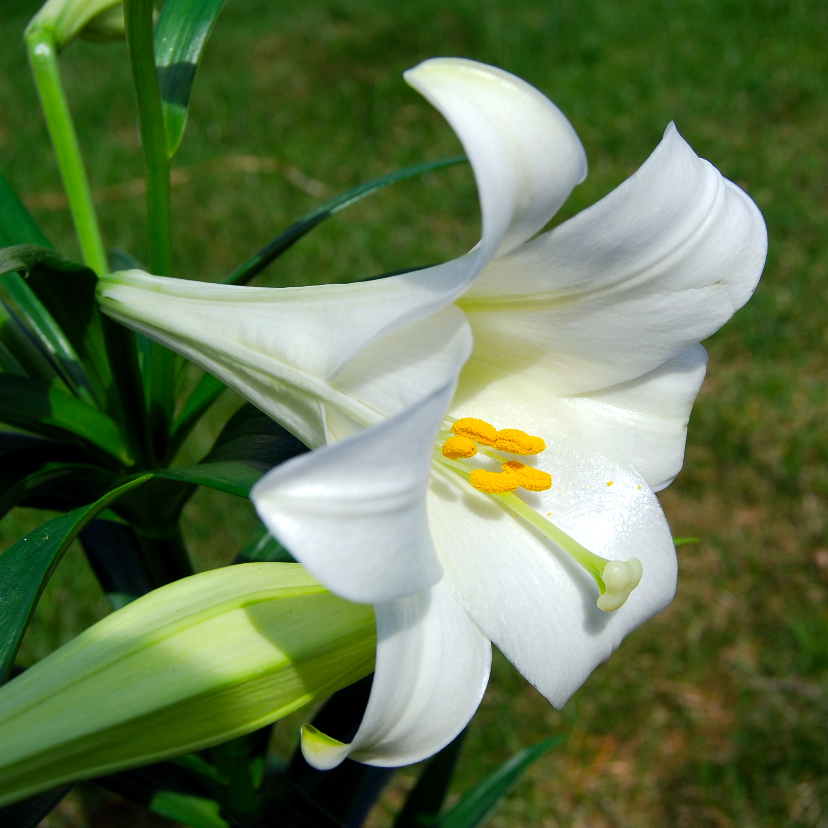
WELCOME TO THE
JACKSON STREET CHURCH OF CHRIST
PLEASE TURN OFF CELLPHONES

Slide 2


Slide 3

LET US PRAY

Slide 4

SINGING

Slide 5
Romans 8:18–25 For I consider that the sufferings of this present time are not worthy to be compared with the glory which shall be revealed in us. ¹⁹ For the earnest expectation of the creation eagerly waits for the revealing of the sons of God. ²⁰ For the creation was subjected to futility, not willingly, but because of Him who subjected it in hope; ²¹ because the creation itself also will be delivered from the bondage of corruption into the glorious liberty of the children of God. ²² For we know that the whole creation groans and labors with birth pangs together until now. ²³ Not only that, but we also who have the firstfruits of the Spirit, even we ourselves groan within ourselves, eagerly waiting for the adoption, the redemption of our body. ²⁴ For we were saved in this hope, but hope that is seen is not hope; for why does one still hope for what he sees? ²⁵ But if we hope for what we do not see, we eagerly wait for it with perseverance.

Slide 6
LET US PRAY

Slide 7
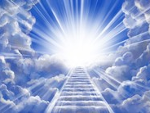
THE CHRISTIAN’S HOPE

Slide 8
HOPE
HOPE IS FOR WHAT IS UNSEEN - Romans 8:24–25 For we were saved in this hope, but hope that is seen is not hope; for why does one still hope for what he sees? ²⁵ But if we hope for what we do not see, we eagerly wait for it with perseverance.
OUR HOPE IN CHRIST IS IN THIS LIFE AND THE LIFE TO COME - 1 Corinthians 15:16–19 For if the dead do not rise, then Christ is not risen. ¹⁷ And if Christ is not risen, your faith is futile; you are still in your sins! ¹⁸ Then also those who have fallen asleep in Christ have perished. ¹⁹ If in this life only we have hope in Christ, we are of all men the most pitiable.
Thus, to live without Christ is to die without hope!

Slide 9
HOPE
Dante, in The Inferno, said the sign over the gate to Hell reads, “Abandon all hope, ye who enter here.”
There is no comfort at death except the sure hope of heaven.
The word “hope” is a Greek word that means “confidence.”
Those who belong to Christ have confidence of glory because they have been cleansed by Jesus’ blood.
They have confidence because of His resurrection; they are confident of a better place.
Therefore, the Christian’s hope is not the uncertain things of this world, but the well-grounded expectation of that which God has prepared for and promised to His people.
What does “the hope of glory” involve?

Slide 10
A GOOD HOPE
Paul said, “Now may our Lord Jesus Christ Himself, and our God and Father, who has loved us and given us everlasting consolation and good hope by grace, comfort your hearts and establish you in every good word and work” (2 Thess. 2:16-17).
In our intercessions and petitions, we would do well to remember God’s past faithfulness and present blessings.
His faithfulness in the past is a promise of His faithfulness for the future.
Illustration: A man watched a little league baseball game one afternoon. He asked a boy in the dugout what the score was. The boy responded, "Eighteen to nothing--we're be-hind." “Wow," said the spectator, "I'll bet you're discouraged." "Why should I be discouraged?" replied the little boy. "We haven't even gotten up to bat yet!" Hope is a good thing; it’s the best thing!

Slide 11
2. A LIVING HOPE
Peter said, “Blessed be the God and Father of our Lord Jesus Christ, who according to His abundant mercy has begotten us again to a living hope through the resurrection of Jesus Christ from the dead” (1 Peter 1:3).
We are born again to a living hope, because we have eternal life in a Savior who has conquered death Himself.
The hope lives because it is set on an inheritance incorruptible, which can never fade away because it is reserved in heaven.
This is a significant contrast to any inheritance on this earth. “There are no hopeless situations; there are only people who have grown hopeless about them” (Clare Luce).

Slide 12
3. A PURIFYING HOPE
1 John 3:1–3 Behold what manner of love the Father has bestowed on us, that we should be called children of God! Therefore the world does not know us, because it did not know Him. 2 Beloved, now we are children of God; and it has not yet been revealed what we shall be, but we know that when He is revealed, we shall be like Him, for we shall see Him as He is. 3 And everyone who has this hope in Him purifies himself, just as He is pure.

Slide 13
3. A PURIFYING HOPE
2 Corinthians 6:17–7:1 Therefore “Come out from among them And be separate, says the Lord. Do not touch what is unclean, And I will receive you.” ¹⁸ “I will be a Father to you, and you shall be My sons and daughters, says the LORD Almighty.” ^{7:1} Therefore, having these promises, beloved, let us cleanse ourselves from all filthiness of the flesh and spirit, perfecting holiness in the fear of God.
Having the anticipation of being with Jesus can have a marvelous purifying effect in our lives.
It makes us want to be ready for His return.
It also makes us want to serve and please Him.

Slide 14
4. A BLESSED HOPE
Paul told Titus, “looking for the blessed hope and glorious appearing of our great God and Savior Jesus Christ” (2:13).
Blessed means happy or joyful.
Grace teaches us to expect and joyfully prepare for our blessed hope; the second coming of Jesus.
Christians should live in joyful expectation of the return of Jesus.

Slide 15
5. AN ETERNAL HOPE
HOFE OF ETERNAL LIFE - Titus 1:1–2 Paul, a bondservant of God and an apostle of Jesus Christ, according to the faith of God’s elect and the acknowledgment of the truth which accords with godliness, ² in hope of eternal life which God, who cannot lie, promised before time began,
OUR FOCUS SHOULD BE ON THE UNSEEN, ETERNAL - 2 Corinthians 4:16–18 Therefore we do not lose heart. Even though our outward man is perishing, yet the inward man is being renewed day by day. ¹⁷ For our light affliction, which is but for a moment, is working for us a far more exceeding and eternal weight of glory, ¹⁸ while we do not look at the things which are seen, but at the things which are not seen. For the things which are seen are temporary, but the things which are not seen are eternal.

Slide 16
5. AN ETERNAL HOPE
HEIRS ACCORDING TO THE HOPE OF ETERNAL LIFE - Titus 3:4–7 But when the kindness and the love of God our Savior toward man appeared, ⁵ not by works of righteousness which we have done, but according to His mercy He saved us, through the washing of regeneration and renewing of the Holy Spirit, ⁶ whom He poured out on us abundantly through Jesus Christ our Savior, ⁷ that having been justified by His grace we should become heirs according to the hope of eternal life.

Slide 17
6. A HEAVENLY HOPE
Colossians 1:3–5 We give thanks to the God and Father of our Lord Jesus Christ, praying always for you, ⁴ since we heard of your faith in Christ Jesus and of your love for all the saints; ⁵ because of the hope which is laid up for you in heaven, of which you heard before in the word of the truth of the gospel,
Matthew 5:11–12 “Blessed are you when they revile and persecute you, and say all kinds of evil against you falsely for My sake. ¹² Rejoice and be exceedingly glad, for great is your reward in heaven, for so they persecuted the prophets who were before you.
2 Corinthians 5:1 For we know that if our earthly house, this tent, is destroyed, we have a building from God, a house not made with hands, eternal in the heavens.

Slide 18
DO YOU HAVE HOPE?
Hope is a firm assurance regarding things that are unseen and unclear - Romans 8:22–25 For we know that the whole creation groans and labors with birth pangs together until now. ²³ Not only that, but we also who have the firstfruits of the Spirit, even we ourselves groan within ourselves, eagerly waiting for the adoption, the redemption of our body. ²⁴ For we were saved in this hope, but hope that is seen is not hope; for why does one still hope for what he sees? ²⁵ But if we hope for what we do not see, we eagerly wait for it with perseverance.

Slide 19
DO YOU HAVE HOPE?
Hebrews 11:1 Now faith is the substance of things hoped for, the evidence of things not seen.
Hebrews 11:6 But without faith it is impossible to please Him, for he who comes to God must believe that He is, and that He is a rewarder of those who diligently seek Him.
Of all people who are living, the Christian is the only one that has true hope.
Romans 15:13 Now may the God of hope fill you with all joy and peace in believing, that you may abound in hope by the power of the Holy Spirit.

Slide 20
SINGING

Slide 21

IN REMEMBRANCE OF JESUS

Slide 22

CONTRIBUTION

Slide 23
SINGING

Slide 24

HAVE A HOPEFUL WEEK

