Slide 1
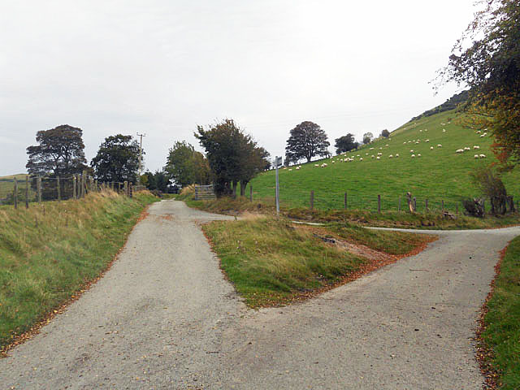
WELCOME TO THE
JACKSON STREET
CHURCH OF CHRIST
PLEASE TURN OFF CELLPHONES
This Photo by Unknown Author is licensed under CC BY-NC-ND

Slide 2


Slide 3


Slide 4

SINGING

Slide 5
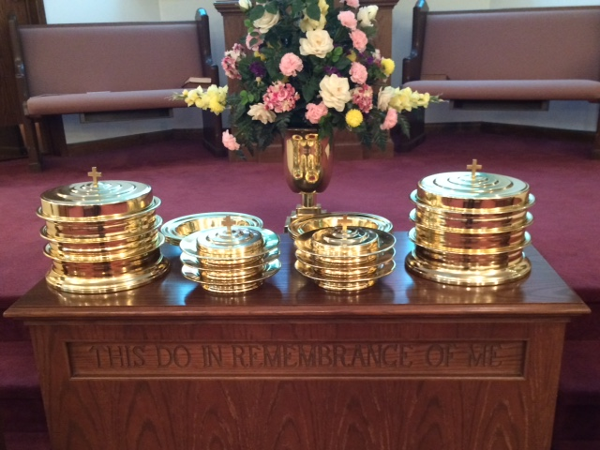
IN REMEMBRANCE OF JESUS

Slide 6
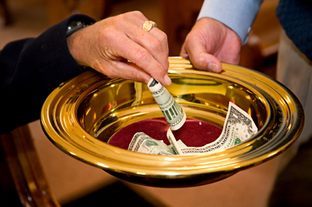
CONTRIBUTION

Slide 7
SINGING

Slide 8
Deuteronomy 30:15–20 “See, I have set before you today life and good, death and evil, ¹⁶ in that I command you today to love the LORD your God, to walk in His ways, and to keep His commandments, His statutes, and His judgments, that you may live and multiply; and the LORD your God will bless you in the land which you go to possess. ¹⁷ But if your heart turns away so that you do not hear, and are drawn away, and worship other gods and serve them, ¹⁸ I announce to you today that you shall surely perish; you shall not prolong your days in the land which you cross over the Jordan to go in and possess. ¹⁹ I call heaven and earth as witnesses today against you, that I have set before you life and death, blessing and cursing; therefore choose life, that both you and your descendants may live; ²⁰ that you may love the LORD your God, that you may obey His voice, and that you may cling to Him, for He is your life and the length of your days; and that you may dwell in the land which the LORD swore to your fathers, to Abraham, Isaac, and Jacob, to give them.”

Slide 10
TWO KINDS OF COURSES IN LIFE

Slide 11
SCHOOL TIME
School is beginning around this time of year.
There’s not a lot of choices in the elementary grades on what classes you are going to take.
As you move up to junior high and especially senior high and college, you start having to make some choices.
Depending on what you plan to major in when you get to college, there will be required courses and elective courses.
This is going to be true in your life from that time on. Required courses and elective courses.

Slide 12
REQUIRED
COURSES

Slide 13
Life - you got no choice - you didn’t ask to be born!
What - girl or boy
When - 1884 or 1984
Where - Africa, Afghanistan, America
Why - planned or unplanned
Who - your name or who your parents were
How - natural or unnatural

Slide 14
Death - you can’t choose not to die!
(1 Cor 15:21-22) For since by man came death, by Man also came the resurrection of the dead. {22} For as in Adam all die, even so in Christ all shall be made alive.
"must all walk through the valley of shadow"
(Psa 89:48) What man can live and not see death? Can he deliver his life from the power of the grave?

Slide 15
Death - you can’t choose not to die!
4. (Gen 3:19) By the sweat of your brow you will eat your food until you return to the ground, since from it you were taken; for dust you are and to dust you will return."
5. (Heb 9:27) And as it is appointed for men to die once, but after this the judgment,

Slide 16
Judgment - we have no choice in being at the judgment!
(2 Cor 5:10) For we must all appear before the judgment seat of Christ, that each one may receive the things done in the body, according to what he has done, whether good or bad.
(Rev 20:12) And I saw the dead, great and small, standing before the throne, and books were opened. Another book was opened, which is the book of life. The dead were judged according to what they had done as recorded in the books.

Slide 17
Judgment - we have no choice in being at the judgment!
3. (John 5:28-29) "Do not marvel at this; for the hour is coming in which all who are in the graves will hear His voice {29} "and come forth; those who have done good, to the resurrection of life, and those who have done evil, to the resurrection of condemnation.

Slide 18
ELECTIVE COURSES

Slide 19
To be saved or to be lost.
1. (Acts 2:40) With many other words he warned them; and he pleaded with them, "Save yourselves from this corrupt generation.“
2. (James 4:8-10) Come near to God and he will come near to you. Wash your hands, you sinners, and purify your hearts, you double-minded. {9} Grieve, mourn and wail. Change your laughter to mourning and your joy to gloom. {10} Humble yourselves before the Lord, and he will lift you up.

Slide 20
To be spiritual or carnal.
1. (Rom 8:13-14) For if you live according to the flesh you will die; but if by the Spirit you put to death the deeds of the body, you will live. {14} For as many as are led by the Spirit of God, these are sons of God.
2. (Rom 6:21-23) What benefit did you reap at that time from the things you are now ashamed of? Those things result in death! {22} But now that you have been set free from sin and have become slaves to God, the benefit you reap leads to holiness, and the result is eternal life. {23} For the wages of sin is death, but the gift of God is eternal life in Christ Jesus our Lord.

Slide 21
To be scriptural or logical.
(1 Cor 1:18) For the message of the cross is foolishness to those who are perishing, but to us who are being saved it is the power of God.
(1 Cor 1:25) Because the foolishness of God is wiser than men, and the weakness of God is stronger than men.

Slide 22
To be safe in God's will or our own will.
(Luke 7:30) But the Pharisees and lawyers rejected the will of God for themselves, not having been baptized by him.
(1 Pet 4:1-2) Therefore, since Christ suffered for us in the flesh, arm yourselves also with the same mind, for he who has suffered in the flesh has ceased from sin, {2} that he no longer should live the rest of his time in the flesh for the lusts of men, but for the will of God.

Slide 23
To be safe in God's will or our own will.
3. (Heb 10:36) For you have need of endurance, so that after you have done the will of God, you may receive the promise:
4. (1 John 2:15-17) Do not love the world or the things in the world. If anyone loves the world, the love of the Father is not in him. {16} For all that is in the world; the lust of the flesh, the lust of the eyes, and the pride of life; is not of the Father but is of the world. {17} And the world is passing away, and the lust of it; but he who does the will of God abides forever.

Slide 24
You had no choice in your physical birth but you can choose to be born again
(John 1:12-13) Yet to all who received him, to those who believed in his name, he gave the right to become children of God-- {13} children born not of natural descent, nor of human decision or a husband's will, but born of God.

Slide 25
You cannot choose not to die physically but you can choose to live eternally
(John 6:51) "I am the living bread which came down from heaven. If anyone eats of this bread, he will live forever; and the bread that I shall give is My flesh, which I shall give for the life of the world."

Slide 26
You cannot choose to stay away from the judgment but you can choose what will happen to you there
(Rom 2:4-10) Or do you despise the riches of His goodness, forbearance, and longsuffering, not knowing that the goodness of God leads you to repentance? {5} But in accordance with your hardness and your impenitent heart you are treasuring up for yourself wrath in the day of wrath and revelation of the righteous judgment of God, >>>

Slide 27
You cannot choose to stay away from the judgment but you can choose what will happen to you there
{6} who "will render to each one according to his deeds": {7} eternal life to those who by patient continuance in doing good seek for glory, honor, and immortality; {8} but to those who are self-seeking and do not obey the truth, but obey unrighteousness; indignation and wrath, >>>

Slide 28
You cannot choose to stay away from the judgment but you can choose what will happen to you there
{9} tribulation and anguish, on every soul of man who does evil, of the Jew first and also of the Greek; {10} but glory, honor, and peace to everyone who works what is good, to the Jew first and also to the Greek.

Slide 29
Make the right choices in this life
(Eccl 9:10) Whatever your hand finds to do, do it with your might; for there is no work or device or knowledge or wisdom in the grave where you are going.

Slide 30
SINGING

Slide 31
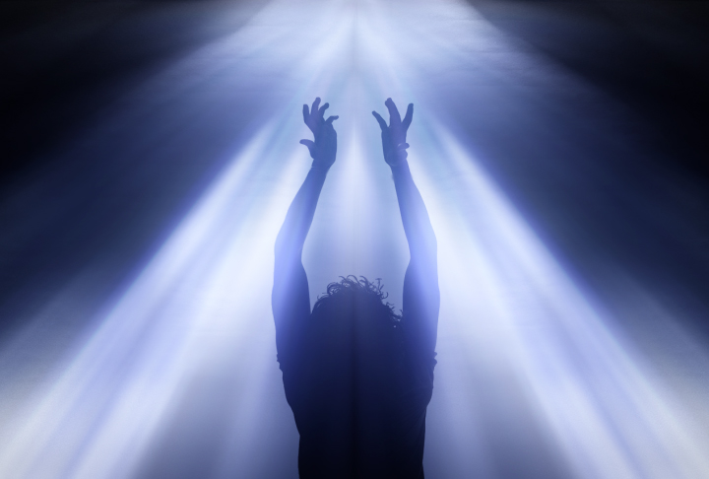
TONIGHT’S
SERMON
DOES GOD CARE?

