Slide 1
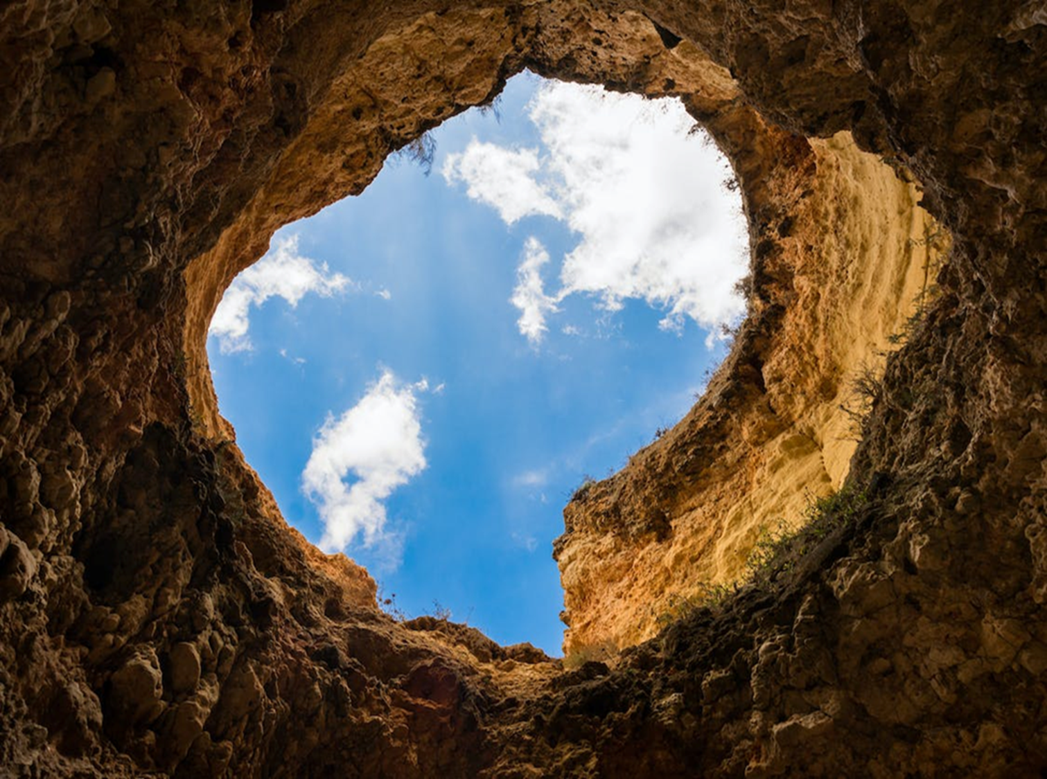
WELCOME TO THE
JACKSON STREET CHURCH OF CHRIST
PLEASE TURN OFF CELLPHONES

Slide 2


Slide 3
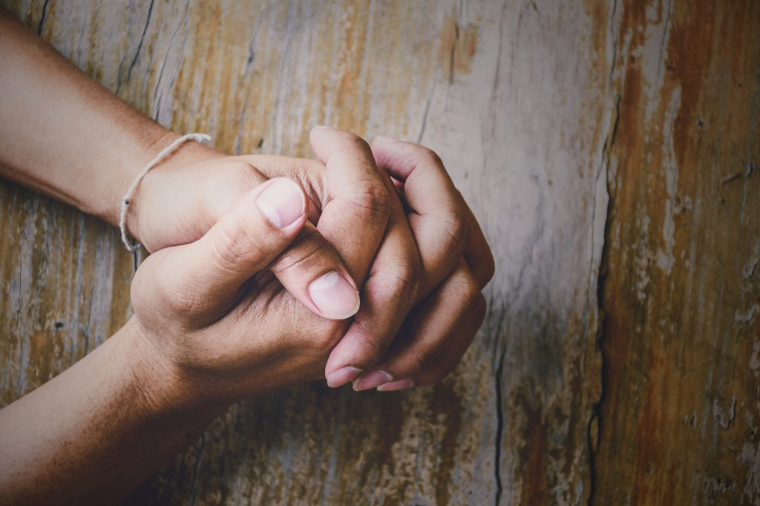
LET US PRAY

Slide 4

SINGING

Slide 5
Psa 40:1-4 I waited patiently for the LORD; And He inclined to me, And heard my cry. {2} He also brought me up out of a horrible pit, Out of the miry clay, And set my feet upon a rock, And established my steps. {3} He has put a new song in my mouth; Praise to our God; Many will see it and fear, And will trust in the LORD. {4} Blessed is that man who makes the LORD his trust* And does not respect the proud, nor such as turn aside to lies.

Slide 6
LET US PRAY

Slide 7

DOES GOD CARE

Slide 8
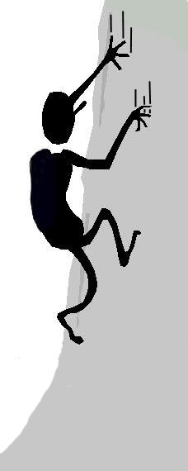
A man fell into a pit and couldn't get himself out
.

Slide 9


A Christian Scientist came along and said: "You only think that you are in a pit.”

Slide 10
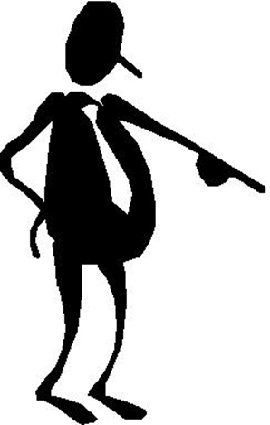
A Pharisee said: "Only bad people fall into a pit."

Slide 11
A Sadducee said: "Don't worry about it you'll be dead soon it will all be over.”

Slide 12
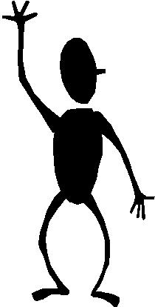
A Charismatic said: "Just confess that you're not in a pit".

Slide 13
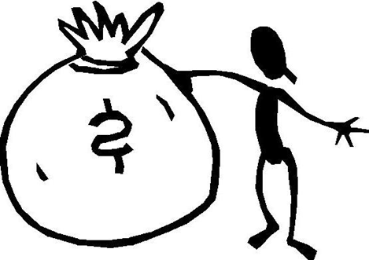
An IRS man asked if he was paying taxes on the pit.”

Slide 14

A Humanist said: "You can get yourself out of your pit."

Slide 15
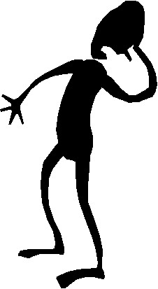
A Moralist said: "You deserve to be in a pit.”

Slide 16
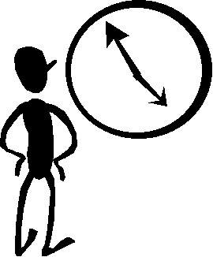
An evolutionist said: “If give it enough time and you’ll evolve out of the pit.”

Slide 17
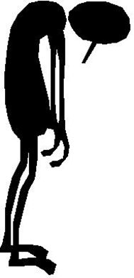
A pessimist said: “The hole is just going to get deeper and deeper.”

Slide 18

An optimist said: “Cheer up, being in that hole is not so bad.”

Slide 19
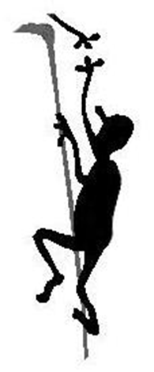
Jesus, seeing the man in the pit, reached down and pulled the man out of the pit.

Slide 20
WE WERE OR ARE ALL IN A PIT
Psa 40:1-4 I waited patiently for the LORD; And He inclined to me, And heard my cry. {2} He also brought me up out of a horrible pit, Out of the miry clay, And set my feet upon a rock, And established my steps. {3} He has put a new song in my mouth; Praise to our God; Many will see it and fear, And will trust in the LORD. {4} Blessed is that man who makes the LORD his trust* And does not respect the proud, nor such as turn aside to lies.

Slide 21
HE KNOWS OUR NAME
LITTLE GIRL PRAYED - OUR FATHER WHO IS IN HEAVEN, HOW DO YOU KNOW MY NAME. WE REMEMBER THE NAME OF THOSE IMPORTANT TO US.
John 10:3 "To him the doorkeeper opens, and the sheep hear his voice; and he calls his own sheep by name and leads them out.
John 10:14 "l am the good shepherd; and I know My sheep, and am known by My own.

Slide 22
HE NUMBERS
THE HAIRS OF OUR HEAD
Mat 10:30 "But the very hairs of your head are all numbered.
WE SEE AND APPRECIATE LITTLE THINGS IN THE ONES WE LOVE

Slide 23
HE NUMBERS
THE STEPS OF OUR FEET
Job 14:16-17 For now You number my steps, Do you not watch over my sin. My transgression is sealed up in a bag, And You cover my iniquity.
WE CARE ABOUT THE ACTIONS OF THOSE WE LOVE

Slide 24
HE BOTTLES THE
TEARS FROM OUR EYES
Psa 56:8 You number my wanderings; Put my tears into Your bottle; Are they not in Your book?
HE'LL WIPE EVERY TEAR FROM OUR EYES AND MAKE UP FOR ALL THOSE WE HAVE SHED. Rom 8:18 For I consider that the sufferings of this present time are not worthy to be compared with the glory which shall be revealed in us.
WE REMEMBER THE TIMES THOSE WE LOVE HURT.

Slide 25
HE HOLDS OUR
RIGHT HAND IN HIS
Isa 41 : 13 For l, the LORD your God, will hold your right hand, Saying to you, 'Fear not, I will help your'
TRUE FRIENDS HELP WHEN THERE IS A NEED - Prov 18:24 But there is a friend who sticks closer than a brother.

Slide 26
HE SUPPLIES ALL OUR NEEDS
Phil 4:19 And my God shall supply all your need according to His riches in glory by Christ Jesus.
Mat 6:33 "But seek first the kingdom of God and His righteousness, and all these things shall be added to you.
WE PROVIDE THE NEEDS OF THOSE WE CARE ABOUT. 1 Tim 5:8 But if anyone does not provide for his own, and especially for those of his household, he has denied the faith and is worse than an unbeliever.

Slide 27
HE PROVIDES A WAY OF ESCAPE FROM TEMPTATION
1 Cor 10:13 No temptation has overtaken you except such as is common to man; but God is faithful, who will not allow you to be tempted beyond what you are able, but with the temptation will also make the way of escape, that you may be able to bear it.
HE DOES ALLOW TEMPTATION SO WE CAN GROW AND DEVELOP CHARACTER. WE MUST DO THE SAME WITH OUR CHILDREN.

Slide 28
HE GAVE HIS SON FOR US
John 3:16 "For God so loved the world that He gave His only begotten Son, that whoever believes in Him should not perish but have everlasting life.
THE EVIDENCE OF HIS CARE - 1 John 3:16 By this we know love, because He laid down His life for us. And we also ought to lay down our lives for the brethren.
WE CAN REJECT HIS CARE - Heb 10:28-29 Anyone who has rejected Moses' law dies without mercy on the testimony of two or three witnesses. {29} Of how much worse punishment, do you suppose, will he be thought worthy who has trampled the Son of God underfoot, counted the blood of the covenant by which he was sanctified a common thing, and insulted the Spirit of grace?

Slide 29
HE GAVE HIS SON FOR US
WE MUST ACCEPT HIS CARE - John 1:10-14 He was in the world, and the world was made through Him, and the world did not know Him. {11} He came to His own, and His own did not receive Him. {12} But as many as received Him, to them He gave the right to become children of God, to those who believe in His name: {13} who were born, not of blood, nor of the will of the flesh, nor of the will of man, but of God. {14} And the Word became flesh and dwelt among us, and we beheld His glory, the glory as of the only begotten of the Father, full of grace and truth.

Slide 30
WE WERE IN A PIT AND GOD REACHED DOWN THROUGH HIS SON AND LIFTED US OUT OF THE PIT.
Have you accepted His love, and taken His hand?
Or, Have you rejected His love, and His hand?
What do you do when you see someone else in a pit?

Slide 31
SINGING

Slide 32
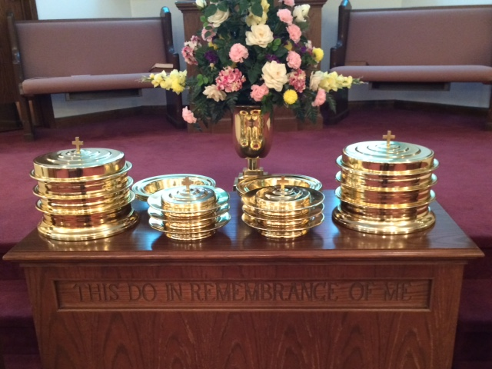
IN REMEMBRANCE OF JESUS

Slide 33
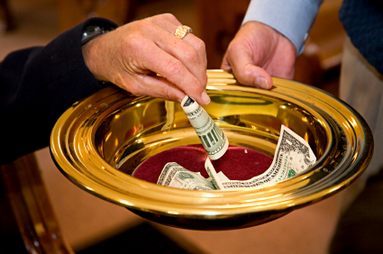
CONTRIBUTION

Slide 34
SINGING

Slide 35
HAVE A
CONFIDENT WEEK
HAVE A RELEASED WEEK

