Slide 1

WELCOME TO THE
JACKSON STREET CHURCH OF CHRIST
PLEASE TURN OFF CELLPHONES

Slide 2


Slide 3


Slide 4

SINGING

Slide 5

IN REMEMBRANCE OF JESUS

Slide 6

CONTRIBUTION

Slide 7



Slide 8
Philippians 4:8 Finally, brethren, whatever things are true, whatever things are noble, whatever things are just, whatever things are pure, whatever things are lovely, whatever things are of good report, if there is any virtue and if there is anything praiseworthy—meditate on these things.

Slide 10
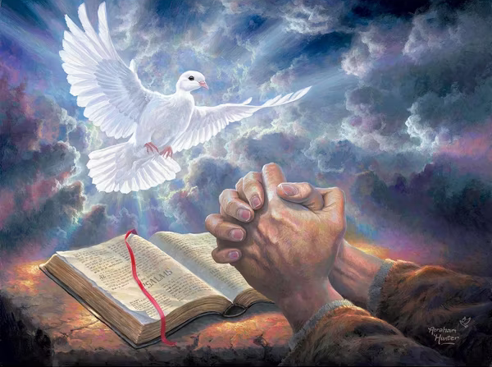
DEVELOPING A POSITIVE SPIRITUAL ATTITUDE

Slide 11
A POSITIVE SPIRITUAL ATTITUDE
W. CLEMENT STONE AND NAPOLEON HILL, SELF MOTIVATION EXPERTS, (PMA) POSITIVE MENTAL ATTITUDE.
WE WILL BE LOOKING AT DEVELOPING A PSA (POSITIVE SPIRITUAL ATTITUDE)
  WE ARE SPIRITUAL BEINGS AS WELL AS PHYSICAL - (2 Cor 4:16) Therefore we do not lose heart. Even though our outward man is perishing, yet the inward man is being renewed day by day.
  WE ARE IN A SPIRITUAL KINGDOM - (Col 1:11-13) strengthened with all might, according to His glorious power, for all patience and longsuffering with joy; {12} giving thanks to the Father who has qualified us to be partakers of the inheritance of the saints in the light. {13} He has delivered us from the power of darkness and conveyed us into the kingdom of the Son of His love,

Slide 12
A POSITIVE SPIRITUAL ATTITUDE
WE WILL BE LOOKING AT DEVELOPING A PSA (POSITIVE SPIRITUAL ATTITUDE)
  WE ARE IN A SPIRITUAL WARFARE - (Eph 6:10-13) Finally, my brethren, be strong in the Lord and in the power of His might. {11} Put on the whole armor of God, that you may be able to stand against the wiles of the devil. {12} For we do not wrestle against flesh and blood, but against principalities, against powers, against the rulers of the darkness of this age, against spiritual hosts of wickedness in the heavenly places. {13} Therefore take up the whole armor of God, that you may be able to withstand in the evil day, and having done all, to stand.
  OUR MISSION IS SPIRITUAL - (Mark 16:15-16) And He said to them, "Go into all the world and preach the gospel to every creature. {16} "He who believes and is baptized will be saved; but he who does not believe will be condemned.

Slide 13
DEVELOPING A POSITIVE
SPIRITUAL ATTITUDE
MAINTAIN A FIRM CONVICTION IN THE EXISTENCE OF GOD - (J0hn 17:3) "And this is eternal life, that they may know You, the only true God, and Jesus Christ whom You have sent.
BELIEVE IN THE POWER OF GOD - (1 John 4:4) You are of God, little children, and have overcome them, because He who is in you is greater than he who is in the world.
DEVELOP A WORKING FAITH – (James 2:18) But someone will say, “You have faith, and I have works.” Show me your faith without your works, and I will show you my faith by my works.
REMEMBER YOU HAVE GOD'S RESOURCES AVAILABLE - (Eph 3:20) Now to Him who is able to do exceedingly abundantly above all that we ask or think, according to the power that works in us,

Slide 14
DEVELOPING A POSITIVE
SPIRITUAL ATTITUDE
PRAY OFTEN - (1 Th 5:17) pray without ceasing,
BELIEVE IN YOURSELF (THRU CHRIST) - (Phil 4:13) I can do all things through Christ who strengthens me.
BELIEVE THAT ALL THINGS WORK TOGETHER FOR GOOD - (Rom 8.28) And we know that all things work together for good to those who love God, to those who are the called according to His purpose
UNDERSTAND THAT GOD EQUIPS US FOR EVERY GOOD WORK - (2 Tim 3:16-17) All Scripture is given by inspiration of God, and is profitable for doctrine, for reproof, for correction, for instruction in righteousness, {17} that the man of God may be complete, thoroughly equipped for every good work.

Slide 15
DEVELOPING A POSITIVE
SPIRITUAL ATTITUDE
REMEMBER YOUR LABOR IN THE LORD IS NOT IN VAIN - (1 Cor 15:58) Therefore, my beloved brethren, be steadfast, immovable, always abounding in the work of the Lord, knowing that your labor is not in vain in the Lord.
BE ASSURRED OF YOUR SALVATION - (1 John 5:13) These things I have written to you who believe in the name of the Son of God, that you may know that you have eternal life, and that you may continue to believe in the name of the Son of God.

Slide 16
THE RESULTS OF A POSITIVE SPIRITUAL ATTITUDE
  An atmosphere of success will be evident toward everything attempted.
  An optimistic attitude toward every phase of God's work will prevail.
  An enthusiasm that is catching will spread through the congregation.
  Encouragement of the weak and discouraged will be practiced.
  Courageous faith will move all programs forward. There will be a "we can do it" attitude.

Slide 17
II. THE RESULTS OF A POSITIVE SPIRITUAL ATTITUDE
  "Can't” will be removed from the leadership's vocabulary.
  Evangelism will be the thrust of every program.
  Growth, physical and spiritual, will occur.
  Long and short range plans will determine the next steps.
  Love and friendship will be shown one to another.
  Christ and his word will be honored and followed.
  The importance of each member will be realized. There will be work for everyone.

Slide 18
DO YOU HAVE A POSITIVE
SPIRITUAL ATTITUDE?
(Phil 2:1-8) Therefore if there is any consolation in Christ, if any comfort of love, if any fellowship of the Spirit, if any affection and mercy, {2} fulfill my joy by being likeminded, having the same love, being of one accord, of one mind. {3} Let nothing be done through selfish ambition or conceit, but in lowliness of mind let each esteem others better than himself. {4} Let each of you look out not only for his own interests, but also for the interests of others. {5} Let this mind be in you which was also in Christ Jesus, {6} who, being in the form of God, did not consider it robbery to be equal with God,

Slide 19
DO YOU HAVE A POSITIVE
SPIRITUAL ATTITUDE?
{7} but made Himself of no reputation, taking the form of a bondservant, and coming in the likeness of men. {8} And being found in appearance as a man, He humbled Himself and became obedient to the point of death, even the death of the cross.
Philippians 4:8 Finally, brethren, whatever things are true, whatever things are noble, whatever things are just, whatever things are pure, whatever things are lovely, whatever things are of good report, if there is any virtue and if there is anything praiseworthy—meditate on these things.

Slide 21

PRAYER

Slide 22


TONIGHT’S SERMON:
GETTING ALONG WITH OTHERS

