Slide 1

WELCOME TO THE
JACKSON STREET CHURCH OF CHRIST
PLEASE TURN OFF CELLPHONES

Slide 2


Slide 3


Slide 4

SINGING

Slide 5
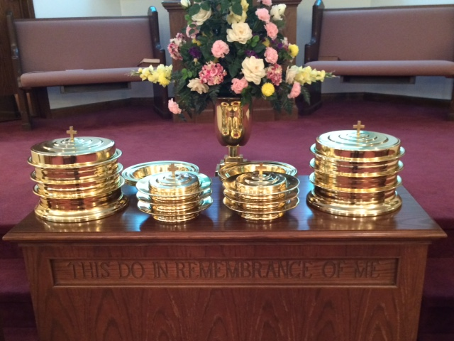
IN REMEMBRANCE OF JESUS

Slide 6
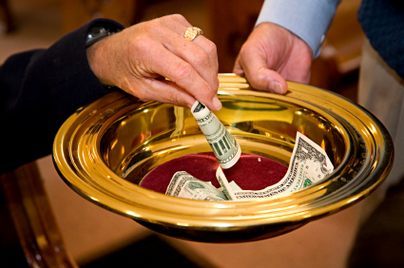
CONTRIBUTION

Slide 7
SINGING

Slide 8
Genesis 3:6–19 So when the woman saw that the tree was good for food, that it was pleasant to the eyes, and a tree desirable to make one wise, she took of its fruit and ate. She also gave to her husband with her, and he ate. ⁷ Then the eyes of both of them were opened, and they knew that they were naked; and they sewed fig leaves together and made themselves coverings. ⁸ And they heard the sound of the Lord God walking in the garden in the cool of the day, and Adam and his wife hid themselves from the presence of the Lord God among the trees of the garden. ⁹ Then the Lord God called to Adam and said to him, “Where are you?” ¹⁰ So he said, “I heard Your voice in the garden, and I was afraid because I was naked; and I hid myself.” ¹¹ And He said, “Who told you that you were naked? Have you eaten from the tree of which I commanded you that you should not eat?” ¹² Then the man said, “The woman whom You gave to be with me, she gave me of the tree, and I ate.” ¹³ And the Lord God said to the woman, “What is this you have done?” The woman said, “The serpent deceived me, and I ate.”

Slide 10
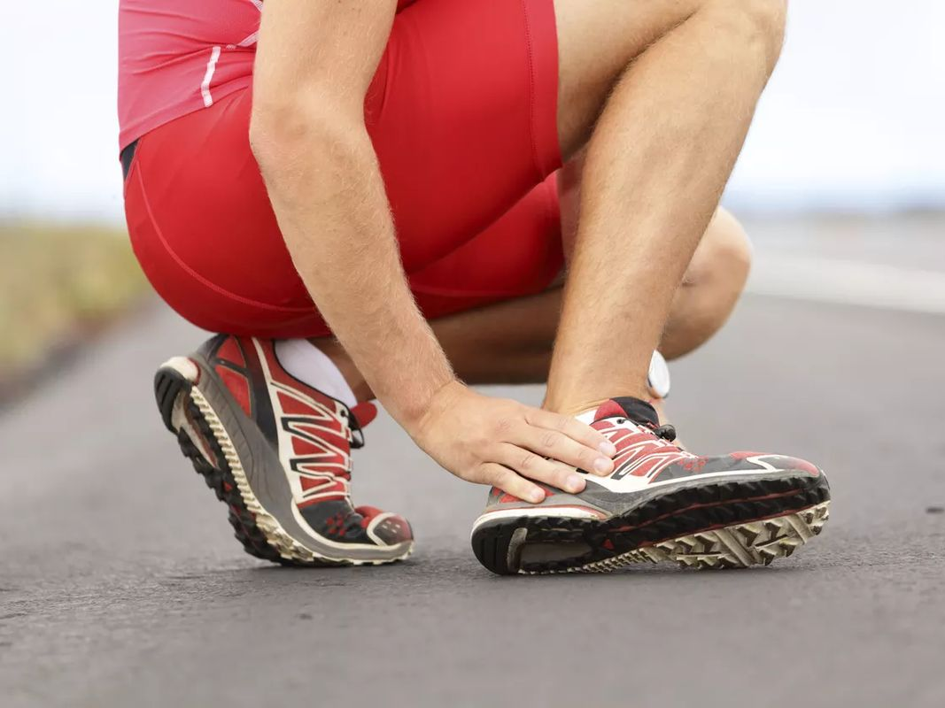
LOSER'S LIMP

Slide 11
LOSER’S LIMP
I seriously doubt that you or I will be able to stand before the Lord on judgment day and say, "But my wife made me do it," or "I did what I did because of my repressive childhood." We won't be able to blame the church, the school, the society, the government, or anyone else.
“It’s not my fault” began with Adam and Eve. Genesis 3:11–13 And He said, “Who told you that you were naked? Have you eaten from the tree of which I commanded you that you should not eat?” ¹² Then the man said, “The woman whom You gave to be with me, she gave me of the tree, and I ate.” ¹³ And the LORD God said to the woman, “What is this you have done?” The woman said, “The serpent deceived me, and I ate.”

Slide 12
LOSER’S LIMP
Pete Hamill wrote an excellent article in the October, 1991 issue of READER'S DIGEST, which he called, "It's Not My Fault!" In it he referred to what he called "victimism" in America, the idea that wrong behavior is not one's own responsibility, but is rather the fault of someone else. Listen as I read a portion taken from Hamill's article.
Many people today live their lives under the never-questioned assumption that if they have problems, there must be someone else who is to blame. When questioned about some otherwise unacceptable behavior, it is always the fault of the justice system or the school system or the government, or their family or their parents or their spouse. Always, it is someone else who is to blame. Surely it isn't them!

Slide 13
LOSER’S LIMP
Such "victimism" Hamill writes, "implies that nobody is personally responsible for the living of a life. The defeats, disappointments and failures once thought to be a part of each human being's portion on this earth are now always the fault of somebody else."
I dropped out of high school and can't get a job. It's not my fault. I'll go on welfare or start stealing cars. I started taking drugs as a teenager and now I can't remember things. It's not my fault. I deserve special medical treatment. I got married on a whim and now I can't stand this person I'm with. It's not my fault! I'll get a divorce.
In a ghetto, a woman points to a hole in the wall of her apartment put there by her boyfriend in a fit of anger. "Why doesn't the landlord fix that!" Why doesn't she fix it herself?

Slide 14
LOSER’S LIMP
Shifting the blame to anyone but me. It's as old as the Garden of Eden. After Adam and Eve ate from the tree, God said in effect, "What is going on here?" Adam said, "The woman made me do it. It wasn't my fault. Eve said, "The Serpent made me do it! It wasn't my fault." Blame shifting. Refusing to take responsibility.
Zig Ziglar calls what I'm talking about "Loser's Limp." In his book, SEE YOU AT THE TOP. Football player chasing the runner toward the end zone – pulls up – losers limp.
Many start to believe their own excuses.
I want to point out three areas of life where blame-shifting "victims" lose.

Slide 15
I. They Lose In Their Society.
Rapist can't stop – too much libido.
Killers can’t get rid of the rage driving them.
Kleptomaniacs can’t stop stealing.
Smokers sue tobacco companies
School shootings – blame society, police, parents, teachers, social workers
Society rejects those who blame others for their mistakes.
Those who shun personal responsibility lose in their society.

Slide 16
II. They Also Lose in their
Personal Relationships.
A 60's folk song by Anna Russell, as quoted by Jay Adams in COMPETENT TO COUNSEL, characterizes what it is often like to go to a counselor.
I went to my psychiatrist to be psychoanalyzed
To find out why I killed the cat and blackened my husband's eyes.
He laid me on a downy couch to see what he could find,
And here is what he dredged up from my subconscious mind:
When I was one, my mommy hid my dolly in a trunk,
And so it follows naturally that I am always drunk.
When I was two, I saw my father kiss the maid one day,
And that is why I suffer now from kleptomania.
At three, I had the feeling of ambivalence toward my brothers,
And so it follows naturally I poison all my lovers.
But I am happy; now I've learned the lesson this has taught;
That everything I do that's wrong is someone else's fault.

Slide 17
II. They Also Lose in their
Personal Relationships.
Proverbs 20:4 The lazy man will not plow because of winter; He will beg during harvest and have nothing.
Proverbs 26:13–16 The lazy man says, “There is a lion in the road! A fierce lion is in the streets!” 14 As a door turns on its hinges, So does the lazy man on his bed. 15 The lazy man buries his hand in the bowl; It wearies him to bring it back to his mouth. 16 The lazy man is wiser in his own eyes Than seven men who can answer sensibly.
Alcoholics, Child abuse, homosexuals, thieves, murderers, fornication, divorce
When we blame those around us for our failures, it destroys those relationships.
The first step in change is accepting responsibility for your actions or, to put it another way, admitting you have a problem you need to deal with.
Shifting blame makes us losers in our society. It also makes us losers in our personal lives.

Slide 18
III. Those Who Shift Blame
Lose with God.
Salvation demands repentance – admit I am a sinner
Can not blame others on judgment day – Parents, spouse, preacher, society, government, schools, neighborhood
1 Corinthians 6:9–11 Do you not know that the unrighteous will not inherit the kingdom of God? Do not be deceived. Neither fornicators, nor idolaters, nor adulterers, nor homosexuals, nor sodomites, ¹⁰ nor thieves, nor covetous, nor drunkards, nor revilers, nor extortioners will inherit the kingdom of God. ¹¹ And such were some of you. But you were washed, but you were sanctified, but you were justified in the name of the Lord Jesus and by the Spirit of our God.

Slide 19
III. Those Who Shift Blame
Lose with God.
There is a way of escape - 1 Corinthians 10:13 No temptation has overtaken you except such as is common to man; but God is faithful, who will not allow you to be tempted beyond what you are able, but with the temptation will also make the way of escape, that you may be able to bear it.
We will stand before God in judgment - 2 Corinthians 5:9–10 Therefore we make it our aim, whether present or absent, to be well pleasing to Him. 10 For we must all appear before the judgment seat of Christ, that each one may receive the things done in the body, according to what he has done, whether good or bad.

Slide 20
III. Those Who Shift Blame
Lose with God.
Grace? Yes. On the basis of confession and repentance. - 1 Corinthians 15:9–10 For I am the least of the apostles, who am not worthy to be called an apostle, because I persecuted the church of God. 10 But by the grace of God I am what I am, and His grace toward me was not in vain; but I labored more abundantly than they all, yet not I, but the grace of God which was with me.
Remain faithful - Revelation 2:10 Do not fear any of those things which you are about to suffer. Indeed, the devil is about to throw some of you into prison, that you may be tested, and you will have tribulation ten days. Be faithful until death, and I will give you the crown of life.

Slide 21
WHAT ABOUT YOU?
Do you have the loser’s limp?
Are you a blame shifter?
An excuse maker?
What are your reasons for not accepting responsibility for your actions?
When are you going to stop it and accept responsibility?
Things can never get better until you do...

Slide 22
SINGING

Slide 23

TONIGHT’S SERMON
COPING WITH CARE

