Slide 1

WELCOME TO THE
JACKSON STREET CHURCH OF CHRIST
PLEASE TURN OFF CELLPHONES

Slide 2


Slide 3

LET US PRAY

Slide 4

SINGING

Slide 5
Luke 10:30–35 Then Jesus answered and said: “A certain man went down from Jerusalem to Jericho, and fell among thieves, who stripped him of his clothing, wounded him, and departed, leaving him half dead. ³¹ Now by chance a certain priest came down that road. And when he saw him, he passed by on the other side. ³² Likewise a Levite, when he arrived at the place, came and looked, and passed by on the other side. ³³ But a certain Samaritan, as he journeyed, came where he was. And when he saw him, he had compassion. ³⁴ So he went to him and bandaged his wounds, pouring on oil and wine; and he set him on his own animal, brought him to an inn, and took care of him. ³⁵ On the next day, when he departed, he took out two denarii, gave them to the innkeeper, and said to him, ‘Take care of him; and whatever more you spend, when I come again, I will repay you.’

Slide 6
LET US PRAY

Slide 7

COPING WITH CARE

Slide 8
COPING WITH CARE
Do you care?
Which is correct? “I Couldn’t care less.” or “I could care less.”
As Christians, neither would be correct for us to say.
We should always care about the things God cares about.

Slide 9
SOME ARE CARELESS - COULDN'T CARE LESS
John 10:12-13 "But a hireling, he who is not the shepherd, one who does not own the sheep, sees the wolf coming and leaves the sheep and flees; and the wolf catches the sheep and scatters them. {13} "The hireling flees because he is a hireling and does not care about the sheep.
John 12:4-6 Then one of His disciples, Judas Iscariot, Simon's son, who would betray Him, said, {5} "Why was this fragrant oil not sold for three hundred denarii and given to the poor?" {6} This he said, not that he cared for the poor, but because he was a thief, and had the money box; and he used to take what was put in it.

Slide 10
SOME ARE CARELESS - COULDN'T CARE LESS
Luke 10:30-32 Then Jesus answered and said: "A certain man went down from Jerusalem to Jericho, and fell among thieves, who stripped him of his clothing, wounded him, and departed, leaving him half dead. {31} "Now by chance a certain priest came down that road. And when he saw him, he passed by on the other side. {32} "Likewise a Levite, when he arrived at the place, came and looked, and passed by on the other side

Slide 11
II. SOME ARE CAREFUL –
FULL OF CARE
Luke 8:11-15 "Now the parable is this: The seed is the word of God. {12} "Those by the wayside are the ones who hear; then the devil comes and takes away the word out of their hearts, lest they should believe and be saved. {13} "But the ones on the rock are those who, when they hear, receive the word with joy; and these have no root, who believe for a while and in time of temptation fall away. {14} "Now the ones that fell among Thorns are those who, when they have heard, go out and are choked with cares, riches, and pleasures of life, and bring no fruit to maturity. {15} "But the ones that fell on the good ground are those who, having heard the word with a noble and good heart, keep it and bear fruit with patience.

Slide 12
II. SOME ARE CAREFUL –
FULL OF CARE
Luke 21:34-36 "But take heed to yourselves, lest your hearts be weighed down with carousing, drunkenness, and cares of this life and that Day come on you unexpectedly. {35} "For it will come as a snare on all those who dwell on the face of the whole earth, {36} "Watch therefore, and pray always that you may be counted worthy to escape all these things that will come to pass, and to stand before the Son of Man."

Slide 13
II. SOME ARE CAREFUL –
FULL OF CARE
Luke 10:38-42 Now it happened as they went that He entered a certain village; and a certain woman named Martha welcomed Him into her house. {39} And she had a sister called Mary, who also sat at Jesus' feet and heard His word. {40} But Martha was distracted with much serving, and she approached Him and said, "Lord, do You not care that my sister has left me to serve alone? Therefore tell her to help me." {41} And Jesus answered and said to her, "Martha, Martha, you are worried and troubled about many things. {42} "But one thing is needed, and Mary has chosen that good part, which will not be taken away from her.

Slide 14
III. SOME ARE CAREFREE –
FREE FROM CARE
1 Pet 5:7 cast all your care upon Him, for He cares for you.
Mat 6:31-34 "Therefore do not worry saying, 'What shall we eat?' or 'What shall we drink?' or 'What shall we wear?' {32} 'For after all these things the Gentiles seek. For your heavenly Father knows that you need all these things. {33} "But seek first the kingdom of God and His righteousness, and all these things shall be added to you. {34} "Therefore do worry about tomorrow, for tomorrow will worry about its own things. Sufficient for the day is its own trouble.
Phil 4:6 Be anxious for nothing, but in everything by prayer and supplication, with thanksgiving, let your requests be made known to God;

Slide 15
III. SOME ARE CAREFREE –
FREE FROM CARE
1 Cor 7:32 But I want you to be without care. He who is unmarried cares for the things of the Lord; how he may please the Lord.
Psa 23 The LORD is my shepherd; I shall not want. {2} He makes me to lie down in green pastures; He leads me beside the still waters. {3} He restores my soul; He leads me in the paths of righteousness For His name's sake. {4} Yea, though I walk through the valley of the shadow of death, I will fear no evil; For You are with me; Your rod and Your staff, they comfort me. {5} You prepare a table before me in the presence of my enemies; You anoint my head with oil; My cup runs over. {6} Surely goodness and mercy shall follow me All the days of my life; And I will dwell in the house of the LORD Forever.

Slide 16
IV. SOME CARE –
ARE CONCERNED ABOUT OTHERS
2 Cor 11:23-28 Are they ministers of Christ? I speak as a fool; I am more: in labors more abundant, in stripes above measure, in prisons more frequently, in deaths often. {24} From the Jews five times I received forty stripes minus one. {25} Three times I was beaten with rods; once I was stoned; three times I was shipwrecked; a night and a day I have been in the deep; {26} in journeys often, in perils of waters, in perils of robbers, in perils of my own countrymen, in perils of the Gentiles, in perils in the city, in perils in the wilderness, in perils in the sea, in perils among false brethren; >>>

Slide 17
IV. SOME CARE –
ARE CONCERNED ABOUT OTHERS
{27} in weariness and toil, in sleeplessness often, in hunger and thirst, in fastings often, in cold and nakedness; {28} besides the other things, what comes upon me daily: my deep concern for all the churches.
Phil 4:10 But I rejoiced in the Lord greatly that now at last your care for me has flourished again; though you surely did care, but you lacked opportunity.
1 Cor 12:25 that there should be no schism in the body, but that the members should have the same care for one another.

Slide 18
HOW ARE YOU
COPING WITH CARE?
Are you careless? Carelessness leads to consequences you won’t like.
Are you careful? Are you full of care about the wrong things?
Are you carefree? Have you turned all you cares and concerns over to God?
Do you care? Are you concerned about others and their needs?

Slide 19
SINGING

Slide 20
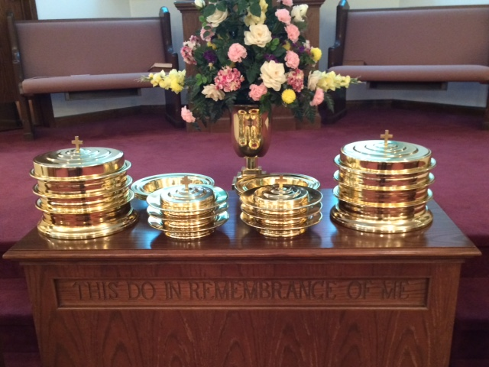
IN REMEMBRANCE OF JESUS

Slide 21
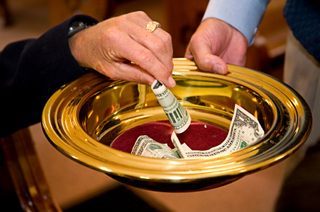
CONTRIBUTION

Slide 22
SINGING

Slide 23

HAVE A CARING WEEK

