Slide 1
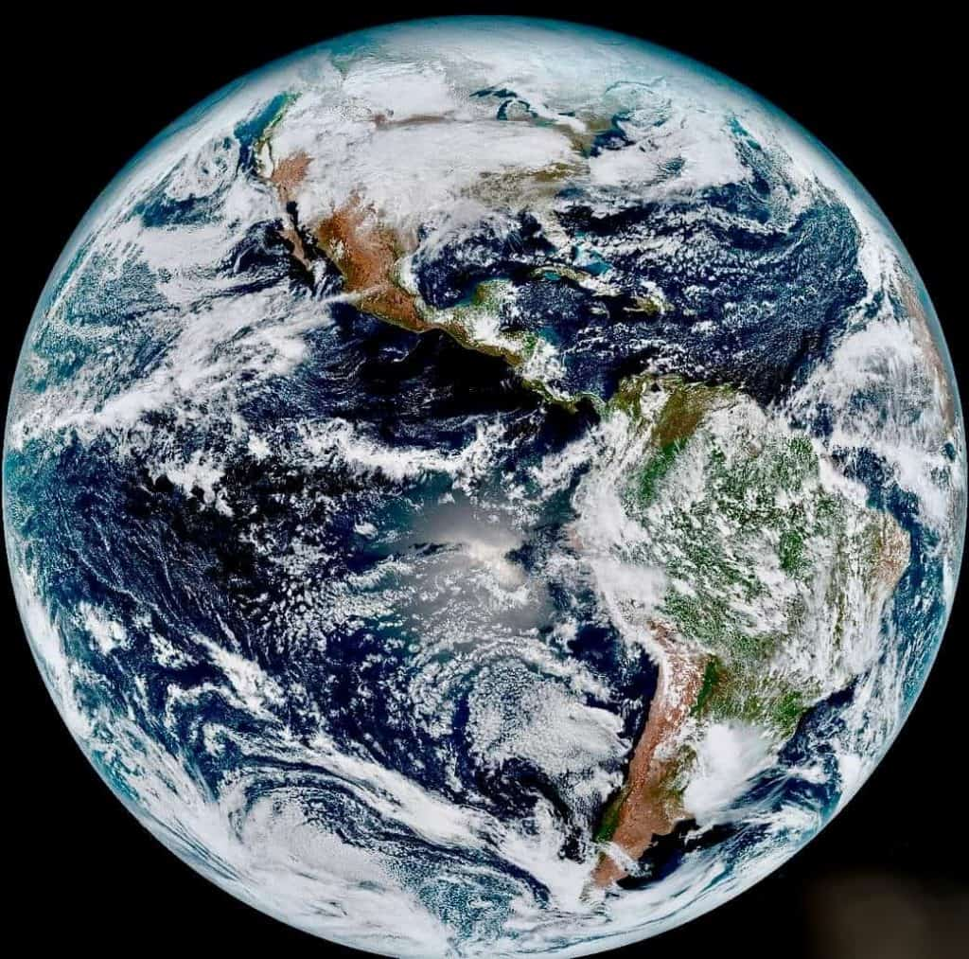
WELCOME TO THE
JACKSON STREET CHURCH OF CHRIST
PLEASE TURN OFF CELLPHONES

Slide 2


Slide 3


Slide 4

SINGING

Slide 5

IN REMEMBRANCE OF JESUS

Slide 6

CONTRIBUTION

Slide 7



Slide 8
(John 17:11-23) "Now I am no longer in the world, but these are in the world, and I come to You. Holy Father, keep through Your name those whom You have given Me, that they may be one as We are. {12} "While I was with them in the world, I kept them in Your name. Those whom You gave Me I have kept; and none of them is lost except the son of perdition, that the Scripture might be fulfilled. {13} "But now I come to You, and these things I speak in the world, that they may have My joy fulfilled in themselves. {14} "I have given them Your word; and the world has hated them because they are not of the world, just as I am not of the world. {15} "l do not pray that You should take them out of the world, but that You should keep them from the evil one. >>>

Slide 9
{16} "They are not of the world, just as I am not of the world. {17} "Sanctify them by Your truth. Your word is truth. {18} "As You sent Me into the world, I also have sent them into the world. {19} "And for their sakes I sanctify Myself, that they also may be sanctified by the truth. {20} "l do not pray for these alone, but also for those who will believe in Me through their word; {21} "that they all may be one, as You, Father, are in Me, and I in You; that they also may be one in Us, that the world may believe that You sent Me. {22} "And the glory which You gave Me t have given them, that they may be one just as We are one: {23} "l in them, and You in Me; that they may be made perfect in one, and that the world may know that You have sent Me, and have loved them as You have loved Me.

Slide 11
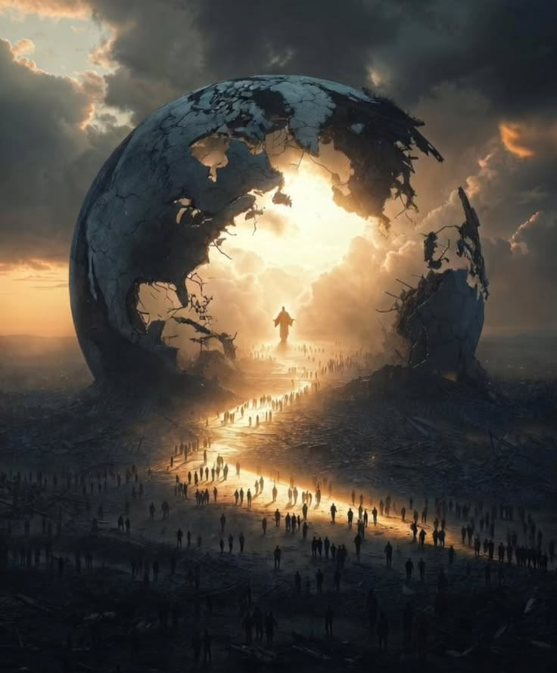
THE CHRISTIANS PLACE IN THE WORLD

Slide 12
OUR PLACE IN THE WORLD
We are in the world
We are not to be of the world
We have responsibilities in and to the world

Slide 13
l. SENT INTO THE WORLD
(John 17:18) 'As You sent Me into the world, I also have sent them into the world.
(John 20:21) So Jesus said to them again, "Peace to you! As the Father has sent Me, I also send you.

Slide 14
ll. PREACHING TO THE WORLD
(Mark 16:15-16) And He said to them, "Go into all the world and preach the gospel to every creature. {16} "He who believes and is baptized will be saved; but he who does not believe will be condemned.
(Acts 8:1) Now Saul was consenting to his death. At that time a great persecution arose against the church which was at Jerusalem; and they were all scattered throughout the regions of Judea and Samaria, except the apostles.
(Acts 8:4) Therefore those who were scattered went everywhere preaching the word.

Slide 15
III. THE LIGHT OF THE WORLD
(Mat 5:14) "You are the light of the world. A city that is set on a hill cannot be hidden.
(Phil 2:14-15) Do all things without complaining and disputing, {15} that you may become blameless and harmless, children of God without fault in the midst of a crooked and perverse generation, among whom you shine as lights in the world,

Slide 16
IV. NOT CONFORMED TO THE WORLD
(John 17:15) "I do not pray that You should take them out of the world, but that You should keep them from the evil one.
(Rom 12:1-2) I beseech you therefore, brethren, by the mercies of God, that you present your bodies a living sacrifice, holy, acceptable to God, which is your reasonable service. {2} And do not be conformed to this world, but be transformed by the renewing of your mind, that you may prove what is that good and acceptable and perfect will of God.

Slide 17
V. PASSING THROUGH THE WORLD
(1 Pet 2:11) Beloved, I beg you as sojourners and pilgrims, abstain from fleshly lusts which war against the soul,
(Philippians 3:20) For our citizenship is in heaven, from which we also eagerly wait for the Savior, the Lord Jesus Christ,

Slide 18
VI. LOVE NOT THE WORLD
(2 Tim 4:10) for Demas has forsaken me, having loved this present world, and has departed for Thessalonica; Crescens for Galatia, Titus for Dalmatia.
(1 John 2:15-17) Do not love the world or the things in the world. If anyone loves the world, the love of the Father is not in him. {16} For all that is in the world; the lust of the flesh, the lust of the eyes, and the pride of life; is not of the Father but is of the world. {17} And the world is passing away, and the lust of it; but he who does the will of God abides forever.

Slide 19
VII. NO FRIENDSHIP WITH THE WORLD
(James 1:27) Pure and undefiled religion before God and the Father is this: to visit orphans and widows in their trouble, and to keep oneself unspotted from the world.
(James 4:4) Adulterers and adulteresses! Do you not know that friendship with the world is enmity with God? Whoever therefore wants to be a friend of the world makes himself an enemy of God.

Slide 20
VIII. LIVE GODLY IN THE WORLD
(Titus 2:11-12) For the grace of God that brings salvation has appeared to all men, {12} teaching us that, denying ungodliness and worldly lusts, we should live soberly, righteously, and godly in the present world,
(Romans 12:1-2) I beseech you therefore, brethren, by the mercies of God, that you present your bodies a living sacrifice, holy, acceptable to God, which is your reasonable service. {2} And do not be conformed to this world, but be transformed by the renewing of your mind, that you may prove what is that good and acceptable and perfect will of God.

Slide 21
YOUR PLACE IN THE WORLD?
What place do you have in the world?
Are you fulfilling your God-given responsibilities in your relationship to the world?
  Sent into the world
  Preaching to the world
  The light of the world
  Not conformed to the world
  Passing through the world
  Love not the world
  No friendship with the world
  Living godly in the world

Slide 23

PRAYER

Slide 24
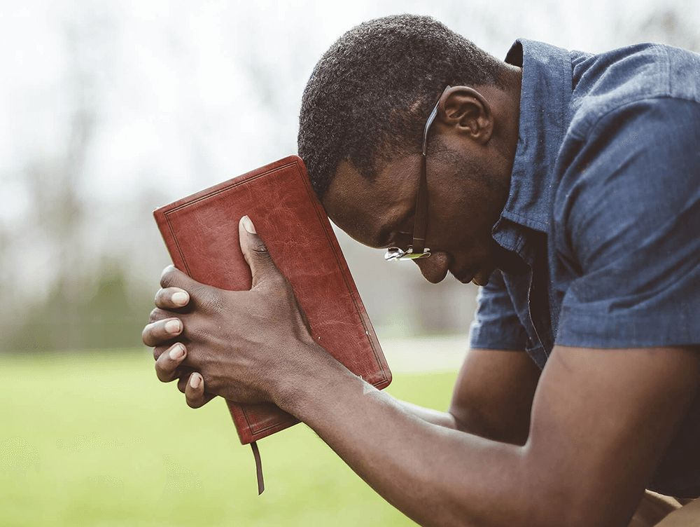
TONIGHT’S SERMON:
A CHRISTIAN IS…

