Slide 1
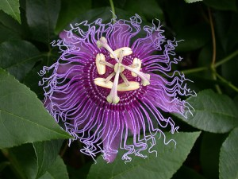
WELCOME TO THE
JACKSON STREET CHURCH OF CHRIST
PLEASE TURN OFF CELLPHONES

Slide 2


Slide 3
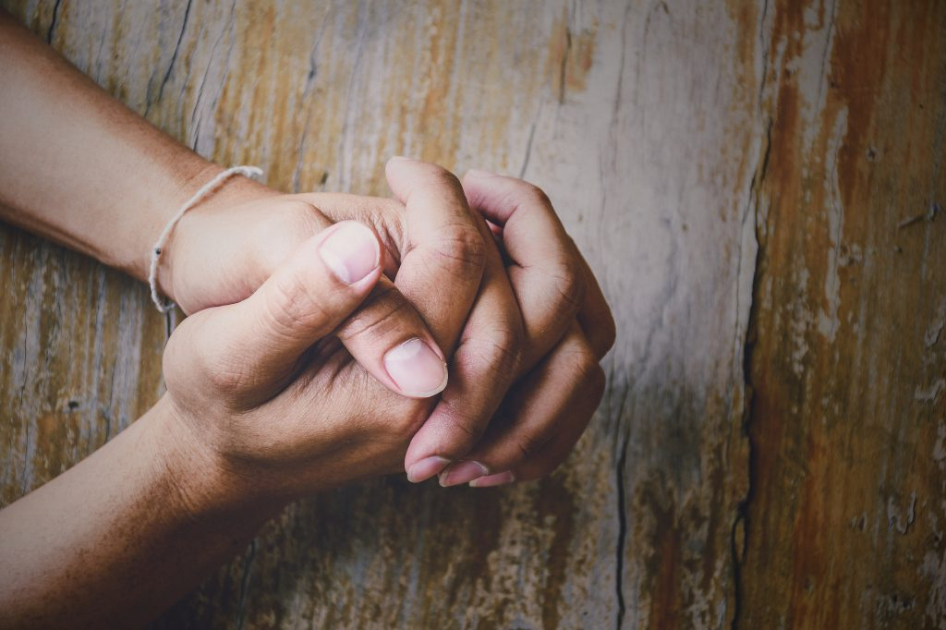
LET US PRAY

Slide 4

SINGING

Slide 5
1 Peter 4:15–19 But let none of you suffer as a murderer, a thief, an evildoer, or as a busybody in other people’s matters. ¹⁶ Yet if anyone suffers as a Christian, let him not be ashamed, but let him glorify God in this matter. ¹⁷ For the time has come for judgment to begin at the house of God; and if it begins with us first, what will be the end of those who do not obey the gospel of God? ¹⁸ Now “If the righteous one is scarcely saved, Where will the ungodly and the sinner appear?” ¹⁹ Therefore let those who suffer according to the will of God commit their souls to Him in doing good, as to a faithful Creator.

Slide 6
LET US PRAY

Slide 7
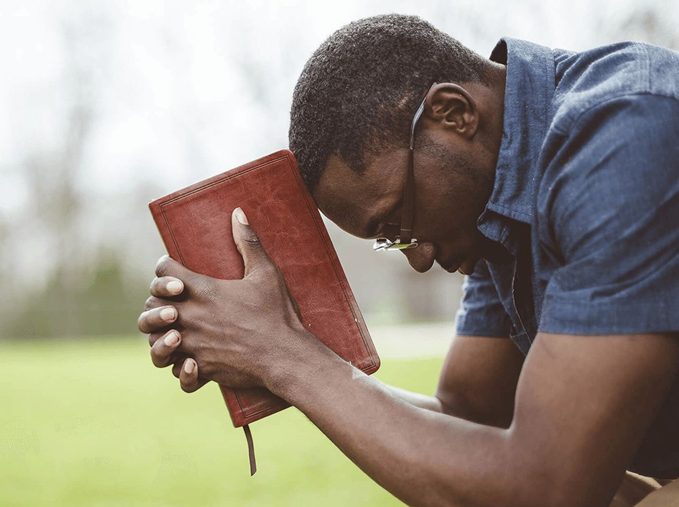
A CHRISTIAN IS... 1 (l PETER)

Slide 8
A CHRISTIAN IS…
The New Testament is the guidebook for children of God.
It is our covenant with God, outlining the way we need to live our lives in a way that pleases God, and also giving us direction to have the best life here on earth.
The book of First Peter gives us a number of characteristics and definitions of the Christian.

Slide 9
GOD'S CHOSEN CHILD
(1 Pet 1:1-2) Peter, an apostle of Jesus Christ, To the pilgrims of the Dispersion in Pontus, Galatia, Cappadocia, Asia, and Bithynia, {2} chosen according to the foreknowledge of God the Father, in sanctification of the Spirit, for obedience and sprinkling of the blood of Jesus Christ: Grace to you and peace be multiplied.

Slide 10
2. GOD’S HEIR
(1 Peter 1:3–5) Blessed be the God and Father of our Lord Jesus Christ, who according to His abundant mercy has begotten us again to a living hope through the resurrection of Jesus Christ from the dead, {4} to an inheritance incorruptible and undefiled and that does not fade away, reserved in heaven for you, {5} who are kept by the power of God through faith for salvation ready to be revealed in the last time.

Slide 11
3. GOD'S OBEDIENT CHILD
(1 Pet 1:13-14) Therefore gird up the loins of your mind, be sober, and rest your hope fully upon the grace that is to be brought to you at the revelation of Jesus Christ; {14} as obedient children, not conforming yourselves to the former lusts, as in your ignorance;

Slide 12
4. HOLY
(1 Pet 1:15-16) but as He who called you is holy, you also be holy in all your conduct, {16} because it is written, "Be holy, for I am holy."

Slide 13
5. REDEEMED
(1 Peter 1:17–19) And if you call on the Father, who without partiality judges according to each one’s work, conduct yourselves throughout the time of your stay here in fear; {18} knowing that you were not redeemed with corruptible things, like silver or gold, from your aimless conduct received by tradition from your fathers, {19} but with the precious blood of Christ, as of a lamb without blemish and without spot.

Slide 14
6. BORN AGAIN
(1 Peter 1:22–2:3) Since you have purified your souls in obeying the truth through the Spirit in sincere love of the brethren, love one another fervently with a pure heart, {23} having been born again, not of corruptible seed but incorruptible, through the word of God which lives and abides forever, {24} because “All flesh is as grass, And all the glory of man as the flower of the grass. The grass withers, And its flower falls away, {25} But the word of the LORD endures forever.” Now this is the word which by the gospel was preached to you. {2:1} Therefore, laying aside all malice, all deceit, hypocrisy, envy, and all evil speaking, {2} as newborn babes, desire the pure milk of the word, that you may grow thereby, {3} if indeed you have tasted that the Lord is gracious.

Slide 15
7. GOD-PRAISING
(1 Pet 2:9) But you are a chosen generation, a royal priesthood, a holy nation, His own special people, that you may proclaim the praises of Him who called you out of darkness into His marvelous light; {10} who once were not a people but are now the people of God, who had not obtained mercy but now have obtained mercy.

Slide 16
8. SPIRITUAL
(1 Pet 2:11) Beloved, I beg you as sojourners and pilgrims, abstain from fleshly lusts which war against the soul,

Slide 17
9. HONORABLE
(1 Pet 2:12) having your conduct honorable among the Gentiles, that when they speak against you as evildoers, they may, by your good works which they observe, glorify God in the day of visitation.

Slide 18
WHAT ABOUT YOU?
ARE YOU …
  God's Chosen Child
  God’s Heir
  God's Obedient Child
  Holy
  Redeemed
  Born Again
  God Praising
  Spiritual
  Honorable
1 Peter 5:10–11 But may the God of all grace, who called us to His eternal glory by Christ Jesus, after you have suffered a while, perfect, establish, strengthen, and settle you. {11} To Him be the glory and the dominion forever and ever. Amen.

Slide 19
SINGING

Slide 20

IN REMEMBRANCE OF JESUS

Slide 21

CONTRIBUTION

Slide 22
SINGING

Slide 23

HAVE A CHRIST-LIKE WEEK

