Slide 1

WELCOME TO THE
JACKSON STREET CHURCH OF CHRIST
PLEASE TURN OFF CELLPHONES

Slide 2


Slide 3


Slide 4

SINGING

Slide 5
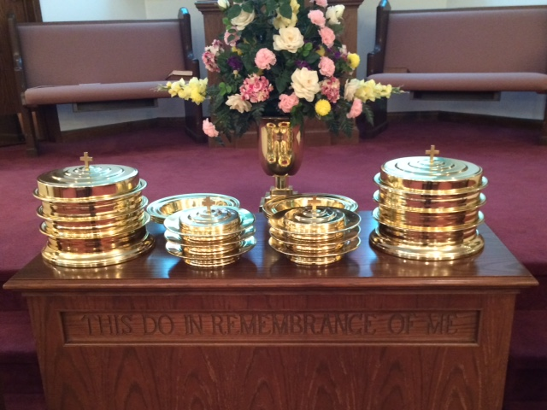
IN REMEMBRANCE OF JESUS

Slide 6
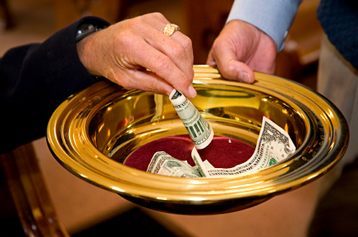
CONTRIBUTION

Slide 7
SINGING

Slide 8
2 Corinthians 11:1–3 Oh, that you would bear with me in a little folly—and indeed you do bear with me. ² For I am jealous for you with godly jealousy. For I have betrothed you to one husband, that I may present you as a chaste virgin to Christ. ³ But I fear, lest somehow, as the serpent deceived Eve by his craftiness, so your minds may be corrupted from the simplicity that is in Christ.

Slide 10
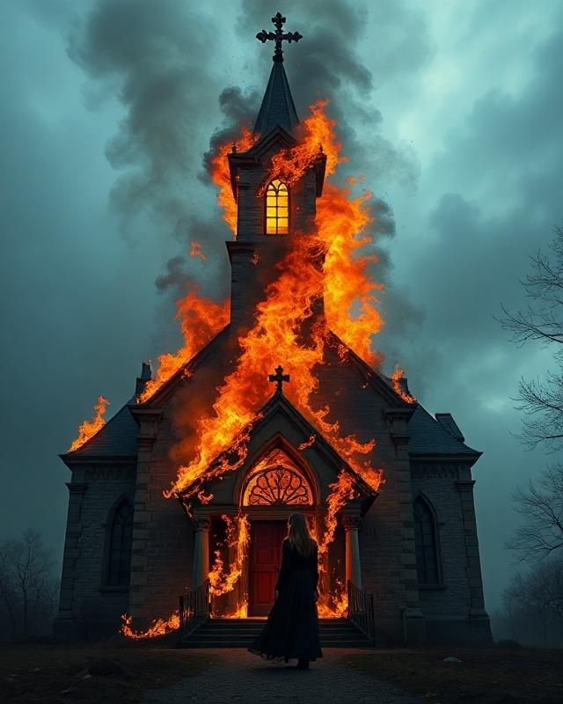
DANGERS THE CHURCH FACES - 1

Slide 11
PAUL’S CONCERN FOR THE CHURCHES
2 Corinthians 11:28 besides the other things, what comes upon me daily: my deep concern for all the churches.
2 Corinthians 12:20 For I fear lest, when I come, I shall not find you such as I wish, and that I shall be found by you such as you do not wish; lest there be contentions, jealousies, outbursts of wrath, selfish ambitions, backbitings, whisperings, conceits, tumults;
2 Corinthians 11:1–3 Oh, that you would bear with me in a little folly—and indeed you do bear with me. ² For I am jealous for you with godly jealousy. For I have betrothed you to one husband, that I may present you as a chaste virgin to Christ. ³ But I fear, lest somehow, as the serpent deceived Eve by his craftiness, so your minds may be corrupted from the simplicity that is in Christ.

Slide 12
IGNORANCE OF GOD'S WORD
Hosea 4:6 My people are destroyed for lack of knowledge. Because you have rejected knowledge, I also will reject you from being priest for Me; Because you have forgotten the law of your God, I also will forget your children.
John 6:45 "It is written in the prophets, 'And they shall all be taught by God.' Therefore everyone who has heard and learned from the Father comes to Me.

Slide 13
IGNORANCE OF GOD'S WORD
Hosea 4:6 My people are destroyed for lack of knowledge. Because you have rejected knowledge, I also will reject you from being priest for Me; Because you have forgotten the law of your God, I also will forget your children.
John 6:45 "It is written in the prophets, 'And they shall all be taught by God.' Therefore everyone who has heard and learned from the Father comes to Me.
Col 1:9 For this reason we also, since the day we heard it, do not cease to pray for you, and to ask that you may be filled with the knowledge of His will in all wisdom and spiritual understanding.
2 Tim 2:15 Be diligent to present yourself approved to God, a worker who does not need to be ashamed, rightly dividing the word of truth.

Slide 14
ll. WORLDLINESS
2 Tim 4:10 for Demas has forsaken me, having loved this present world, and has departed for Thessalonica; Crescens for Galatia, Titus for Dalmatia.
Gal 5:19-21 Now the works of the flesh are evident, which are: adultery, fornication, uncleanness, lewdness, ²⁰ idolatry, sorcery, hatred, contentions, jealousies, outbursts of wrath, selfish ambitions, dissensions, heresies, ²¹ envy, murders, drunkenness, revelries, and the like; of which I tell you beforehand, just as I also told you in time past, that those who practice such things will not inherit the kingdom of God.

Slide 15
ll. WORLDLINESS
James 1:27 Pure and undefiled religion before God and the Father is this: to visit orphans and widows in their trouble, and to keep oneself unspotted from the world.
1 John 2:15-17 Do not love the world or the things in the world. If anyone loves the world, the love of the Father is not in him. ¹⁶ For all that is in the world; the lust of the flesh, the lust of the eyes, and the pride of life; is not of the Father but is of the world. ¹⁷ And the world is passing away, and the lust of it; but he who does the will of God abides forever.

Slide 16
Ill. MATERIALISM
Luke 8:14 "Now the ones that fell among thorns are those who, when they have heard, go out and are choked with cares, riches, and pleasures of life, and bring no fruit to maturity.
1 Tim 6:6-10 Now godliness with contentment is great gain. ⁷ For we brought nothing into this world, and it is certain we can carry nothing out. ⁸ And having food and clothing, with these we shall be content. ⁹ But those who desire to be rich fall into temptation and a snare, and into many foolish and harmful lusts which drown men in destruction and perdition. ¹⁰ For the love of money is a root of all kinds of evil, for which some have strayed from the faith in their greediness, and pierced themselves through with many sorrows.

Slide 17
Ill. MATERIALISM
2 Cor 4:18 while we do not look at the things which are seen, but at the things which are not seen. For the things which are seen are temporary, but the things which are not seen are eternal.
Col 3:1-3 If then you were raised with Christ, seek those things which are above, where Christ is, sitting at the right hand of God. ² Set your mind on things above, not on things on the earth. ³ For you died, and your life is hidden with Christ in God.

Slide 18
LUKEWARMNESS IN OUR RELATIONSHIP WITH GOD
  Rev 3:14-18 "And to the angel of the church of the Laodiceans write, 'These things says the Amen, the Faithful and True Witness, the Beginning of the creation of God: ¹⁵ 'Il know your works, that you are neither cold nor hot. I could wish you were cold or hot. ¹⁶ "So then, because you are lukewarm, and neither cold nor hot, I will vomit you out of My mouth. ¹⁷ 'Because you say, am rich, have become wealthy, and have need of nothing'; and do not know that you are wretched, miserable, poor, blind, and naked; ¹⁸ "l counsel you to buy from Me gold refined in the fire, that you may be rich; and white garments, that you may be clothed, that the shame of your nakedness may not be revealed; and anoint your eyes with eye salve, that you may see.

Slide 19
LUKEWARMNESS IN OUR RELATIONSHIP WITH GOD
  Eccl 9:10 Whatever your hand finds to do, do it with your might; for there is no work or device or knowledge or wisdom in the grave where you are going.
  Luke 6:46 "But why do you call Me 'Lord, Lord,' and do not do the things which I say?
  Mat 7:21 "Not everyone who says to Me, 'Lord, Lord,' shall enter the kingdom of heaven, but he who does the will of My Father in heaven.

Slide 20
INDIFFERENCE TO
THOSE AROUND US
  Phil 2:4 Let each of you look out not only for his own interests, but also for the interests of others.
  Rom 15:1 We then who are strong ought to bear with the scruples of the weak, and not to please ourselves.
  1 John 4:7 Beloved, let us love one another, for love is of God; and everyone who loves is born of God and knows God.
  Gal 5:13 For you, brethren, have been called to liberty; only do not use liberty as an opportunity for the flesh, but through love serve one another.

Slide 21
UNCONCERN FOR THE LOST
  2 Pet 3:9 The Lord is not slack concerning His promise, as some count slackness, but is longsuffering toward us, not willing that any should perish but that all should come to repentance.
  Luke 19:10 "for the Son of Man has come to seek and to save that which was lost."
  2 Cor 5:11, 15 Knowing, therefore, the terror of the Lord, we persuade men; but we are well known to God, and I also trust are well known in your consciences... ¹⁵ and He died for all, that those who live should live no longer for themselves, but for Him who died for them and rose again.
  2 Tim 2:2 And the things that you have heard from me among many witnesses, commit these to faithful men who will be able to teach others also.

Slide 22
VII. FAILURE TO TRAIN OUR CHILDREN CORRECTLY
  Deu 6:4-9 "Hear, O Israel: The LORD our God, the LORD is one! ⁵ 'You shall love the LORD your God with all your heart, with all your soul, and with all your strength. ⁶ "And these words which I command you today shall be in your heart. ⁷ "You shall teach them diligently to your children, and shall talk of them when you sit in your house, when you walk by the way, when you lie down, and when you rise up. ⁸ "You shall bind them as a sign on your hand, and they shall be as frontlets between your eyes. ⁹ "You shall write them on the doorposts of your house and on your gates.

Slide 23
VII. FAILURE TO TRAIN OUR CHILDREN CORRECTLY
  Prov 22:6 Train up a child in the way he should go, And when he is old he will not depart from it.
  Eph 6:4 And you, fathers, do not provoke your children to wrath, but bring them up in the training and admonition of the Lord.
  Heb 12:11 Now no chastening seems to be joyful for the present, but painful; nevertheless, afterward it yields the peaceable fruit of righteousness to those who have been trained by it.

Slide 24
MARRIAGE FAILURE
  God uses "marriage" to describe his relationship with Israel, Christ’s relationship with the church, and the husband / wife relationship.
  GOD & ISRAEL - Isa 54:5-6 For your Maker is your husband, The LORD of hosts is His name; And your Redeemer is the Holy One of Israel; He is called the God of the whole earth. ⁶ For the LORD has called you Like a woman forsaken and grieved in spirit, Like a youthful wife when you were refused," Says your God.

Slide 25
MARRIAGE FAILURE
  CHRIST & THE CHURCH - Rev 19:6-9 And I heard, as it were, the voice of a great multitude, as the sound of many waters and as the sound of mighty thunderings, saying, "Alleluia! For the Lord God Omnipotent reigns! ⁷ "Let us be glad and rejoice and give Him glory, for the marriage of the Lamb has come, and His wife has made herself ready." ⁸ And to her it was granted to be arrayed in fine linen, clean and bright, for the fine linen is the righteous acts of the saints. ⁹ Then he said to me, "Write: 'Blessed are those who are called to the marriage supper of the Lamb!' " And he said to me, "These are the true sayings of God."

Slide 26
MARRIAGE FAILURE
  HUSBAND AND WIFE
    Malachi 2:15–16 But did He not make them one, Having a remnant of the Spirit? And why one? He seeks godly offspring. “Therefore take heed to your spirit, And let none deal treacherously with the wife of his youth. ¹⁶ “For the LORD God of Israel says That He hates divorce, For it covers one’s garment with violence,” Says the LORD of hosts. Therefore take heed to your spirit, That you do not deal treacherously.”

Slide 27
MARRIAGE FAILURE
  HUSBAND AND WIFE
    Matthew 19:3–6 The Pharisees also came to Him, testing Him, and saying to Him, “Is it lawful for a man to divorce his wife for just any reason?” ⁴ And He answered and said to them, “Have you not read that He who made them at the beginning ‘made them male and female,’ ⁵ and said, ‘For this reason a man shall leave his father and mother and be joined to his wife, and the two shall become one flesh’? ⁶ So then, they are no longer two but one flesh. Therefore what God has joined together, let not man separate.”

Slide 28
WHAT ARE YOU DOING TO GUARD AGAINST THESE DANGERS WHICH THE CHURCH IS FACING:
IGNORANCE,
WORLDLINESS,
MATERIALISM,
LUKEWARMNESS,
INDIFFERENCE,
UNCONCERN FOR LOST,
TRAINING OUR CHILDREN,
MARRIAGE FAILURE

Slide 29
SINGING

Slide 30

TONIGHT’S SERMON
DAILY ACTIVITIES OF EARLY CHRISTIANS

