Slide 1

WELCOME TO THE
JACKSON STREET CHURCH OF CHRIST
PLEASE TURN OFF CELLPHONES

Slide 2


Slide 3

LET US PRAY

Slide 4

SINGING

Slide 5
Luke 9:23-27 Then He said to them all, "If anyone desires to come after Me, let him deny himself, and take up his cross daily, and follow Me. {24} "For whoever desires to save his life will lose it, but whoever loses his life for My sake will save it. {25} "For what profit is it to a man if he gains the whole world, and is himself destroyed or lost? {26} "For whoever is ashamed of Me and My words, of him the Son of Man will be ashamed when He comes n His own glory, and in His Father's, and of the holy angels. {27} "But tell you truly, there are some standing here who shall not taste death till they see the kingdom of God."

Slide 6
LET US PRAY

Slide 7
DAILY
ACTIVITIES
OF EARLY
CHRISTIANS

Slide 8
DAILY ACTIVITIES
In our attempt to restore New Testament Christianity today, we need to consider what they did on a daily basis.
Their daily activities show their commitment to Christ and His church and doing the will of God in their lives.

Slide 9
l. DAILY BIBLE STUDY

Slide 10
Acts 242 And they continued steadfastly in the apostles' doctrine and fellowship, in the breaking of bread, and in prayers.
Acts 17:11 These were more fair-minded than those in Thessalonica, in that they received the word with all readiness, and searched the Scriptures daily to find out whether these things were so.
2 Tim 2:15 Be diligent to present yourself approved to God, a worker who does not need to be ashamed, rightly dividing the word of truth.

Slide 11
ll. DAILY PRAYER
Phil 4:6 Be anxious for nothing, but in everything by prayer and supplication, with thanksgiving, let your requests be made known to God;
1 Th 5:17 Pray without ceasing.
James 5:16-18 Confess your trespasses to one another and pray for one another, that you may be healed. The effective, fervent prayer of a righteous man avails much. {17} Elijah was a man with a nature like ours, and he prayed earnestly that it would not rain; and it did not rain on the land for three years and six months. {18} And he prayed again, and the heaven gave rain, and the earth produced its fruit

Slide 12
Ill. DAILY CROSS BEARING
Mat 10:38 "And he who does not take his cross and follow after Me is not worthy of
Luke 9:23-27 Then He said to them all, "If anyone desires to come after Me, let him deny himself, and take up his cross daily, and follow Me. {24} "For whoever desires to save his life will lose it, but whoever loses his life for My sake will save it. {25} "For what profit is it to a man if he gains the whole world, and is himself destroyed or lost? {26} "For whoever is ashamed of Me and My words, of him the Son of Man will be ashamed when He comes n His own glory, and in His Father's, and of the holy angels. {27} "But tell you truly, there are some standing here who shall not taste death till they see the kingdom of God."

Slide 13
Ill. DAILY CROSS BEARING
Mark 10:17-22 Now as He was going out on the road, one came running, knelt before Him, and asked Him, "Good Teacher, what shall I do that I may inherit eternal life?" {18} So Jesus said to him, "Why do you call Me good? No one is good but One, that is, God. {19} 'You know the commandments: 'Do not commit adultery,' 'Do not murder,' 'Do not steal, 'Do not bear false witness,' 'Do not defraud,' 'Honor your father and your mother."' {20} And he answered and said to Him, "Teacher, all these things I have kept from my youth," {21} Then Jesus, looking at him, loved him, and said to him, "One thing you lack: Go your way, sell whatever you have and give to the poor, and you will have treasure in heaven; and come, take the cross, and follow Me." {22} But he was sad at this word, and went away sorrowful, for he had great possessions.

Slide 14
DAILY EVANGELISM
  Mat 26:55 In that hour Jesus said to the multitudes, "Have you come out, as against a robber, with swords and clubs to take Me? I sat daily with you, teaching in the temple, and you did not seize Me.
  Acts 5:42 And daily in the temple, and in every house, they did not cease teaching and preaching Jesus as the Christ.
  Acts 8:4 Therefore those who were scattered went everywhere preaching the word.

Slide 15
DAILY EVANGELISM
  Acts 16:5 So the churches were strengthened in the faith, and increased in number daily.
  Acts 17:16–17 Now while Paul waited for them at Athens, his spirit was provoked within him when he saw that the city was given over to idols. ¹⁷ Therefore he reasoned in the synagogue with the Jews and with the Gentile worshipers, and in the marketplace daily with those who happened to be there.
  Acts 20:31 "Therefore watch, and remember that for three years I did not cease to warn everyone night and day with tears.

Slide 16
V. DAILY SERVING
  Mat 26: 11 "For you have the poor with you always, but Me you do not have always.
  Acts 6:1-7 Now in those days, when the number of the disciples was multiplying, there arose a complaint against the Hebrews by the Hellenists, because their widows were neglected in the daily distribution. {2} Then the twelve summoned the multitude of the disciples and said, "It is not desirable that we should leave the word of God and serve tables. {3} "Therefore, brethren, seek out from among you seven men of good reputation, full of the Holy Spirit and wisdom, whom we may appoint over this business; >>>

Slide 17
V. DAILY SERVING
  {4} "but we will give ourselves continually to prayer and to the ministry of the word." {5} And the saying pleased the whole multitude. And they chose Stephen: a man full of faith and the Holy Spirit, and Philip, Prochorus, Nicanor, Timon, Parmenas, and Nicolas, a proselyte from Antioch, {6} whom they set before the apostles; and when they had prayed, they laid hands on them. {7} Then the word of God spread, and the number of the disciples multiplied greatly in Jerusalem, and a great many of the priests were obedient to the faith.

Slide 18
V. DAILY SERVING
  Gal 6:10 Therefore, as we have opportunity, let us do good to all, especially to those who are of the household of faith.
  James 2:14–17 What does it profit, my brethren, if someone says he has faith but does not have works? Can faith save him? ¹⁵ If a brother or sister is naked and destitute of daily food, ¹⁶ and one of you says to them, “Depart in peace, be warmed and filled,” but you do not give them the things which are needed for the body, what does it profit? ¹⁷ Thus also faith by itself, if it does not have works, is dead.

Slide 19
VI. DAILY EXHORTATION
  Heb 3:13 but exhort one another daily, while it is called Today," lest any of you be hardened through the deceitfulness of sin.
  Heb 10:25 not forsaking the assembling of ourselves together, as is the manner of some, but exhorting one another, and so much the more as you see the Day approaching.
  1 Th 2:11-12 as you know how we exhorted, and comforted, and charged every one of you, as a father does his own children, {12} that you would walk worthy of God who calls you into His own kingdom and glory.

Slide 20
VII. DAILY CONVERSIONS
  Acts 2:47 praising God and having favor with all the people. And the Lord added to the church daily those who were being saved.
  Acts 16:5 So the churches were strengthened in the faith, and increased in number daily.

Slide 21
YOUR DAILY ACTIVITIES
  Are you trying to imitate the activities of those in the first century church?
  Just imagine what we could accomplish for God’s Kingdom if we imitated the daily activities of the early Christians.

Slide 22
SINGING

Slide 23
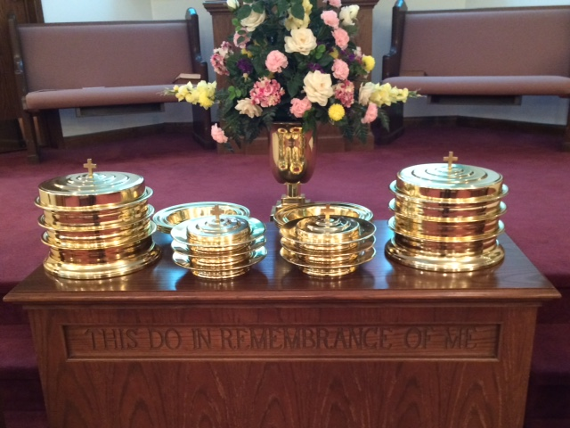
IN REMEMBRANCE OF JESUS

Slide 24
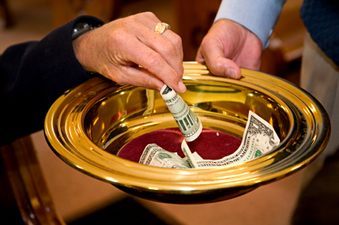
CONTRIBUTION

Slide 25
SINGING

Slide 26

HAVE AN ACTIVE WEEK

