Slide 1

WELCOME TO THE
JACKSON STREET CHURCH OF CHRIST
PLEASE TURN OFF CELLPHONES

Slide 2


Slide 3


Slide 4

SINGING

Slide 5

IN REMEMBRANCE OF JESUS

Slide 6

CONTRIBUTION

Slide 7



Slide 8
Philippians 3:17–4:1 Brethren, join in following my example, and note those who so walk, as you have us for a pattern. ¹⁸ For many walk, of whom I have told you often, and now tell you even weeping, that they are the enemies of the cross of Christ: ¹⁹ whose end is destruction, whose god is their belly, and whose glory is in their shame—who set their mind on earthly things. ²⁰ For our citizenship is in heaven, from which we also eagerly wait for the Savior, the Lord Jesus Christ, ²¹ who will transform our lowly body that it may be conformed to His glorious body, according to the working by which He is able even to subdue all things to Himself. ^{4:1} Therefore, my beloved and longed-for brethren, my joy and crown, so stand fast in the Lord, beloved.

Slide 10
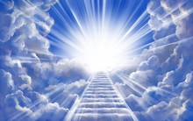
THE
HEAVENWARD
BOUND

Slide 11
PAUL’S RESOLVES & GOALS
SACRIFICIAL - Phil 3:8-16 Yet indeed I also count all things loss for the excellence of the knowledge of Christ Jesus my Lord, for whom I have suffered the loss of all things, and count them as rubbish, that I may gain Christ
RIGHTEOUSNESS FROM GOD - {9} and be found in Him, not having my own righteousness, which is from the law, but that which is through faith in Christ, the righteousness which is from God by faith;
SUFFERING - {10} that I may know Him and the power of His resurrection, and the fellowship of His sufferings, being conformed to His death, {11} if, by any means, I may attain to the resurrection from the dead.

Slide 12
PAUL’S RESOLVES & GOALS
PRESSING ON - {12} Not that I have already attained, or am already perfected; but I press on, that I may lay hold of that for which Christ Jesus has also laid hold of me. {13} Brethren, I do not count myself to have apprehended;
FORGETTING THE PAST, FOCUSING ON HEAVEN - but one thing I do, forgetting those things which are behind and reaching forward to those things which are ahead, {14} I press toward the goal for the prize of the upward call of God in Christ Jesus.
UNITED IN GOALS - {15) Therefore let us, as many as are mature, have this mind; and if in anything you think otherwise, God will reveal even this to you. {16} Nevertheless, to the degree that we have already attained, let us walk by the same rule, let us be of the same mind.

Slide 13
CHARACTERISTICS OF THE HEAVENWARD BOUND

Slide 14
ENCOURAGES OTHERS
TO DO RIGHT
JOIN IN - Philippians 3:17 Brethren, join in following my example, and note those who so walk, as you have us for a pattern.
STIR UP - Heb 10:24 And let us consider one another in order to stir up love and good works,

Slide 15
II. SETS AN EXAMPLE WORTH FOLLOWING
FOLLOW MY EXAMPLE - Phil 3:17 Brethren, join in following my example, and note those who so walk, as you have us for a pattern.
FOLLOW US - 2 Th 3:7-9 For you yourselves know how you ought to follow us, for we were not disorderly among you; {8} nor did we eat anyone's bread free of charge, but worked with labor and toil night and day, that we might not be a burden to any of you, {9} not because we do not have authority, but to make ourselves an example of how you should follow us.

Slide 16
OBSERVES OTHER CHRISTIANS AND LEARNS FROM THEM
NOTE THE PATTERN Phil 3:17 Brethren, join in following my example, and note those who so walk, as you have us for a pattern.
LEARN FROM ANTS - Prov 6: 6 Go to the ant, you sluggard! Consider her ways and be wise,

Slide 17
IV. WEEPS OVER SIN
AND THE LOST
ENEMIES OF THE CROSS - Phil 3:18 For many walk, of whom I have told you often, and now tell you even weeping, that they are the enemies of the cross of Christ:
JESUS WEPT OVER JERUSALEM
  Luke 19:41 Now as He drew near, He saw the city (Jerusalem) and wept over it,
  Mat 23:37 "O Jerusalem, Jerusalem, the one who kills the prophets and stones those who are sent to her! How often I wanted to gather your children together, as a hen gathers her chicks under her wings, but you were not willing!

Slide 18
V. GLORIES IN THE CROSS RATHER THAN BEING ENEMIES OF IT
ENEMIES OF THE CROSS - Phil 3:18 For many walk, of whom I have told you often, and now tell you even weeping, that they are the enemies of the cross of Christ:
BOAST IN THE CROSS - Gal 6:14 But God forbid that I should boast except in the cross of our Lord Jesus Christ, by whom the world has been crucified to me, and I to the world.

Slide 19
VI. WORSHIPS THE TRUE GOD RATHER THAN THEIR APPETITES
MIND EARTHLY THINGS - Phil 3:19 whose end is destruction, whose god is their appetite and whose glory is in their shame; who set their mind on earthly things.
DO NOT LOVE THE WORLD - 1 John 2:15–17 Do not love the world or the things in the world. If anyone loves the world, the love of the Father is not in him. ¹⁶ For all that is in the world—the lust of the flesh, the lust of the eyes, and the pride of life—is not of the Father but is of the world. ¹⁷ And the world is passing away, and the lust of it; but he who does the will of God abides forever.

Slide 20
VII. GLORIES IN GODLINESS RATHER THAN SHAMEFUL THINGS
PLEASE SELF - Phil 3:19 whose end is destruction, whose god is their appetite and whose glory is in their shame; who set their mind on earthly things.
PLEASING GOD - 1 John 3:22 And whatever we ask we receive from Him, because we keep His commandments and do those things that are pleasing in His sight.
FULLY PLEASING THE LORD - Colossians 1:10 that you may walk worthy of the Lord, fully pleasing Him, being fruitful in every good work and increasing in the knowledge of God;

Slide 21
VIII. SETS MIND ON HEAVENLY THINGS RATHER THAN EARTHLY
MIND EARTHLY THINGS - Phil 3:19 whose end is destruction, whose god is their appetite and whose glory is in their shame; who set their mind on earthly things.
WHAT IS SEEN IS TEMPORARY - 2 Cor 4:18 while we do not look at the things which are seen, but at the things which are not seen. For the things which are seen are temporary, but the things which are not seen are eternal .
SET MIND ON THINGS ABOVE - Colossians 3:1–4 If then you were raised with Christ, seek those things which are above, where Christ is, sitting at the right hand of God. ² Set your mind on things above, not on things on the earth. ³ For you died, and your life is hidden with Christ in God. 4 When Christ who is our life appears, then you also will appear with Him in glory.

Slide 22
IX. KNOWS WHERE HOME IS
CITIZENS OF HEAVEN - Phil 3:20 For our citizenship is in heaven, from which we also eagerly wait for the Savior, the Lord Jesus Christ,
JESUS IS PREPARING A PLACE FOR US - John 14:1–4 “Let not your heart be troubled; you believe in God, believe also in Me. ² In My Father’s house are many mansions; if it were not so, I would have told you. I go to prepare a place for you. ³ And if I go and prepare a place for you, I will come again and receive you to Myself; that where I am, there you may be also. ⁴ And where I go you know, and the way you know.”

Slide 23
IX. KNOWS WHERE HOME IS
GOD PREPARED A CITY FOR US - Heb 11:13-16 These al l died in faith, not having received the promises, but having seen them afar off were assured of them, embraced < them> and confessed that they were strangers and pilgrims on the earth. {14} For those who say such things declare plainly that they seek a homeland. {15} And truly if they had called to mind that country from which they had come out, they would have had opportunity to return. {16} But now they desire a better, that is, a heavenly country Therefore God is not ashamed to be called their God, for He has prepared a city for them.

Slide 24
X. ANTICIPATES
THE RETURN OF CHRIST
EAGERLY WAIT - Phil 3:20 For our citizenship is in heaven, from which we also eagerly wait for the Savior, the Lord Jesus Christ,
EAGERLY WAITING - 1 Cor 1:7 so that you come short in no gift, eagerly waiting for the revelation of our Lord Jesus Christ,

Slide 25
XI. ACCEPTS JESUS AS LORD
THE LORD - Phil 3:20 For our citizenship is in heaven, from which we also eagerly wait for the Savior, the Lord Jesus Christ,
CONTROLS OUR LIFE - Luke 6:46 "But why do you call Me 'Lord, Lord, and do not do the things which I say?

Slide 26
XII. LOOKS FORWARD TO RELEASE FROM THE PHYSICAL
TRANSFORMED BODY - Phil 3:21 who will transform our lowly body that it may be conformed to His glorious body, according to the working by which He is able even to subdue all things to Himself,
RAISED INCORRUPTIBLE - 1 Corinthians 15:51–52 Behold, I tell you a mystery: We shall not all sleep, but we shall all be changed—⁵² in a moment, in the twinkling of an eye, at the last trumpet. For the trumpet will sound, and the dead will be raised incorruptible, and we shall be changed.

Slide 27
XII. LOOKS FORWARD TO RELEASE FROM THE PHYSICAL
RAISED A SPIRITUAL BODY - I Cor 15:42 So also is the resurrection of the dead. The body is sown in corruption, it is raised in incorruption. {43} It is sown in dishonor, it is raised in glory. It is sown in weakness, it is raised in power. {44} It is sown a natural body, it is raised a spiritual body. There is a natural body, and there is a spiritual body.

Slide 28
XIII. STANDS FAST IN THE LORD
STAND FAST - Phil 4:1 Therefore, my beloved and longed—for brethren, my joy and crown, so stand fast in the Lord, beloveds
STEDFAST, IMMOVABLE - 1 Cor 15:58 Therefore, my beloved brethren, be steadfast, immovable, always abounding in the work of the Lord, knowing that your labor is not in vain in the Lord.

Slide 29
DO YOU…
Encourage others to do right?
Set an example worth following?
Observe other Christians and learns from them?
Weep over sin and the lost?
Glory in the cross rather than being an enemy of it?
Worship the true God rather than your appetites?
Glory in godliness rather than shameful things?
Set mind on heavenly things rather than earthly?
Know where your home is?
Anticipate the return of Christ?
Accept Jesús as your Lord?
Look forward to release from the physical?
Stand fast in the Lord?

Slide 31

PRAYER

Slide 32
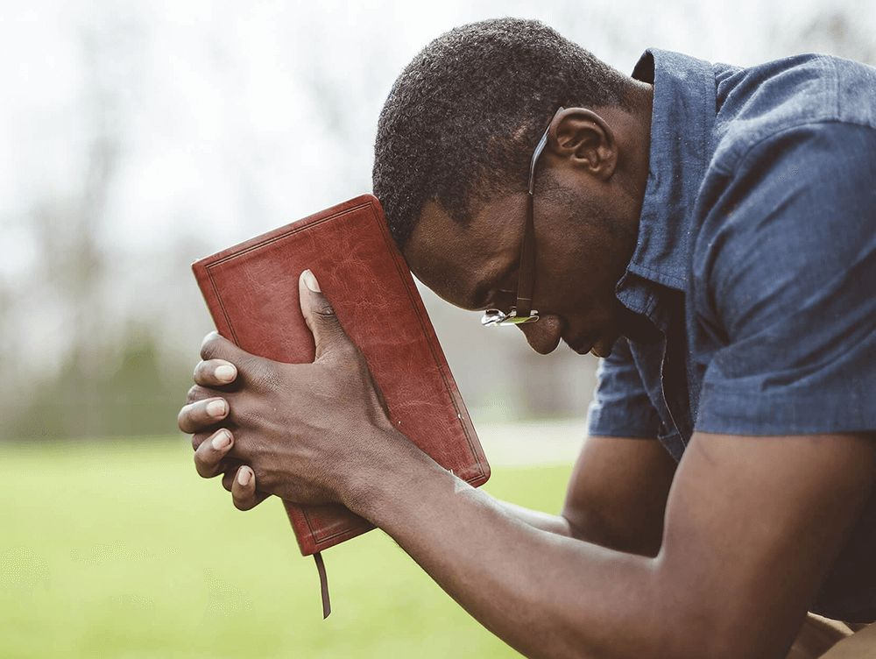
TONIGHT’S SERMON:
A CHRISTIAN IS - 2

