Slide 1

WELCOME TO THE
JACKSON STREET CHURCH OF CHRIST
PLEASE TURN OFF CELLPHONES

Slide 2


Slide 3
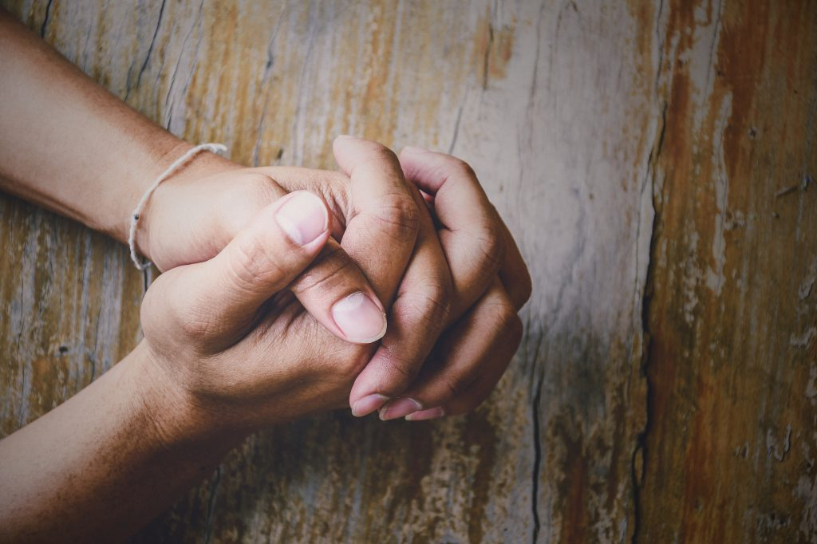
LET US PRAY

Slide 4

SINGING

Slide 5
1 Peter 4:15–19 But let none of you suffer as a murderer, a thief, an evildoer, or as a busybody in other people’s matters. ¹⁶ Yet if anyone suffers as a Christian, let him not be ashamed, but let him glorify God in this matter. ¹⁷ For the time has come for judgment to begin at the house of God; and if it begins with us first, what will be the end of those who do not obey the gospel of God? ¹⁸ Now “If the righteous one is scarcely saved, Where will the ungodly and the sinner appear?” ¹⁹ Therefore let those who suffer according to the will of God commit their souls to Him in doing good, as to a faithful Creator.

Slide 6
LET US PRAY

Slide 7
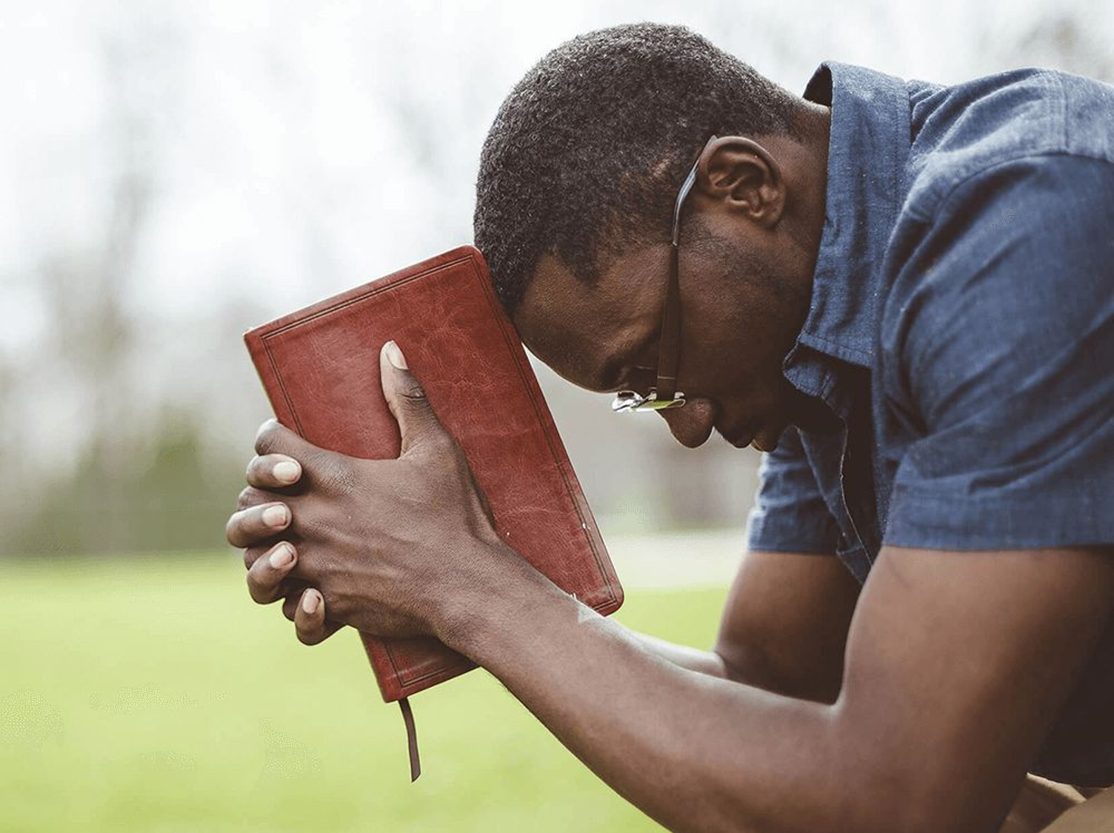
A CHRISTIAN IS... 2 (l PETER)

Slide 8
A CHRISTIAN IS…
The New Testament is the guidebook for children of God.
It is our covenant with God, outlining the way we need to live our lives in a way that pleases God, and also giving us direction to have the best life here on earth.
The book of First Peter gives us a number of characteristics and definitions of the Christian.
Last week we saw a Christian is…
  God's Chosen Child
  God’s Heir
  God's Obedient Child
  Holy
  Redeemed
  Born Again
  God Praising
  Spiritual
  Honorable
Tonight we will be looking at more ways to describe a Christian.

Slide 9
LAW-ABIDING
(1 Peter 2:13–17) Therefore submit yourselves to every ordinance of man for the Lord’s sake, whether to the king as supreme, {14} or to governors, as to those who are sent by him for the punishment of evildoers and for the praise of those who do good. {15} For this is the will of God, that by doing good you may put to silence the ignorance of foolish men—{16} as free, yet not using liberty as a cloak for vice, but as bondservants of God. {17} Honor all people. Love the brotherhood. Fear God. Honor the king.

Slide 10
11. CONSCIENTIOUS
(1 Peter 2:18–25) Servants, be submissive to your masters with all fear, not only to the good and gentle, but also to the harsh. {19} For this is commendable, if because of conscience toward God one endures grief, suffering wrongfully. {20} For what credit is it if, when you are beaten for your faults, you take it patiently? But when you do good and suffer, if you take it patiently, this is commendable before God. {21} For to this you were called, because Christ also suffered for us, leaving us an example, that you should follow His steps: {22} “Who committed no sin, Nor was deceit found in His mouth”; {23} who, when He was reviled, did not revile in return; when He suffered, He did not threaten, but committed Himself to Him who judges righteously; {24} who Himself bore our sins in His own body on the tree, that we, having died to sins, might live for righteousness—by whose stripes you were healed. {25} For you were like sheep going astray, but have now returned to the Shepherd and Overseer of your souls.

Slide 11
12. WIVES – SUBMISSIVE
(1 Peter 3:1–6) Wives, likewise, be submissive to your own husbands, that even if some do not obey the word, they, without a word, may be won by the conduct of their wives, {2} when they observe your chaste conduct accompanied by fear. {3} Do not let your adornment be merely outward—arranging the hair, wearing gold, or putting on fine apparel—{4} rather let it be the hidden person of the heart, with the incorruptible beauty of a gentle and quiet spirit, which is very precious in the sight of God. {5} For in this manner, in former times, the holy women who trusted in God also adorned themselves, being submissive to their own husbands, {6} as Sarah obeyed Abraham, calling him lord, whose daughters you are if you do good and are not afraid with any terror.

Slide 12
13. HUSBANDS – UNDERSTANDING/HONORING
(1 Peter 3:7) Husbands, likewise, dwell with them with understanding, giving honor to the wife, as to the weaker vessel, and as being heirs together of the grace of life, that your prayers may not be hindered.

Slide 13
14. COMPASSIONATE
(1 Peter 3:8–11) Finally, all of you be of one mind, having compassion for one another; love as brothers, be tenderhearted, be courteous; {9} not returning evil for evil or reviling for reviling, but on the contrary blessing, knowing that you were called to this, that you may inherit a blessing. {10} For “He who would love life And see good days, Let him refrain his tongue from evil, And his lips from speaking deceit. {11} Let him turn away from evil and do good; Let him seek peace and pursue it.

Slide 14
15. RIGHTEOUS
(1 Pet 3:12) For the eyes of the LORD are on the righteous, And His ears are open to their prayers; But the face of the LORD is against those who do evil."

Slide 15
16. CLEAR IN CONSCIENCE
(1 Pet 3:13-16) And who is he who will harm you if you become followers of what is good? {14} But even if you should suffer for righteousness’ sake, you are blessed. “And do not be afraid of their threats, nor be troubled. {15} ”But sanctify the Lord God in your hearts, and always be ready to give a defense to everyone who asks you a reason for the hope that is in you, with meekness and fear; {16} having a good conscience, that when they defame you as evildoers, those who revile your good conduct in Christ may be ashamed,

Slide 16
17. SAVED
(1 Peter 3:18–22) For Christ also suffered once for sins, the just for the unjust, that He might bring us to God, being put to death in the flesh but made alive by the Spirit, {19} by whom also He went and preached to the spirits in prison, {20} who formerly were disobedient, when once the Divine longsuffering waited in the days of Noah, while the ark was being prepared, in which a few, that is, eight souls, were saved through water. {21} There is also an antitype which now saves us—baptism (not the removal of the filth of the flesh, but the answer of a good conscience toward God), through the resurrection of Jesus Christ, {22} who has gone into heaven and is at the right hand of God, angels and authorities and powers having been made subject to Him.

Slide 17
18. LIVING FOR GOD
{1 Peter 4:1–3} Therefore, since Christ suffered for us in the flesh, arm yourselves also with the same mind, for he who has suffered in the flesh has ceased from sin, {2} that he no longer should live the rest of his time in the flesh for the lusts of men, but for the will of God. {3} For we have spent enough of our past lifetime in doing the will of the Gentiles—when we walked in lewdness, lusts, drunkenness, revelries, drinking parties, and abominable idolatries.

Slide 18
WHAT ABOUT YOU?
Are you…
  Law-Abiding
  Conscientious
  Wives – Submissive
  Husbands – Understanding/Honoring
  Compassionate
  Righteous
  Clear In Conscience
  Saved
  Living For God
1 Peter 5:10–11 But may the God of all grace, who called us to His eternal glory by Christ Jesus, after you have suffered a while, perfect, establish, strengthen, and settle you. {11} To Him be the glory and the dominion forever and ever. Amen.

Slide 19
SINGING

Slide 20

IN REMEMBRANCE OF JESUS

Slide 21

CONTRIBUTION

Slide 22
SINGING

Slide 23

HAVE A CHRIST-LIKE WEEK

