Slide 1

WELCOME TO THE
JACKSON STREET CHURCH OF CHRIST
PLEASE TURN OFF CELLPHONES

Slide 2


Slide 3

LET US PRAY

Slide 4

SINGING

Slide 5
Mat 6:25-34 "Therefore I say to you, do not worry about your life, what you will eat or what you will drink; nor about your body, what you will put on. Is not life more than food and the body more than clothing? {26} "Look at the birds of the air, for they neither sow nor reap nor gather into barns; yet your heavenly Father feeds them. Are you not of more value than they? {27} "Which of you by worrying can add one cubit to his stature? {28} "So why do you worry about clothing? Consider the lilies of the field, how they grow: they neither toil nor spin; {29} "and yet I say to you that even Solomon in all his glory was not arrayed like one of these. {30} "Now if God so clothes the grass of the field, which today is, and tomorrow is thrown into the oven, will He not much more clothe you, O you of little faith? {31} "Therefore do not worry, saying, 'What shall we eat? or 'What shall we drink?' or 'What shall we wear?' {32} "For after all these things the Gentiles seek. For your heavenly Father knows that you need all these things. {33} "But seek first the kingdom of God and His righteousness, and all these things shall be added to you. {34} "Therefore do not worry about tomorrow, for tomorrow will worry about its own things. Sufficient for the day is its own trouble.

Slide 6
LET US PRAY

Slide 7

DON'T WORRY ABOUT LIVING

Slide 8
WORRY
Said the Robin to the Sparrow,
"l should really like to know
Why these anxious human beings
Rush about and hurry so."
Said the Sparrow to the Robin,
"Friend, I think that it must be
That they have no Heavenly Father
Such as cares for you and me."
Elizabeth Cheney

Slide 9
WORRY
A widow who had successfully raised a very large family was being interviewed by a reporter. In addition to six children of her own, she had adopted 12 other youngsters, and through it all she had maintained stability and an air of confidence. When asked the secret of her outstanding accomplishment, her answer to the newsman was quite surprising. She said, "l managed so well because I'm in a partnership!" "What do you mean?" he inquired. The woman replied, "Many years ago I said, 'Lord, I’ll do the work and You do the worrying.' And I haven't had an anxious care since.“ >>>

Slide 10
WORRY
We could all profit by following the example of that mother. When we carry our part of the load, we need not be disturbed by the demands of life.
God grant me the serenity to accept the things I cannot change, the courage to change the things I can, and the wisdom to know the difference.
There are only two things you should not worry about. The things you can change and the things you can't change.

Slide 11
CAUSES OF WORRY
PRIDE AND LACK OF FAITH - 1 Pet 5:6-7 Therefore humble yourselves under the mighty hand of God, that He may exalt you in due time, {7} casting all your care upon Him, for He cares for you.
FOCUS ON THE PAST - Phil 3:13 Brethren, I do not count myself to have apprehended; but one thing I do, forgetting those things which are behind and reaching forward to those things which are ähead,
FOCUS ON THE FUTURE - Mat 6:34 "Therefore do not worry about tomorrow, for tomorrow will worry about its own things. Sufficient for the day is its own trouble.

Slide 12
II. THE RESULTS OF WORRY
WORRY BRING DEPRESSION Prov 12:25 Anxiety in the heart of man causes depression, But a good word makes it glad.
WORRY KEEPS US UNFRUITFUL - Mat 13:22 "Now he who received seed among the thoms is he who hears the word, and the cares of this world and the deceitfulness of riches choke the word, and he becomes unfruitful.
WORRY IS PHYSICALLY UNHEALTHY
  Prov 15:13 A merry heart makes a cheerful countenance, But by sorrow of the heart the spirit is broken.
  Prov 15:15 All the days of the afflicted are evil, But he who is of a merry heart has a continual feast.
  Prov 17:22 A merry heart does good, like medicine, But a broken spirit dries the bones.

Slide 13
III. THE CURE FOR WORRY
PRAYER DISPELLS ANXIETY - Phil 4:6-7 Be anxious for nothing, but in everything by prayer and supplication, with thanksgiving, let your requests be made known to God; {7} and the peace of God, which surpasses all understanding, will guard your hearts and minds through Christ Jesus.
Worry? Why worry? What can worry do?
It never keeps a trouble from overtaking you.
It gives you indigestion: and wakeful hours at night,
and fills with gloom the days and weeks, however fair and bright.

Slide 14
III. THE CURE FOR WORRY
It puts a frown upon the face, and sharpness in the tone;
We're unfit to live with others, and unfit to live alone.
Worry? Why worry? What can worry do?
It never keeps a trouble from overtaking you.
Pray? Why pray? What can praying do?
Prayer really changes things; arranges life anew.
It’s good for your digestion, gives peaceful sleep at night,
And fills the grayest days with rays of golden, glowing light.
It puts a smile upon your face, a love note in your tone.
It makes you fit to live with others, and fit to live alone.
Pray? Why pray? What can praying do?
It brings God down from heaven to live and work with you.

Slide 15
III. THE CURE FOR WORRY
GODS COMFORT - Psa 94:19 In the multitude of my anxieties within me, Your comforts delight my soul.
TRUST IN GOD
KEEP GOD FOCUSED ON GOD - Isa 26:3 You will keep him in perfect peace, Whose mind is stayed on You, Because he trusts in You.
TRUST IN GOD - Jer 17:7-8 "Blessed is the man who trusts in the LORD, And whose hope is the LORD. {8} For he shall be like a tree planted by the waters, Which spreads out its roots by the river, And will not fear when heat comes; But its leaf will be green, And will not be anxious in the year of drought, Nor will cease from yielding fruit.
GOD IS WITH US - Psa 23:4 Yea: though I walk through the valley of the shadow of death, I will fear no evil; For You are with me; Your rod and Your staff, they comfort me.

Slide 16
III. THE CURE FOR WORRY
BELIEVE IN GOD - John 14:1-3 "Let not your heart be troubled; you believe in God, believe also in Me. {2} "In My Father's house are many mansions; if it were not so, I would have told you. I go to prepare a place for you, {3} "And if I go and prepare a place for you, I will come again and receive you to Myself; that where I am, there you may be also.
CLAIM THE PEACE JESUS LEFT YOU - John 14:27 "Peace I leave with you, My peace I give to you; not as the world gives do I give to you. Let not your heart be troubled, neither let it be afraid.
ASK GOD'S HELP IN RECOGNIZING YOUR ANXIETIES - Psa 139:23 Search me, O God, and know my heart; Try me, and know my anxieties,

Slide 17
III. THE CURE FOR WORRY
TURN YOUR WORRY OVER TO GOD
    Psa 55:22 Cast your burden on the LORD, And He shall sustain you; He shall never permit the righteous to be moved.
    1 Pet 5:6-7 Therefore humble yourselves under the mighty hand of God, that He may exalt you in due time, {7} casting all your care upon Him, for He cares for you.
KEEP FOCUSED ON THE PRESENT - Psa 118.24 This is the day the LORD has made; We will rejoice and be glad in it.

Slide 18
ARE YOU WORRIED ABOUT LIFE?
OUR EMPHASIS SHOULD BE ON THE SPIRITUAL - 2 Cor 4:18 while we do not look at the things which are seen, but at the things which are not seen. For the things which are seen are temporary, but the things which are not seen are eternal.
THE PROMISE OF HEAVEN MAKES THE SUFFERING OF THIS LIFE WORTHWHILE - Romans 8:18 For I consider that the sufferings of this present time are not worthy to be compared with the glory which shall be revealed in us.

Slide 19
ARE YOU WORRIED ABOUT LIFE?
SPIRITUAL THINGS CAN'T BE TAKEN FROM US - Luke 10:38-42 Now it happened as they went that He entered a certain village; and a certain woman named Martha welcomed Him into her house. {39} And she had a sister called Mary, who also sat at Jesus’ feet and heard His word. {40} But Martha was distracted with much serving, and she approached Him and said, "Lord, do You not care that my sister has left me to serve atone? Therefore tell her to help me." {41} And Jesus answered and said to her, "Martha, Martha, you are worried and troubled about many things. {42} "But one thing is needed, and Mary has chosen that good part, which will not be taken away from her."

Slide 20
SINGING

Slide 21
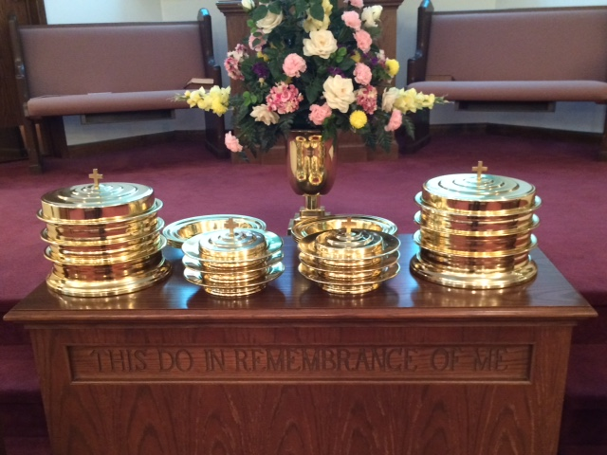
IN REMEMBRANCE OF JESUS

Slide 22
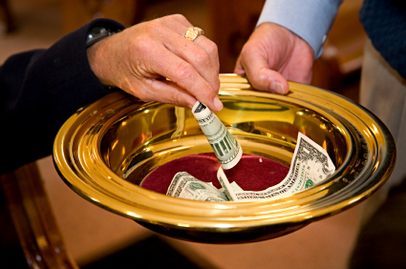
CONTRIBUTION

Slide 23
SINGING

Slide 24

HAVE A
WORRY-FREE
WEEK

