Slide 1
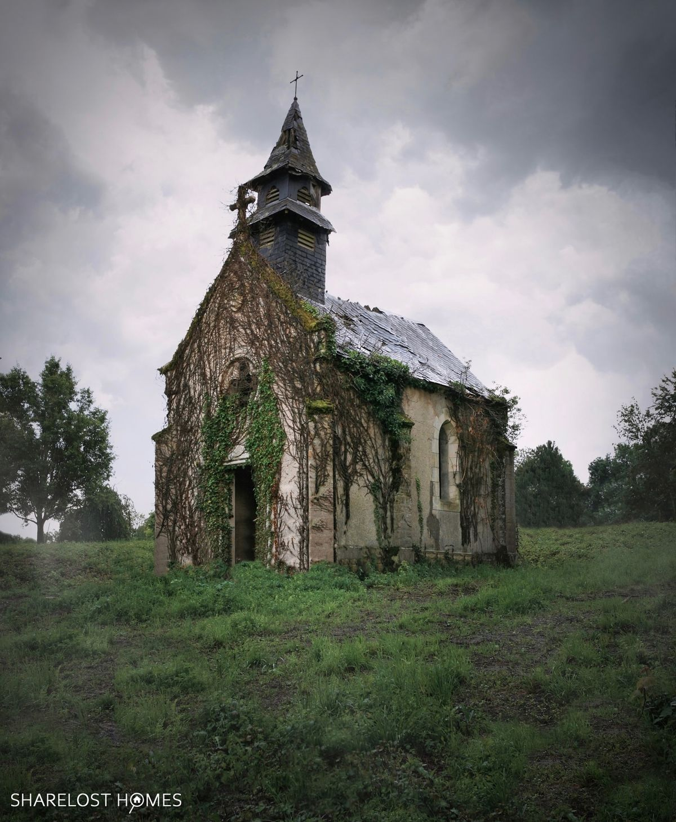
WELCOME TO THE
JACKSON STREET CHURCH OF CHRIST
PLEASE TURN OFF CELLPHONES

Slide 2


Slide 3


Slide 4
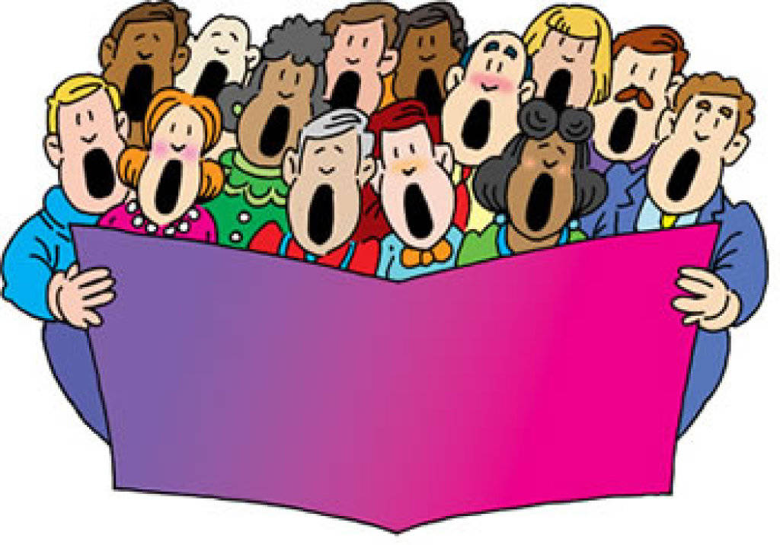
SINGING

Slide 5
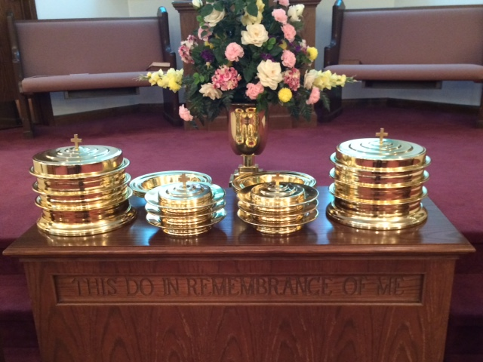
IN REMEMBRANCE OF JESUS

Slide 6
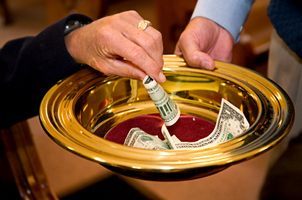
CONTRIBUTION

Slide 7
SINGING

Slide 8
John 8:31-32 Then Jesus said to those Jews who believed Him, "If you abide in My word, you are My disciples indeed. ³² "And you shall know the truth, and the truth shall make you free."

Slide 10
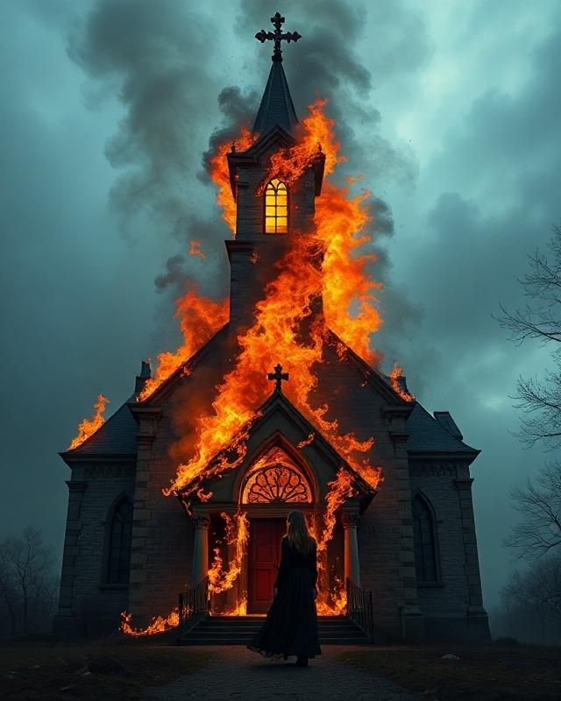
DANGERS THE CHURCH FACES – 2
IGNORANCE

Slide 11
INTRODUCTION
2 Tim 2:24-26 And a servant of the Lord must not quarrel but be gentle to all, able to teach, patient, ²⁵ in humility correcting those who are in opposition, if God perhaps will grant them repentance, so that they may know the truth, ²⁶ and that they may come to their senses and escape the snare of the devil, having been taken captive by him to do his will.
If you desire ease, forsake learning
  If you desire learning, forsake ease.
  How can a man at ease acquire knowledge
  And how can an earnest student enjoy ease?
  Nagarjuna c. 100-200 AD

Slide 12
l. GOD IS DISPLEASED WITH OUR IGNORANCE OF HIS WORD
Hosea 4:6 My people are destroyed for lack of knowledge. Because you have rejected knowledge, I also will reject you from being priest for Me; Because you have forgotten the law of your God, I also will forget your children.
2 Tim 2:15 Be diligent to present yourself approved to God, a worker who does not need to be ashamed, rightly dividing the word of truth.

Slide 13
ll. KNOWLEDGE OF GOD'S WORD IS NECESSARY FOR OUR SALVATION
James 1:21 Therefore lay aside all filthiness and overflow of wickedness, and receive with meekness the implanted word, which is able to save your souls.
2 Tim 3:14-15 But you must continue in the things which you have learned and been assured of, knowing from whom you have learned them, ¹⁵ and that from childhood you have known the Holy Scriptures, which are able to make you wise for salvation through faith which is in Christ Jesus.

Slide 14
Ill. IF WE REALLY LOVE THE WORD WE WILL STRIVE TO LEARN IT
Prov 23:23 Buy the truth, and do not sell it, Also wisdom and instruction and understanding.
2 Th 2:8-12 And then the lawless one will be revealed, whom the Lord will consume with the breath of His mouth and destroy with the brightness of His coming. ⁹ The coming of the lawless one is according to the working of Satan, with all power, signs, and lying wonders, ¹⁰ and with all unrighteous deception among those who perish, because they did not receive the love of the truth, that they might be saved. ¹¹ And for this reason God will send them strong delusion, that they should believe the lie, ¹² that they all may be condemned who did not believe the truth but had pleasure in unrighteousness.

Slide 15
Ill. IF WE REALLY LOVE THE WORD WE WILL STRIVE TO LEARN IT
Psa 119:47-48, 97, 127, 163, 165 And I will delight myself in Your commandments, Which I love. ⁴⁸ My hands also I will lift up to Your commandments, Which I love, And I will meditate on Your statutes.... ⁹⁷ Oh, how I love Your law! It is my meditation all the day ¹²⁷ Therefore I love Your commandments More than gold, yes, than fine gold ¹⁶³ I hate and abhor lying, But I love Your law..... ¹⁶⁵ Great peace have those who love Your law, And nothing causes them to stumble.

Slide 16
IV. THE WORD OF GOD IS THE ONLY WAY WE KNOW GOD'S WILL
Mat 7:21 "Not everyone who says to Me, 'Lord, Lord,' shall enter the kingdom of heaven, but he who does the will of My Father in heaven.
Heb 5:9 And having been perfected, He became the author of eternal salvation to all who obey Him,
2 Pet 1:2-4 Grace and peace be multiplied to you in the knowledge of God and of Jesus our Lord, ³ as His divine power has given to us all things that pertain to life and godliness, through the knowledge of Him who called us by glory and virtue, ⁴ by which have been given to us exceedingly great and precious promises, that through these you may be partakers of the divine nature, having escaped the corruption that is in the world through lust.

Slide 17
V. THE WORD OF GOD WILL JUDGE US
Acts 17:30-31 "Truly, these times of ignorance God overlooked, but now commands all men everywhere to repent, ³¹ "because He has appointed a day on which He will judge the world in righteousness by the Man whom He has ordained. He has given assurance of this to all by raising Him from the dead."
John 12:48 "He who rejects Me, and does not receive My words, has that which judges him; the word that I have spoken will judge him in the last day.
2 Th 1:7-8 and to give you who are troubled rest with us when the Lord Jesus is revealed from heaven with His mighty angels, ⁸ in flaming fire taking vengeance on those who do not know God, and on those who do not obey the gospel of our Lord Jesus Christ.

Slide 18
HOW IS YOUR KNOWLEDGE?
Will you be destroyed (lost) because of ignorance of God’s Word?
Are you making an effort to learn God’s will from His Word?
Do you take advantage of every opportunity to study and learn God’s Word?
Do you think God is satisfied with your study and knowledge of the Bible?

Slide 19
SINGING

Slide 20
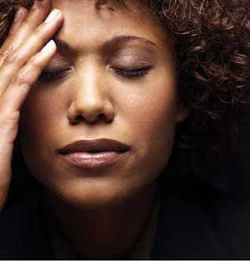
TONIGHT’S SERMON
DON’T WORRY

