Slide 1

WELCOME TO THE
JACKSON STREET CHURCH OF CHRIST
PLEASE TURN OFF CELLPHONES

Slide 2


Slide 3

LET US PRAY

Slide 4

SINGING

Slide 5
1 Timothy 4:6–11 If you instruct the brethren in these things, you will be a good minister of Jesus Christ, nourished in the words of faith and of the good doctrine which you have carefully followed. ⁷ But reject profane and old wives’ fables, and exercise yourself toward godliness. ⁸ For bodily exercise profits a little, but godliness is profitable for all things, having promise of the life that now is and of that which is to come. ⁹ This is a faithful saying and worthy of all acceptance. ¹⁰ For to this end we both labor and suffer reproach, because we trust in the living God, who is the Savior of all men, especially of those who believe. ¹¹ These things command and teach.

Slide 6
LET US PRAY

Slide 7
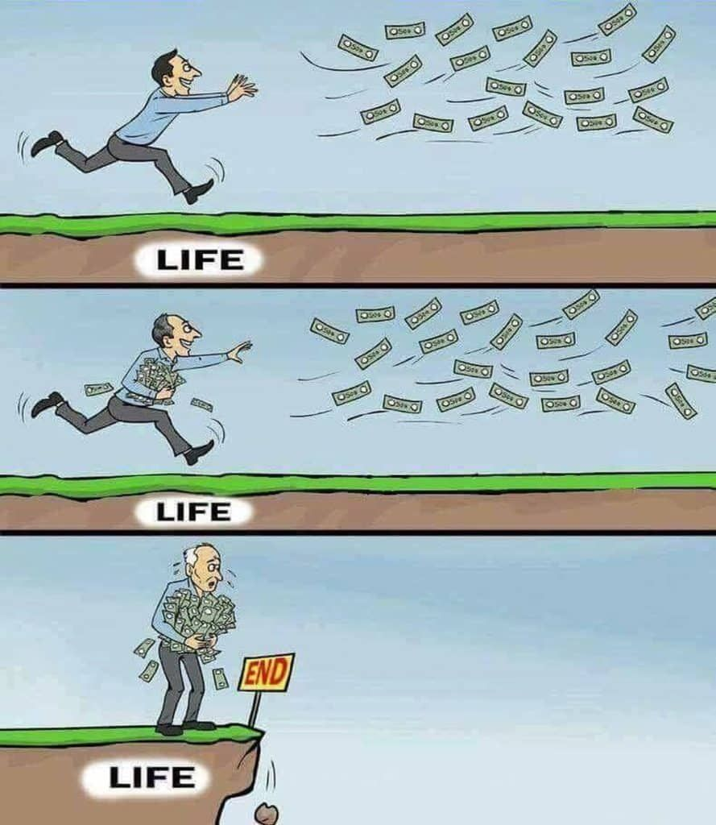
CHRIST BRINGS MEANING TO LIFE

Slide 8
CHRIST BRINGS MEANING TO LIFE
Rom 6:1-7 What shall we say then? Shall we continue in sin that grace may abound? {2} Certainly not! How shall we died to sin live any longer in it? {3} Or do you not know that as many of us as were baptized into Christ Jesus were baptized into His death? {4} Therefore we were buried with Him through baptism into death, that just as Christ was raised from the dead by the glory of the Father, even so we also should walk in newness of life. {5} For if we have been united together in the likeness of His death, certainly we also shall be in the likeness of His resurrection, {6} knowing this, that our old man was crucified with Him, that the body of sin might be done away with, that we should no longer be slaves of sin. {7} For he who has died has been freed from sin.

Slide 9
CHRIST BRINGS MEANING TO LIFE
John 10:10 "I have come that they may have life, and that they may have it more abundantly.
1 Cor 15:19 If in this life only we have hope in Christ, we are of all men the most pitiable.
1 Tim 4:7-8 exercise yourself toward godliness. {8} For bodily exercise profits a little, but godliness is profitable for all things, having promise of the life that now is and of that which is to come.

Slide 10
LOVE - LOVING THROUGH GOD
1 John 4:11 Beloved, if God so loved us, we also ought to love one another.
1 John 4:19 We love Him because He first loved us.
1 John 4:7 Beloved, let us love one another, for love is of God; and everyone who loves is born of God and knows God.
Romans 5:5 Now hope does not disappoint, because the love of God has been poured out in our hearts by the Holy Spirit who was given to us.
2 Corinthians 13:11 Finally, brethren, farewell. Become complete. Be of good comfort, be of one mind, live in peace; and the God of love and peace will be with you.

Slide 11
INSTRUCTION - LEARNING FROM GOD
Psa 32:8 I will instruct you and teach you in the way you should go; I will guide you with My eye.
Psa 25:8-10 Good and upright is the LORD; Therefore He teaches sinners in the way. {9} The humble He guides in justice, And the humble He teaches His way. {10} All the paths of the LORD are mercy and truth, To such as keep His covenant and His testimonies.
Eph 5:15-17 See then that you walk circumspectly, not as fools but as wise, {16} redeeming the time, because the days are evil. {17} Therefore do not be unwise, but understand what the will of the Lord is.

Slide 12
FREEDOM - LIBERTY IN CHRIST
Gal 5:1 Stand fast therefore in the liberty by which Christ has made us free, and do not be entangled again with a yoke of bondage.
Gal 5:13 For you, brethren, have been called to liberty; only do not use liberty as an opportunity for the flesh, but through love serve one another.
James 2:8-13 If you really fulfill the royal law according to the Scripture, "You shall love your neighbor as yourself," you do well; {9} but if you show partiality, you commit sin, and are convicted by the law as transgressors. {10} For whoever shall keep the whole law, and yet stumble in one point, he is guilty of all. {11} For He who said, "Do not commit adultery," also said, "Do not murder." Now if you do not commit adultery, but you do murder, you have become a transgressor of the law. {12} So speak and so do as those who will be judged by the law of liberty. {13} For judgment is without mercy to the one who has shown no mercy. Mercy triumphs over judgment.

Slide 13
ETERNAL LIFE - LIVING WITH CHRIST
1 John 5:11-13 And this is the testimony: that God has given us eternal life, and this life is in His Son. {12} He who has the Son has life; he who does not have the Son of God does not have life. {13} These things I have written to you who believe in the name of the Son of God, that you may know that you have eternal life, and that you may continue to believe in the name of the Son of God.
John 14:1-3 "Let not your heart be troubled; you believe in God, believe also in Me. {2} "In My Father's house are many mansions; if it were not so, I would have told you. I go to prepare a place for you. {3} "And if I go and prepare a place for you, I will come again and receive you to Myself; that where I am, there you may be also.

Slide 14
ETERNAL LIFE - LIVING WITH CHRIST
Phil 1:21-24 For to me, to live is Christ, and to die is gain. {22} But if I live on in the flesh, this will mean fruit from my labor; yet what I shall choose I cannot tell. {23} For I am hard pressed between the two, having a desire to depart and be with Christ, which is far better. {24} Nevertheless to remain in the flesh is more needful for you.
Rom 6:3-8 Or do you not know that as many of us as were baptized into Christ Jesus were baptized into His death? >>>

Slide 15
ETERNAL LIFE - LIVING WITH CHRIST
{4} Therefore we were buried with Him through baptism into death, that just as Christ was raised from the dead by the glory of the Father, even so we also should walk in newness of life. {5} For if we have been united together in the likeness of His death, certainly we also shall be in the likeness of His resurrection, {6} knowing this, that our old man was crucified with Him, that the body of sin might be done away with, that we should no longer be slaves of sin. {7} For he who has died has been freed from sin. {8} Now if we died with Christ, we believe that we shall also live with Him.

Slide 16
IS YOUR LIFE MEANINGFUL?
LIFE INDEED - 1 Tim 6:17-19 Instruct those who are rich in this present world not to be conceited or to fix their hope on the uncertainty of riches, but on God, who richly supplies us with all things to enjoy. {18} Instruct them to do good, to be rich in good works, to be generous and ready to share, {19} storing up for themselves the treasure of a good foundation for the future, so that they may take hold of that which is life indeed.
The most meaningful life is found in Christ. – That new life begins in baptism - Romans 6:3–4 Or do you not know that as many of us as were baptized into Christ Jesus were baptized into His death? 4 Therefore we were buried with Him through baptism into death, that just as Christ was raised from the dead by the glory of the Father, even so we also should walk in newness of life.

Slide 17
HAS CHRIST BROUGHT MEANING TO YOUR LIFE?
L - LOVE - LOVING THROUGH CHRIST
I - INSTRUCTION - LEARNING FROM CHRIST
F - FREEDOM - LIBERTY IN CHRIST
E - ETERNAL LIFE - LIVING WITH CHRIST

Slide 18
SINGING

Slide 19
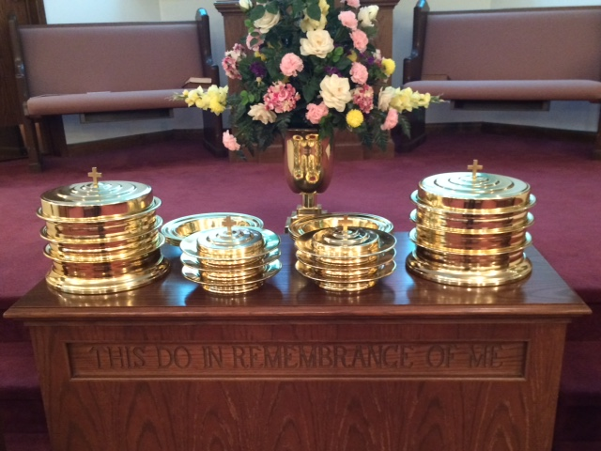
IN REMEMBRANCE OF JESUS

Slide 20
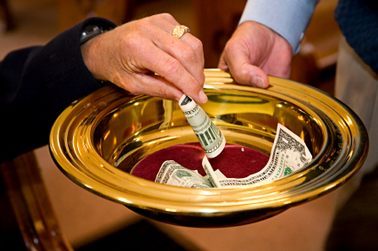
CONTRIBUTION

Slide 21
SINGING

Slide 22

HAVE A
MEANINGFUL
WEEK

