Slide 1

WELCOME TO THE
JACKSON STREET CHURCH OF CHRIST
PLEASE TURN OFF CELLPHONES

Slide 2


Slide 3


Slide 4

SINGING

Slide 5
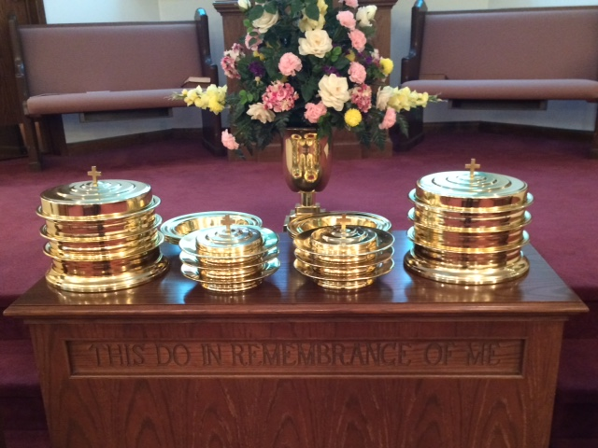
IN REMEMBRANCE OF JESUS

Slide 6
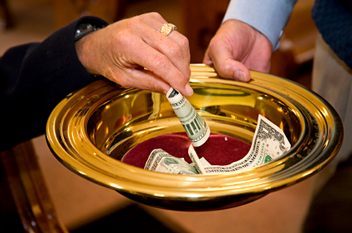
CONTRIBUTION

Slide 7
SINGING

Slide 8
1 John 2:15-17 Do not love the world or the things in the world. If anyone loves the world, the love of the Father is not in him. ¹⁶ For all that is in the world; the lust of the flesh, the lust of the eyes, and the pride of life; is not of the Father but is of the world. ¹⁷ And the world is passing away, and the lust of it; but he who does the will of God abides forever.

Slide 10
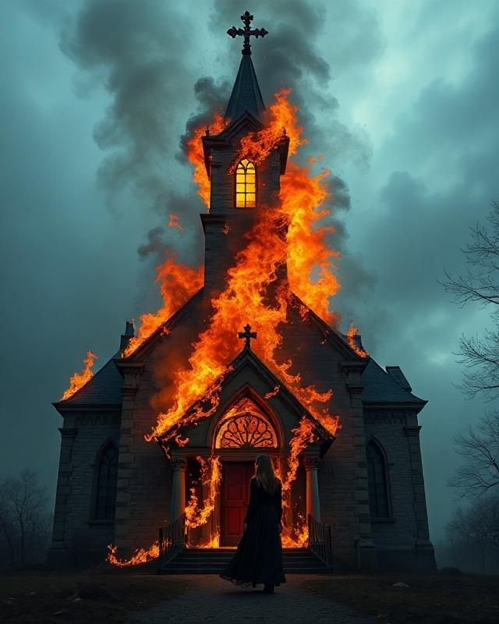
DANGERS THE CHURCH FACES – 3
WORLDLINESS

Slide 11
WORLDLINESS
Boats don’t sink because they are in the water, they sink because water gets in the boat.
The problem in the church is not that too many Christians are in the world but that the world is in too many Christians.
One of the great dangers facing the church is worldliness.

Slide 12
l. THE WORLD BELONGS TO SATAN
2 Cor 4:4 whose minds the god of this age has blinded, who do not believe, lest the light of the gospel of the glory of Christ, who is the image of God, should shine on them.
John 12:31 "Now is the judgment of this world; now the ruler of this world will be cast out.
1 Cor 2:12 Now we have received, not the spirit of the world, but the Spirit who is from God, that we might know the things that have been freely given to us by God.
1 Cor 7:31 and those who use this world as not misusing it. For the form of this world is passing away.

Slide 13
II. WE ARE NOT TO BE OF THE WORLD
John 15:18-19 "If the world hates you, you know that it hated Me before it hated you. ¹⁹ "If you were of the world, the world would love its own. Yet because you are not of the world, but I chose you out of the world, therefore the world hates you.
John 17:14-15 "l have given them Your word; and the world has hated them because they are not of the world, just as I am not of the world. ¹⁵ "l do not pray that You should take them out of the world, but that You should keep them from the evil one.

Slide 14
II. WE ARE NOT TO BE OF THE WORLD
John 18:36 Jesus answered, "My kingdom is not of this world. If My kingdom were of this world, My servants would fight, so that I should not be delivered to the Jews; but now My kingdom is not from here."
1 Cor 4:9 For I think that God has displayed us, the apostles, last, as men condemned to death; for we have been made a spectacle to the world, both to angels and to men.
1 Cor 4:13 being defamed, we entreat. We have been made as the filth of the world, the offscouring of all things until now.

Slide 15
III. WE ARE NOT TO CONFORM
TO THE WORLD
Rom 12:1-2 1 beseech you therefore, brethren, by the mercies of God, that you present your bodies a living sacrifice, holy, acceptable to God, which is your reasonable service. ² And do not be conformed to this world, but be transformed by the renewing of your mind, that you may prove what is that good and acceptable and perfect will of God.
Gal 6:14 But God forbid that I should boast except in the cross of our Lord Jesus Christ, by whom the world has been crucified to me, and I to the world.
James 1:27 Pure and undefiled religion before God and the Father is this: to visit orphans and widows in their trouble, and to keep oneself unspotted from the world.

Slide 16
III. WE ARE NOT TO CONFORM
TO THE WORLD
2 Pet 1:3-11 as His divine power has given to us all things that pertain to life and godliness, through the knowledge of Him who called us by glory and virtue, ⁴ by which have been given to us exceedingly great and precious promises, that through these you may be partakers of the divine nature, having escaped the corruption that is in the world through lust. ⁵ But also for this very reason, giving all diligence, add to your faith virtue, to virtue knowledge, ⁶ to knowledge self-control, to self-control perseverance, to perseverance godliness, ⁷ to godliness brotherly kindness, and to brotherly kindness love. ⁸ For if these things are yours and abound, you will be neither barren nor unfruitful in the knowledge of our Lord Jesus Christ. ⁹ For he who lacks these things is shortsighted, even to blindness, and has forgotten that he was cleansed from his old sins. >>>

Slide 17
III. WE ARE NOT TO CONFORM
TO THE WORLD
¹⁰ Therefore, brethren, be even more diligent to make your call and election sure, for if you do these things you will never stumble. ¹¹ for so an entrance will be supplied to you abundantly into the everlasting kingdom of our Lord and Savior Jesus Christ.
2 Pet 2:20-22 For if, after they have escaped the pollutions of the world through the knowledge of the Lord and Savior Jesus Christ, they are again entangled in them and overcome, the latter end is worse for them than the beginning. ²¹ For it would have been better for them not to have known the way of righteousness, than having known it, to turn from the holy commandment delivered to them. ²² But it has happened to them according to the true proverb: "A dog returns to his own vomit," and, "a sow, having washed, to her wallowing in the mire."

Slide 18
IV. WE ARE NOT TO LOVE THE WORLD
2 Tim 4:10 for Demas has forsaken me, having loved this present world, and has departed for Thessalonica; Crescens for Galatia, Titus for Dalmatia.
1 John 2:15-17 Do not love the world or the things in the world. If anyone loves the world, the love of the Father is not in him. ¹⁶ For all that is in the world; the lust of the flesh, the lust of the eyes, and the pride of life; is not of the Father but is of the world. ¹⁷ And the world is passing away, and the lust of it; but he who does the will of God abides forever.

Slide 19
IV. WE ARE NOT TO LOVE THE WORLD
James 4:4 Adulterers and adulteresses! Do you not know that friendship with the world is enmity with God? Whoever therefore wants to be a friend of the world makes himself an enemy of God.
Mat 13:22 "Now he who received seed among the thorns is he who hears the word, and the cares of this world and the deceitfulness of riches choke the word, and he becomes unfruitful.
Mat 16:26 "For what profit is it to a man if he gains the whole world* and loses his own soul? Or what will a man give in exchange for his soul?
John 12:25 "He who loves his life will lose it, and he who hates his life in this world will keep it for eternal life.

Slide 20
V. WE ARE TO BE AN INFLUENCE IN THE WORLD
Mat 5:13-16 "You are the salt of the earth; but if the salt loses its flavor, how shall it be seasoned? It is then good for nothing but to be thrown out and trampled underfoot by men. ¹⁴ "You are the light of the world. A city that is set on a hill cannot be hidden. ¹⁵ "Nor do they light a lamp and put it under a basket, but on a lampstand, and it gives light to all who are in the house. ¹⁶ "Let your light so shine before men, that they may see your good works and glorify your Father in heaven.

Slide 21
V. WE ARE TO BE AN INFLUENCE IN THE WORLD
Phil 2:15 that you may become blameless and harmless, children of God without fault in the midst of a crooked and perverse generation, among whom you shine as lights in the world.
1 John 4:4 You are of God, little children, and have overcome them, because He who is in you is greater than he who is in the world.
Titus 2:12 teaching us that, denying ungodliness and worldly lusts, we should live soberly, righteously, and godly in the present age.

Slide 22
WHAT IS YOUR RELATIONSHIP TO THE WORLD TODAY?
In the world or the world in you?
Conforming to the world being influenced by the world?
Loving the world wanting to be like the world?
Influencing the world to be more godly?
Are you working for the kingdom of God or the kingdom of Satan?

Slide 23
SINGING

Slide 24

TONIGHT’S SERMON
CHRIST BRINGS MEANING TO LIFE

