Slide 1

WELCOME TO THE
JACKSON STREET CHURCH OF CHRIST
PLEASE TURN OFF CELLPHONES

Slide 2


Slide 3


Slide 4

SINGING

Slide 5

IN REMEMBRANCE OF JESUS

Slide 6

CONTRIBUTION

Slide 7



Slide 8
John 13:12–17 So when He had washed their feet, taken His garments, and sat down again, He said to them, “Do you know what I have done to you? ¹³ You call Me Teacher and Lord, and you say well, for so I am. ¹⁴ If I then, your Lord and Teacher, have washed your feet, you also ought to wash one another’s feet. ¹⁵ For I have given you an example, that you should do as I have done to you. ¹⁶ Most assuredly, I say to you, a servant is not greater than his master; nor is he who is sent greater than he who sent him. ¹⁷ If you know these things, blessed are you if you do them.

Slide 10


Slide 11
EXAMPLES
We are all examples of some kind: good, bad, indifferent; positive, negative, apathetic.
We should follow good examples set by others: parents, teachers, heroes, friends etc.
But we should learn from bad examples as we see the results of their actions.

Slide 12
1. JESUS
EXAMPLE OF SERVICE - John 13:3-17 Jesus, knowing that the Father had given all things into His hands, and that He had come from God and was going to God, {4} rose from supper and laid aside His garments, took a towel and girded Himself. {5} After that, He poured water into a basin and began to wash the disciples' feet, and to wipe them with the towel with which He was girded. {6} Then He came to Simon Peter. And Peter said to Him, Lord, are You washing my feet?" {7} Jesus answered and said to him, "What I am doing you do not understand now, but you will know after this." {8) Peter said to Him, "You shall never wash my feet! Jesus answered him, 'If I do not wash you, you have no part with Men >>>

Slide 13
1. JESUS
{9} Simon Peter said to Him, Lord, not my feet only, but also my hands and my head. " {10} Jesus said to him, "He who is bathed needs only to wash his feet but is completely clean; and you are clean, but not all of you. {11} For He knew who would betray Him; therefore He said, you are not all clean. {12} So when He had washed their feet, taken His garments, and sat down again, He said to them, "Do you know what I have done to you? {13} "You call me Teacher and Lord, and you say well, for so I am. {14} If I then, your Lord and Teacher, have washed your feet, you also ought to wash one another's feet. {15} "For I have given you an example, that you should do as I have done to you. {16} "Most assuredly, I say to you, a servant is not greater than his master; nor is he who is sent greater than he who sent him. {17} "If you know these things, blessed are you if you do them.

Slide 14
1. JESUS
EXAMPLE OF SUFFERING - 1 Pet 2:19-21 For this is commendable, if because of conscience toward God one endures grief, suffering wrongfully. {20} For what credit is it if, when you are beaten for your faults, you take it patiently? But when you do good and suffer, if you take it patiently, this is commendable before God. {21} For to this you were called, because Christ also suffered for us, leaving us an example, that you should follow His steps.

Slide 15
2. THE PROPHETS & JOB – EXAMPLE OF SUFFERING & PATIENCE
James 5:10-11 My brethren, take the prophets, who spoke in the name of the Lord, as an example of suffering and patience. {11} Indeed we count them blessed who endure. You have heard of the perseverance of Job and seen the end intended by the Lord; that the Lord is very compassionate and mercy.

Slide 16
3. PAUL
EXAMPLE OF GOAL SETTING - Phil 3:12-17 Not that I have already attained, or am already perfected; but I press on, that I may lay hold of that for which Christ Jesus has also laid hold of me. {13) Brethren, I do not count myself to have apprehended; but one thing I do, forgetting those things which are behind and reaching forward to those things which are ahead, {14} I press toward the goal for the prize of the upward call of God in Christ Jesus. {15} Therefore let us, as many as are mature, have this mind; and if in anything you think otherwise, God will reveal even this to you. {16} Nevertheless, to the degree that we have already attained, let us walk by the same rule, let us be of the same mind. {17} Brethren, join in following my example, and note those who so walk, as you have us for a pattern.

Slide 17
3. PAUL
EXAMPLE OF WORKING - 2 Th 3:6-13 But we command you, brethren, in the name of our Lord Jesus Christ, that you withdraw from every brother who walks disorderly and not according to the tradition which he received from us. {7} For you yourselves know how you ought to follow us, for we were not disorderly among you; {8} nor did we eat anyone's bread free of charge, but worked with labor and toil night and day, that we might not be a burden to any of you, {9) not because we do not have authority, but to make ourselves an example of how you should follow us. >>>

Slide 18
3. PAUL
{10} For even when we were with you, we commanded you this: If anyone will not work, neither shall he eat. {11} For we hear that there are some who walk among you in a disorderly manner, not working at all, but are busybodies. {12} Now those who are such we command and exhort through our Lord Jesus Christ that they work in quietness and eat their own bread. {13} But as for you, brethren, do not grow weary in doing good.

Slide 19
4. THE ISRAELITES – EXAMPLE OF DISOBEDIENCE
Heb 4:8-11 For if Joshua had given them rest, then He would not afterward have spoken of another day a {9} There remains therefore a rest for the people of God, {10} For he who has entered His rest has himself also ceased from his works as God did from His. {11} Let us therefore be diligent to enter that rest, lest anyone fan according to the same example of disobedience.

Slide 20
5. SODOM & GOMORRAH
EXAMPLE OF LIVING UNGODLY - 2 Pet 2:4-6 For if God did not spare the angels who sinned, but cast them down to hell and delivered them into chains of darkness, to be reserved for judgment; {5} and did not spare the ancient world, but saved Noah, one of eight people, a preacher of righteousness, bringing in the flood on the world of the ungodly; {6} and turning the cities of Sodom and Gomorrah into ashes, condemned them to destruction, making <hem an example to those who afterward would live ungodly;
EXAMPLE OF SEXUAL IMMORALITY - HOMOSEXUALITY - Jude 1:7 as Sodom and Gomorrah, and the cities around them in a similar manner to these, having given themselves over to sexual immorality and gone after strange flesh, are set forth as an example, suffering the vengeance of eternal fire.

Slide 21
WHAT ABOUT YOU?
Do you call yourself a Christian?
Do you follow Christ in your life?
What kind of examples are you following?
What kind of examples are you setting for others?
Change your name or change your life (Stonewall Jackson)

Slide 23

PRAYER

Slide 24
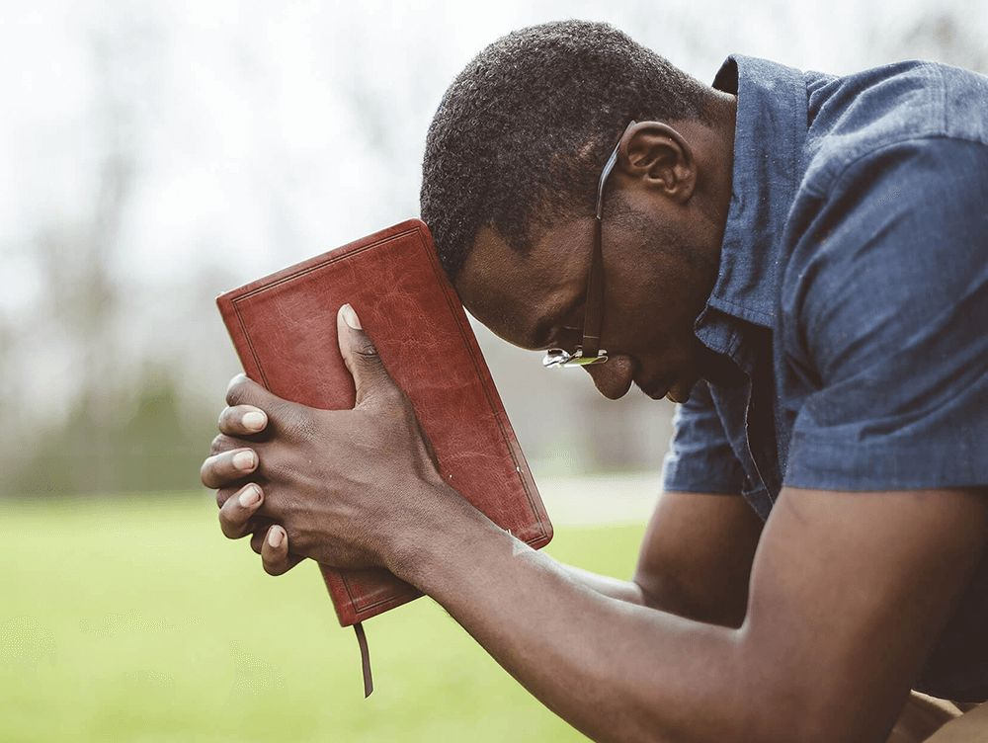
TONIGHT’S SERMON:
A CHRISTIAN IS - 3

