Slide 1

WELCOME TO THE
JACKSON STREET CHURCH OF CHRIST
PLEASE TURN OFF CELLPHONES

Slide 2


Slide 3
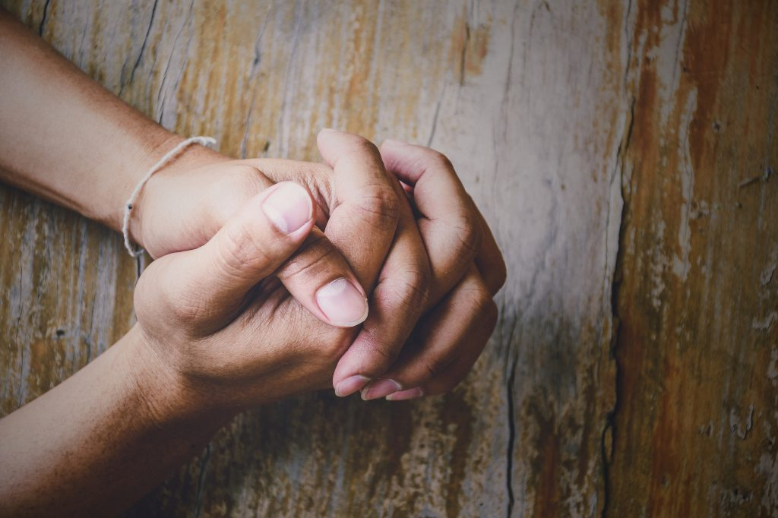
LET US PRAY

Slide 4

SINGING

Slide 5
1 Peter 4:15–19 But let none of you suffer as a murderer, a thief, an evildoer, or as a busybody in other people’s matters. ¹⁶ Yet if anyone suffers as a Christian, let him not be ashamed, but let him glorify God in this matter. ¹⁷ For the time has come for judgment to begin at the house of God; and if it begins with us first, what will be the end of those who do not obey the gospel of God? ¹⁸ Now “If the righteous one is scarcely saved, Where will the ungodly and the sinner appear?” ¹⁹ Therefore let those who suffer according to the will of God commit their souls to Him in doing good, as to a faithful Creator.

Slide 6
LET US PRAY

Slide 7
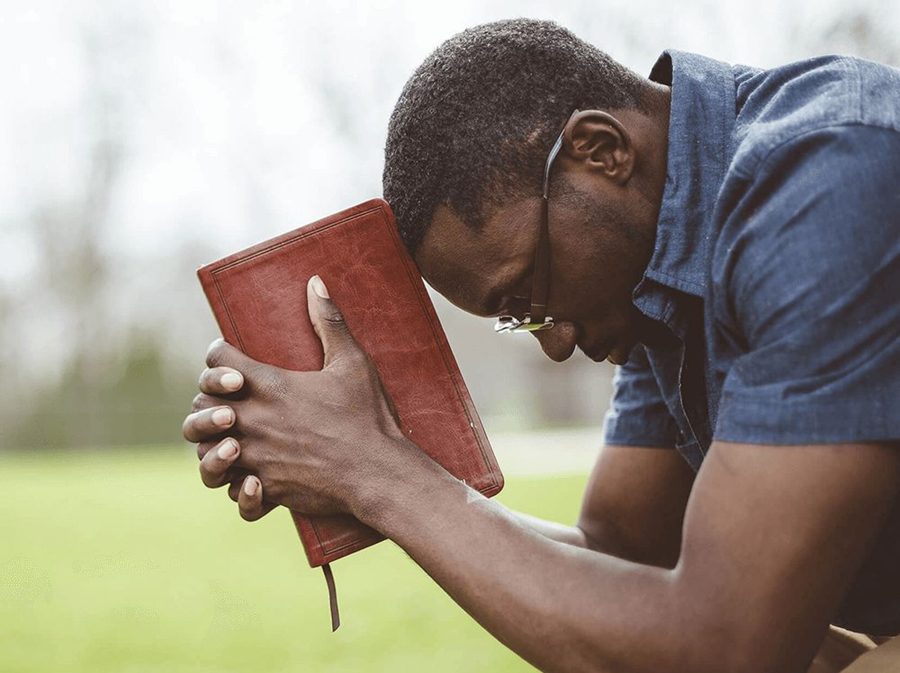
A CHRISTIAN IS... 3 (l PETER)

Slide 8
A CHRISTIAN IS…
The New Testament is the guidebook for children of God.
It is our covenant with God, outlining the way we need to live our lives in a way that pleases God, and also giving us direction to have the best life here on earth.
The book of First Peter gives us a number of characteristics and definitions of the Christian.

Slide 9
A CHRISTIAN IS…
The last two weeks we saw that a Christian is…
E. Tonight we will look at the rest of what defines a Christian in 1st Peter.
God's Chosen Child God’s Heir God's Obedient Child Holy Redeemed Born Again God Praising Spiritual Honorable Law-Abiding | 11. Conscientious 12. Wives – Submissive Husbands – Understanding / Honoring 14. Compassionate 15. Righteous 16. Clear In Conscience 17. Saved 18. Living For God

Slide 10
PRAYERFUL
{1 Peter 4:7} But the end of all things is at hand; therefore be serious and watchful in your prayers.

Slide 11
20. LOVING
{1 Peter 4:8} And above all things have fervent love for one another, for “love will cover a multitude of sins.”

Slide 12
21. HOSPITABLE
{1 Peter 4:9} Be hospitable to one another without grumbling.

Slide 13
22. A GOOD STEWARD
(1 Pet 4:10-11) As each one has received a gift, minister it to one another, as good stewards of the manifold grace of God. {11} If anyone speaks, let him speak as the oracles of God. If anyone ministers, let him do it as with the ability which God supplies, that in all things God may be glorified through Jesus Christ, to whom belong the glory and the dominion forever and ever. Amen.

Slide 14
23. WILLING TO UNASHAMEDLY SUFFER
(1 Peter 4:12-19} Beloved, do not think it strange concerning the fiery trial which is to try you, as though some strange thing happened to you; {13} but rejoice to the extent that you partake of Christ’s sufferings, that when His glory is revealed, you may also be glad with exceeding joy. {14} If you are reproached for the name of Christ, blessed are you, for the Spirit of glory and of God rests upon you. On their part He is blasphemed, but on your part He is glorified. {15} But let none of you suffer as a murderer, a thief, an evildoer, or as a busybody in other people’s matters. {16} Yet if anyone suffers as a Christian, let him not be ashamed, but let him glorify God in this matter. {17} For the time has come for judgment to begin at the house of God; and if it begins with us first, what will be the end of those who do not obey the gospel of God? {18} Now “If the righteous one is scarcely saved, where will the ungodly and the sinner appear?” {19} Therefore let those who suffer according to the will of God commit their souls to Him in doing good, as to a faithful Creator.

Slide 15
24. ELDERS – SHEPHERD / OVERSEE / BE EXAMPLES
1 Peter 5:1–4 The elders who are among you I exhort, I who am a fellow elder and a witness of the sufferings of Christ, and also a partaker of the glory that will be revealed: {2} Shepherd the flock of God which is among you, serving as overseers, not by compulsion but willingly, not for dishonest gain but eagerly; {3} nor as being lords over those entrusted to you, but being examples to the flock; {4}and when the Chief Shepherd appears, you will receive the crown of glory that does not fade away.

Slide 16
25. HUMBLE
1 Peter 5:5–7 Likewise you younger people, submit yourselves to your elders. Yes, all of you be submissive to one another, and be clothed with humility, for “God resists the proud, but gives grace to the humble.” {6} Therefore humble yourselves under the mighty hand of God, that He may exalt you in due time, {7} casting all your care upon Him, for He cares for you.

Slide 17
26. ONE WHO RESISTS THE DEVIL
(1 Pet 5:8-9) Be sober, be vigilant; because your adversary the devil walks about like a roaring lion, seeking whom he may devour. {9} Resist him, steadfast in the faith, knowing that the same sufferings are experienced by your brotherhood in the world.

Slide 18
WHAT ABOUT YOU?
Are you…
  Prayerful
  Loving
  Hospitable
  A Good Steward
  Willing To Unashamedly Suffer
  Elders – Shepherd/Oversee/Be Examples
  Humble
  One Who Resists The Devil
1 Peter 5:10–11 But may the God of all grace, who called us to His eternal glory by Christ Jesus, after you have suffered a while, perfect, establish, strengthen, and settle you. {11} To Him be the glory and the dominion forever and ever. Amen.

Slide 19
SINGING

Slide 20

IN REMEMBRANCE OF JESUS

Slide 21

CONTRIBUTION

Slide 22
SINGING

Slide 23

HAVE A CHRIST-LIKE WEEK

