Slide 1
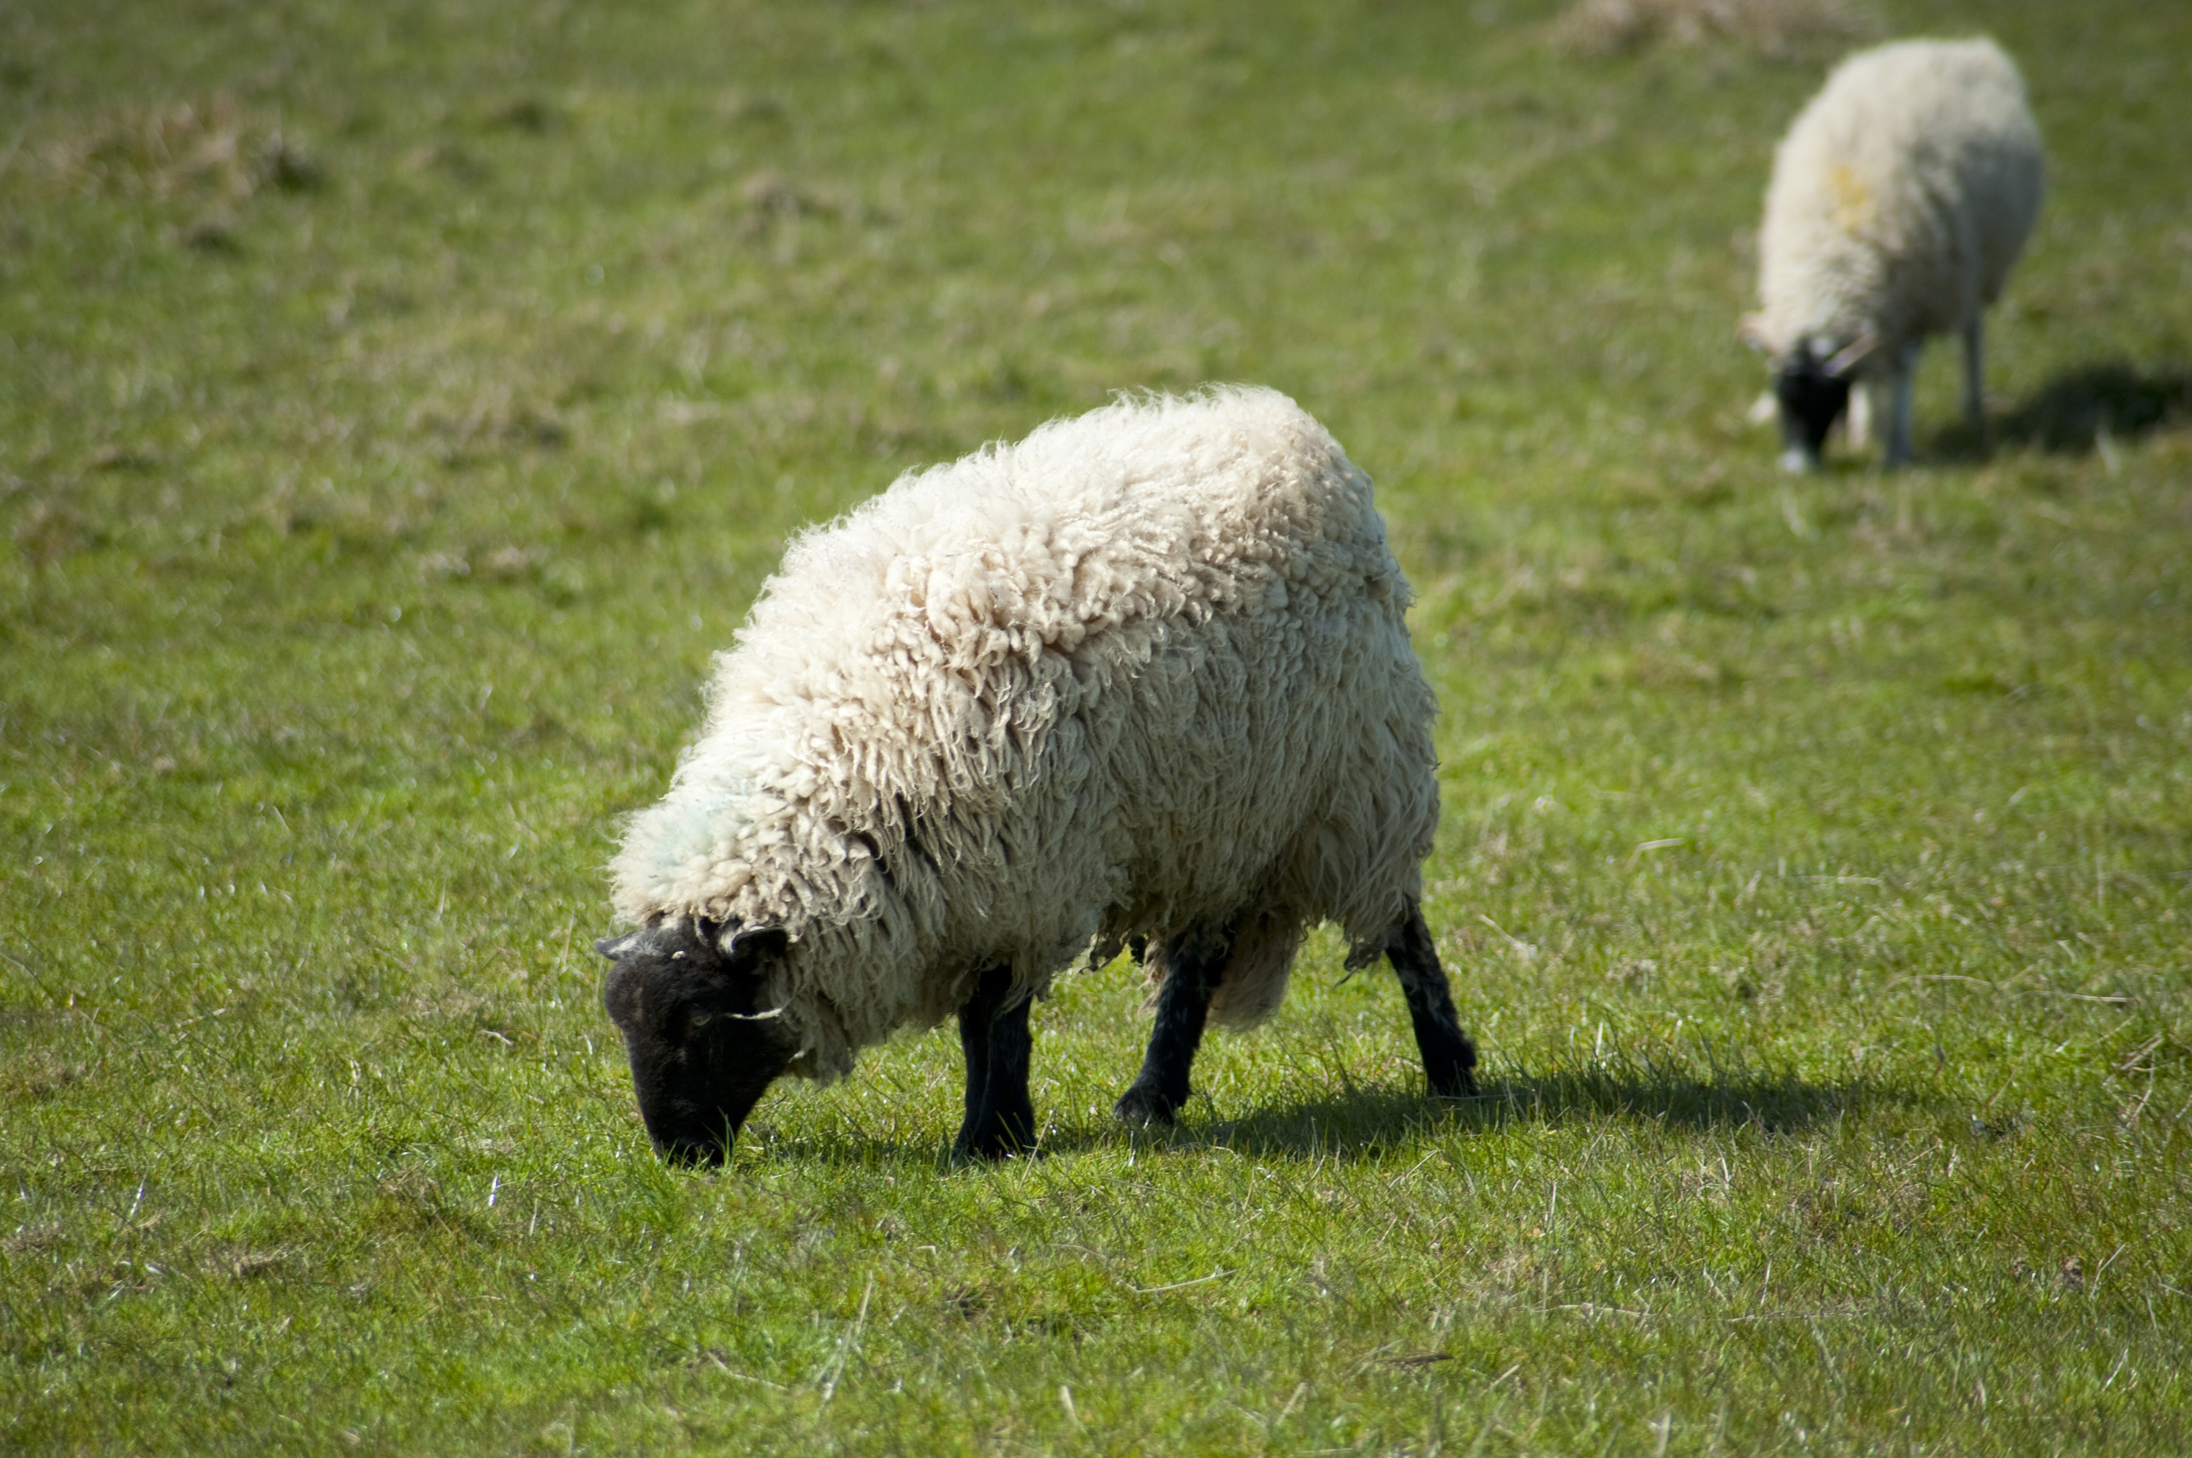
WELCOME TO THE
JACKSON STREET CHURCH OF CHRIST
PLEASE TURN OFF CELLPHONES

Slide 2


Slide 3


Slide 4

SINGING

Slide 5

IN REMEMBRANCE OF JESUS

Slide 6

CONTRIBUTION

Slide 7



Slide 8
1 Th 1:6-8 And you became followers of us and of the Lord, having received the word in much affliction, with joy of the Holy Spirit, {7} so that you became examples to all in Macedonia and Achaia who believe. {8} For from you the word of the Lord has sounded forth, not only in Macedonia and Achaia, but also in every place, Your faith toward God has gone out, so that we do not need to say anything.

Slide 10
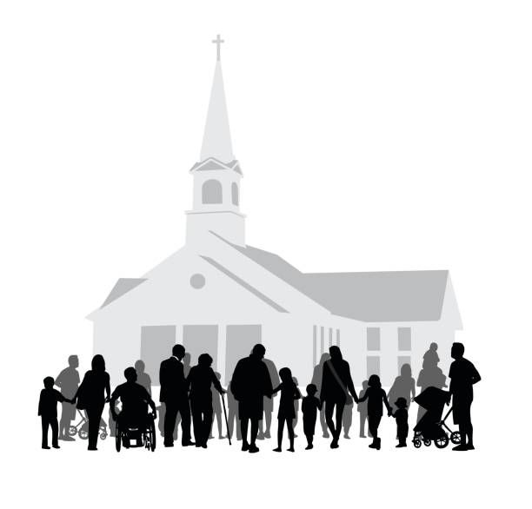
EXAMPLES 3
BEING EXAMPLES TO
OTHER CHRISTIANS AND CHILDREN

Slide 11
EXAMPLES TO OTHER CHRISTIANS AND CHILDREN
1 Tim 4:12 Let no one despise your youth, but be an example to the believers in word, in conduct, in love, in spirit, in faith, in purity.
2 Th 3:7-13 For you yourselves know how you ought to follow us, for we were not disorderly among you; {8} nor did we eat anyone's bread free of charge, but worked with labor and toil night and day, that we might not be a burden to any of you, {9} not because we do not have authority, but to make ourselves an example of how you should follow us, {10} For even when we were with you, we commanded you this: If anyone will not work, neither shall he eat. {11} For we hear that there are some who walk among you in a disorderly manner, not working at all, but are busybodies, {12} Now those who are such we command and exhort through our Lord Jesus Christ that they work in quietness and eat their own bread. {13} But as for you, brethren, do not grow weary in doing good.
1 Pet 5:3 nor as being lords over those entrusted to you, but being examples to the flock.

Slide 12
I. THE EXAMPLE OF
ASSEMBLING WITH THE SAINTS
ASSEMBLING - Heb 10:25 not forsaking the assembling of ourselves together, as is the manner of some, but exhorting one another, and so much the more as you see the Day approaching.
BIBLE STUDY - 2 Tim 2:15 Be diligent to present yourself approved to God, a worker who does not need to be ashamed, rightly dividing the word of truth.
EDIFICATION - Eph 4:16 from whom the whole body, joined and knit together by what every joint supplies, according to the effective working by which every part does its share, causes growth of the body for the edifying of itself in love.

Slide 13
II. THE EXAMPLE OF UNITY
John 17:20–23 “I do not pray for these alone, but also for those who will believe in Me through their word; ²¹ that they all may be one, as You, Father, are in Me, and I in You; that they also may be one in Us, that the world may believe that You sent Me. ²² And the glory which You gave Me I have given them, that they may be one just as We are one: ²³ I in them, and You in Me; that they may be made perfect in one, and that the world may know that You have sent Me, and have loved them as You have loved Me.
Eph 4:1 therefore, the prisoner of the Lord, beseech you to walk worthy of the calling with which you were called, {2} with all lowliness and gentleness, with longsuffering, bearing with one another in love, {3} endeavoring to keep the unity of the Spirit in the bond of peace.

Slide 14
III. THE EXAMPLE OF STEWARDSHIP - HOW ARE WE USING WHAT WE HAVE FOR GOD – TIME, MONEY, ENERGY, POSSESSIONS, ETC.
1 Cor 6:20 For you were bought at a price; therefore glorify God in your body and in your spirit, which are God's.
1 Corinthians 10:31 Therefore, whether you eat or drink, or whatever you do, do all to the glory of God.

Slide 15
IV. THE EXAMPLE OF FELLOWSHIP - ENJOYING SPENDING TIME WITH OTHER CHRISTIANS
Acts 2:42-47 And they continued steadfastly in the apostles' doctrine and fellowship, in the breaking of bread} and in prayers. {43} Then fear came upon every soul, and many wonders and signs were done through the apostles. {44} Now al l who believed were together, and had all things in common, {45} and sold their possessions and goods, and divided them among all, as anyone had need, {46} So continuing daily with one accord in the temple, and breaking bread from house to house, they ate their food with gladness and simplicity of heart, {47} praising God and having favor with all the people. And the Lord added to the church daily those who were being saved.

Slide 16
IV. THE EXAMPLE OF FELLOWSHIP - ENJOYING SPENDING TIME WITH OTHER CHRISTIANS
Hebrews 10:23–25 Let us hold fast the confession of our hope without wavering, for He who promised is faithful. ²⁴ And let us consider one another in order to stir up love and good works, ²⁵ not forsaking the assembling of ourselves together, as is the manner of some, but exhorting one another, and so much the more as you see the Day approaching.

Slide 17
V. THE EXAMPLE IN EVANGELISM - CONCERN FOR THE LOST
2 Tim 2:2 And the things that you have heard from me among many witnesses, commit these to faithful men who will be able to teach others also.
Jude 22–23 And on some have compassion, making a distinction; ²³ but others save with fear, pulling them out of the fire, hating even the garment defiled by the flesh.

Slide 18
VI. THE EXAMPLE OF BENEVOLENCE - CARING ABOUT THE PHYSICAL NEEDS OF OTHERS
Gal 6:10 Therefore, as we have opportunity, let us do good to all, especially to those who are of the household of faith.
James 2:14–17 What does it profit, my brethren, if someone says he has faith but does not have works? Can faith save him? ¹⁵ If a brother or sister is naked and destitute of daily food, ¹⁶ and one of you says to them, “Depart in peace, be warmed and filled,” but you do not give them the things which are needed for the body, what does it profit? ¹⁷ Thus also faith by itself, if it does not have works, is dead.

Slide 19
VII. THE EXAMPLE OF PUTTING GOD FIRST IN YOUR LIFE, IN ALL OF THE ABOVE, BEFORE: RECREATION, RELAXATION, WORK, CLUBS, SPORTS, FAMILY, SELF. REALLY PUTTING GOD FIRST.
Mark 12:29–30 Jesus answered him, “The first of all the commandments is: ‘Hear, O Israel, the LORD our God, the LORD is one. ³⁰ And you shall love the LORD your God with all your heart, with all your soul, with all your mind, and with all your strength.’ This is the first commandment.
Matthew 6:33 But seek first the kingdom of God and His righteousness, and all these things shall be added to you.

Slide 20
'TWAS A SHEEP
‘Twas a sheep, not a lamb, that strayed away,
in a parable Jesus told,
A grown-up sheep, that had gone astray,
from ninety and nine in the fold.
Out on the hillside, out in the cold,
it was a sheep the good shepherd sought;
And back to the flock, safe in the fold,
'twas a sheep, the good shepherd brought.
Why for the sheep, should we earnestly long,
and as earnestly, hope and pray?

Slide 21
'TWAS A SHEEP
Because there is danger; if they go wrong,
they will lead the lambs astray.
For the lambs will follow the sheep,
you know, wherever the sheep may stray,
When the sheep go wrong, it will not be long,
'til the lambs are as wrong as they.
And so with the sheep, we earnestly plead,
for the sake of the lambs today;
If the lambs are lost, what a terrible cost,
some sheep will have to pay.

Slide 23

PRAYER

Slide 24

TONIGHT’S SERMON:
TAKE TIME TO BE HOLY

