Slide 1

WELCOME TO THE
JACKSON STREET CHURCH OF CHRIST
PLEASE TURN OFF CELLPHONES

Slide 2


Slide 3

LET US PRAY

Slide 4

SINGING

Slide 5
Hebrews 12:14–15 Pursue peace with all people, and holiness, without which no one will see the Lord: 15 looking carefully lest anyone fall short of the grace of God; lest any root of bitterness springing up cause trouble, and by this many become defiled;

Slide 6
LET US PRAY

Slide 7
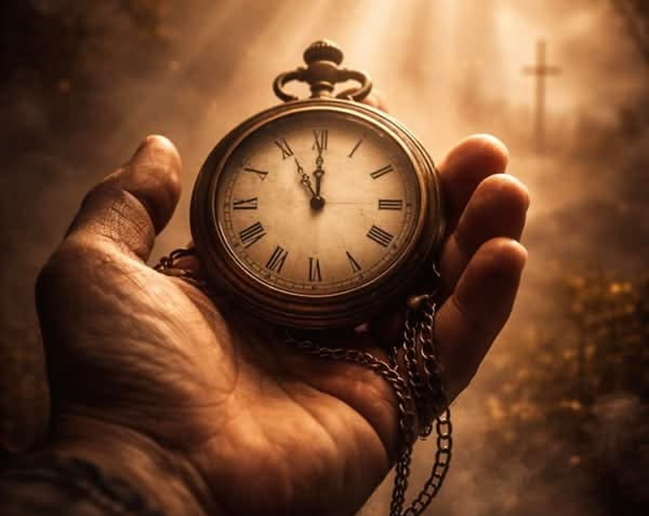
TAKE TIME TO BE HOLY #343

Slide 8
TAKE TIME TO BE HOLY #627
Written in 1874 by William D. Longstaff
Many more time pressures today?
  Telephone had not been invented (1876)
  The phonograph had not been invented (1877) first recording/playback instrument.
  The QWERTY typewriter had just been introduced. (1873)
  The light bulb had not been invented (1879)
  The internal combustion engine had not been invented (1879) leading to the first automobile. (1885)
  No electricity anywhere in homes. Not common until 1920-1930
Did all of our time saving devices end up causing more time pressures?

Slide 9
IT TAKES TIME TO BE HOLY
IN 1874 AND IN 2026, IT TAKES TIME TO BE HOLY
  Colossians 1:21-23 And you, who once were alienated and enemies in your mind by wicked works, yet now He has reconciled {22} in the body of His flesh through death, to present you holy, and blameless, and above reproach in His sight; {23} if indeed you continue in the faith, grounded and steadfast, and are not moved away from the hope of the gospel which you heard, which was preached to every creature under heaven, of which I, Paul, became a minister.
  Romans 12:1 I beseech you therefore, brethren, by the mercies of God, that you present your bodies a living sacrifice, holy, acceptable to God, which is your reasonable service.

Slide 10
I. TAKE TIME TO BE HOLY
1 Peter 1:15–16 but as He who called you is holy, you also be holy in all your conduct, ¹⁶ because it is written, “Be holy, for I am holy.”

Slide 11
SPEAK OFT WITH THY LORD
1 Thessalonians 5:17 pray without ceasing,

Slide 12
ABIDE IN HIM ALWAYS - LIVE IN CHRIST
John 15:4-8 "Abide in Me, and I in you. As the branch cannot bear fruit of itself, unless it abides in the vine, neither can you, unless you abide in Me. {5} I am the vine, you are the branches. He who abides in Me, and I in him, bears much fruit; for without Me you can do nothing. {6} Anyone does not abide in Me, he is cast out as a branch and is withered; and they gather them and throw them into the fire, and they are burned. {7} If you abide in Me, and My words abide in you, you will ask what you desire, and it shall be done for you. {8} "By this My Father is glorified, that you bear much fruit; so you will be My disciples.

Slide 13
AND FEED ON HIS WORD – STUDY
& MEDITATE
I Peter 2:2 as newborn babes, desire the pure milk of the word, that you may grow thereby.

Slide 14
MAKE FRIENDS OF GOD'S CHILDREN - DEVELOPING FRIENDSHIPS TAKES TIME.
Proverbs 18:24 A man who has friends must himself be friendly, But there is a friend who sticks closer than a brother.
Hebrews 10:25 not forsaking the assembling of ourselves together, as is the manner of some, but exhorting one another, and so much the more as you see the Day approaching.

Slide 15
HELP THOSE WHO ARE WEAK - HELPING OTHERS IS AN IMPORTANT PART OF HOLINESS
1 Thessalonians 5:14 Now we exhort you, brethren, warn those who are unruly, comfort the fainthearted, uphold the weak, be patient with all -
Galatians 6:2 Bear one another's burdens, and so fulfill the law of Christ,

Slide 16
FORGETTING IN NOTHING HIS BLESSINGS TO SEEK - DON'T FORGET WHO YOUR LORD & MASTER IS, WHO YOU SERVE
James 4:13-15 Come now, you who say, "Today or tomorrow we will go to such and such a city, spend a year there, buy and sell, and make a profit", {14} whereas you do not know what will happen tomorrow. For what is your life? It is even a vapor that appears for a little time and then vanishes away. {15} Instead you ought to say, "If the Lord wills, we shall live and do this or that."
Ephesians 1:3 Blessed be the God and Father of our Lord Jesus Christ, who has blessed us with every spiritual blessing in the heavenly places in Christ,

Slide 17
II. TAKE TIME TO BE HOLY
THE WORLD RUSHES ON
Romans 1:28-32 And even as they did not like to retain God in their knowledge, God gave them over to a debased mind, to do those things which are not fitting; {29} being filled with all unrighteousness, sexual immorality, wickedness, covetousness, maliciousness; full of envy, murder, strife, deceit, evil-mindedness; they are whisperers, {30} backbiters, haters of God violent, proud, boasters, inventors of evil things, disobedient to parents, {31} undiscerning, untrustworthy, unloving, unforgiving, unmerciful; {32} who, knowing the righteous judgment of God, that those who practice such things are deserving of death, not only do the same but also approve of those who practice them.

Slide 18
SPEND MUCH TIME IN SECRET WITH JESUS ALONE
Matthew 6:6 But you, when you pray, go into your room, and when you have shut your door, pray to your Father who is in the secret place; and your Father who sees in secret will reward you openly.
Matthew 28:19-20 "Go therefore and make disciples of all the nations, baptizing them in the name of the Father and of the Son and of the Holy Spirit, {20} "teaching them to observe all things that I have commanded you; and lo, I am with you always, even to the end of the age. Amen.

Slide 19
ABIDING IN JESUS, LIKE HIM YOU SHALL BE
Romans 8:29 For whom He foreknew, He also predestined to be conformed to the image of His Son, that He might be the firstborn among many brethren.
2 Corinthians 3:18 But we all, with unveiled face beholding as in a mirror the glory of the Lord, are being transformed into the same image from glory to glory, just as by the Spirit of the Lord.

Slide 20
THY FRIEND IN THY CONDUCT HIS LIKENESS SHALL SEE
Colossians 3:17 And whatever you do in word or deed, do all in the name of the Lord Jesus, giving thanks to God the Father through Him.
1 Peter 2:21 For to this you were called, because Christ also suffered for us, leaving us an example, that you should follow His steps:

Slide 21
III. TAKE TIME TO BE HOLY
BE CALM IN THY SOUL
Philippians 4:6–7 Be anxious for nothing, but in everything by prayer and supplication, with thanksgiving, let your requests be made known to God; ⁷ and the peace of God, which surpasses all understanding, will guard your hearts and minds through Christ Jesus.

Slide 22
EACH THOUGHT AND EACH MOTIVE BENEATH HIS CONTROL
2 Corinthians 10:5 casting down arguments and every high thing that exalts itself against the knowledge of God, bringing every thought into captivity to the obedience of Christ,

Slide 23
THUS LED BY HIS SPIRIT TO FOUNTAINS OF LOVE
Romans 5:5 Now hope does not disappoint, because the love of God has been poured out in our hearts by the Holy Spirit who was given to us.

Slide 24
THOU SOON SHALL BE FITTED FOR SERVICE ABOVE
Revelation 7:13-17 Then one of the elders answered, saying to me, "Who are these arrayed in white robes, and where did they come from?" {14} And I said to him, Sir, you know. So he said to me, "These are the ones who come out of the great tribulation, and washed their robes and made them white in the blood of the Lamb, {15} "Therefore they are before the throne of God, and serve Him day and night in His temple. And He who sits on the throne will dwell among them. {16} "They shall neither hunger anymore nor thirst anymore; the sun shall not strike them, nor any heat; {17} "for the Lamb who is in the midst of the throne will shepherd them and lead them to living fountains of waters. And God will wipe away every tear from their eyes.

Slide 25
It takes time to be holy.
Are you giving holiness enough of your time?

Slide 26
SINGING

Slide 27

IN REMEMBRANCE OF JESUS

Slide 28

CONTRIBUTION

Slide 29
SINGING

Slide 30
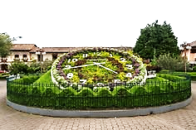
HAVE A TIME-AWARE WEEK

