Slide 1

WELCOME TO THE
JACKSON STREET CHURCH OF CHRIST
PLEASE TURN OFF CELLPHONES

Slide 2


Slide 3


Slide 4

SINGING

Slide 5

IN REMEMBRANCE OF JESUS

Slide 6

CONTRIBUTION

Slide 7



Slide 8
1 Corinthians 10:1–5 Moreover, brethren, I do not want you to be unaware that all our fathers were under the cloud, all passed through the sea, ² all were baptized into Moses in the cloud and in the sea, ³ all ate the same spiritual food, ⁴ and all drank the same spiritual drink. For they drank of that spiritual Rock that followed them, and that Rock was Christ. ⁵ But with most of them God was not well pleased, for their bodies were scattered in the wilderness.

Slide 10
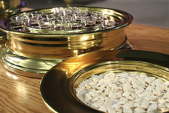
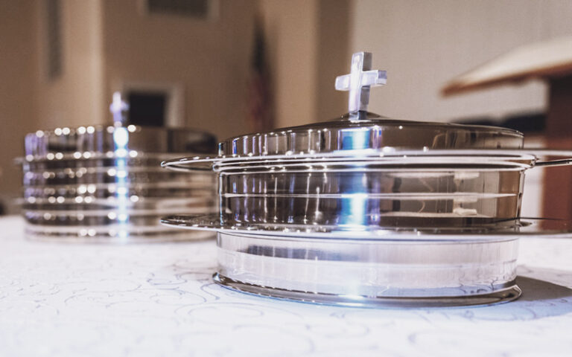
THE LORD'S SUPPER

Slide 11
THE LORD’S SUPPER
PAUL USES AN ANALOGY TO LEAD INTO HIS DISCUSSION OF THE LORD’S SUPPER IN CHAPTER 11. - 1 Corinthians 10:1–5 Moreover, brethren, I do not want you to be unaware that all our fathers were under the cloud, all passed through the sea, ² all were baptized into Moses in the cloud and in the sea, ³ all ate the same spiritual food, ⁴ and all drank the same spiritual drink. For they drank of that spiritual Rock that followed them, and that Rock was Christ. ⁵ But with most of them God was not well pleased, for their bodies were scattered in the wilderness.

Slide 12
THE LORD’S SUPPER
THE LORD’S SUPPER WAS INSTITUTED BY JESUS - Mat 26:26-28 And as they were eating, Jesus took bread, blessed and broke it, and gave it to the disciples and said, Take eat; this is My body. {27} Then He took the cup, and gave thanks, and gave it to them, saying, Drink from it, all of you. {28} For this is My blood of the new covenant, which is shed for many for the remission of sins,

Slide 13
THE LORD’S SUPPER
IT WAS CONTINUED IN THE CHURCHES - 1 Cor 11:23-25 For I received from the Lord that which I also delivered to you: that the Lord Jesus on the same night in which He was betrayed took bread; {24} and when He had given thanks, He broke it and said, Take eat; this is My body which is broken for you; do this in remembrance of Me. {25} In the same manner He also took the cup after supper, saying, “This cup is the new covenant in My blood. This do, as often as you drink it, in remembrance of Me, "

Slide 14
WHAT ARE THE ELEMENTS OF THE LORD'S SUPPER?
BREAD ONLY OR BREAD AND FRUIT OF THE VINE?
  1 Cor 11:26 For as often as you eat this bread and drink this cup, you proclaim the Lord's death till He comes.
  2 Cor 10:16-17 The cup of blessing which we bless, is it not the communion of the blood of Christ? The bread which we break, is it not the communion of the body of Christ? {17} For we, though many, are one bread and one body; for we all partake of that one bread.

Slide 15
WHAT ARE THE ELEMENTS OF THE LORD'S SUPPER?
FERMENTED OR NOT?
  In the N.T, fruit of the vine and wine both refer to fermented or unfermented grape juice, the context determines which.
  They did not have the preservation methods in the first century that we do now and at times the grape juice (wine) would go through natural fermentation. 1 Cor. 11:21 indicates that what was used at that time was able to cause drunkenness. 1 Corinthians 11:21 For in eating, each one takes his own supper ahead of others; and one is hungry and another is drunk.
  It is interesting to note that Jesus always referred to it as the fruit of the vine, not wine.
  Since we can preserve the grape juice and since there is a serious problem of alcoholism in our society we use unfermented only.

Slide 16
II. WHEN EATEN: DAILY, WEEKLY, MONTHLY, GUARTERLY, YEARLY???
IT WAS OBSERVED WHEN THEY CAME TOGETHER - 1 Corinthians 11:17–20 Now in giving these instructions I do not praise you, since you come together not for the better but for the worse. ¹⁸ For first of all, when you come together as a church, I hear that there are divisions among you, and in part I believe it. ¹⁹ For there must also be factions among you, that those who are approved may be recognized among you. ²⁰ Therefore when you come together in one place, it is not to eat the Lord’s Supper.

Slide 17
II. WHEN EATEN: DAILY, WEEKLY, MONTHLY, GUARTERLY, YEARLY???
THEY CAME TOGETHER ON THE FIRST DAY OF EVERY WEEK
  Acts 20: 7 Now on the first day of the week, when the disciples came together to break bread, Paul ready to depart the next day, spoke to them and continued his message until midnight.
  1 Cor 16:2 On the first day of the week let each one of you lay something aside, storing up as he may prosper, that there be no collections when I come.
C. Every first day of the week just as every sabbath was to be kept holy under the Old Covenant.

Slide 18
III. WHY DO WE PARTAKE
NOT A FEAST TO SATISFY HUNGER
1 Cor 11:22 What! Do you not have houses to eat and drink in? Or do you despise the church of God and shame those who have nothing? What shall I say to you? Shall I praise you in this? I do not praise you.
1 Cor 11:34 But if anyone is hungry, let him eat at home, lest you come together for judgment. And the rest, I will set in order when I come.

Slide 19
III. WHY DO WE PARTAKE
IT IS A MEMORIAL TO REMEMBER WHAT JESUS DID
1 Cor 11:23-25 For I received from the Lord that which I also delivered to you: that the Lord Jesus on the same night in which He was betrayed took bread; {24} and when He had given thanks, He broke it and said, eat; this is My body which is broken for you; do this in remembrance of Me. {25} In the same manner He also took the cup after supper, saying, “This cup is the new covenant in My blood. This do, as often as you drink it, in remembrance of Me.
1 Cor 11:26 For as often as you eat this bread and drink this cup, you proclaim the Lord's death till He comes.

Slide 20
IV. WHO: CLOSED OR
OPEN COMMUNION
EACH PERSON IS TO EXAMINE THEMSELF BEFORE THEY PARTAKE - 1 Cor 11:27-82 Therefore whoever eats this bread or drinks this cup of the Lord in an unworthy manner will be guilty of the body and blood of the Lord, {28} But let a man examine himself, and so let him eat of the bread and drink of the cup. {29} For he who eats and drinks in an unworthy manner eats and drinks judgment to himself, not discerning the Lord's body. {30} For this reason many are weak and sick among you, and many sleep. {31} For if we would judge ourselves, we would not be judged. 32} But when we are judged we are chastened by the Lord, that we may not be condemned with the world.
Since the Lord's supper is a part of the regular assembly, then it is passed to all present and each person decides whether to partake or not.

Slide 21
V. HOW: TRANSUBSTANTIATION OR REPRESENTS BODY AND BLOOD???
1 Cor 11:24 and when He had given thanks, He broke it and said, “Take eat; this is My body which is broken for you; do this in remembrance of Me”.
1 Cor 11:25 In the same manner He also took the cup after supper, saying, “This cup is the new covenant in My blood. This do, as often as you drink it in remembrance of Me”.
Acts 15:29 that you abstain from things offered to idols, from blood, from things strangled, and from sexual immorality. If you keep yourselves from these, you will do well. Farewell

Slide 22
THE LORD’S SUPPER
Are you qualified to partake of the Lord’s Supper?
Remembering your cleansing from sin by the blood of Christ.
Are you partaking of the Lord’s Supper in the proper way?
Are you living a life of appreciation for what Jesus did on the cross.
2 Corinthians 5:15 and He died for all, that those who live should live no longer for themselves, but for Him who died for them and rose again.

Slide 24

PRAYER

Slide 25

TONIGHT’S SERMON: PRAYER

