Slide 1
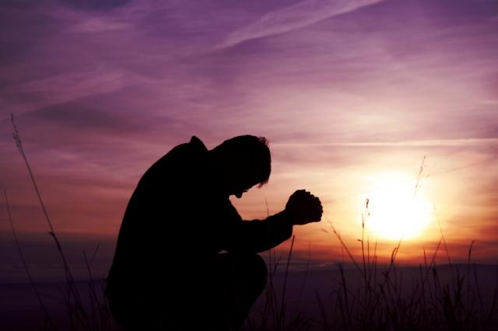
WELCOME TO THE
JACKSON STREET CHURCH OF CHRIST
PLEASE TURN OFF CELLPHONES

Slide 2


Slide 3
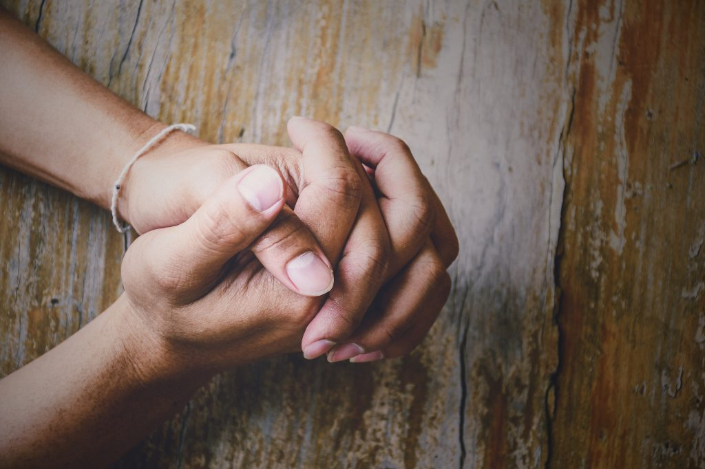
LET US PRAY

Slide 4
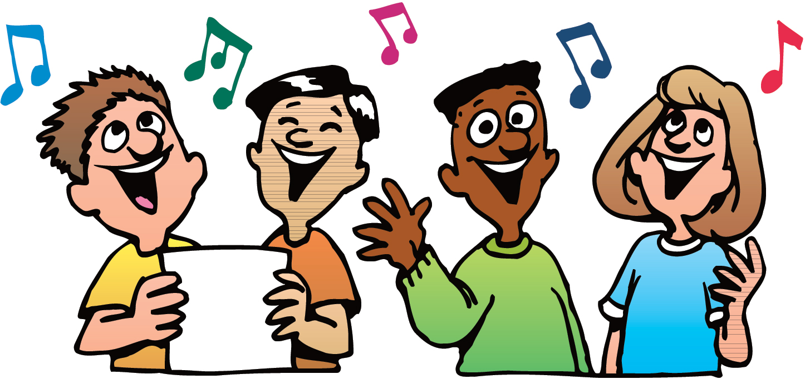
SINGING

Slide 5
Luke 11:1–4 Now it came to pass, as He was praying in a certain place, when He ceased, that one of His disciples said to Him, “Lord, teach us to pray, as John also taught his disciples.” 2 So He said to them, “When you pray, say: Our Father in heaven, Hallowed be Your name. Your kingdom come. Your will be done On earth as it is in heaven. 3 Give us day by day our daily bread. 4 And forgive us our sins, For we also forgive everyone who is indebted to us. And do not lead us into temptation, But deliver us from the evil one.”

Slide 6
LET US PRAY

Slide 7
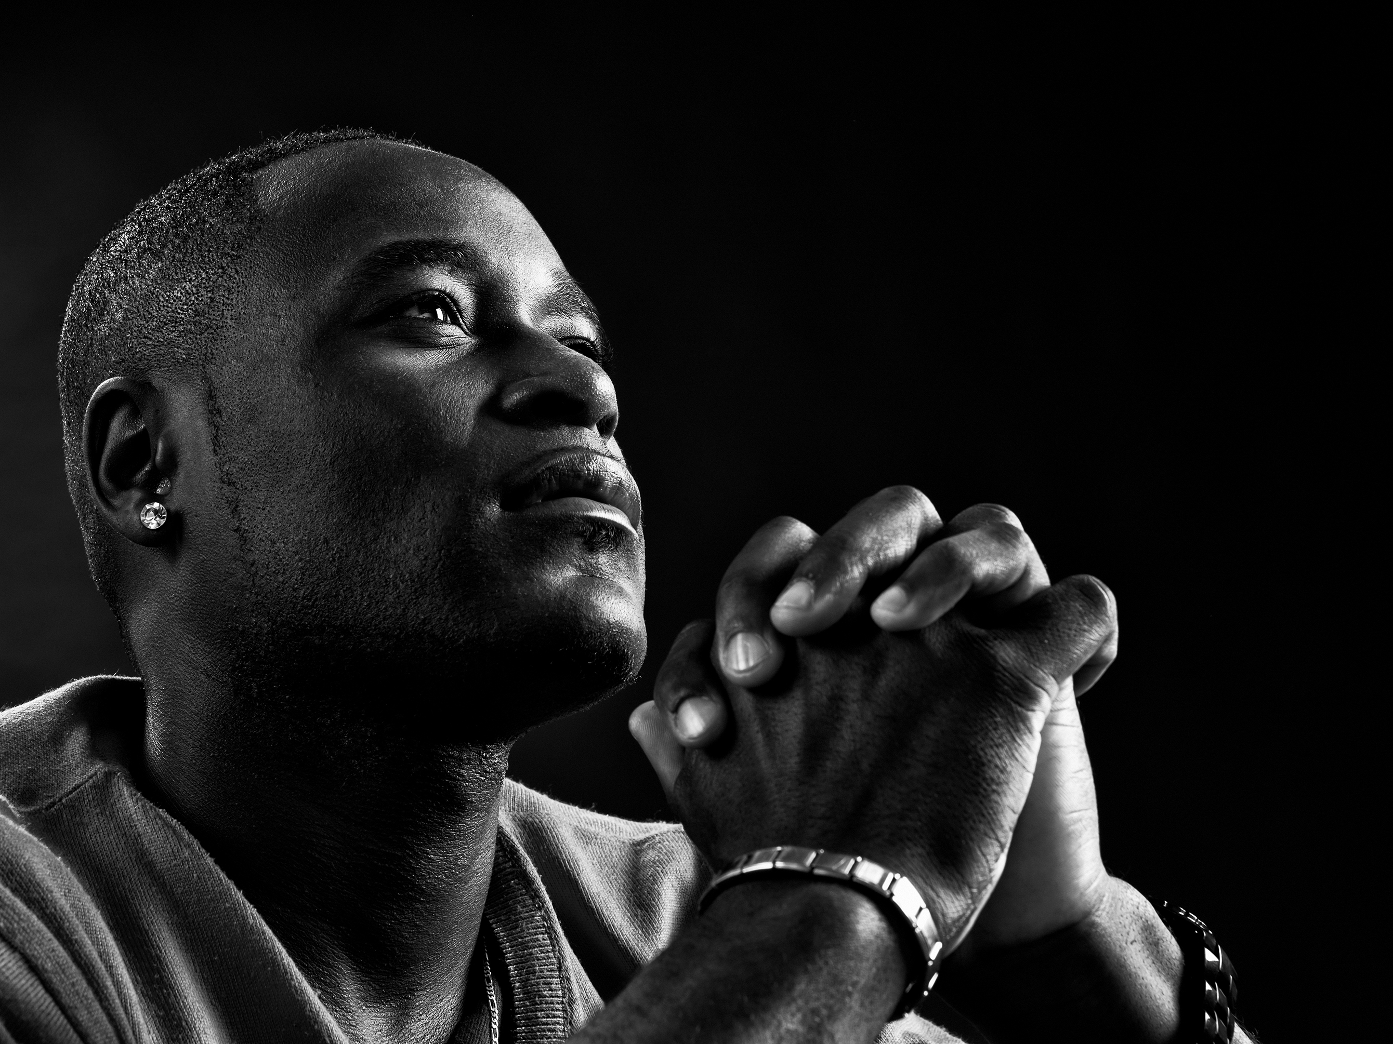
PRAYER

Slide 8
PRAYER
God communicates with us through His word. The bible.
Prayer is our way of communicating with God.
Prayer is for our benefit, to help us realize our connection to our heavenly Father.

Slide 9
I. WHO MAY PRAY AND BE HEARD?
CHRISTIANS - 1 Peter 2 For the eyes of the LORD are on the righteous, And His ears are open to their prayers; But the face of the LORD is against those who do evil.
NON-CHRISTIANS WANTING TO PLEASE GOD – Cornelius - Acts 10:4 And when he observed him, he was afraid, and said, 'What is it, lord?" So he said to him, Your prayers and your alms have come up for a memorial before God.

Slide 10
II. WHY PRAY?
TO EXPRESS - ADORATION Matthew 6:9 In this manner, therefore, pray: Our Father in heaven, Hal lowed be Your name.
TO ACKNOWLEDGE OUR SINS - CONFESSION Matthew 6:12 And forgive us our debts, As we forgive our debtors.
TO SHOW OUR THANKFULNESS - THANKSGIVING - 1 Timothy Therefore I exhort first of all that supplications, prayers, intercessions, and giving of thanks be made for all men.
TO ASK FOR HELP - SUPPLICATION Matthew 6:11 Give us this day our daily bread
TO INTERCEDE FOR OTHERS - INTERCESSION - 1 John 5:16 If anyone sees his brother sinning a sin which does not lead to death, he will ask, and He will give him life for those who commit sin not leading to death. There is sin leading to death. I do not say that he should pray about that.

Slide 11
III. FOR WHAT SHOULD WE PRAY?
SELF
NEEDS - Matthew 6:11 Give us this day our daily bread,
SINS - Matthew 6:12 And forgive us our debts, As we forgive our debtors.
WISDOM - James If any of you lacks wisdom, let him ask of God, who gives to all liberally and without reproach, and it will be given to him.
DELIVERANCE - Matthew 6:13 And do not lead us into temptation, But deliver us from the evil one. For Yours is the kingdom and the power and the glory forever, Amen.
BOLDNESS - Ephesians 6:19 and (pray) for me, that utterance may be given to me, that I may open my mouth boldly to make known the mystery of the gospel.

Slide 12
III. FOR WHAT SHOULD WE PRAY?
OTHERS
ENEMIES - Matthew 5:44 But I say to you, love your enemies, bless those who curse you, do good to those who hate you, and pray for those who spitefully use you and persecute you,
SICK - James 5:16 Confess your trespasses to one another, and pray for one another, that you may be healed. The effective, fervent prayer of a righteous man avails much,

Slide 13
III. FOR WHAT SHOULD WE PRAY?
OTHERS
SINNING BROTHER - 1 John 5:16 If anyone sees his brother sinning a sin which does not lead to death, he will ask, and He will give him life for those who commit sin not leading to death. There is sin leading to death. I do not say that he should pray about that.
RULERS - 1 Timothy 2:1-3 Therefore I exhort fi ret of al l that suppl i cat ions, prayers, intercessions, and giving of thanks be made for al l men, {2} for kings and al l who are in authority, that we may lead a quiet and peaceable life in al l godliness and reverence. {3} For this is good and acceptable in the sight of God our Savior.

Slide 14
III. FOR WHAT SHOULD WE PRAY?
THE WORK OF THE LORD
Matthew 6:10 Your kingdom come, Your will be done On earth as it is in heaven,
Colossians 4:3 meanwhile praying also for us, that God would open to us a door for the word, to speak the mystery of Christ, for which I am also in chains.
2 Thessalonians 3:1 Finally, brethren, pray for us, that the word of the Lord may run swiftly and be glorified, just as it is with you,

Slide 15
IV. WHEN SHOULD WE PRAY
CONTINUALLY 1 Thessalonians 5:17 pray without ceasing,
WHEN IN NEED AND IN ABUNDANCE
IN CONFIDENCE AND IN FEAR
IN FREEDOM AND IN BONDAGE
AT RISING
AT MEALS
AT BEDTIME
AT DEVOTIONALS AND ASSEMBLIES

Slide 16
V. WHERE SHOULD WE PRAY
IN PUBLIC
  DEVOTIONALS
  GET-TOGETHERS
  CHURCH (ASSEMBLIES)
  MEALS
IN PRIVATE
Matthew 6:6 But you, when you pray, go into your room , and when you have shut your door, pray to your Father who is in the secret place; and your Father who sees in secret will reward you openly.
AT TIMES OF PERSONAL NEEDS AS WITH JESUS IN THE GARDEN

Slide 17
VI. HOW SHOULD WE PRAY
TRUSTING IN GOD TO ANSWER - James 1:6-7 But let him ask in faith, with no doubting, for he who doubts is like a wave of the sea driven and tossed by the wind. {7} For let not that man suppose that he will receive anything from the Lord;
HUMBLY - Luke 18:9-14 Also He spoke this parable to some who trusted in themselves that they were righteous, and despised others: {10} "Two men went up to the temple to pray, one a Pharisee and the other a tax collector. >>>

Slide 18
VI. HOW SHOULD WE PRAY
{11} The Pharisee stood and prayed thus with himself, 'God, I thank You that I am not like other men; extortioners, unjust, adulterers, or even as this tax collector. {12} I fast twice a week. I give tithes of all that I possess.' {13} "And the tax collector, standing afar off, would not so much as raise his eyes to but beat his breast, saying, 'God, be merciful to me a sinner! {14} I tell you, this man went down to his house justified rather than the other; for everyone who exalts himself will be humbled, and he who humbles himself will be exalted.'

Slide 19
VI. HOW SHOULD WE PRAY
ACCORDING TO GODS WILL - 1 John 5:14 Now this is the confidence that we have in Him, that if we ask anything according to His will , He hears us.
WITHOUT VAIN REPETITIONS - Matthew 6:7 And when you pray, do not use vain repetitions as the heathen do. For they think that they will be heard for their many words,
UNSELFISHLY - James You ask and do not receive, because you ask amiss, that you may spend it on your pleasures.

Slide 20
VI. HOW SHOULD WE PRAY
NOT TO BE SEEN OF MEN - Matthew "And when you pray, you shall not be like the hypocrites. For they love to pray standing in the synagogues and on the corners of the streets, that they may be seen by men, Assuredly, I say to you, they have their reward.
VERBALLY OR SILENTLY - 1 Samuel 1:12–13 And it happened, as she continued praying before the LORD, that Eli watched her mouth. ¹³ Now Hannah spoke in her heart; only her lips moved, but her voice was not heard. Therefore Eli thought she was drunk.

Slide 21
YOUR PRAYER LIFE?
Are you a child of God, so you may pray to Him as your Father?
As a child of God, are you praying like you should?

Slide 22
SINGING

Slide 23

IN REMEMBRANCE OF JESUS

Slide 24

CONTRIBUTION

Slide 25
SINGING

Slide 26
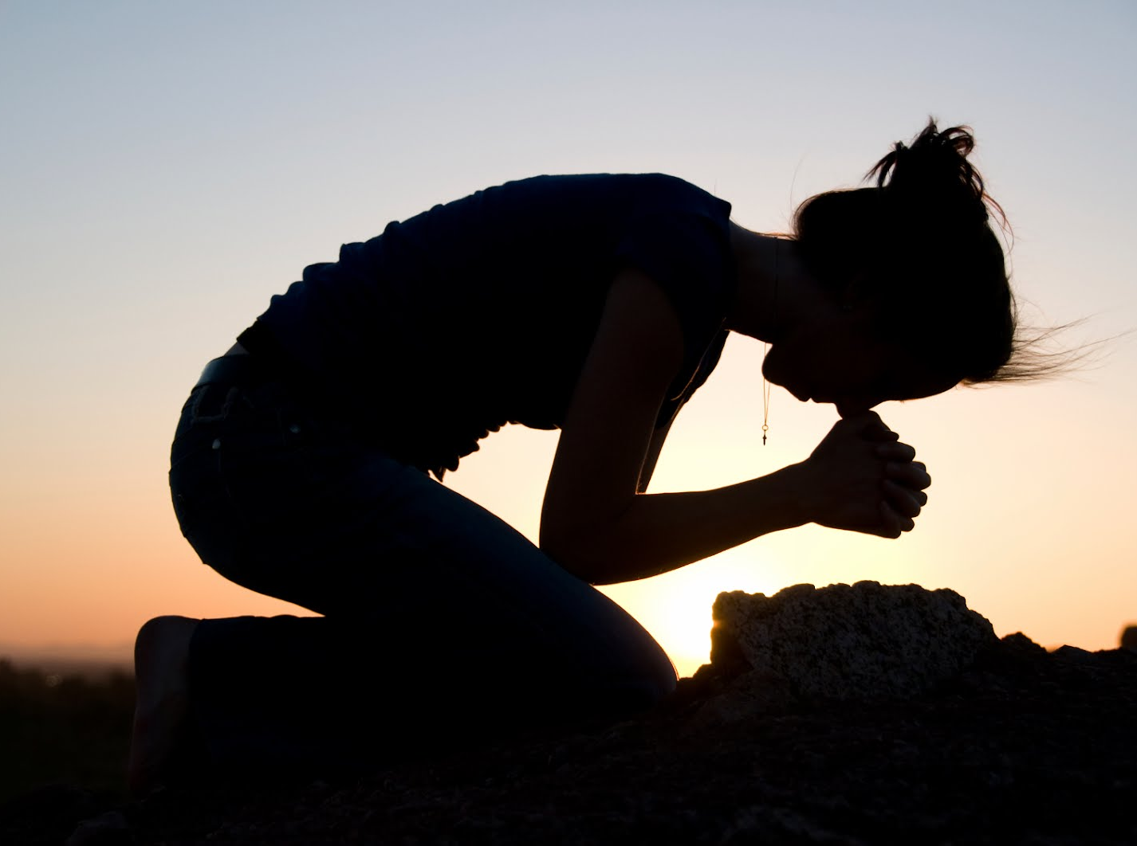
HAVE A PRAYERFUL WEEK

