Slide 1

WELCOME TO THE
JACKSON STREET CHURCH OF CHRIST
PLEASE TURN OFF CELLPHONES

Slide 2


Slide 3


Slide 4

SINGING

Slide 5

IN REMEMBRANCE OF JESUS

Slide 6

CONTRIBUTION

Slide 7



Slide 8
Isaiah 62:1–5 For Zion’s sake I will not hold My peace, And for Jerusalem’s sake I will not rest, Until her righteousness goes forth as brightness, And her salvation as a lamp that burns. ² The Gentiles shall see your righteousness, And all kings your glory. You shall be called by a new name, Which the mouth of the LORD will name. ³ You shall also be a crown of glory In the hand of the LORD, And a royal diadem In the hand of your God. ⁴ You shall no longer be termed Forsaken, Nor shall your land any more be termed Desolate; But you shall be called Hephzibah, and your land Beulah; For the LORD delights in you, And your land shall be married. ⁵ For as a young man marries a virgin, So shall your sons marry you; And as the bridegroom rejoices over the bride, So shall your God rejoice over you.

Slide 10
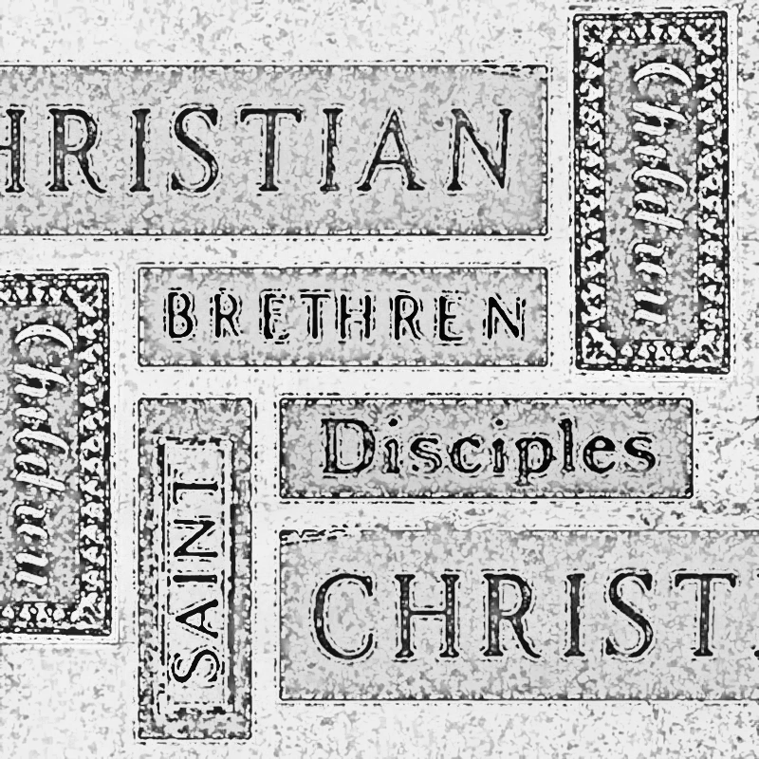
CHRISTIAN NAMES AND DESIGNATIONS

Slide 11
NAMES
How do you feel when someone calls you by the wrong name?
Dale Carnegie once said, “a person’s name is to that person the sweetest and most important sound in any language.
We normally think of ourselves as Christians, but there are other names which describe followers of Jesus.

Slide 12
CHRISTIANS – TELLS OF OUR FOLLOWING CHRIST
CHRISTIANS BY NAME - Acts 11:26 And when he had found him, he brought him to Antioch. So it was that for a whole year they assembled with the church and taught a great many people. And the disciples were first called Christians in Antioch.
CHRISTIANS BY FOLLOWING CHRIST - Acts 26:28 Then Agrippa said to Paul, 'You almost persuade me to become a Christian.
CHRISTIANS IN GLORIFYING GOD - 1 Peter 4:16 Yet if anyone suffers as a Christian, let him not be ashamed, but let him glorify God in this name.

Slide 13
II. BELIEVERS –
TELLS OF OUR FAITH
BELIEVERS IN GOD - Romans 4:22-24 And therefore "it was accounted to him for righteousness, {23} Now it was not written for his sake alone that it was imputed to him, {24} but also for us. It shall be imputed to us who believe in Him who raised up Jesus our Lord from the dead,
BELIEVERS IN JESUS - John 8:24 "Therefore I said to you that you will die in your sins; for if you do not believe that I am He, you will die in your sins,
BELIEVERS IN GOD'S LOVE - John 3:16-18 For God so loved the world that He gave His only begotten Son, that whoever believes in Him should not perish but have everlasting life. {17) "For God did not send His Son into the world to condemn the world, but that the world through Him might be saved. {18} "He who believes in Him is not condemned; but he who does not believe is condemned already, because he has not believed in the name of the only begotten Son of God.

Slide 14
II. BELIEVERS –
TELLS OF OUR FAITH
BELIEVERS IN GOD'S WORD - John 12:47-50 'And if anyone hears My words and does not believe, I do not judge him; for I did not come to judge the world but to save the world. {48} He who rejects Me, and does not receive My words, has that which judges him; the word that I have spoken will judge him in the last day. {49} "For I have not spoken on My own authority; but the Father who sent Me gave Me a command, what I should say and what I should speak. {50} “ And I know that His command is everlasting Life. Therefore, whatever I speak, just as the Father has told Me, so I speak.
PRAYER, HEAVEN, HELL, SALVATION, SIN, SATAN
EVERYTHING THE BIBLE SAYS IS TO BE BELIEVED

Slide 15
III. DISCIPLES –
TELLS OF OUR KNOWLEDGE
LEARNERS OF TRUTH (THE WORD) - John 8:32 And you shall know the truth, and the truth shall make you free.
LEARNERS OF OBEDIENCE - Hebrews 5:8 though He was a Son, yet He learned obedience by the things which suffered.
LEARNERS OF JESUS - Matthew 11:29 Take My yoke upon you and learn from Me, for I am gentle and lowly in heart, and you will find rest for your souls.
LEARNERS OF THE MEANING OF CONTENTMENT - Philippians 4:11 Not that I speak in regard to need, for I have learned in whatever state I am, to be content:

Slide 16
IV. BRETHREN – TELLS OF OUR LOVE FOR EACH OTHER
BRETHREN IN EQUALITY - Matthew 23:8-12 'But you, do not be called 'Rabbi' for One is your Teacher, the Christ, and you are all brethren. {9} "Do not call anyone on earth your father; for One is your Father, He who is in heaven. {10} "And do not be called teachers; for One is your Teacher, the Christ. {11} "But he who is greatest among you shall be your servant. {12} And whoever exalts himself will be humbled, and he who humbles himself will be exalted,
BRETHREN IN ADVERSITY - 1 John 3:17-18 But whoever has this world's goods, and sees his brother in need, and shuts up his heart from him, how does the love of God abide in him? {18) My little children, let us not love in word or in tongue, but in deed and in truth.

Slide 17
IV. BRETHREN – TELLS OF OUR LOVE FOR EACH OTHER
BRETHREN IN EXAMPLE (OUR WALK) - 1 John 2:9-11 He who says he is in the light, and hates his brother, is in darkness until now. {10} He who loves his brother abides in the 1 light, and there is no cause for stumbling in him, {11} But he who hates his brother is in darkness and walks in darkness, and does not know where he is going, because the darkness has blinded his eyes.
BRETHREN IN ETERNITY - 1 John 3:14-15 We know that we have passed from death to life, because we love the brethren. He who does not love his brother abides in death. {15} Whoever hates his brother is a murderer, and you know that no murderer has eternal life abiding in him.

Slide 18
V. SAINTS TELLS OF OUR HOLINESS
SAINTS IN ASSOCIATIONS - 2 Corinthians 6:17-18 Therefore "Come out from among them And be separate, says the Lord. Do not touch what is unclean, And I will receive you. {18} I will be a Father to you, And you shall be My sons and daughters, Says the LORD Almighty.
SAINTS IN SERVICE - 1 Peter 2:5 you also, as living stones, are being built up a spiritual house, a holy priesthood, to offer up spiritual sacrifices acceptable to God through Jesus Christ.

Slide 19
V. SAINTS TELLS OF OUR HOLINESS
SAINTS IN LIVING - 1 Peter 1:13-16 Therefore gird up the loins of your mind, be sober, and rest your hope fully upon the grace that is to be brought to you at the revelation of Jesus Christ; {14} as obedient children, not conforming yourselves to the former lusts, as in your ignorance; {15} but as He who called you is holy, you also be holy in all your conduct, {16} because it is written, 'Be holy, for I am holy.’
SAINTS IN TOTALITY - 1 Thessalonians 5: 22-23 Abstain from every form of evil . {23} Now may the God of peace Himself sanctify you completely; and may your whole spirit, soul , and body be preserved blameless at the coming of our Lord Jesus Christ.

Slide 20
VI. SERVANTS TELLS OF OUR ATTITUDE
SERVANTS IN HUMILITY - Luke 17:10 So likewise you, when you have done all those things which you are commanded, say, 'We are unprofitable servants. We have done what was our duty to do.'
SERVANTS IN ACTION - 1 Corinthians 9:19 For though I am free from all men, I have made myself a servant to all, that I might win the more;
SERVANTS IN POSITION Mark 9:35 And He sat down, called the twelve, and said to them, "If anyone desires to be first, he shall be last of all and servant of all."
SERVANTS IN LOYALTY - Luke 16:13 "No servant can serve two masters; for either he will hate the one and love the other, or else he will be loyal to the one and despise the other, You cannot serve God and mammon."

Slide 21
WHAT ABOUT YOU?
Are You A Christian
Are You A Believer
Are You A Disciple
Are You A Brother
Are You A Saint
Are You A Servant

Slide 23

PRAYER

Slide 24

TONIGHT’S SERMON: PRIDE
Proverbs 16:18 Pride goes before destruction,
And a haughty spirit before a fall.

