Slide 1

WELCOME TO THE
JACKSON STREET CHURCH OF CHRIST
PLEASE TURN OFF CELLPHONES
Notes:
[Sources]
AI-generated illustration: prideful golden flower, created for this slide.
[/Sources]
[Sources]
AI-generated illustration: family of flowers.
[/Sources]

Slide 2


Slide 3

LET US PRAY

Slide 4

SINGING

Slide 5
Proverbs 15:15–18 All the days of the afflicted are evil, But he who is of a merry heart has a continual feast. ¹⁶ Better is a little with the fear of the LORD, Than great treasure with trouble. ¹⁷ Better is a dinner of herbs where love is, Than a fatted calf with hatred. ¹⁸ A wrathful man stirs up strife, But he who is slow to anger allays contention.

Slide 6
LET US PRAY

Slide 7
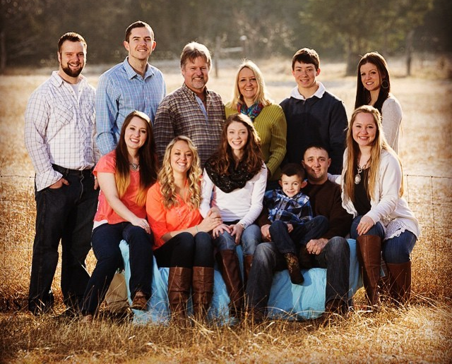
HOME LIFE IN PROVERBS

Slide 8
HOME LIFE IN PROVERBS
When God designed the home, He had man's best interest in mind.
It was not designed to be a battleground, but rather a haven.
Although Proverbs does not provide pat answers for all the problems the home faces, it does point us in the right direction.
It's instructions are worthy and valid for having successful families.
It impresses us with the persona! responsibility of every family member for the benefit of the whole.

Slide 9
HOME LIFE IN PROVERBS
Proverbs 18:22 He who finds a wife finds a good thing; And obtains favor from the LORD.
Proverbs 19:14 House and wealth are an inheritance from fathers, But a prudent wife is from the LORD.
Genesis 2:18 Then the LORD God said, "It is not good for the man to be alone; I will make him a helper suitable for him."
Proverbs 11:29 He who troubles his own house will inherit wind, And the foolish will be servant to the wisehearted.

Slide 10
l. PURPOSE OF A HOME
Contribute to the Happiness of Each Member.
  Proverbs 5:18 Let your fountain be blessed, And rejoice in the wife of your youth.
  Proverbs 10:1 The proverbs of Solomon. A wise son makes a father glad, But a foolish son is a grief to his mother.
  Proverbs 15:20 A wise son makes a father glad, But a foolish man despises his mother.
  Proverbs 17:6 Grandchildren are the crown of old men, And the glory of sons is their fathers.

Slide 11
l. PURPOSE OF A HOME
Contribute to the Happiness of Each Member.
  Proverbs 23:15 My son, if your heart is wise, My own heart also will be glad; [16] And my inmost being will rejoice When your lips speak what is right
  Proverbs 29:3 A man who loves wisdom makes his father glad, But he who keeps company with harlots wastes his wealth.
  Proverbs 31:28-29 Her children rise up and bless her; Her husband also, and he praises her saying: [29] "Many daughters have done nobly, But you excel them all."

Slide 12
l. PURPOSE OF A HOME
Contribute to the Happiness of Each Member.
  Families are God's way of blessing all of us.
Psalm 127:3-5 Behold, children are a gift of the LORD, The fruit of the womb is a reward. [4] Like arrows in the hand of a warrior, So are the children of one's youth. [5] How blessed is the man whose quiver is full of them; They will not be ashamed When they speak with their enemies in the gate.
Psalm 128:3-4 Your wife shall be like a fruitful vine Within your house, Your children like olive plants Around your table. [4] Behold, for thus shall the man be blessed Who fears the LORD
The righteous family member brings happiness to all the rest.

Slide 13
l. PURPOSE OF A HOME
Training Ground for Children
Proverbs 22:6 Train up a child in the way he should go, Even when he is old he will not depart from it.
Proverbs 23:13-14 Do not hold back discipline from the child, Although you strike him with the rod, he will not die. [14] You shall strike him with the rod And rescue his soul from Sheol.
Proverbs 1:8-9 Hear, my son, your father's instruction And do not forsake your mother's teaching, [9] Indeed, they are a graceful wreath to your head And ornaments about your neck.

Slide 14
l. PURPOSE OF A HOME
Training Ground for Children
In the home, children get the direction and guidance necessary to grow and develop. They also receive instruction that will prepare them and stick with them into adulthood
Proverbs 6:20-23 My son, observe the commandment of your father And do not forsake the teaching of your mother; [21] Bind them continually on your heart; Tie them around your neck. [22] When you walk about, they will guide you; When you sleep, they will watch over you; And when you awake, they will talk to you. [23] For the commandment is a lamp and the teaching is light; And reproofs for discipline are the way of life.

Slide 15
ll. MAKING OF A HOME
Complementing One Another. Each family is comprised of different members with various roles and responsibilities. Each has his own place and effect on all the other members of the home. Their lives are all interrelated and influence one another.
  Husband and Father
    Proverbs 20:7 A righteous man who walks in his integrity- How blessed are his sons after him.
    Proverbs 17:6 Grandchildren are the crown of old men, And the glory of sons is their fathers.
    Proverbs 15:27 He who profits illicitly troubles his own house, But he who hates bribes will live.
    His wise and righteous life benefits his family.

Slide 16
ll. MAKING OF A HOME
Complementing One Another.
  Wife and Mother
      Proverbs 14:1 The wise woman builds her house, But the foolish tears it down with her own hands.
      Proverbs 12:4 An excellent wife is the crown of her husband, But she who shames him is like rottenness in his bones.
      Proverbs 31:10 An excellent wife, who can find? For her worth is far above jewels.

Slide 17
ll. MAKING OF A HOME
Complementing One Another.
  Children
    Proverbs 10:1 The proverbs of Solomon. A wise son makes a father glad, But a foolish son is a grief to his mother.
    Proverbs 15:20 A wise son makes a father glad, But a foolish man despises his mother.
    Ephesians 6:1-3 Children, obey your parents in the Lord, for this is right. [2] Honor your father and mother (which is the first commandment with a promise), [3] so that it may be well with you, and that you may live long on the earth.

Slide 18
ll. MAKING OF A HOME
Complementing One Another.
  Children
    Good Children
      Proverbs 23:15 My son, if your heart is wise, My own heart also will be glad; 16] And my inmost being will rejoice When your lips speak what is right.
      Proverbs 23:24-25 The father of the righteous will greatly rejoice, And he who sires a wise son will be glad in him. [25] Let your father and your mother be glad, And let her rejoice who gave birth to you.

Slide 19
ll. MAKING OF A HOME
Complementing One Another.
  Children
    Good Children
      Proverbs 29:3 A man who loves wisdom makes his father glad, But he who keeps company with harlots wastes his wealth.
      Proverbs 29: 17 Correct your son, and he will give you comfort; He will also delight your soul. 5) They are a delight to their parents—children of whom they can be proud.

Slide 20
ll. MAKING OF A HOME
B. Complementing One Another. Children
  Children
e. Bad Children
      Proverbs 17:21 He who sires a fool does so to his sorrow, And the father of a fool has no joy
      Proverbs 17:25 A foolish son is a grief to his father And bitterness to her who bore him
      Proverbs 19:27 Cease listening, my son, to discipline, And you will stray from the words of knowledge.
      Even a parent's love for these children cannot make the pain and the shame go away— it only intensifies them!

Slide 21
ll. MAKING OF A HOME
B. Complementing One Another.
4. Aged
    Proverbs 17:6 Grandchildren are the crown of old men, And the glory of sons is their fathers.
    Here we see the solidity and harmony of family life spanning three generations. Instead of generation gaps, each generation finds enrichment in and derives honor from the other. Grandchildren are the blessing of the elderly. Older family members have much to contribute to their family.
    Proverbs 20:29 The glory of young men is their strength, And the honor of old men is their gray hair.
    Proverbs 16:31 A gray head is a crown of glory; It is found in the way of righteousness

Slide 22
Ill. WORTH OF A GOOD HOME
It May Be a Man's Most Precious Possession.
  Proverbs-24:3-4 By wisdom a house is built, And by understanding it is established; [4] And by knowledge the rooms are filled With all precious and pleasant riches.
  Proverbs 15:6 Great wealth is in the house of the righteous trouble is in the income of the wicked.
Unity is the Most Important Thing a Family Can Have
  Proverbs 15:6,17 Great wealth is in the house of the righteous, But trouble is in the income of the wicked. [17] Better is a dish of vegetables where love is Than a fattened ox served with hatred.
  Proverbs 17:1 Better is a dry morsel and quietness with it Than a house full of feasting with strife.
  It is far more valuable than the greatest wealth and pleasures.

Slide 23
A GOOD HOME?
Are you doing your part to have a good home?
It takes time and effort to have a good home.
Don’t fall for Satan’s trap of settling for less.
  The marshmallow test.
  A bird in the hand is worth two in the bush
  A little enjoyment now is worth more than greater enjoyment later.

Slide 24
SINGING

Slide 25

IN REMEMBRANCE OF JESUS

Slide 26

CONTRIBUTION

Slide 27
SINGING

Slide 28

HAVE A HOME-BUILDING WEEK
Notes:
[Sources]
AI-generated illustration: a family building a house.
[/Sources]

