Slide 1
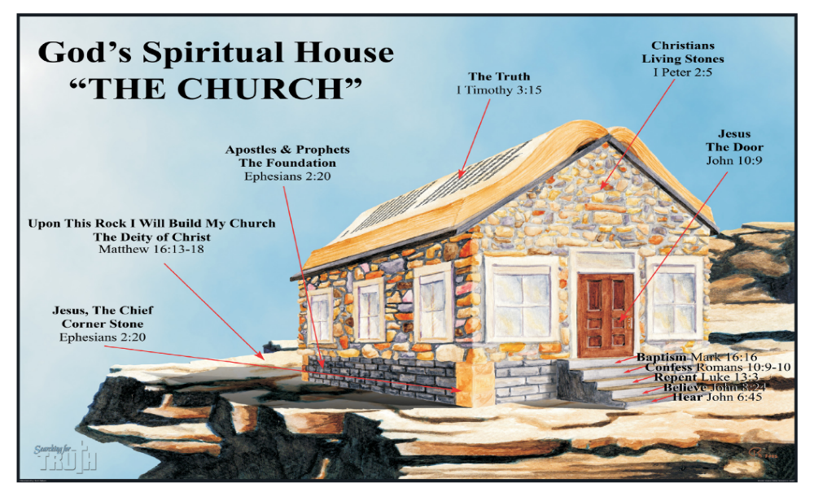
WELCOME TO THE
JACKSON STREET CHURCH OF CHRIST
PLEASE TURN OFF CELLPHONES

Slide 2


Slide 3


Slide 4

SINGING

Slide 5

IN REMEMBRANCE OF JESUS

Slide 6

CONTRIBUTION

Slide 7



Slide 8
Col 2:8-13 Beware lest anyone cheat you through philosophy and empty deceit, according to the tradition of men, according to the basic principles of the world, and not according to Christ. {9} For in Him dwells all the fullness of the Godhead bodily; {10} and you are complete in Him, who is the head of all principality and powers {11} In Him you were also circumcised with the circumcision made without hands, by putting off the body of the sins of the flesh, by the circumcision of Christ, {12} buried with Him in baptism, in which you also were raised with Him through faith in the working of God, who raised Him from the dead. {13} And you, being dead in your trespasses and the uncircumcision of your flesh, He has made alive together with Him, having forgiven you all trespasses.

Slide 10

SALVATION OUTSIDE THE CHURCH?

Slide 11
SALVATION OUTSIDE THE CHRUCH
Many, in the religious world today, believe and teach that you don’t have to be in the church to be saved.
They say, “You are saved when you believe”. (Faith Only)
Then, after you are saved, you can “join” the church. If you want.
What does the bible say about the church and salvation?

Slide 12
I. WHERE DOES GOD SAY SOMEONE CAN BE SAVED OUTSIDE THE CHURCH?
“EKKLESIA” means called out of. We are called out of the world into Christ and the church
IF ONE CAN BE SAVED OUTSIDE THE CHURCH, THEN ALL CAN, AND THE CHURCH IS UNNECESSARY.
IF SALVATION CAN BE OUTSIDE THE CHURCH, CHRIST DIED IN VAIN - Acts 20:28 "Therefore take heed to yourselves and to al l the flock, among which the Holy Spirit has made you overseers, to shepherd the church of God which He purchased with His own blood.
IF WE CAN BE SAVED OUTSIDE THE CHURCH THE WHY DID JESUS BUILD IT - Mat 16:18 "And I also say to you that you are Peter, and on this rock I will build My church, and the gates of Hades shall not prevail against it.

Slide 13
II. IF SALVATION CAN BE HAD OUTSIDE THE CHURCH THEN SALVATION IS …
WITHOUT BEING IN THE KINGDOM - Col 1:13 He has delivered us from the power of darkness and conveyed us into the kingdom of the Son of His love.
WITHOUT BEING A PART OF GOD'S BUILDING - 1 Cor 3:9 For we are God's fellow workers; you are God's field, you are God's building.
WITHOUT BEING IN GOD'S FAMILY - Eph 3:15 from whom the whole family in heaven and earth is named.
WITHOUT BEING IN CHRIST - Gal 3:26-27 For you are all sons of God through faith in Christ Jesus, {27} For as many of you as were baptized into Christ have put on Christ.

Slide 14
II. IF SALVATION CAN BE HAD OUTSIDE THE CHURCH THEN SALVATION IS …
WITHOUT BEING IN CHRIST'S BODY - Eph 5:23 For the husband is head of the wife, as also Christ is head of the church; and He is the Savior of the body.
WITHOUT BEING SUBJECT TO CHRIST - Eph 5:24 Therefore, just as the church is subject to Christ, so let the wives be to their own husbands in everything.
WITHOUT BEING SANCTIFIED - Eph 5:26 that He might sanctify and cleanse her with the washing of water by the word,
WITHOUT BEING PURCHASED BY HIS BLOOD - Acts 20:28 Therefore take heed to yourselves and to al l the flocky among which the Holy Spirit has made you overseers, to shepherd the church of God which He purchased with His own blood -

Slide 15
II. IF SALVATION CAN BE HAD OUTSIDE THE CHURCH THEN SALVATION IS …
WITHOUT BEING ENROLLED IN HEAVEN - Heb 12:23 to the general assembly and church of the firstborn who are registered in heaven, to God the Judge of all, to the spirits of just men made perfect.
WITHOUT HAVING REDEMPTION AND FORGIVENESS - Eph 1:7 In Him we have redemption through His blood, the forgiveness of sins, according to the riches of His grace.
WITHOUT SPIRITUAL BLESSINGS – Eph 2:6 Blessed be the God and Father of our Lord Jesus Christ, who has blessed us with every spiritual blessing in the heavenly places in Christ.

Slide 16
II. IF SALVATION CAN BE HAD OUTSIDE THE CHURCH THEN SALVATION IS …
WITHOUT HIS EQUIPPING, BUILDING UP, UNITY, KNOWLEDGE & MATURITY - Eph 4:11-13 And He Himself gave some to be apostles, some prophets, some evangelists, and some pastors and teachers, {12} for the equipping of the saints for the work of ministry, for the edifying of the body of Christ, {13} till we all come to the unity of the faith and of the knowledge of the Son of God, to a perfect man, to the measure of the stature of the fullness of Christ.

Slide 17
II. IF SALVATION CAN BE HAD OUTSIDE THE CHURCH THEN SALVATION IS …
WITHOUT ASSEMBLING WITH THE SAINTS - Heb 10:25-26 not forsaking the assembling of ourselves together, as is the manner of some, but exhorting one another, and so much the more as you see the Day approaching. {26} For if we sin willfully after we have received the knowledge of the truth, there no longer remains a sacrifice for sins.
WITHOUT BEING IN GOD'S HOUSEHOLD - 1 Tim 3:15 but if I am delayed, I write so that you may know how you ought to conduct yourself in the house of God, which is the church of the living God, the pillar and ground of the truth.

Slide 18
III. WHAT ABOUT
GOOD MORAL PEOPLE?
CORNELIUS - Acts 10:1-2 There was a certain man in Caesarea called Cornelius, a centurion of what was called the Italian Regiment, {2} a devout man and one who feared God with all his household, who gave alms generously to the people, and prayed to God always.
BE TOLD HOW TO BE SAVED - Acts 11:13-14 "And he told us how he had seen an angel standing in his house, who said to him, 'Send men to Joppa, and call for Simon whose surname is Peter, {14} who will tell you words by which you and all your household will be saved.
ONLY TOLD TO BE BAPTIZED - Acts 10:48 And he commanded them to be baptized in the name of the Lord, Then they asked him to stay a few days.

Slide 19
IV. BAPTISM IS INVOLVED
IN THE NEW BIRTH
MUST BE BORN AGAIN - John 3:3–5 Jesus answered and said to him, “Most assuredly, I say to you, unless one is born again, he cannot see the kingdom of God.” ⁴ Nicodemus said to Him, “How can a man be born when he is old? Can he enter a second time into his mother’s womb and be born?” ⁵ Jesus answered, “Most assuredly, I say to you, unless one is born of water and the Spirit, he cannot enter the kingdom of God.
NEW BIRTH COMES AFTER BAPTISM - Rom 6:3-5 or do you not know that as many of us as were baptized into Christ Jesus were baptized into His death? >>>

Slide 20
IV. BAPTISM IS INVOLVED
IN THE NEW BIRTH
{4} Therefore we were buried with Him through baptism into death, that just as Christ was raised from the dead by the glory of the Father, even so we also should walk in newness of life. {5} For if we have been united together in the likeness of His death, certainly we also shall be in the likeness of His resurrection.
WASHING OF REGENERATION - Titus 3:5 not by works of righteousness which we have done, but according to His mercy He saved us, through the washing of regeneration and renewing of the Holy Spirit,

Slide 21
V. BAPTISM PUTS US IN CHRIST, HIS BODY, THE CHURCH
BAPTIZED INTO CHRIST - Gal 3:27 For as many of you as were baptized into Christ have put on Christ.
BAPTIZED INTO HIS BODY - 1 Cor 12:13 For by one Spirit we were all baptized into one body; whether Jews or Greeks, whether slaves or free; and have all been made to drink into one Spirit.
BAPTIZED INTO CHRIST - Eph 1:22-23 And He put all things under His feet, and gave Him to be head over all things to the church, {23} which is His body, the fullness of Him who fills all in all.

Slide 22
V. BAPTISM PUTS US IN CHRIST, HIS BODY, THE CHURCH
SALVATION IS IN THE BODY, THE CHURCH - Eph 5:23 For the husband is head of the wife, as also Christ is head of the church; and He is the Savior of the body.
BAPTISM IS NECESSARY FOR SALVATION - 1 Pet 3:21 There is also an antitype which now saves us; baptism (not the removal of the filth of the flesh, but the answer of a good conscience toward God), through the resurrection of Jesus Christ.

Slide 23
SALVATION OUTSIDE THE CHURCH?
Where does the bible say you can be saved outside the church?
The church is the body of Christ and all spiritual blessings are in Christ, thus in the church.
If Cornelius could not be saved outside the church as good as he was then no one can.
Baptism is involved in the new birth
Baptism puts us in Christ, in the body, in the church

Slide 25

PRAYER

Slide 26

TONIGHT’S SERMON
READY TO DEFEND

