Slide 1
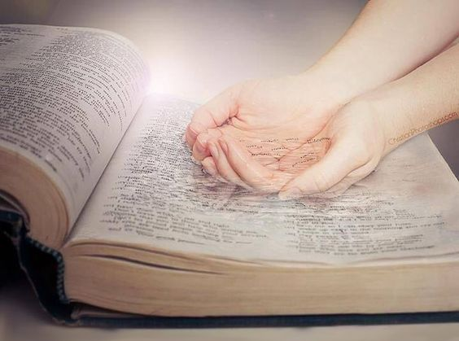
WELCOME TO THE
JACKSON STREET CHURCH OF CHRIST
PLEASE TURN OFF CELLPHONES

Slide 2


Slide 3

LET US PRAY

Slide 4

SINGING

Slide 5
2 Tim 4:6-8 "For I am already being poured out as a drink offering, and the time of my departure is at hand, ⁷ 1 have fought the good fight, I have finished the race, I have kept the faith. ⁸ Finally, there is laid up for me the crown of righteousness, which the Lord, the righteous Judge, will give to me on that Day, and not to me only but also to all who have loved His appearing."

Slide 6
LET US PRAY

Slide 7

KEEPING
THE

Slide 8
KEEPING THE FAITH
KEEP THE FAITH IN SPITE OF PROBLEMS WE FACE - 2 Cor 11:23-28 "Are they ministers of Christ?; I speak as a fool; am more: in labors more abundant, in stripes above measure, in prisons more frequently, in deaths often. ²⁴ From the Jews five times I received forty stripes minus one. ²⁵ Three times I was beaten with rods; once I was stoned; three times I was shipwrecked; a night and a day I have been in the deep; ²⁶ in journeys often, in perils of waters, in perils of robbers, in perils of my own countrymen, in perils of the Gentiles, in perils in the city, in perils in the wilderness, in perils in the sea, in perils among false brethren; ²⁷ in weariness and toil, in sleeplessness often, in hunger and thirst, in fastings often, in cold and nakedness; ²⁸ besides the other things, what comes upon me daily: my deep concern for all the churches."

Slide 9
KEEPING THE FAITH
KEEP THE FAITH WITHOUT WAVERING - Hebrews 10:22-25 let us draw near with a true heart in full assurance of faith, having our hearts sprinkled from an evil conscience and our bodies washed with pure water. ²³ Let us hold fast the confession of our hope without wavering, for He who promised is faithful. ²⁴ And let us consider one another in order to stir up love and good works, ²⁵ not forsaking the assembling of ourselves together, as is the manner of some, but exhorting one another, and so much the more as you see the Day approaching.

Slide 10
DEPEND ON GOD
FOR PROTECTION - Rom 8:31-39 "What then shall we say to these things? If God is for us, who can be against us? ³² He who did not spare His own Son, but delivered Him up for us all, how shall He not with Him also freely give us all things? ³³ Who shall bring a charge against God's elect? It is God who justifies. ³⁴ Who is he who condemns? It is Christ who died, and furthermore is also risen, who is even at the right hand of God, who also makes intercession for us. ³⁵ Who shall separate us from the love of Christ? Shall tribulation, or distress, or persecution, or famine, or nakedness, or peril, or sword? ³⁶ As it is written: "For Your sake we are killed all day long; We are accounted as sheep for the slaughter." ³⁷ Yet in all these things we are more than conquerors through Him who loved us. ³⁸ For I am persuaded that neither death nor life, nor angels nor principalities nor powers, nor things present nor things to come, ³⁹ nor height nor depth, nor any other created thing, shall be able to separate us from the love of God which is in Christ Jesus our Lord."

Slide 11
DEPEND ON GOD
FOR DELIVERANCE FROM TEMPTATION - 1 Cor 10:13 "No temptation has overtaken you except such as is common to man; but God is faithful, who will not allow you to be tempted beyond what you are able, but with the temptation will also make the way of escape, that you may be able to bear it."
FOR STRENGTH - Eph 6:10-18 "Finally, my brethren, be strong in the Lord and in the power of His might. ¹¹ Put on the whole armor of God, that you may be able to stand against the wiles of the devil. ¹² For we do not wrestle against flesh and blood, but against principalities, against powers, against the rulers of the darkness of this age, against spiritual hosts of wickedness in the heavenly places. >>>

Slide 12
DEPEND ON GOD
¹³ Therefore take up the whole armor of God, that you may be able to withstand in the evil day, and having done all, to stand. ¹⁴ Stand therefore, having girded your waist with truth, having put on the breastplate of righteousness, ¹⁵ and having shod your feet with the preparation of the gospel of peace; ¹⁶ above all, taking the shield of faith with which you will be able to quench all the fiery darts of the wicked one. ¹⁷ And take the helmet of salvation, and the sword of the Spirit, which is the word of God; ¹⁸ praying always with all prayer and supplication in the Spirit, being watchful to this end with all perseverance and supplication for all the saints;"

Slide 13
II. STAY BUSY DOING GOOD
Gal 6:9 "And let us not grow weary while doing good, for in due season we shall reap if we do not lose heart."
Rom 2:7 “eternal life to those who by patient continuance in doing good seek for glory, honor, and immortality;"
1 Cor 15:58 "Therefore, my beloved brethren, be steadfast, immovable, always abounding in the work of the Lord, knowing that your labor is not in vain in the Lord.”

Slide 14
llI. ALLOW OTHERS TO HELP – DON’T BURN YOURSELF OUT
Gal 6:2 "Bear one another's burdens, and so fulfill the law of Christ."
Rom 15:1 "We then who are strong ought to bear with the scruples of the weak, and not to please ourselves."
James 2:8 "If you really fulfill the royal law according to the Scripture, "You shaft love your neighbor as yourself, you do well;"

Slide 15
IV. KEEP THE PROPER DIRECTION
Col 3:1-4 "If then you were raised with Christ, seek those things which are above, where Christ is, sitting at the right hand of God. ² Set your mind on things above, not on things on the earth. ³ For you died, and your life is hidden with Christ in God. ⁴ When Christ who is our life appears, then you also will appear with Him in glory."
2 Cor 4:16 - 5:1 "Therefore we do not lose heart. Even though our outward man is perishing, yet the inward man is being renewed day by day. ¹⁷ For our light affliction, which is but for a moment, is working for us a far more exceeding and eternal weight of glory, ¹⁸ while we do not look at the things which are seen, but at the things which are not seen. For the things which are seen are temporary, but the things which are not seen are eternal. ¹ For we know that if our earthly house, this tent, is destroyed, we have a building from God, a house not made with hands, eternal in the heavens."

Slide 16
IV. KEEP THE PROPER DIRECTION
Phil 3:7-14 "But what things were gain to me, these I have counted loss for Christ. ⁸ Yet indeed I also count all things loss for the excellence of the knowledge of Christ Jesus my Lord, for whom I have suffered the loss of all things, and count them as rubbish, that I may gain Christ ⁹ and be found in Him, not having my own righteousness, which is from the law, but that which is through faith in Christ, the righteousness which is from God by faith; ¹⁰ that I may know Him and the power of His resurrection, and the fellowship of His sufferings, being conformed to His death, ¹¹ if, by any means, I may attain to the resurrection from the dead. ¹² Not that I have already attained, or am already perfected; but I press on that I may lay hold of that for which Christ Jesus has also laid hold of me. ¹³ Brethren, I do not count myself to have apprehended; but one thing I do, forgetting those things which are behind and reaching forward to those things which are ahead, ¹⁴ I press toward the goal for the prize of the upward call of God in Christ Jesus."

Slide 17
V. BE PREPARED AND READY
2 Cor 5:6-9 "So we are always confident, knowing that while we are at home in the body we are absent from the Lord. ⁷ For we walk by faith, not by sight. ⁸ We are confident, yes, well pleased rather to be absent from the body and to be present with the Lord, ⁹ Therefore we make it our aim, whether present or absent, to be well pleasing to Him."
Phil 1:21-23 "For to me, to live is Christ, and to die is gain. ²² But if I live on in the flesh, this will mean fruit from my labor; yet what I shall choose I cannot tell. ²³ For I am hard pressed between the two, having a desire to depart and be with Christ, which is far better."

Slide 18
FAITH IS THE VICTORY
1 John 5:16 "Whoever believes that Jesus is the Christ is born of God, and everyone who loves Him who begot also loves him who is begotten of Him. ² By this we know that we love the children of God, when we love God and keep His commandments. ³ For this is the love of God, that we keep His commandments. And His commandments are not burdensome. ⁴ For whatever is born of God overcomes the world. And this is the victory that has overcome the world; our faith. ⁵ Who is he who overcomes the world, but he who believes that Jesus is the Son of God?"

Slide 19
FAITH IS THE VICTORY
Tis The Set Of The Sail - Ella Wheeler Wilcox
But to every mind there openeth,
A way, and way, and away,
A high soul climbs the highway,
And the low soul gropes the low,
And in between on the misty flats,
The rest drift to and fro.
But to every man there openeth,
A high way and a low,
And every mind decideth,
The way his soul shall go.

Slide 20
FAITH IS THE VICTORY
One ship sails East,
And another West,
By the self-same winds that blow,
'Tis the set of the sails
And not the gales,
That tells the way we go.
Like the winds of the sea
Are the waves of time,
As we journey along through life,
'Tis the set of the soul,
That determines the goal,
And not the calm or the strife.

Slide 21
FAITH IS THE VICTORY
TWO PEOPLE FACE THE SAME PROBLEMS IN LIFE
ONE MOVES TOWARD GOD THE OTHER MOVES AWAY FROM HIM
IT'S THE MIND-SET THAT DETERMINES WHICH WE DO.
HOWS THE SET OF YOUR SAIL?
  1. TOWARD GOD OR AWAY FROM GOD?
  2. GROWING FAITH OR WEAKENING FAITH?

Slide 22
SINGING

Slide 23
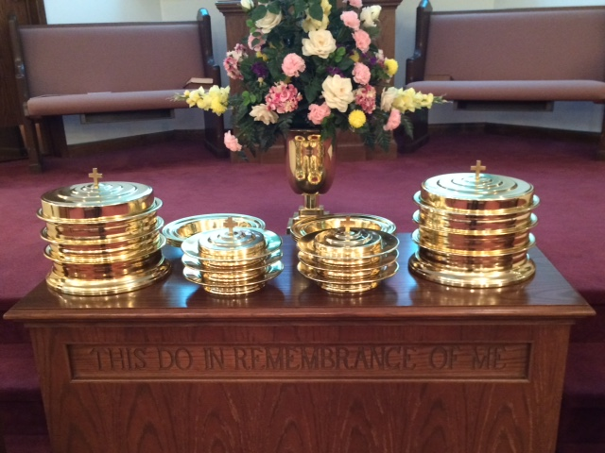
IN REMEMBRANCE OF JESUS

Slide 24
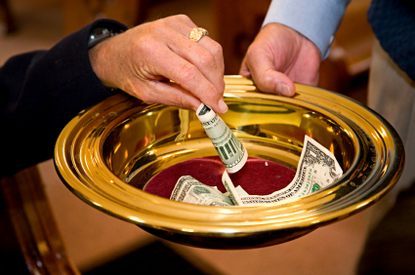
CONTRIBUTION

Slide 25
SINGING

Slide 26
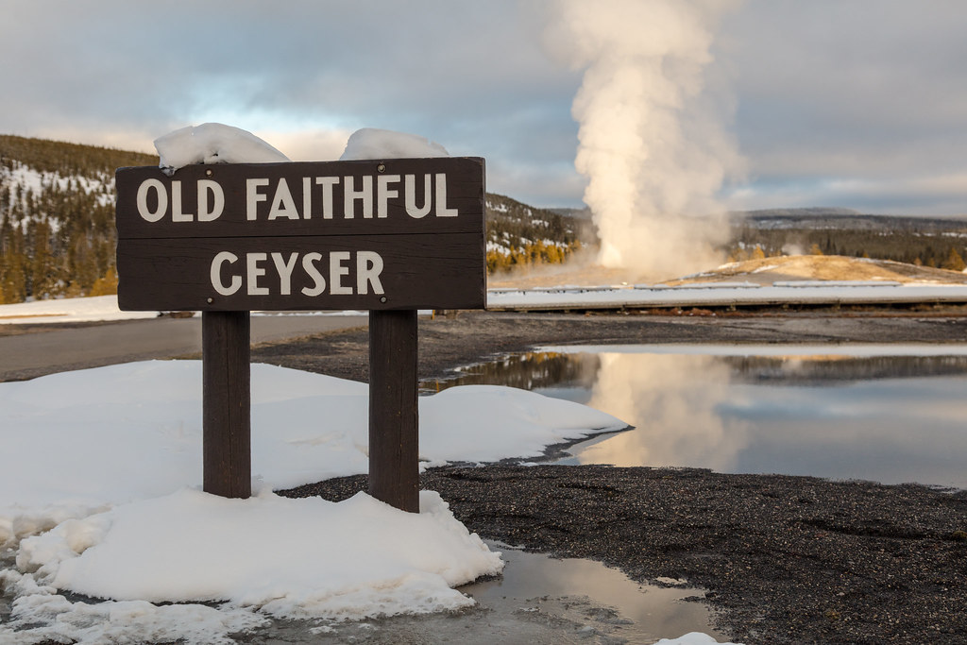
HAVE A
FAITHFUL
WEEK

