Slide 1
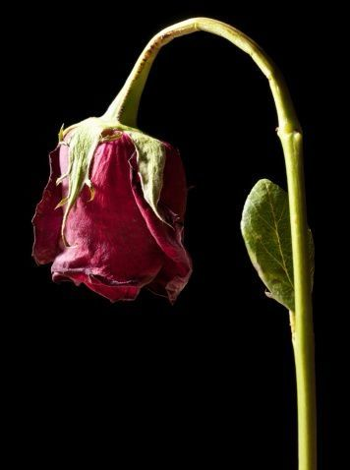
WELCOME TO THE
JACKSON STREET CHURCH OF CHRIST
PLEASE TURN OFF CELLPHONES

Slide 2


Slide 3

LET US PRAY

Slide 4

SINGING

Slide 5
Proverbs 12:25 Anxiety in the heart of man causes depression, But a good word makes it glad.

Slide 6
LET US PRAY

Slide 7

CONQUERING DEPRESSION

Slide 8
THE ONLY TIME IN THE NKJV THE WORD DEPRESSION IS USED - Proverbs 12:25 Anxiety in the heart of man causes depression, But a good word makes it glad.
PROGRESSIVE SYMPTOMS OF DEPRESSION
  Passiveness
  Loss Of Interest
  Pessimism
  Hopelessness
  Self-Deprecation
  Withdrawal
  Pre-Occupation With Self
  Dislike Of Happy People
  Change Of Personality Or Habit
  Fatigue
  Over Or Under Eating
  Increase In Use Of Alcohol Or Drugs
  Poor Concentration
  Hypochondria
  Suicidal Tendencies
  Sudden Improvement
  The Call To Death

Slide 9
BELIEVE GOD IS GREATER THAN YOUR PROBLEMS AND CIRCUMSTANCES
Ephesians 3:20 Now to Him who is able to do exceedingly abundantly above all that we ask or think, according to the power that works in us.
Said the Robin to the Sparrow,
"l should really like to know
Why these anxious human beings
Rush about and hurry so."
Said the Sparrow to the Robin,
"Friend, I think that it must be
That they have no Heavenly Father
Such as cares for you and me."
Elizabeth Cheney

Slide 10
II. TURN ALL YOUR PROBLEMS OVER TO HIM IN PRAYER
Philippians 4:6-7 Be anxious for nothing, but in everything by prayer and supplication, with thanksgiving, let your requests be made known to God; {7} and the peace of God, which surpasses all understanding, will guard your hearts and minds through Christ Jesus.
1 John 5:14-15 Now this is the confidence that we have in Him, that if we ask anything according to His will, He hears us, {15} And if we know that He hears us, whatever we ask, we know that we have the petitions that we have asked of Him.

Slide 11
III. BELIEVE GOD CAN WORK YOUR PROBLEMS FOR GOOD
Romans 8:28 And we know that all things work together for good to those who love God to those who are the called according to His purposes.

Slide 12
IV. RECOGNIZE THAT DEPRESSION IS SELF PITY AND SINFUL; DEPRESSION PUTS YOU FIRST RATHER THAN GOD AND OTHERS.
Philippians 2:3-4 Let nothing be done through selfish ambition or conceit, but in lowliness of mind let each esteem others better than himself. {4} Let each of you look out not only for his own interests, but also for the interests of others.

Slide 13
V. REALIZE THAT THINGS WILL NEVER ALWAYS GO YOUR WAY
Acts 14:22b 'We must through many tribulations enter the kingdom of God.

Slide 14
VI. ACKNOWLEDGE THAT THERE IS NO VALID EXCUSE FOR STAYING DEPRESSED
Ephesians 1:3 Blessed be the God and Father of our Lord Jesus Christ, who has blessed us with every spiritual blessing in the heavenly places in Christ.

Slide 15
VII. GET UP AND GET OUT, FACE REALITY AND LIFE
Ecclesiastes 9:10 Whatever your hand finds to do, do it with your might; for there is no work or device or knowledge or wisdom in the grave where you are going.

Slide 16
VIII. CONFESS AND FORSAKE SINFUL THOUGHTS AND ACTIONS
1 John 1:6-10 If we say that we have fellowship with Him, and walk in darkness, we lie and do not practice the truth, {7} But if we walk in the light as He is in the light, we have fellowship with one another, and the blood of Jesus Christ His Son cleanses us from all sin. {8} If we say that we have no sin, we deceive ourselves, and the truth is not in us, {9} If we confess our sins, He is faithful and just to forgive us our sins and to cleanse us from all unrighteousness. {10} If we say that we have not sinned, we make Him a liar, and His word is not in us.

Slide 17
IX. GET YOUR PRIORITIES IN PROPER ORDER
JESUS, OTHERS, YOU - Matthew 6:33 "But seek first the kingdom of God and His righteousness, and all these things shall be added to you.

Slide 18
X. THINK ON GOOD THINGS
Philippians 4:8-9 Finally, brethren, whatever things are true, whatever things are noble, whatever things are just, whatever things are pure, whatever things are lovely, whatever things are of good report, if there is any virtue and if there is anything praiseworthy; meditate on these things, {9} The things which you learned and received and heard and saw in me, these do, and the God of peace will be with you.

Slide 19
XI. DON’T SEPARATE FROM
YOUR SPIRITUAL FAMILY
Hebrews 10:24–25 And let us consider one another in order to stir up love and good works, ²⁵ not forsaking the assembling of ourselves together, as is the manner of some, but exhorting one another, and so much the more as you see the Day approaching.

Slide 20
XII. LEARN TO LIVE
ONE DAY AT A TIME
Psalm 118:24 This is the day the LORD has made; We will rejoice and be glad in it.
Anxiety does not empty tomorrow of its sorrows but only empties today of its strength – Spurgeon.
Our problem is not so much the trouble of today but combining it with yesterday and tomorrow.

Slide 21
CONCLUSION
We all face situations which may bring periods of depression.
There is nothing wrong with having these feelings occasionally.
However, if we dwell on these things to the extent that it affects our normal activities of life, it is a good indication that we have a problem
Worry - a God, invisible but omnipotent. It steals the bloom from the cheek and lightness from the pulse; it takes away the appetite, and turns the hair gray. - Benjamin Disraeli

Slide 22
SINGING

Slide 23
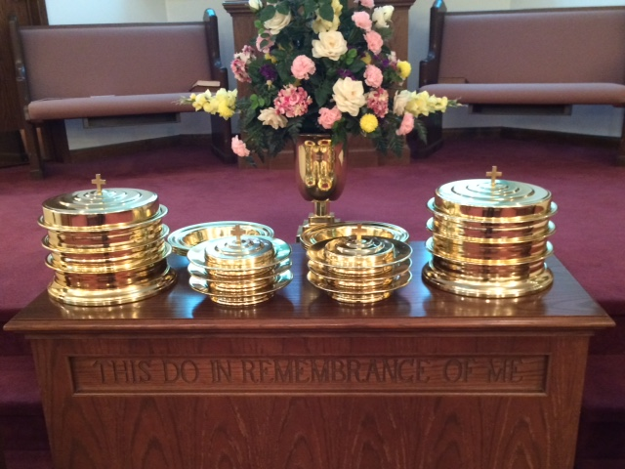
IN REMEMBRANCE OF JESUS

Slide 24
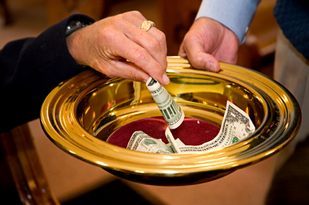
CONTRIBUTION

Slide 25
SINGING

Slide 26

HAVE AN EXCITING WEEK

