Slide 1
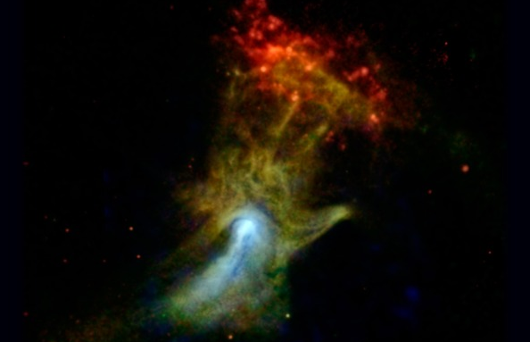
WELCOME TO THE
JACKSON STREET CHURCH OF CHRIST
PLEASE TURN OFF CELLPHONES

Slide 2


Slide 3
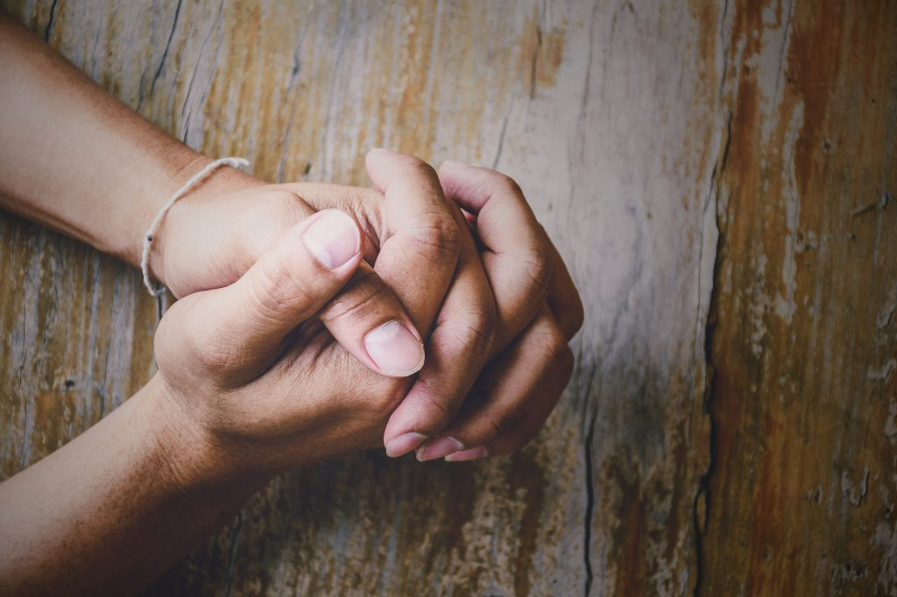
LET US PRAY

Slide 4

SINGING

Slide 5
Psa 68:32-35 Sing to God, you kingdoms of the earth; Oh, sing praises to the Lord, Selah {33} To Him who rides on the heaven of heavens, which were of old! Indeed, He sends out His voice, a mighty voice. {34} Ascribe strength to God; His excellence is over Israel, And His strength is in the clouds. {35} O God, You are more awesome than Your holy places. The God of Israel is He who gives strength and power to His people. Blessed be God!

Slide 6
LET US PRAY

Slide 7
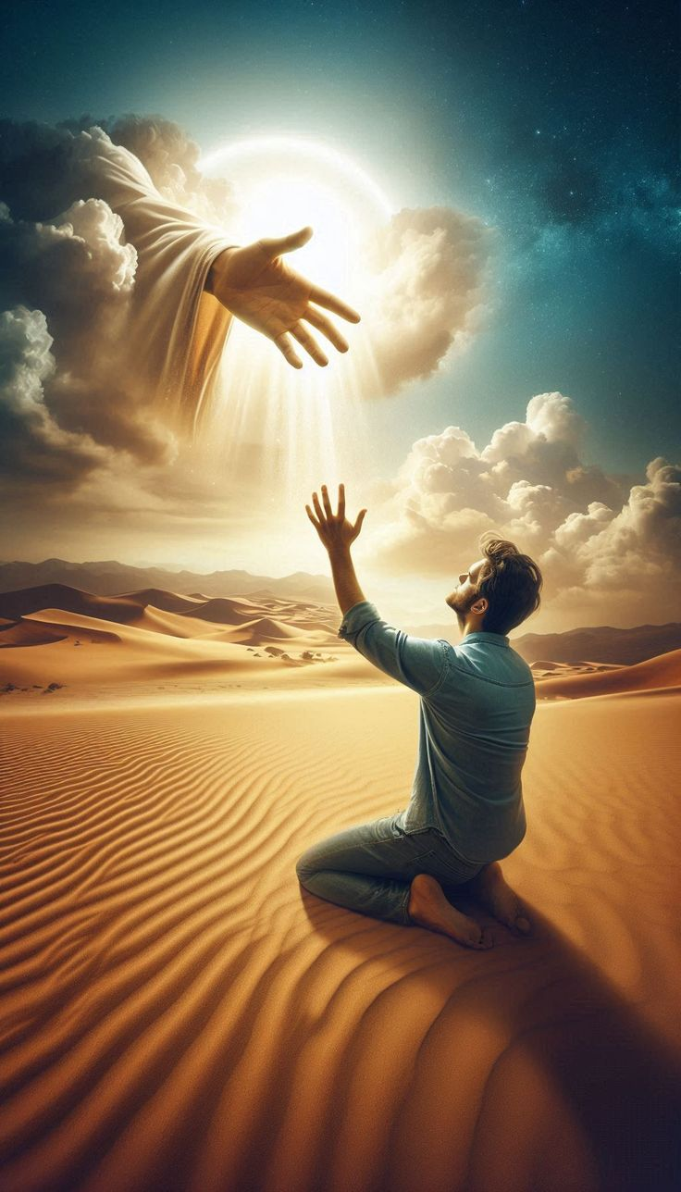
OUR HOLY GOD

Slide 8
OUR HOLY GOD
What Do You Think Of God?
How Important Is He To You?
How Much Control Do You Allow Him To Have In Your Life?

Slide 9
l. WE ENTER INTO THE PRESENCE OF GOD
Gen 5:22-24 After he begot Methuselah, Enoch walked with God three hundred years and had sons and daughters. {23} So all the days of Enoch were three hundred and sixty-five years. {24} And Enoch walked with God; and he was not, for God took him.
Gen 6:9 This is the genealogy of Noah. Noah was a just man, perfect in his generations. Noah walked with God,

Slide 10
l. WE ENTER INTO THE PRESENCE OF GOD
John 1:1 In the beginning was the Word, and the Word was with God, and the Word was God.
John 1:14 And the Word became flesh and dwelt among us, and we beheld His glory, the glory as of the only begotten of the Father, full of grace and truth.
Mat 18:20 "For where two or three are gathered together in My name, I am there in the midst of them."

Slide 11
ll. WE DESIRE A RELATIONSHIP WITH GOD
Deu 4:27-30 "And the LORD will scatter you among the peoples, and you will be left few in number among the nations where the LORD will drive you. {28} "And there you will serve gods, the work of men's hands, wood and stone, which neither see nor hear nor eat nor smell, {29} "But from there you will seek the LORD your God, and you will find Him if you seek Him with all your heart and with all your soul. {30} "When you are in distress, and all these things come upon you in the latter days, when you turn to the LORD your God and obey His voice.
There is a vacuum inside each of us that only God can fill. We try to fill that vacuum with everything the world has to offer but come up feeling empty.

Slide 12
ll. WE DESIRE A RELATIONSHIP WITH GOD
Psa 42:1-3 As the deer pants for the water brooks, So pants my soul for You, O God. {2} My soul thirsts for God, for the living God. When shall I come and appear before God? {3} My tears have been my food day and night, While they continually say to me, "Where is your God?"
Psa 105:1-5 Oh, give thanks to the LORD! Cali upon His name; Make known His deeds among the peoples. {2} Sing to Him, sing psalms to Him; Talk of all His wondrous works! {3} Glory in His holy name; Let the hearts of those rejoice who seek the LORD! {4} Seek the LORD and His strength; Seek His face evermore! {5} Remember His marvelous works which He has done, His wonders, and the judgments of His mouth.

Slide 13
III. WE EXPERIENCE TRUE JOY AND HAPPINESS WITH GOD
Psa 144:15 Happy are the people whose God is the LORD!
Psa 146:5-10 Happy is he who has the God of Jacob for his help, Whose hope is in the LORD his God, {6} Who made heaven and earth, The sea, and all that is in them; Who keeps truth forever, {7} Who executes justice for the oppressed, Who gives food to the hungry. The LORD gives freedom to the prisoners, {8} The LORD opens the eyes of the blind; The LORD raises those who are bowed down; The LORD loves the righteous. {9} The LORD watches over the strangers; He relieves the fatherless and widow; But the way of the wicked He turns upside dom. {10} The LORD shall reign forever; Your God, O Zion, to all generations. Praise the LORD!

Slide 14
III. WE EXPERIENCE TRUE JOY AND HAPPINESS WITH GOD
Prov 16:20 whoever trusts in the LORD, happy is he.
Mat 5:3-12 "Blessed are the poor in spirit, For theirs is the kingdom of heaven. {4} Blessed are those who mourn, For they shall be comforted. {5} Blessed are the meek, For they shall inherit the earth. {6} Blessed are those who hunger and thirst for righteousness, For they shall be filled. {7} Blessed are the merciful, For they shall obtain mercy. {8} Blessed are the pure in heart, For they shall see God. {9} Blessed are the peacemakers, For they shall be called sons of God. {10} Blessed are those who are persecuted for righteousness' sake, For theirs is the kingdom of heaven. {11} "Blessed are you when they revile and persecute you, and say all kinds of evil against you falsely for My sake. {12} "Rejoice and be exceedingly glad, for great is your reward in heaven, for so they persecuted the prophets who were before you.

Slide 15
WE NEED HIM TO CHANGE OUR LIVES
Eph 3:14-21 For this reason I bow my knees to the Father of our Lord Jesus Christ, {15} from whom the whole family in heaven and earth is named, {16} that He would grant you, according to the riches of His glory, to be strengthened with might through His Spirit in the inner man, {17} that Christ may dwell in your hearts through faith; that you, being rooted and grounded in love, {18} may be able to comprehend with all the saints what is the width and length and depth and height; {19} to know the love of Christ which passes knowledge; that you may be filled with all the fullness of God. {20} Now to Him who is able to do exceedingly abundantly above ail that we ask or think, according to the power that works in us, {21} to Him be glory in the church by Christ Jesus to all generations, forever and ever. Amen.

Slide 16
WE NEED HIM TO CHANGE OUR LIVES
2 Cor 3:18 But we all, with unveiled face, beholding as in a mirror the glory of the Lord, are being transformed into the same image from glory to glory, just as by the Spirit of the Lord.
Phil 3:20-21 For our citizenship is in heaven, from which we also eagerly wait for the Savior, the Lord Jesus Christ, {21} who will transform our lowly body that it may be conformed to His glorious body, according to the working by which He is able even to subdue all things to Himself.

Slide 17
WE CAN SHINE WITH JESUS
John 8:12 Then Jesus spoke to them again, saying, "l am the light of the world. He who follows Me shall not walk in darkness, but have the light of life."
Mat 5:14-16 You are the light of the world. A city that is set on a hill cannot be hidden. {15} Nor do they light a lamp and put it under a basket, but on a lampstand, and it gives light to all who are in the house. {16} Let your light so shine before men, that they may see your good works and glorify your Father in heaven.
Phil 2:14-16 Do all things without complaining and disputing, {15} that you may become blameless and harmless, children of God without fault in the midst of a crooked and perverse generation, among whom you shine as lights in the world, {16} holding fast the word of life, so that I may rejoice in the day of Christ that I have not run in vain or labored in vain.

Slide 18
OUR HOLY GOD
What Do You Think Of God?
How Important Is He To You?
How Much Control Do You Allow Him To Have In Your Life?

Slide 19
SINGING

Slide 20
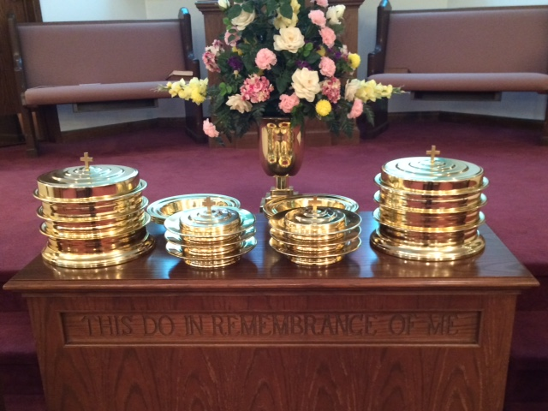
IN REMEMBRANCE OF JESUS

Slide 21
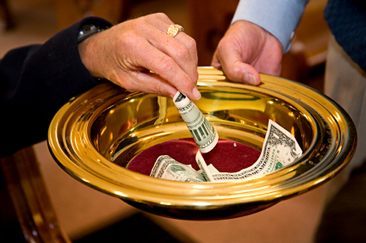
CONTRIBUTION

Slide 22
SINGING

Slide 23
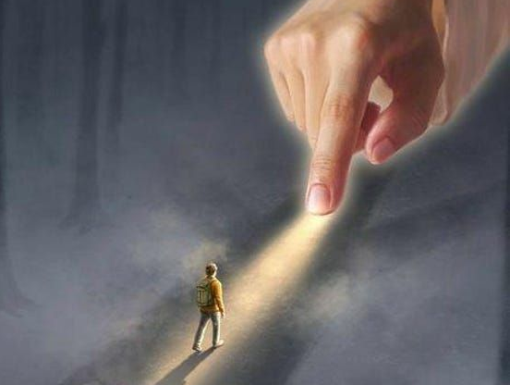
HAVE A
GODLY
WEEK

